Slide 1
Lecture 13
Flip-Flop Applications

Slide 2

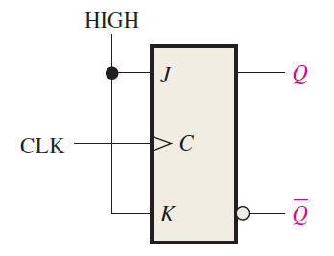

Frequency Division

Slide 3
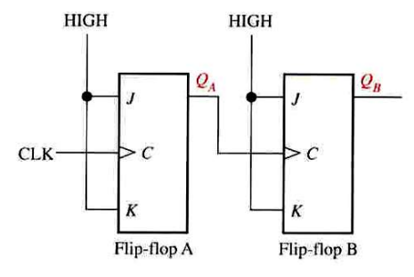
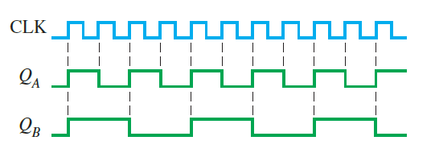
Frequency Division

Slide 4
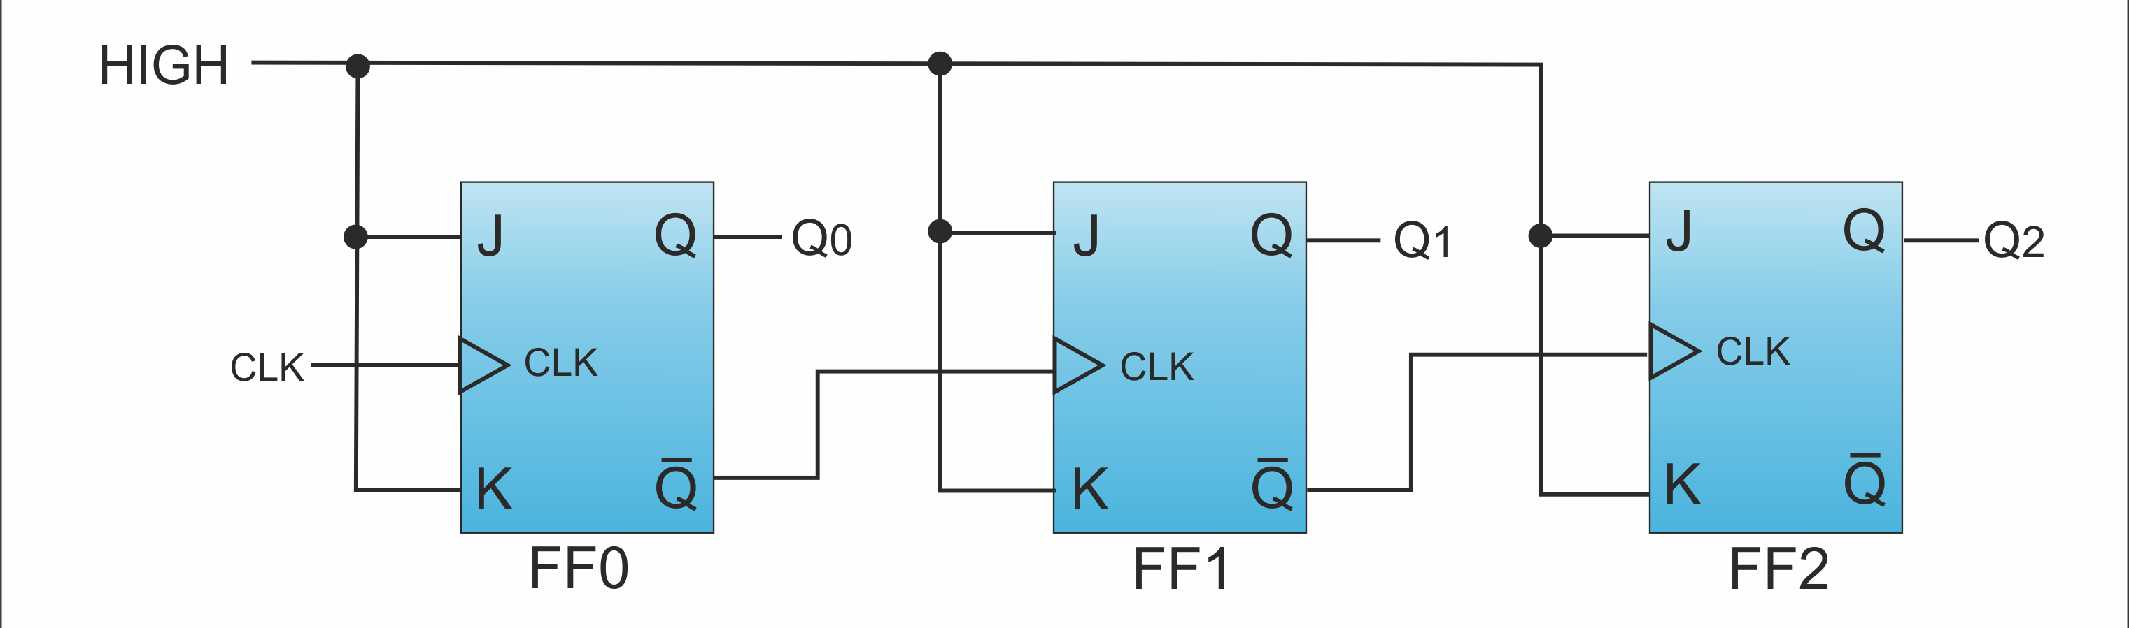
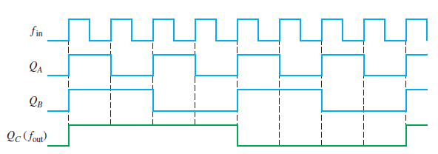
Frequency Division
2

Slide 5
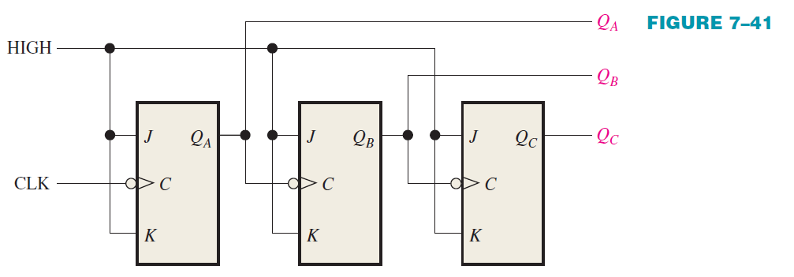
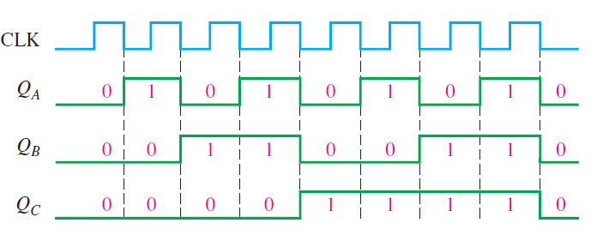
Asynchronous Counters
2

Slide 6
Asynchronous Counters
2

Slide 7
Thanks

