Slide 1
Secure Data Hiding in Image Using Steganography
CAPSTONE PROJECT
Presented By: Md Akif Sk
Student Name : Md Akif Sk
College Name : Hooghly Engineering & Technology College
Department : Computer Science and Engineering

Slide 2
OUTLINE
Problem Statement
Technology used
Wow factor
End users
Result
Conclusion
Git-hub Link
Future scope

Slide 3
Problem Statement
Steganography is the technique of hiding secret data within an ordinary, non-secret, file or message in order to avoid detection; the secret data is then extracted at its destination.
The use of steganography can be combined with encryption as an extra step for hiding or protecting data.
This project focuses on implementing an efficient and secure data hiding technique.
The word steganography is derived from the Greek words steganos (meaning hidden or covered) and the Greek root graph (meaning to write)

Slide 4
Technology used
Programming Language: Python
IDE: Visual Studio Code
Library: OpenCV
Platform: Windows/Linux
Algorithm Used: LSB (Least Significant Bit) steganography

Slide 5
Wow factors
Highly secure method for data hiding
Minimal distortion in the cover image
Can be used for covert communication
Custom encryption before embedding for added security

Slide 6
End users
Government agencies for secure communication
In Army level for safe data sharing
Journalists and whistleblowers for safe data transmission
General users concerned about privacy
Organizations handling confidential data

Slide 7
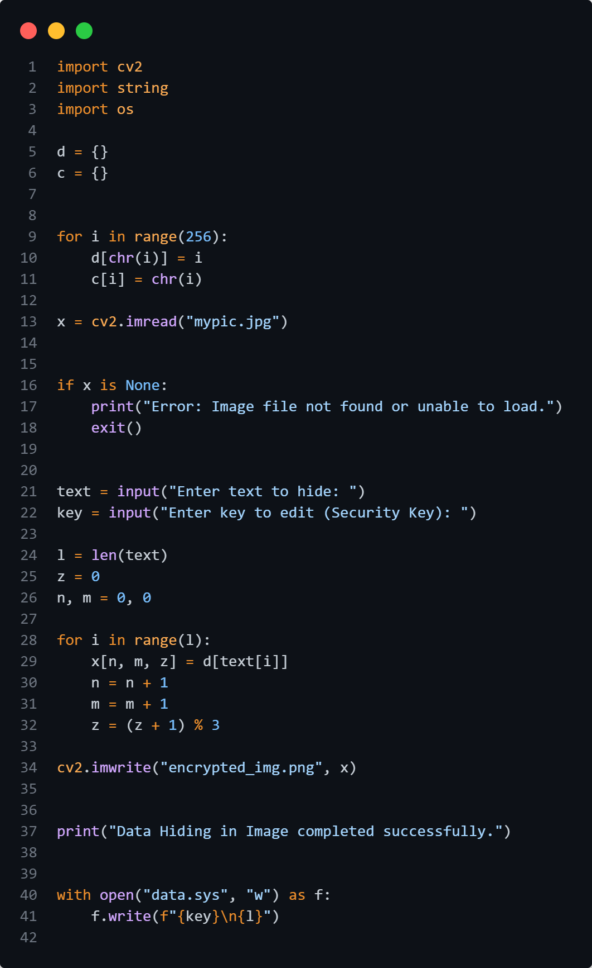
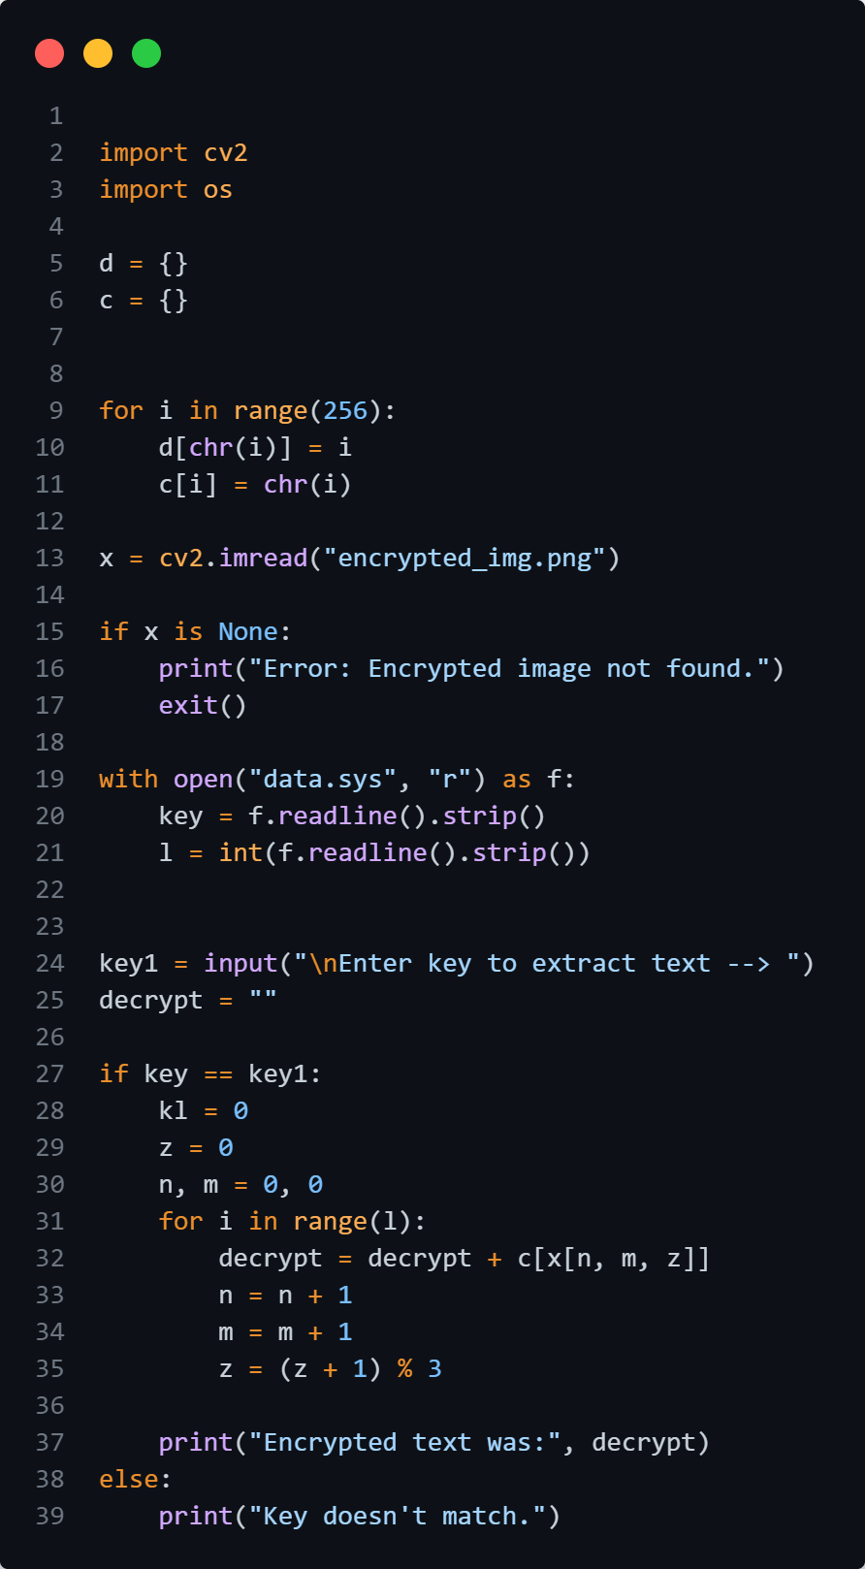
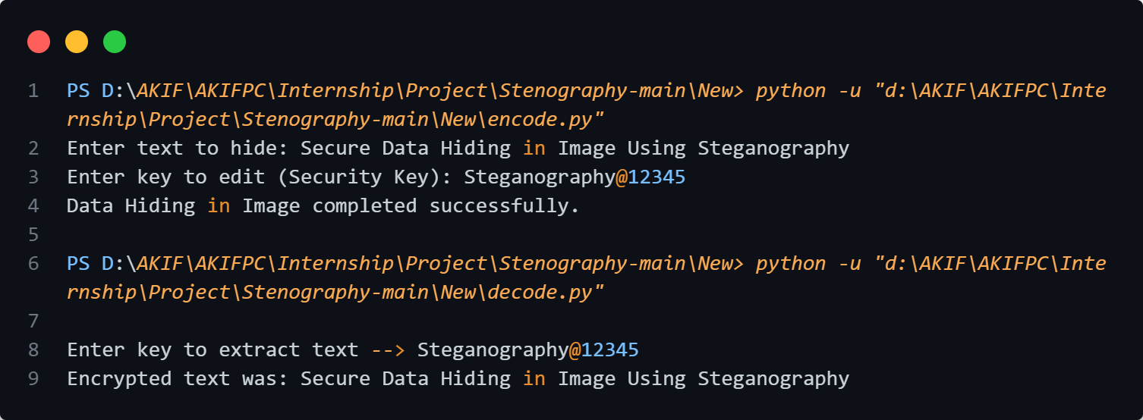
Results
encode.py
decode.py
OUTPUT

Slide 8
Conclusion
The project successfully implements steganography for secure data hiding in images. The method ensures confidentiality without drawing attention to the presence of hidden data. This can be improved with advanced cryptographic techniques for even greater security.

Slide 9
GitHub Link
🔗 GitHub: https://github.com/786akifsk/myStego

Slide 10
Future scope(optional)
Support for Larger Data Hiding
Multi-Format Support (like JPG, BMP, TIFF, and GIF)
GUI-Based Implementation

Slide 11
THANK YOU

