Slide 1
Introduction about cloud computing
Introduction about cloud
Regions and AZ's
how to login to Linux instances using putty and mobaxterm
Today's Agenda

Slide 2
Training flow high level
AWS fundamentals
Linux and networking fundamentals
AWS services
Git
Maven
Jenkins
Nexus
Shell script
Ansible
Docker
Grafana

Slide 3
AMAZON WEB SERVICES
What is Cloud Computing?
Cloud computing is the on-demand delivery of compute power, database storage, applications, and other IT resources through a cloud services platform via the internet with pay-as-you-go pricing.

Slide 4
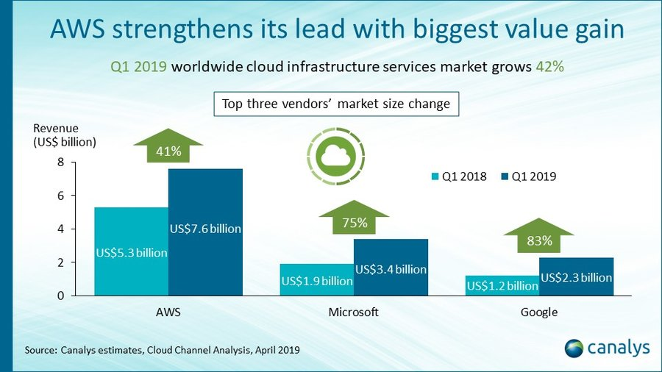

Slide 5
Types of Clouds:
There are three types of clouds − Public, Private, and Hybrid cloud.
Public Cloud
In public cloud, the third-party service providers make resources and services available to their customers via Internet. Customer’s data and related security is with the service providers’ owned infrastructure.
Private Cloud
A private cloud also provides almost similar features as public cloud, but the data and services are managed by the organization or by the third party only for the customer’s organization. In this type of cloud, major control is over the infrastructure so security related issues are minimized.
Hybrid Cloud
A hybrid cloud is the combination of both private and public cloud. The decision to run on private or public cloud usually depends on various parameters like sensitivity of data and applications, industry certifications and required standards, regulations, etc.

Slide 6
Cloud Service Models:
There are three types of service models in cloud − IaaS, PaaS, and SaaS.
IaaS
IaaS stands for Infrastructure as a Service. It provides users with the capability to provision processing, storage, and network connectivity on demand. Using this service model, the customers can develop their own applications on these resources.
PaaS
PaaS stands for Platform as a Service. Here, the service provider provides various services like databases, queues, workflow engines, e-mails, etc. to their customers. The customer can then use these components for building their own applications. The services, availability of resources and data backup are handled by the service provider that helps the customers to focus more on their application's functionality.
SaaS
SaaS stands for Software as a Service. As the name suggests, here the third-party providers provide end-user applications to their customers with some administrative capability at the application level, such as the ability to create and manage their users. Also some level of customizability is possible such as the customers can use their own corporate logos, colors, etc.

Slide 7
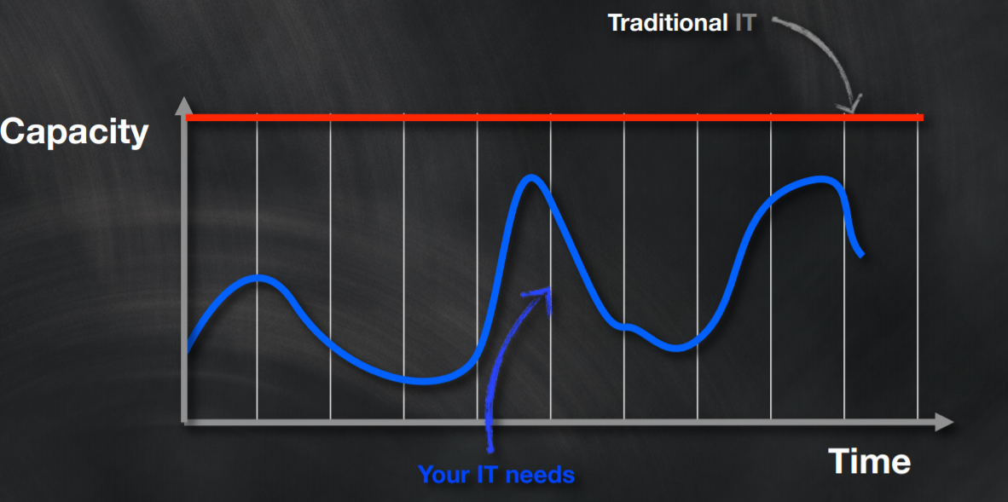
Traditional vs Required IT

Slide 9
Cloud Computing Basics
Whether you are running applications that share photos to millions of mobile users or you’re supporting the critical operations of your business, a cloud services platform provides rapid access to flexible and low cost IT resources. With cloud computing, you don’t need to make large upfront investments in hardware and spend a lot of time on the heavy lifting of managing that hardware. Instead, you can provision exactly the right type and size of computing resources you need to power your newest bright idea or operate your IT department. You can access as many resources as you need, almost instantly, and only pay for what you use.
Six Advantages and Benefits of Cloud Computing
1.Trade capital expense for variable expense
Instead of having to invest heavily in data centers and servers before you know how you’re going to use them, you can only pay when you consume computing resources, and only pay for how much you consume.
2.Go global in minutes
Easily deploy your application in multiple regions around the world with just a few clicks. This means you can provide a lower latency and better experience for your customers simply and at minimal cost.

Slide 10
3.Benefit from massive economies of scale
By using cloud computing, you can achieve a lower variable cost than you can get on your own. Because usage from hundreds of thousands of customers are aggregated in the cloud, providers such as Amazon Web Services can achieve higher economies of scale which translates into lower pay as you go prices.
4.Stop guessing capacity
Eliminate guessing on your infrastructure capacity needs. When you make a capacity decision prior to deploying an application, you often either end up sitting on expensive idle resources or dealing with limited capacity. With cloud computing, these problems go away. You can access as much or as little as you need, and scale up and down as required with only a few minutes notice.
5.Increase speed and agility
In a cloud computing environment, new IT resources are only ever a click away, which means you reduce the time it takes to make those resources available to your developers from weeks to just minutes. This results in a dramatic increase in agility for the organization, since the cost and time it takes to experiment and develop is significantly lower.
6.Stop spending money on running and maintaining data centers
Focus on projects that differentiate your business, not the infrastructure. Cloud computing lets you focus on your own customers, rather than on the heavy lifting of racking, stacking and powering servers.

Slide 11
AWS Global Infrastructure
The AWS Cloud operates 42 Availability Zones within 16 geographic Regions around the world, with nine more Availability Zones and four more Regions coming online throughout the next year.
AWS Regions and Availability Zones
The AWS Cloud infrastructure is built around Regions and Availability Zones (“AZs”). A Region is a physical location in the world where we have multiple Availability Zones. Availability Zones consist of one or more discrete data centers, each with redundant power, networking and connectivity, housed in separate facilities. These Availability Zones offer you the ability to operate production applications and databases which are more highly available, fault tolerant and scalable than would be possible from a single data center. The AWS Cloud operates 38 Availability Zones within 14 geographic Regions around the world.

Slide 12
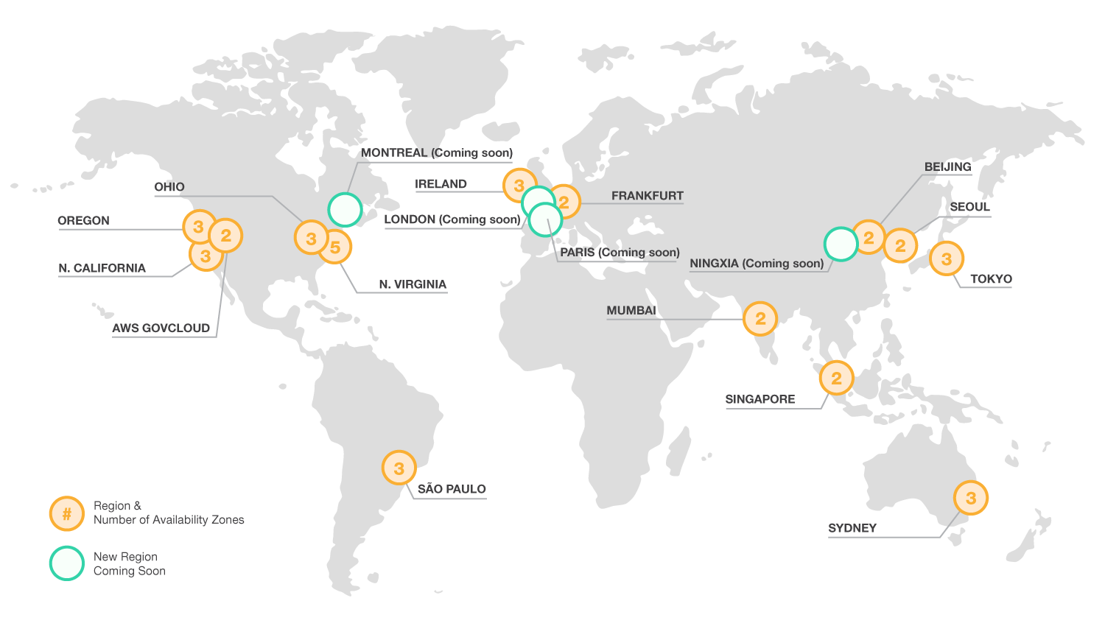

Slide 13
Choosing an AWS Region
Choosing an AWS region is the first decision you have to make when you set up your AWS components.
There are a lot of other factors to consider when choosing a region. Since the goal is to make
applications grow on AWS, we should consider factors that will make a difference.
• Target User Base(Latency)
Most AWS customers choose one based on proximity to themselves or to their end users, which
sounds like a sensible thing to do. If most of your users access your application from within
North America, then it typically makes sense to deploy your software in an AWS region located
in the US or Canada.

Slide 14
• Compliance/Security
Sometimes, due to regulatory reasons you might be forced to choose a particular region - there are laws that mandate certain data to be stored in a particular country. For example, the European Union has very strong Compliance clause that all the data of European union customers has to be stored on Servers present within European union. Thus, if you are designing applications for European customers or companies and are using AWS, you are required as per the compliance requirements to use of EU region of Amazon.
• Cost
Cost changes by Region - pick the wrong one and you could wind up paying significantly more. In the most common configurations, it's not hard to locate a 30% or 75% value difference with the least expensive AWS Region. N. Virginia is the least expensive Region. Sao Paolo generally costliest.

Slide 15
• Service Availability
Not all services are available in all regions (some take a VERY long time before they are). This can be a serious issue for your application, especially if you have a multi-region deployment and suddenly realize you don’t have all the AWS components you need in all the regions your application will be deployed to.

Slide 16
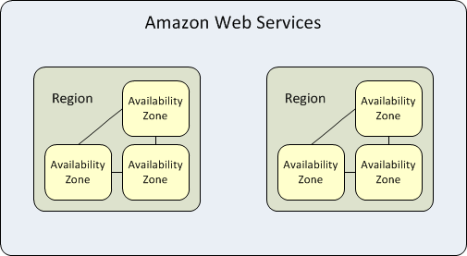
Region and Availability Zone Concepts
Each region is completely independent. Each Availability Zone is isolated, but the Availability Zones in a region are connected through low-latency links. The following diagram illustrates the relationship between regions and Availability Zones.

Slide 17
Regions in AWS
US East (N. Virginia)
US East (Ohio)
US West (N. California)
US West (Oregon)
EU (Ireland)
EU (Frankfurt)
Asia Pacific (Tokyo)
Asia Pacific (Seoul)
Asia Pacific (Singapore)
Asia Pacific (Sydney)
Asia Pacific (Mumbai)
South America (São Paulo)

Slide 18
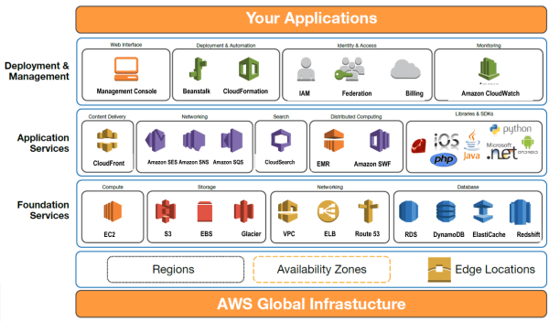

Slide 19
