Slide 1
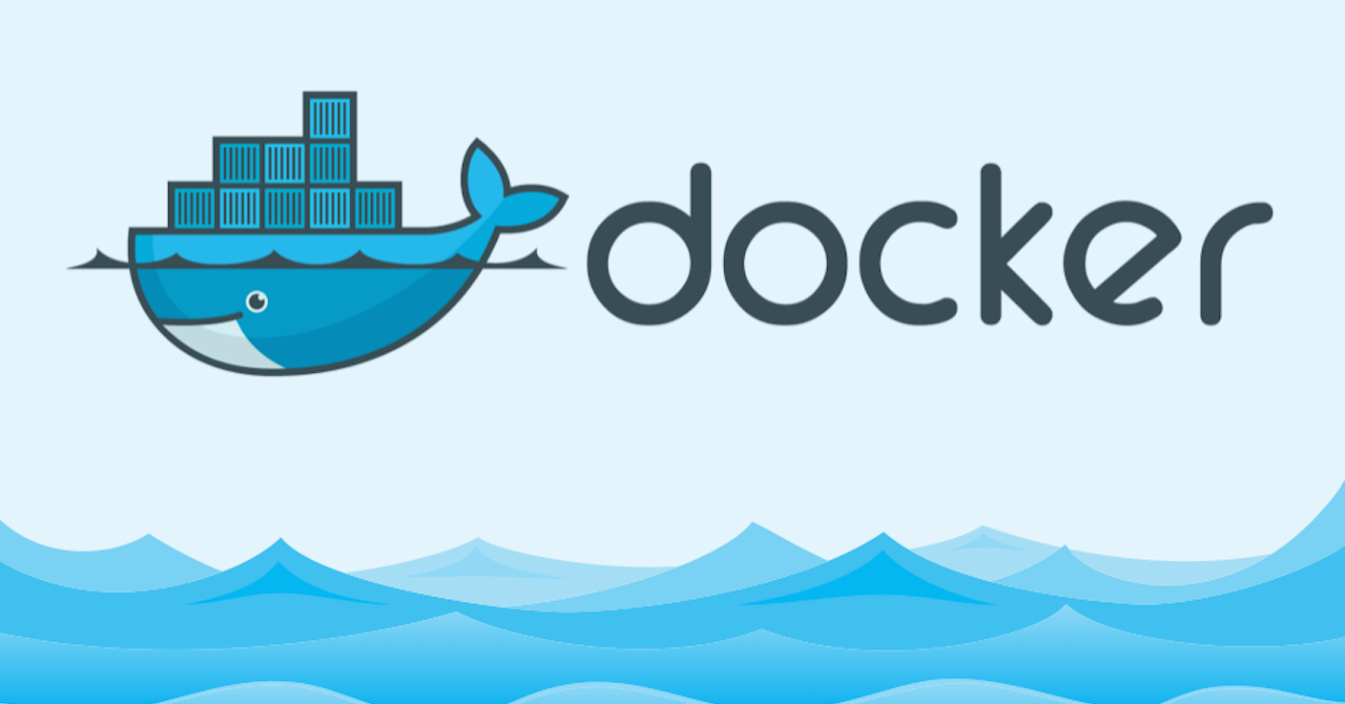

Slide 2
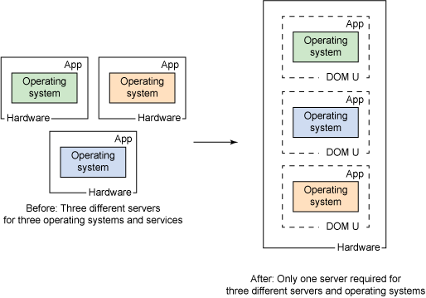
Virtualization:
Virtualization is changing the mindset from physical to logical.
What virtualization means is creating more logical IT resources, called virtual systems, within one physical system. That’s called system virtualization. It most commonly uses the hypervisor for managing the resources for every virtual system. The hypervisor is a software that can virtualize the hardware resources.

Slide 3
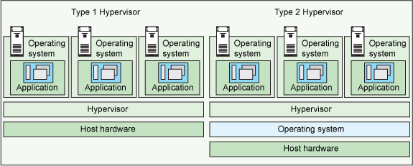
Hypervisors Overview:
There are two types of hypervisors:
Type 1 hypervisor: hypervisors run directly on the system hardware – A “bare metal” embedded hypervisor,
Ex: VMware ESXi, Microsoft Hyper-V server and open source KVM
Type 2 hypervisor: hypervisors run on a host operating system that provides virtualization services, such as I/O device support and memory management.
Ex: VMware Fusion, Oracle VM VirtualBox, Oracle VM Server for x86, Oracle Solaris Zones, Parallels and VMware Workstation

Slide 4
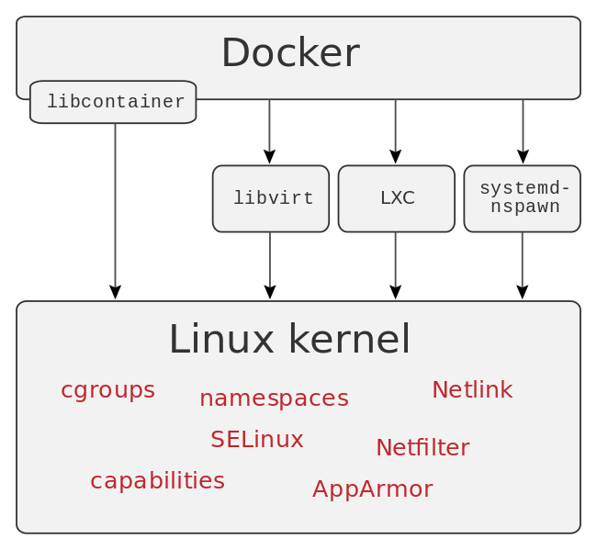
Docker internals:

Slide 5
://medium.com/@BeNitinAgarwal/understanding-the-docker-internals-7ccb052ce9fe
Docker takes advantage of several features of the Linux kernel to deliver its functionality.
Namespaces:
Docker makes use of kernel namespaces to provide the isolated workspace called the container. When you run a container, Docker creates a set of namespaces for that container. These namespaces provide a layer of isolation. Each aspect of a container runs in a separate namespace and its access is limited to that namespace.
Cgroups
Docker also makes use of kernel control groups for resource allocation and isolation. A cgroup limits an application to a specific set of resources. Control groups allow Docker Engine to share available hardware resources to containers and optionally enforce limits and constraints.

Slide 6
Union File Systems
Union file systems operate by creating layers, making them very lightweight and fast. Docker Engine uses UnionFS to provide the building blocks for containers. Docker Engine can use multiple UnionFS variants, including AUFS, btrfs, vfs, and devicemapper.
Container Format
Docker Engine combines the namespaces, control groups and UnionFS into a wrapper called a container format. The default container format is libcontainer.
Security
Docker Engine makes use of AppArmor, Seccomp, Capabilities kernel features for security purposes.

Slide 7
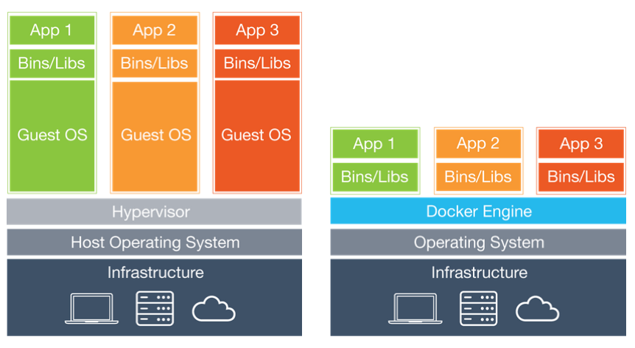
Difference between VM and Docker

Slide 8
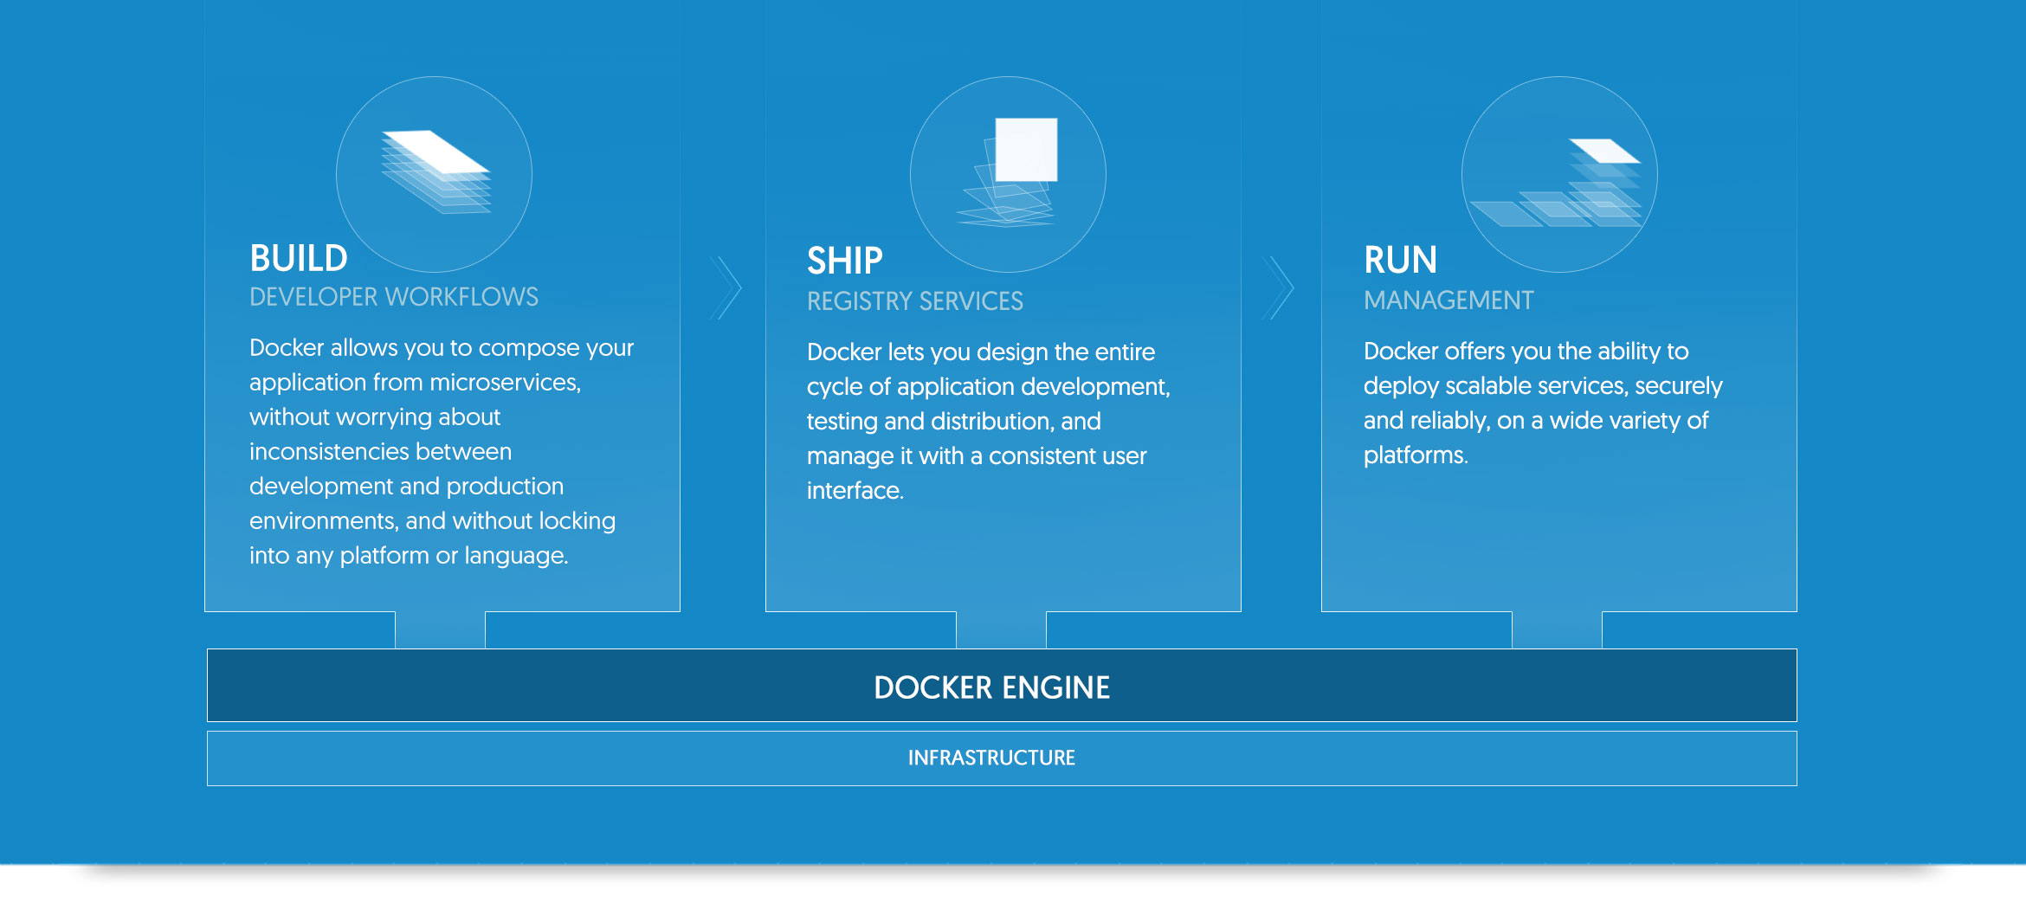

Slide 9
Prerequisites
Docker requires a 64-bit OS and version 3.10 or higher of the Linux kernel.
To check your current kernel version, open a terminal and use uname -r to display your kernel version:
$ uname -r
3.10.0-229.el7.x86_64
Finally, it is recommended that you fully update your system. Keep in mind that your system should be fully patched to fix any potential kernel bugs. Any reported kernel bugs may have already been fixed on the latest kernel packages.
Install Docker Engine¶
There are two ways to install Docker Engine. You can install using the yum package manager. Or you can use curl with the get.docker.com site. This second method runs an installation script which also installs via the yum package manager.
Install with yum¶
Log into your machine as a user with sudo or root privileges.
Make sure your existing packages are up-to-date.
$ sudo yum update
Add the yum repo.
$ sudo tee /etc/yum.repos.d/docker.repo <<-'EOF'
[dockerrepo]
name=Docker Repository
baseurl=https://yum.dockerproject.org/repo/main/centos/7/
enabled=1
gpgcheck=1
gpgkey=https://yum.dockerproject.org/gpg
EOF
$sudo yum install docker
$service docker start

Slide 10
Docker Installation with script:
Log into your machine as a user with sudo or root privileges.
Make sure your existing packages are up-to-date.
$ sudo yum update
Run the Docker installation script.
$ curl -fsSL https://get.docker.com/ | sh
This script adds the docker.repo repository and installs Docker.
Enable the service.
$ sudo systemctl enable docker.service
Start the Docker daemon.
$ sudo systemctl start docker
Verify docker is installed correctly by running a test image in a container.
$ sudo docker run --rm hello-world
To un-install Docker
$ sudo yum -y remove docker-engine.x86_64
$ sudo yum -y remove docker-engine-selinux.noarch

Slide 11
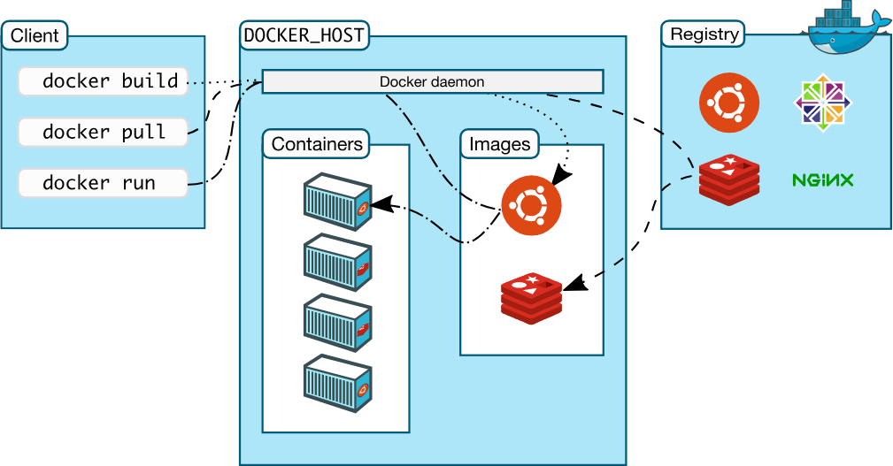

Slide 12
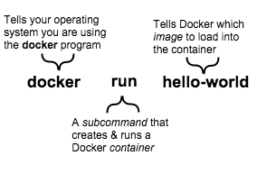
Learn about images and containers:
Docker Engine provides the core Docker technology that enables images and containers. As the last step in your installation, you ran the docker run hello-world command. The command you ran had three parts.
An image is a file system and parameters to use at runtime. It doesn’t have state and never changes. A container is a running instance of an image. When you ran the command, Docker Engine:
checked to see if you had the hello-world software image
downloaded the image from the Docker Hub (more about the hub later)
loaded the image into the container and “ran” it
Depending on how it was built, an image might run a simple, single command and then exit. This is what hello-world did.
A Docker image, though, is capable of much more. An image can start software as complex as a database, wait for you (or someone else) to add data, store the data for later use, and then wait for the next person.
Who built the hello-world software image though? In this case, Docker did but anyone can. Docker Engine lets people (or companies) create and share software through Docker images. Using Docker Engine, you don’t have to worry about whether your computer can run the software in a Docker image — a Docker container can always run it.

Slide 13
Find and run the whalesay image:
People all over the world create Docker images. You can find these images by browsing the Docker Hub. In this next section, you’ll search for and find the image you’ll use in the rest of this getting started.
Step 1: Locate the whalesay image
https://hub.docker.com
Step 2:$ docker run docker/whalesay cowsay boo
Step 3:$ docker images
REPOSITORY TAG IMAGE ID CREATED SIZE
docker/whalesay latest fb434121fc77 3 hours ago 247 MB
hello-world latest 91c95931e552 5 weeks ago 910 B

Slide 14
Build your own image:
Step 1: Write a Dockerfile¶
In this step, you use a text editor to write a short Dockerfile. A Dockerfile is a recipe which describes the files, environment, and commands that make up an image. Your recipe is going to be very short.
You run these steps in a terminal window on Linux or macOS, or a command prompt on Windows. Remember that if you are using macOS or Windows, you are still creating an image which runs on Linux.
Make a new directory. If you’re on Windows, use md instead of mkdir.
$ mkdir mydockerbuild
This directory will contain all the things you need to build your image. Right now, it’s empty.
Change to your new directory. Whether you’re on Linux, macOS, or Windows, the cd command is the same.
$ cd mydockerbuild
Edit a new text file named Dockerfile in the current directory, using a text editor such as nano or vi on Linux or Mac, or notepad on Windows.
$ vim Dockerfile
Add a FROM statement by copying the following line into the file:
FROM docker/whalesay:latest
The FROM keyword tells Docker which image your image is based on. Whalesay is cute and has the cowsay program already, so we’ll start there.

Slide 15
Add a RUN statement which will install the fortunes program into the image.
RUN apt-get -y update && apt-get install -y fortunes
The whalesay image is based on Ubuntu, which uses apt-get to install packages. These two commands refresh the list of packages available to the image and install the fortunes program into it. The fortunes program has prints out wise sayings for our whale to say.
Add a CMD statement, which tells the image the final command to run after its environment is set up. This command runs fortune -a and sends its output to the cowsay command.
CMD /usr/games/fortune -a | cowsay
Check your work. Your file should look just like this:
FROM docker/whalesay:latest
RUN apt-get -y update && apt-get install -y fortunes
CMD /usr/games/fortune -a | cowsay
Save the file and close the text editor. At this point, your software recipe is described in the Dockerfile file. You are ready to build a new image.
Step 2: Build an image from your Dockerfile¶
While you are in the mydockerbuild directory, build the image using the docker build command. The -t parameter gives your image a tag, so you can run it more easily later. Don’t forget the . command, which tells the docker build command to look in the current directory for a file called Dockerfile. This command works the same in Linux, macOS, or Windows.
$ docker build -t docker-whale .

Slide 16
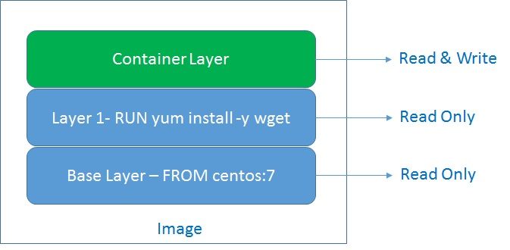
Image layers:

Slide 17
Run sample example:
RUN apt-get update && apt-get install -y \ package-bar \ package-baz \ package-foo=1.3.*
Add examples:
ADD hom* /mydir/ # adds all files starting with "hom" ADD hom?.txt /mydir/ # ? is replaced with any single character, e.g., "home.txt"
MAINTAINER <give the maintainer name>
COPY and ADD
Although ADD and COPY are functionally similar, generally speaking, COPY is preferred. That’s because it’s more transparent than ADD. COPY only supports the basic copying of local files into the container, while ADD has some features (like local-only tar extraction and remote URL support) that are not immediately obvious. Consequently, the best use for ADD is local tar file auto-extraction into the image, as in ADD rootfs.tar.xz /.
For COPY:
COPY resources/jdk-7u79-linux-x64.tar.gz /tmp/ RUN tar -zxvf /tmp/jdk-7u79-linux-x64.tar.gz -C /usr/local RUN rm /tmp/jdk-7u79-linux-x64.tar.gz
For ADD:
ADD resources/jdk-7u79-linux-x64.tar.gz /usr/local/
ADD supports local-only tar extraction. Besides it, COPY will use three layers, but ADD only uses one layer.

Slide 18
Difference between CMD and ENTRYPOINT:
ENTRYPOINT: command to run when container starts.
CMD: command to run when container starts or arguments to ENTRYPOINT if specified.
Yes, it's mixing up.
You can override any of them when running docker run.
Difference between CMD and ENTRYPOINT by example:
docker run -it --rm yourcontainer /bin/bash <-- /bin/bash overrides CMD <-- /bin/bash does not override ENTRYPOINT docker run -it --rm --entrypoint ls yourcontainer <-- overrides ENTRYPOINT with ls docker run -it --rm --entrypoint ls yourcontainer -la <-- overrides ENTRYPOINT with ls and overrides CMD with -la
More on difference between CMD and ENTRYPOINT:
Argument to docker run such as /bin/bash overrides any CMD command we wrote in Dockerfile.
ENTRYPOINT cannot be overriden at run time with normal commands such as docker run [args]. The args at the end of docker run [args] are provided as arguments to ENTRYPOINT. In this way we can create a container which is like a normal binary such as ls.
So CMD can act as defaul
t parameters to ENTRYPOINT and then we can override the CMD args from [args].
ENTRYPOINT can be overridden with --entrypoint.

Slide 19
FROM ubuntu
MAINTAINER Ram chandra
RUN apt-get update
RUN apt-get install -y nginx
COPY index.html /usr/share/nginx/html/
ENTRYPOINT [“/usr/sbin/nginx”,”-g”,”daemon off;”]
EXPOSE 80
The ENTRYPOINT specifies a command that will always be executed when the container starts.
The CMD specifies arguments that will be fed to the ENTRYPOINT.
More on difference between CMD and ENTRYPOINT:
Argument to docker run such as /bin/bash overrides any CMD command we wrote in Dockerfile.
ENTRYPOINT cannot be overridden at run time with normal commands such as docker run [args]. The args at the end of docker run [args] are provided as arguments to ENTRYPOINT. In this way we can create a container which is like a normal binary such as ls.
So CMD can act as default parameters to ENTRYPOINT and then we can override the CMD args from [args].
ENTRYPOINT can be overriden with --entrypoint.

Slide 20
FROM centos:7
MAINTAINER The CentOS Project <cloud-ops@centos.org>
LABEL Vendor="CentOS" \
License=GPLv2 \
Version=2.4.6-40
RUN yum -y --setopt=tsflags=nodocs update && \
yum -y --setopt=tsflags=nodocs install httpd && \
yum clean all
EXPOSE 80
# Simple startup script to avoid some issues observed with container restart
ENTRYPOINT ["/usr/sbin/httpd", "-D", "FOREGROUND"]

Slide 21
Environment variables are supported by the following list of instructions in the Dockerfile:
ADD
COPY
ENV
EXPOSE
FROM
LABEL
STOPSIGNAL
USER
VOLUME
WORKDIR
RUN
CMD

Slide 22
Run the created image:
$ docker run -t ram.whale .
Create a Docker Hub account and repository
Step 1: Sign up for an account
https://hub.docker.com/register/?utm_source=getting_started_guide&utm_medium=embedded_MacOSX&utm_campaign=create_docker_hub_account
Tag, push, and pull your image:
In this section, you tag and push your docker-whale image to your newly created repository. When you are done, you test the repository by pulling your new image.
Step 1: Tag and push the image¶
If you don’t already have a terminal open, open one now:

Slide 23
Go back to your command line terminal.
At the prompt, type docker images to list the images you currently have:
$ docker images
REPOSITORY TAG IMAGE ID CREATED SIZE
docker-whale latest 7d9495d03763 38 minutes ago 273.7 MB
<none> <none> 5dac217f722c 45 minutes ago 273.7 MB
docker/whalesay latest fb434121fc77 4 hours ago 247 MB
hello-world latest 91c95931e552 5 weeks ago 910 B
Find the IMAGE ID for your docker-whale image.
In this example, the id is 7d9495d03763.
Notice that currently, the `REPOSITORY` shows the repo name `docker-whale`
but not the namespace. You need to include the `namespace` for Docker Hub to
associate it with your account. The `namespace` is the same as your Docker
Hub account name. You need to rename the image to
`YOUR_DOCKERHUB_NAME/docker-whale`.

Slide 24
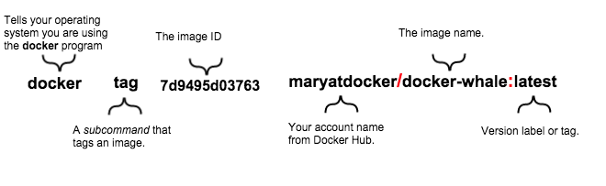
Command for uploading Docker image;
$ docker tag 7d9495d03763 ramcloud/ram.whale:latest
By above command we can change the names and versions of image
$ docker login
Enter your username and password
$ docker push ramcloud/docker-whale
Use the docker rmi to remove the ramcloud/docker-whale and docker-whale images.
You can use an ID or the name to remove an image.
$ docker rmi -f 7d9495d03763
$ docker rmi -f docker-whale
To run your own image enter the below command
$docker run yourusername/docker-whale

Slide 25
Hello world in a container:
Docker allows you to run applications, worlds you create, inside containers. Running an application inside a container takes a single command: docker run
Run a Hello world
Let’s run a hello world container.
$ docker run ubuntu /bin/echo 'Hello world' Hello world
You just launched your first container!
In this example:
docker run runs a container.
ubuntu is the image you run, for example the Ubuntu operating system image. When you specify an image, Docker looks first for the image on your Docker host. If the image does not exist locally, then the image is pulled from the public image registry Docker Hub.
/bin/echo is the command to run inside the new container.
The container launches. Docker creates a new Ubuntu environment and executes the /bin/echo command inside it and then prints out:
Hello world
So what happened to the container after that? Well, Docker containers only run as long as the command you specify is active. Therefore, in the above example, the container stops once the command is executed.

Slide 26
Run an interactive container:
Let’s specify a new command to run in the container.
$ docker run -t -i ubuntu /bin/bash root@af8bae53bdd3:/#
In this example:
docker run runs a container.
ubuntu is the image you would like to run.
-t flag assigns a pseudo-tty or terminal inside the new container.
-i flag allows you to make an interactive connection by grabbing the standard input (STDIN) of the container.
/bin/bash launches a Bash shell inside our container.
The container launches. We can see there is a command prompt inside it:
root@af8bae53bdd3:/#
Let’s try running some commands inside the container:
root@af8bae53bdd3:/# pwd root@af8bae53bdd3:/# ls

Slide 27
Start a daemonized Hello world:
Let’s create a container that runs as a daemon.
$ docker run -d ubuntu /bin/sh -c "while true; do echo hello world; sleep 1; done" 1e5535038e285177d5214659a068137486f96ee5c2e85a4ac52dc83f2ebe4147
In this example:
docker run runs the container.
-d flag runs the container in the background (to daemonize it).
ubuntu is the image you would like to run.
Finally, we specify a command to run:
/bin/sh -c "while true; do echo hello world; sleep 1; done"
In the output, we do not see hello world but a long string:
1e5535038e285177d5214659a068137486f96ee5c2e85a4ac52dc83f2ebe4147
This long string is called a container ID. It uniquely identifies a container so we can work with it.
Note: The container ID is a bit long and unwieldy. Later, we will cover the short ID and ways to name our containers to make working with them easier.

Slide 28
We can use this container ID to see what’s happening with our hello world daemon.
First, let’s make sure our container is running. Run the docker ps command. The docker ps command queries the Docker daemon for information about all the containers it knows about.
$ docker ps CONTAINER ID IMAGE COMMAND CREATED STATUS PORTS NAMES 1e5535038e28 ubuntu /bin/sh -c 'while tr 2 minutes ago Up 1 minute insane_babbage
In this example, we can see our daemonized container. The docker ps returns some useful information:
1e5535038e28 is the shorter variant of the container ID.
ubuntu is the used image.
the command, status, and assigned name insane_babbage.
Note: Docker automatically generates names for any containers started. We’ll see how to specify your own names a bit later.
Now, we know the container is running. But is it doing what we asked it to do? To see this we’re going to look inside the container using the docker logs command.
Let’s use the container name insane_babbage.
docker run -p 8080:8080 -p 50000:50000 jenkins
docker run -it --rm -p 8888:8080 tomcat:8.0

Slide 29
$ docker logs insane_babbage hello world hello world hello world...
In this example:
docker logs looks inside the container and returns hello world.
Awesome! The daemon is working and you have just created your first Dockerized application!
docker logs looks inside the container and returns hello world.
Awesome! The daemon is working and you have just created your first Dockerized application!
Next, run the docker stop command to stop our detached container.
$ docker stop insane_babbage insane_babbage
The docker stop command tells Docker to politely stop the running container and returns the name of the container it stopped.
Let’s check it worked with the docker ps command.
$ docker ps

Slide 30
Run a web application in Docker
Now that you’ve learned a bit more about the Docker client, you can move onto the important stuff: running more containers. So far none of the containers you’ve run did anything particularly useful, so you can change that by running an example web application in Docker.
For the web application you’re going to run a Python Flask application. Start with a docker run command.
$ docker run -d -P training/webapp python app.py
This command consists of the following parts:
The -d flag runs the container in the background (as a so-called daemon).
The -P flag maps any required network ports inside the container to your host. This lets you view the web application.
The training/webapp image is a pre-built image that contains a simple Python Flask web application.
The remaining arguments make up the command that is run inside the container. The python app.pycommand launches the web application.

Slide 31
View the web application container
Now you can see your running container using the docker ps command.
$ docker ps -l CONTAINER ID IMAGE COMMAND CREATED STATUS PORTS NAMES bc533791f3f5 training/webapp:latest python app.py 5 seconds ago Up 2 seconds 0.0.0.0:49155->5000/tcp nostalgic_morse
The -l flag shows only the details of the last container started.
Note: By default, the docker ps command only shows information about running containers. If you want to see stopped containers too, use the -a flag.
You can see the same details you saw when you first dockerized a container, with one important addition in the PORTS column.
PORTS 0.0.0.0:49155->5000/tcp

Slide 32
When you passed the -P flag to the docker run command, Docker mapped any ports exposed in the container to your host.
Note: You’ll learn more about how to expose ports in Docker images when you learn how to build images.
In this case Docker has exposed port 5000 (the default Python Flask port) on port 49155.
Network port bindings are very configurable in Docker. In the last example the -P flag is a shortcut for -p 5000that maps port 5000 inside the container to a high port (from ephemeral port range which typically ranges from 32768 to 61000) on the local Docker host. You can also bind Docker containers to specific ports using the -p flag, for example:
$ docker run -d -p 80:5000 training/webapp python app.py
This would map port 5000 inside your container to port 80 on your local host. You might be asking about now: why wouldn’t we just want to always use 1:1 port mappings in Docker containers rather than mapping to high ports? Well, 1:1 mappings have the constraint of only being able to map one of each port on your local host.
Suppose you want to test two Python applications: both bound to port 5000 inside their own containers. Without Docker’s port mapping you could only access one at a time on the Docker host.
So you can now browse to port 49155 in a web browser to see the application.

Slide 33
A network port shortcut
Using the docker ps command to return the mapped port is a bit clumsy, so Docker has a useful shortcut you can use: docker port. To use docker port, specify the ID or name of your container and then the port for which you need the corresponding public-facing port.
$ docker port nostalgic_morse 5000 0.0.0.0:49155
In this case you’ve looked up what port is mapped externally to port 5000 inside the container.
View the web application’s logs
You can also find out a bit more about what’s happening with your application and use another of the commands you’ve learned, docker logs.
$ docker logs -f nostalgic_morse * Running on http://0.0.0.0:5000/ 10.0.2.2 - - [06/Nov/2016 20:16:31] "GET / HTTP/1.1" 200 - 10.0.2.2 - - [06/Nov/2016 20:16:31] "GET /favicon.ico HTTP/1.1" 404 -
The -f flag causes the docker logs command to act like the tail -f command and watch the container’s standard output. You can see here the logs from Flask showing the application running on port 5000 and the access log entries for it.
$ docker top nostalgic_morse

Slide 34
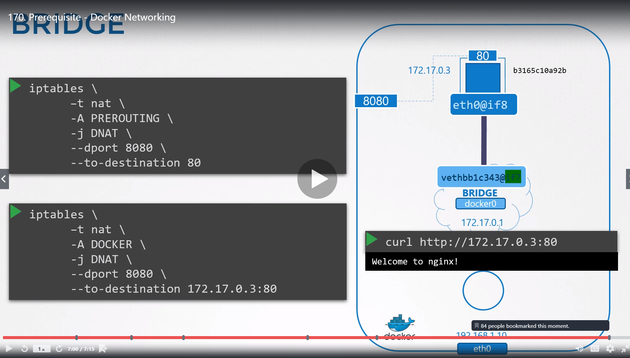
Docker network port forwarding (image src udemy)

Slide 35
$ docker stop nostalgic_morse
$ docker ps -l
$ docker start nostalgic_morse
$ docker rm nostalgic_morse
https://docs.docker.com/engine/userguide/networking/
To login to a container use below command
docker exec -it 3228e563137d /bin/bash
$docker exec -it <continer iD> <shell promt>

Slide 36
Docker Networking
Network drivers
Docker’s networking subsystem is pluggable, using drivers. Several drivers exist by default, and provide core networking functionality:
bridge: The default network driver. If you don’t specify a driver, this is the type of network you are creating. Bridge networks are usually used when your applications run in standalone containers that need to communicate. See bridge networks.
host: For standalone containers, remove network isolation between the container and the Docker host, and use the host’s networking directly. host is only available for swarm services on Docker 17.06 and higher. See use the host network.
overlay: Overlay networks connect multiple Docker daemons together and enable swarm services to communicate with each other. You can also use overlay networks to facilitate communication between a swarm service and a standalone container, or between two standalone containers on different Docker daemons. This strategy removes the need to do OS-level routing between these containers. See overlay networks.
macvlan: Macvlan networks allow you to assign a MAC address to a container, making it appear as a physical device on your network. The Docker daemon routes traffic to containers by their MAC addresses. Using the macvlan driver is sometimes the best choice when dealing with legacy applications that expect to be directly connected to the physical network, rather than routed through the Docker host’s network stack. See Macvlan networks.
none: For this container, disable all networking. Usually used in conjunction with a custom network driver. none is not available for swarm services. See disable container networking.
Network plugins: You can install and use third-party network plugins with Docker. These plugins are available from Docker Storeor from third-party vendors. See the vendor’s documentation for installing and using a given network plugin.

Slide 37
Docker none network:
[Ram]$docker run -itd --name none-network1 --network none centos /bin/bash
d1952fbc9fdc0b03048bf808904fc49962d6b33647b03bd35e92b5d8e3c114de
[Ram]$docker ps
CONTAINER ID IMAGE COMMAND CREATED STATUS PORTS NAMES
d1952fbc9fdc centos "/bin/bash" 3 seconds ago Up 2 seconds none-network1
When we docker inspect we won’t find any ip address assigned to it
[Ram]$docker inspect d1952fbc9fdc
….
"IPAddress": "",
"IPPrefixLen": 0,

Slide 38
Docker host network:
[Ram]$docker run -itd --name host-network --network host -p 80:80 nginx /bin/bash
WARNING: Published ports are discarded when using host network mode
251ebf040f242d0df85a71994de19179eacde8b01ae35fefd50b2520295e3cb6
[Ram]$docker ps
CONTAINER ID IMAGE COMMAND CREATED STATUS PORTS NAMES
251ebf040f24 nginx "/docker-entrypoint.…" 20 seconds ago Up 19 seconds host-network
Try to create the container with same port number it won’t work in linux port numbers unique to a process
By Default ports won’t work for host network

Slide 39
Network driver summary
User-defined bridge networks are best when you need multiple containers to communicate on the same Docker host.
Host networks are best when the network stack should not be isolated from the Docker host, but you want other aspects of the container to be isolated.
→ The host networking driver only works on Linux hosts, and is not supported on Docker for Mac, Docker for Windows, or Docker EE for Windows Server.
Overlay networks are best when you need containers running on different Docker hosts to communicate, or when multiple applications work together using swarm services.
Macvlan networks are best when you are migrating from a VM setup or need your containers to look like physical hosts on your network, each with a unique MAC address.
→ The macvlan networking driver only works on Linux hosts, and is not supported on Docker for Mac, Docker for Windows, or Docker EE for Windows Server.
Third-party network plugins allow you to integrate Docker with specialized network stacks.

Slide 40
Docker container networking
Default Networks¶
When you install Docker, it creates three networks automatically. You can list these networks using the docker network ls command:
$ docker network ls
Historically, these three networks are part of Docker’s implementation. When you run a container you can use the --network flag to specify which network you want to run a container on. These three networks are still available to you.
$ ifconfig
The default bridge network in detail¶
The default bridge network is present on all Docker hosts. The docker network inspect command returns information about a network:
$ docker network inspect bridge
The Engine automatically creates a Subnet and Gateway to the network. The docker run command automatically adds new containers to this network

Slide 41
$ docker run -itd --name=container1 busybox
$ docker run -itd --name=container2 busybox
Inspecting the bridge network again after starting two containers shows both newly launched containers in the network. Their ids show up in the “Containers” section of docker network inspect:
You can attach to a running container and investigate its configuration:
$ docker attach container1
Then use ping to send three ICMP requests and test the connectivity of the containers on this bridge network.
root@0cb243cd1293:/# ping -w3 172.17.0.3
root@0cb243cd1293:/# cat /etc/hosts
To detach from a container1 and leave it running use CTRL-p CTRL-q.Then, attach to container2 and repeat these three commands.

Slide 42
User-defined networks:
You can create your own user-defined networks that better isolate containers. Docker provides some default network drivers for creating these networks. You can create a new bridge network, overlay network or MACVLAN network. You can also create a network plugin or remote network written to your own specifications.
You can create multiple networks. You can add containers to more than one network. Containers can only communicate within networks but not across networks. A container attached to two networks can communicate with member containers in either network. When a container is connected to multiple networks, its external connectivity is provided via the first non-internal network, in lexical order.
The next few sections describe each of Docker’s built-in network drivers in greater detail.
A bridge network:
The easiest user-defined network to create is a bridge network. This network is similar to the historical, default docker0 network. There are some added features and some old features that aren’t available.
$ docker network create --driver bridge isolated_nw
1196a4c5af43a21ae38ef34515b6af19236a3fc48122cf585e3f3054d509679b
$ docker network inspect isolated_nw
$ docker network ls
After you create the network, you can launch containers on it using the docker run --network=<NETWORK> option.
$ docker run --network=isolated_nw -itd --name=container3 busybox
$ docker network inspect isolated_nw
Entering into Container
$docker exec -it <container_name_or_uuid> <shell_command>
To run tomcat
$docker exec -itd 0a4f5321b672 /bin/bash
$ docker stats

Slide 43
Creating docker with Driver bridge
$ docker network create -d bridge my-bridge-network
-- -d for driver
docker run -itd --name=ram-cont1 --network=ram-own httpd
docker network create -d bridge ram --subnet 15.10.0.0/16 --gateway 15.10.0.15
docker run -itd --name=httpd2 --network=ram-own -p 85:8000 httpd
docker run -itd --name=httpd4 --network=ram-netw -p 82:6003 httpd /bin/bash
docker run --rm -itd --name test --network ram-network-own -p 80:80 httpd:latest /bin/bash
docker run -itd --network ram --ip 172.10.0.10 --name test5 centos /bin/bash
→ above command is to delete the continer after the stop
To see the list of containers
docker ps -a
docker stop container ID
docker restart container ID
Note: When you stop the Docker container, Container will not get destroy the data you stored on the container, Container will remains same even after you stop the service also
Check the process using docker ps -a, until unless you delete the container using Docker rm -f <Container name>

Slide 44
Running multiple process in one container
https://docs.docker.com/engine/admin/multi-service_container/
Taking backup of images to S3
https://hub.docker.com/r/dockercloud/dockup/

Slide 45
Linking two containers:
Scenario where you want to link two containers
docker run --name some-wordpress --link some-mysql:mysql -d wordpress
docker network connect --link container1<network type> container2
docker network connect --link test3 ram test4

Slide 46
Assigning cpu and memory shares dynamical
$ docker run -d \
--name='low_prio' \
--cpuset-cpus=0 \
--cpu-shares=20 \
busybox md5sum /dev/urandom
$ docker run -d \
--name='high_prio' \
--cpuset-cpus=0 \
--cpu-shares=80 \
busybox md5sum /dev/urandom
Usage: docker update [OPTIONS] CONTAINER [CONTAINER...]
Update configuration of one or more containers
--blkio-weight Block IO (relative weight), between 10 and 1000
--cpu-shares CPU shares (relative weight)
--cpu-period Limit CPU CFS (Completely Fair Scheduler) period
--cpu-quota Limit CPU CFS (Completely Fair Scheduler) quota
--cpuset-cpus CPUs in which to allow execution (0-3, 0,1)
--cpuset-mems MEMs in which to allow execution (0-3, 0,1)
--help Print usage
--kernel-memory Kernel memory limit
-m, --memory Memory limit
--memory-reservation Memory soft limit
--memory-swap Swap limit equal to memory plus swap: '-1' to enable unlimited swap
--restart Restart policy to apply when a container exits

Slide 47
Update a container with cpu-shares=512¶
To limit a container’s cpu-shares to 512, first identify the container name or ID. You can use docker ps to find these values. You can also use the ID returned from the docker run command. Then, do the following:
$ docker update --cpu-shares 512 abebf7571666
Update a container with cpu-shares and memory¶
To update multiple resource configurations for multiple containers:
$ docker update --cpu-shares 512 -m 300M abebf7571666 hopeful_morse

Slide 48
Docker Commands
ab -n 10000 -c 10 http://ip-of-your-rpi/
To remove all the containers
docker rm $(docker ps -a)
docker rm -f $(docker ps -a -q)

Slide 49
Run a image: docker run -itd -p 8888:8080 --name test4 3b73c22a46ed
To enter into container: docker exec -it 9adf9e8b18c7 /bin/bash
Dockerfile:
FROM tomcat:8.0
RUN apt-get -y update && apt-get install -y fortunes
USER root
COPY enterprise-watchdog.war /usr/local/tomcat/webapps/

Slide 50
Docker SWARM tutorial
Feature highlights
Cluster management integrated with Docker Engine: Use the Docker Engine CLI to create a swarm of Docker Engines where you can deploy application services. You don’t need additional orchestration software to create or manage a swarm.
Decentralized design: Instead of handling differentiation between node roles at deployment time, the Docker Engine handles any specialization at runtime. You can deploy both kinds of nodes, managers and workers, using the Docker Engine. This means you can build an entire swarm from a single disk image.
Declarative service model: Docker Engine uses a declarative approach to let you define the desired state of the various services in your application stack. For example, you might describe an application comprised of a web front end service with message queueing services and a database backend.
Scaling: For each service, you can declare the number of tasks you want to run. When you scale up or down, the swarm manager automatically adapts by adding or removing tasks to maintain the desired state.

Slide 51
Desired state reconciliation: The swarm manager node constantly monitors the cluster state and reconciles any differences between the actual state and your expressed desired state. For example, if you set up a service to run 10 replicas of a container, and a worker machine hosting two of those replicas crashes, the manager will create two new replicas to replace the replicas that crashed. The swarm manager assigns the new replicas to workers that are running and available.
Multi-host networking: You can specify an overlay network for your services. The swarm manager automatically assigns addresses to the containers on the overlay network when it initializes or updates the application.
Service discovery: Swarm manager nodes assign each service in the swarm a unique DNS name and load balances running containers. You can query every container running in the swarm through a DNS server embedded in the swarm.
Load balancing: You can expose the ports for services to an external load balancer. Internally, the swarm lets you specify how to distribute service containers between nodes.
Secure by default: Each node in the swarm enforces TLS mutual authentication and encryption to secure communications between itself and all other nodes. You have the option to use self-signed root certificates or certificates from a custom root CA.
Rolling updates: At rollout time you can apply service updates to nodes incrementally. The swarm manager lets you control the delay between service deployment to different sets of nodes. If anything goes wrong, you can roll-back a task to a previous version of the service.

Slide 52
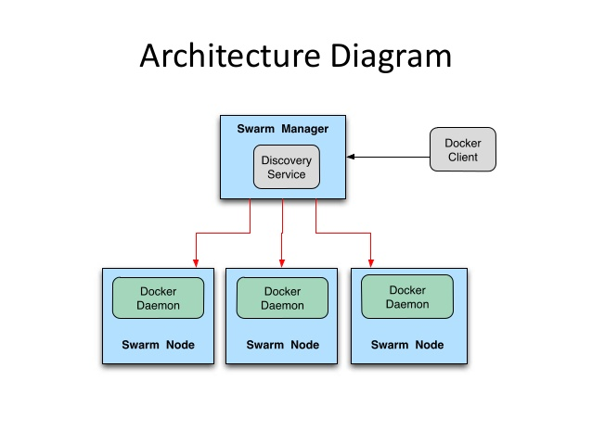
SWARM Architecture:

Slide 53
The tutorial guides you through the following activities:
initializing a cluster of Docker Engines in swarm mode
adding nodes to the swarm
deploying application services to the swarm
managing the swarm once you have everything running
Three networked host machines
The tutorial uses three networked host machines as nodes in the swarm. These can be virtual machines on your PC, in a data center, or on a cloud service provider. This tutorial uses the following machine names:
manager1
worker1
worker2
Here we are using AWS EC2 Instances
→ Open protocols and ports between the hosts
The following ports must be available. On some systems, these ports are open by default.
TCP port 2377 for cluster management communications
TCP and UDP port 7946 for communication among nodes
UDP port 4789 for overlay network traffic
If you are planning on creating an overlay network with encryption (--opt encrypted), you will also need to ensure ip protocol 50 (ESP) traffic is allowed.

Slide 54
Step1 :
Login to the master host via ssh
Step 2:
Run the following command to create a new swarm:
docker swarm init --advertise-addr <MANAGER-IP>
#docker swarm init --advertise-addr 10.0.1.137
Swarm initialized: current node (b8dsmtwxbvmxyyg0i0aaqxoo4) is now a manager.
To add a worker to this swarm, run the following command:
docker swarm join \
--token SWMTKN-1-4gg6zwipx13fsjssscmeps248ytxkpbsb3twackh9gqlu42hjn-c49fcz5t4ke6f71nbryew3lsd \
10.0.1.191:2377
To add a manager to this swarm, run 'docker swarm join-token manager' and follow the instructions.

Slide 55
Step 4: Run docker info to view the current state of the swarm:
[root@ip-10-0-1-191 ec2-user]# docker info
Containers: 2 Running: 0 Paused: 0 Stopped: 2 ...snip... Swarm: active NodeID: dxn1zf6l61qsb1josjja83ngz Is Manager: truea Managers: 1 Nodes: 1 ...snip…
Step 5:
[root@ip-10-0-1-191 ec2-user]# docker node ls
ID HOSTNAME STATUS AVAILABILITY MANAGER STATUS
b8dsmtwxbvmxyyg0i0aaqxoo4 * ip-10-0-1-191 Ready Active Leader

Slide 56
Step 6: Adding nodes to Swarm
1.Open a terminal and ssh into the machine where you want to run a worker node. This tutorial uses the name worker1.
2.Run the command produced by the docker swarm init output from the Create a swarm tutorial step to create a worker node joined to the existing swarm:
docker swarm join \
--token SWMTKN-1-4gg6zwipx13fsjssscmeps248ytxkpbsb3twackh9gqlu42hjn-c49fcz5t4ke6f71nbryew3lsd \
10.0.1.191:2377
Note: before entering this command docker should have been installed and running
[root@ip-10-0-1-156 ec2-user]# docker swarm join \
> --token SWMTKN-1-4gg6zwipx13fsjssscmeps248ytxkpbsb3twackh9gqlu42hjn-c49fcz5t4ke6f71nbryew3lsd \
> 10.0.1.191:2377
This node joined a swarm as a worker.
Do the same for other node also
Removing node as a worker run “docker swarm leave”

Slide 57
Step 7:Deploy a service to the swarm
1. ssh to manager host
2.Run the following command:
[root@ip-10-0-1-191 mydockerbuild]# docker service create --replicas 1 --name tomcat-web 1630fd3579f4
eeyhrl68y8sajl0uasfn1lzuy
[root@ip-10-0-1-191 mydockerbuild]# docker service ls
ID NAME REPLICAS IMAGE COMMAND
eeyhrl68y8sa tomcat-web 0/1 1630fd3579f4
[root@ip-10-0-1-191 mydockerbuild]# docker service inspect --pretty tomcat-web
ID: eeyhrl68y8sajl0uasfn1lzuy
Name: tomcat-web
Mode: Replicated
Replicas: 1
Placement:
UpdateConfig:
Parallelism: 1
On failure: pause
ContainerSpec:
Image: 1630fd3579f4
Resources:
Note: If you ignored --pretty you will get output in JSON formate

Slide 58
Step 8: Scale the service in the swarm
Run the following command to change the desired state of the service running in the swarm:
$ docker service scale <SERVICE-ID>=<NUMBER-OF-TASKS>
[root@ip-10-0-1-191 ec2-user]# docker service scale tomcat-web=5
tomcat-web scaled to 5
[root@ip-10-0-1-191 ec2-user]# docker service ls
ID NAME REPLICAS IMAGE COMMAND
eeyhrl68y8sa tomcat-web 0/5 1630fd3579f4
[root@ip-10-0-1-191 ec2-user]# docker service inspect --pretty tomcat-web
ID: eeyhrl68y8sajl0uasfn1lzuy
Name: tomcat-web
Mode: Replicated
Replicas: 5
Placement:
UpdateConfig:
Parallelism: 1
On failure: pause
ContainerSpec:
Image: 1630fd3579f4
Resources:

Slide 59
[root@ip-10-0-1-191 ec2-user]# docker service ps ram-tomcat
ID NAME IMAGE NODE DESIRED STATE CURRENT STATE ERROR
2o8s981g5wjhwmo4psnp5nr24 ram-tomcat.1 mytomcat-web ip-10-0-1-191 Ready Ready 1 seconds ago
9z3jizwvwesgq7d22kwvi96i1 ram-tomcat.2 mytomcat-web ip-10-0-1-156 Ready Rejected less than a second ago "No such image: mytomcat-web:l…"
020l1lhayvwizdr1zzw3boq1d ram-tomcat.3 mytomcat-web ip-10-0-1-156 Ready Rejected 2 seconds ago "No such image: mytomcat-web:l…"
d5pu5ngdijeq4gyoggjpg5avv ram-tomcat.4 mytomcat-web ip-10-0-1-156 Ready Rejected 2 seconds ago "No such image: mytomcat-web:l…"
1xawrmhe32x2x9iipgu8ag8f8 ram-tomcat.5 mytomcat-web ip-10-0-1-156 Ready Rejected 2 seconds ago "No such image: mytomcat-web:l…"
->Run docker service rm helloworld to remove the helloworld service.
$ docker service rm ram-tomcat
→ creating a service with port number
#docker service create --name web4 --replicas=5 --publish published=8080,target=80 nginx
docker network create -d overlay --opt encrypted pets-overlay docker service create --network pets-overlay --name db redis docker service create --network pets-overlay -p 8000:5000 -e DB=db --name web chrch/web
#######

Slide 60
https://stackoverflow.com/questions/41083328/what-is-the-use-of-host-and-none-network-in-docker
Docker by default supports 3 networks:
1) None:
This mode will not configure any IP for the container and doesn’t have any access to the external network as well as for other containers. It does have the loopback address and can be used for running batch jobs.
# docker run -it --network=none ubuntu:14.04 /bin/bash
root@66308c6686be:/# ifconfig lo Link encap:Local Loopback inet addr:127.0.0.1 Mask:255.0.0.0 UP LOOPBACK RUNNING MTU:65536 Metric:1 RX packets:0 errors:0 dropped:0 overruns:0 frame:0 TX packets:0 errors:0 dropped:0 overruns:0 carrier:0 collisions:0 txqueuelen:0 RX bytes:0 (0.0 B) TX bytes:0 (0.0 B) # # docker inspect 66308c6686be | grep -i ipaddr "SecondaryIPAddresses": null, "IPAddress": "", "IPAddress": "",
2) Host
In this mode container will share the host’s network stack and all interfaces from the host will be available to the container. The container’s host name will match the host name on the host system
# docker run -it --net=host ubuntu:14.04 /bin/bash
root@labadmin-VirtualBox:/# hostname labadmin-VirtualBox
Even the IP configuration is same as the host system's IP configuration
In host and none mode are not configured directly but default bridge network can be configured as well as create your own user-defined bridge networks.

Slide 61
3) Bridge Mode
It is the Docker default networking mode which will enable the connectivity to the other interfaces of the host machine as well as among containers.
# docker run -it --network=bridge ubuntu:14.04 /bin/bash root@58b0b1f18b2e:/# ifconfig eth0 Link encap:Ethernet HWaddr 02:42:ac:11:00:0c inet addr:172.17.0.12 Bcast:0.0.0.0 Mask:255.255.0.0 UP BROADCAST RUNNING MULTICAST MTU:1500 Metric:1 RX packets:16 errors:0 dropped:0 overruns:0 frame:0 TX packets:0 errors:0 dropped:0 overruns:0 carrier:0 collisions:0 txqueuelen:0 RX bytes:2668 (2.6 KB) TX bytes:0 (0.0 B)
Accessibility to other containers is possible in bridge mode.
root@58b0b1f18b2e:/# ping 172.17.0.11 PING 172.17.0.11 (172.17.0.11) 56(84) bytes of data. 64 bytes from 172.17.0.11: icmp_seq=1 ttl=64 time=0.143 ms 64 bytes from 172.17.0.11: icmp_seq=2 ttl=64 time=0.050 ms
Connectivity to external network.
root@58b0b1f18b2e:/# ping google.com PING google.com (216.58.197.46) 56(84) bytes of data. 64 bytes from maa03s20-in-f46.1e100.net (216.58.197.46): icmp_seq=1 ttl=51 time=16.9 ms
Connectivity to host machine
root@labadmin-VirtualBox:~# ip a | grep eth0 2: eth0: <BROADCAST,MULTICAST,UP,LOWER_UP> mtu 1500 qdisc pfifo_fast state UP group default qlen 1000 inet 10.0.2.15/24 brd 10.0.2.255 scope global eth0
Along with these docker provides MACVLAN network which allows to configure multiple Layer 2(MAC) addresses on a single physical interface.

Slide 62
Docker linking containers
https://rominirani.com/docker-tutorial-series-part-8-linking-containers-69a4e5bf50fb

Slide 63
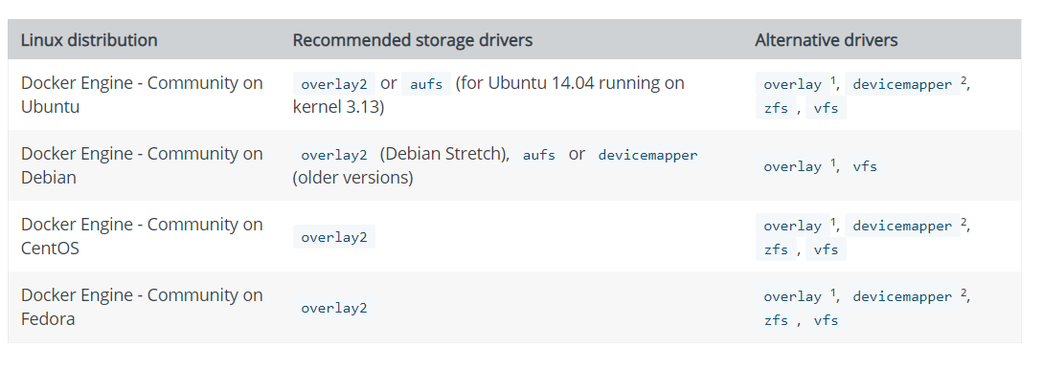
Docker storage drivers
To use storage drivers effectively, it’s important to know how Docker builds and stores images, and how these images are used by containers. You can use this information to make informed choices about the best way to persist data from your applications and avoid performance problems along the way.
Storage drivers allow you to create data in the writable layer of your container. The files won’t be persisted after the container is deleted, and both read and write speeds are lower than native file system performance.

Slide 64
Docker Volumes:
It is possible to store data within the writable layer of a container, but there are some downsides:
The data won’t persist when that container is no longer running, and it can be difficult to get the data out of the container if another process needs it.
A container’s writable layer is tightly coupled to the host machine where the container is running. You can’t easily move the data somewhere else.
Writing into a container’s writable layer requires a storage driver to manage the filesystem. The storage driver provides a union filesystem, using the Linux kernel. This extra abstraction reduces performance as compared to using data volumes, which write directly to the host filesystem.
Docker offers three different ways to mount data into a container from the Docker host: volumes, bind mounts, or tmpfsvolumes. When in doubt, volumes are almost always the right choice.
Sharing your local repo to docker container
docker run -d -v ~/nginxlogs:/var/log/nginx -p 5000:80 -i nginx

Slide 65
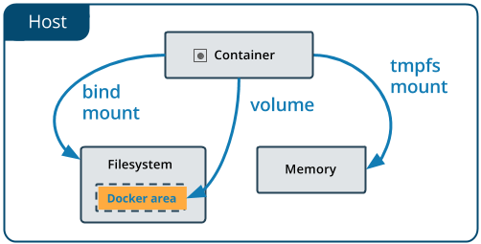
Volumes are the preferred mechanism for persisting data generated by and used by Docker containers. While bind mounts are dependent on the directory structure of the host machine, volumes are completely managed by Docker. Volumes have several advantages over bind mounts:
Volumes are easier to back up or migrate than bind mounts.
You can manage volumes using Docker CLI commands or the Docker API.
Volumes work on both Linux and Windows containers.
Volumes can be more safely shared among multiple containers.
Volume drivers let you store volumes on remote hosts or cloud providers, to encrypt the contents of volumes, or to add other functionality.
New volumes can have their content pre-populated by a container.

Slide 66
docker volume create --name=demo --opt o=size=100m
docker volume create --name=demo
docker run -it -v <volume name>:/home --name nginx5 -p 93:80 nginx /bin/bash
docker run -itd --name vol --volume-driver rexray/ebs --mount src=ebs-vol,target=/home/ centos
$docker volume create -d flocker -o size=20GB my-named-volume
$ docker volume create --driver local --opt type=tmpfs --opt device=tmpfs --opt o=size=100m,uid=1000
Another example:
$ docker volume create --driver local --opt type=btrfs --opt device=/dev/sda2

Slide 67
Docker-Compose
Compose is a tool for defining and running multi-container Docker applications. With Compose, you use a Compose file to configure your application’s services. Then, using a single command, you create and start all the services from your configuration
Compose is great for development, testing, and staging environments, as well as CI workflows. You can learn more about each case in Common Use Cases.
Using Compose is basically a three-step process.
Define your app’s environment with a Dockerfile so it can be reproduced anywhere.
Define the services that make up your app in docker-compose.yml so they can be run together in an isolated environment.
Lastly, run docker-compose up and Compose will start and run your entire app.
Install Docker Compose
$ curl -L "https://github.com/docker/compose/releases/download/1.9.0/docker-compose-$(uname -s)-$(uname -m)" -o /usr/local/bin/docker-compose
$chmod +x /usr/local/bin/docker-compose
$export $PATH:/usr/local/bin
$pip install docker-compose

Slide 68
Step 1: Setup
Create a directory for the project:
$ mkdir composetest $ cd composetest
Create a file called app.py in your project directory and paste this in:
from flask import Flask from redis import Redis app = Flask(__name__) redis = Redis(host='redis', port=6379) @app.route('/') def hello(): count = redis.incr('hits') return 'Hello World! I have been seen {} times.\n'.format(count) if __name__ == "__main__": app.run(host="0.0.0.0", debug=True)
Create another file called requirements.txt in your project directory and paste this in:
flask redis
These define the application’s dependencies.

Slide 69
Step 2: Create a Dockerfile
In this step, you write a Dockerfile that builds a Docker image. The image contains all the dependencies the Python application requires, including Python itself.
In your project directory, create a file named Dockerfile and paste the following:
FROM python:3.4-alpine ADD . /code WORKDIR /code RUN pip install -r requirements.txt CMD ["python", "app.py"]
This tells Docker to:
Build an image starting with the Python 3.4 image.
Add the current directory . into the path /code in the image.
Set the working directory to /code.
Install the Python dependencies.
Set the default command for the container to python app.py
For more information on how to write Dockerfiles, see the Docker user guide and the Dockerfile reference

Slide 70
Step 3: Define services in a Compose file
Create a file called docker-compose.yml in your project directory and paste the following:
version: '2' services: web: build: . ports: - "5000:5000" volumes: - .:/code redis: image: "redis:alpine"
This Compose file defines two services, web and redis. The web service:
Uses an image that’s built from the Dockerfile in the current directory.
Forwards the exposed port 5000 on the container to port 5000 on the host machine.
Mounts the project directory on the host to /code inside the container, allowing you to modify the code without having to rebuild the image.
The redis service uses a public Redis image pulled from the Docker Hub registry.
$ docker-compose up

Slide 71
version: '2'
services:
db:
image: mysql:5.7
volumes:
- db_data:/var/lib/mysql
restart: always
environment:
MYSQL_ROOT_PASSWORD: rootpassword123
MYSQL_DATABASE: wordpress
MYSQL_USER: wordpress_user
MYSQL_PASSWORD: wordpress_password
wordpress:
depends_on:
- db
image: wordpress:latest
ports:
- "8000:80"
restart: always
environment:
WORDPRESS_DB_HOST: db:3306
WORDPRESS_DB_USER: wordpress_user
WORDPRESS_DB_PASSWORD: wordpress_password
volumes:
db_data:

Slide 72
http://containertutorials.com/get_started_kubernetes/index.html
Docker Cheat Sheet→
https://github.com/wsargent/docker-cheat-sheet
[ec2-user@ip-172-31-10-58 ~]$ cat .bash_profile
# .bash_profile
# Get the aliases and functions
if [ -f ~/.bashrc ]; then
. ~/.bashrc
fi
# User specific environment and startup programs
PATH=$PATH:$HOME/.local/bin:$HOME/bin
PATH=/usr/local/bin/:$PATH
export PATH

Slide 73
Assigning static IP address to container
Create a network with your Ip address range
# docker network create ram --subnet=10.0.0.0/24
Use the IP address which you want to assign to a container
# docker run -itd --name static1 --network ram --ip 10.0.0.15 httpd:latest /bin/bash

Slide 74
Docker compose for static IP
version: '2'
services:
nginx:
image: nginx
container_name: nginx-container
networks:
static-network:
ipv4_address: 172.20.128.2
networks:
static-network:
ipam:
config:
- subnet: 172.20.0.0/16
#docker-compose v3+ do not use ip_range
ip_range: 172.28.5.0/24

Slide 75
Moving images from one VM to another VM
Way 1:
# docker commit 249ee174863b test-migration
# docker images
# docker save test-migration:latest > docker-backup-image.tar
Way2:
#docker save -o <path for generated tar file> <image name>
Use scp,cp or rysnc(for large files) to copy files
#docker load -i <path to image tar file>

Slide 76
Docker Interview Questions
Some of the popular Docker interview questions are:
What is Docker?
What is the difference between Docker image and Docker container?
How will you remove an image from Docker?
How is a Docker container different from a hypervisor?
Can we write compose file in json file instead of yaml?
Can we run multiple apps on one server with Docker?
What are the common use cases of Docker?
What are the main features of Docker-compose?
What is the most popular use of Docker?
What is the role of open source development in the popularity of Docker?
What is the difference between Docker commands: up, run and start?
What is Docker Swarm?
What are the features of Docker Swarm?
What is a Docker Image?
What is a Docker Container?
What is Docker Machine?
Why do we us
e Docker Machine?
How will you create a Container in Docker?
Do you think Docker is Application-centric or Machine-centric?
Can we lose our data when a Docker Container exits?
Can we run more than one process in a Docker container?
What are the objects created by Docker Cloud in Amazon Web Services (AWS) EC2?
How will you take backup of Docker container volumes in AWS S3?
What are the three main steps of Docker Compose?
What is Pluggable Storage Driver architecture in Docker based containers?
What is Docker Hub?
What are the main features of Docker Hub?
What are the main security concerns with Docker based containers?
What are the security benefits of using Container based system?
How can we check the status of a Container in Docker?
What are the main benefits of using Docker?
How does Docker simplify Software Development process?
What is the basic architecture behind Docker?
What are the popular tasks that you can do with Docker Command line tool?
What type of applications- Stateless or Stateful are more suitable for Docker Container?
How can Docker run on different Linux distributions?
Why do we use Docker on top of a virtual machine?
How can Docker container share resources?
What is the difference between Add and Copy command in a Dockerfile?
What is Docker Entrypoint?
What is ONBUILD command in Docker?
What is Build cache in Docker?
What are the most common instructions in Dockerfile?
What is the purpose of EXPOSE command in Dockerfile?
What are the different kinds of namespaces available in a Container?
How will you monitor Docker in production?
What are the Cloud platforms that support Docker?
How can we control the startup order of services in Docker compose?
Why Docker compose does not wait for a container to be ready before moving on to start next service in dependency order?
How will you customize Docker compose file for different environments?

