Slide 1
EBS(Elastic block storage)
--Ram Chandra

Slide 2
Amazon Elastic Block Store (Amazon EBS) provides block level storage volumes for use with EC2 instances. EBS volumes behave like raw, unformatted block devices. You can mount these volumes as devices on your instances. You can mount multiple volumes on the same instance, and you can mount a volume to multiple instances at a time. You can create a file system on top of these volumes, or use them in any way you would use a block device (like a hard drive). You can dynamically change the configuration of a volume attached to an instance.
EBS volumes are highly available and reliable storage volumes that can be attached to any running instance that is in the same Availability Zone. EBS volumes that are attached to an EC2 instance are exposed as storage volumes that persist independently from the life of the instance. With Amazon EBS, you pay only for what you use.
Amazon EBS is recommended when data must be quickly accessible and requires long-term persistence. EBS volumes are particularly well-suited for use as the primary storage for file systems, databases, or for any applications that require fine granular updates and access to raw, unformatted, block-level storage. Amazon EBS is well suited to both database-style applications that rely on random reads and writes, and to throughput-intensive applications that perform long, continuous reads and writes

Slide 3
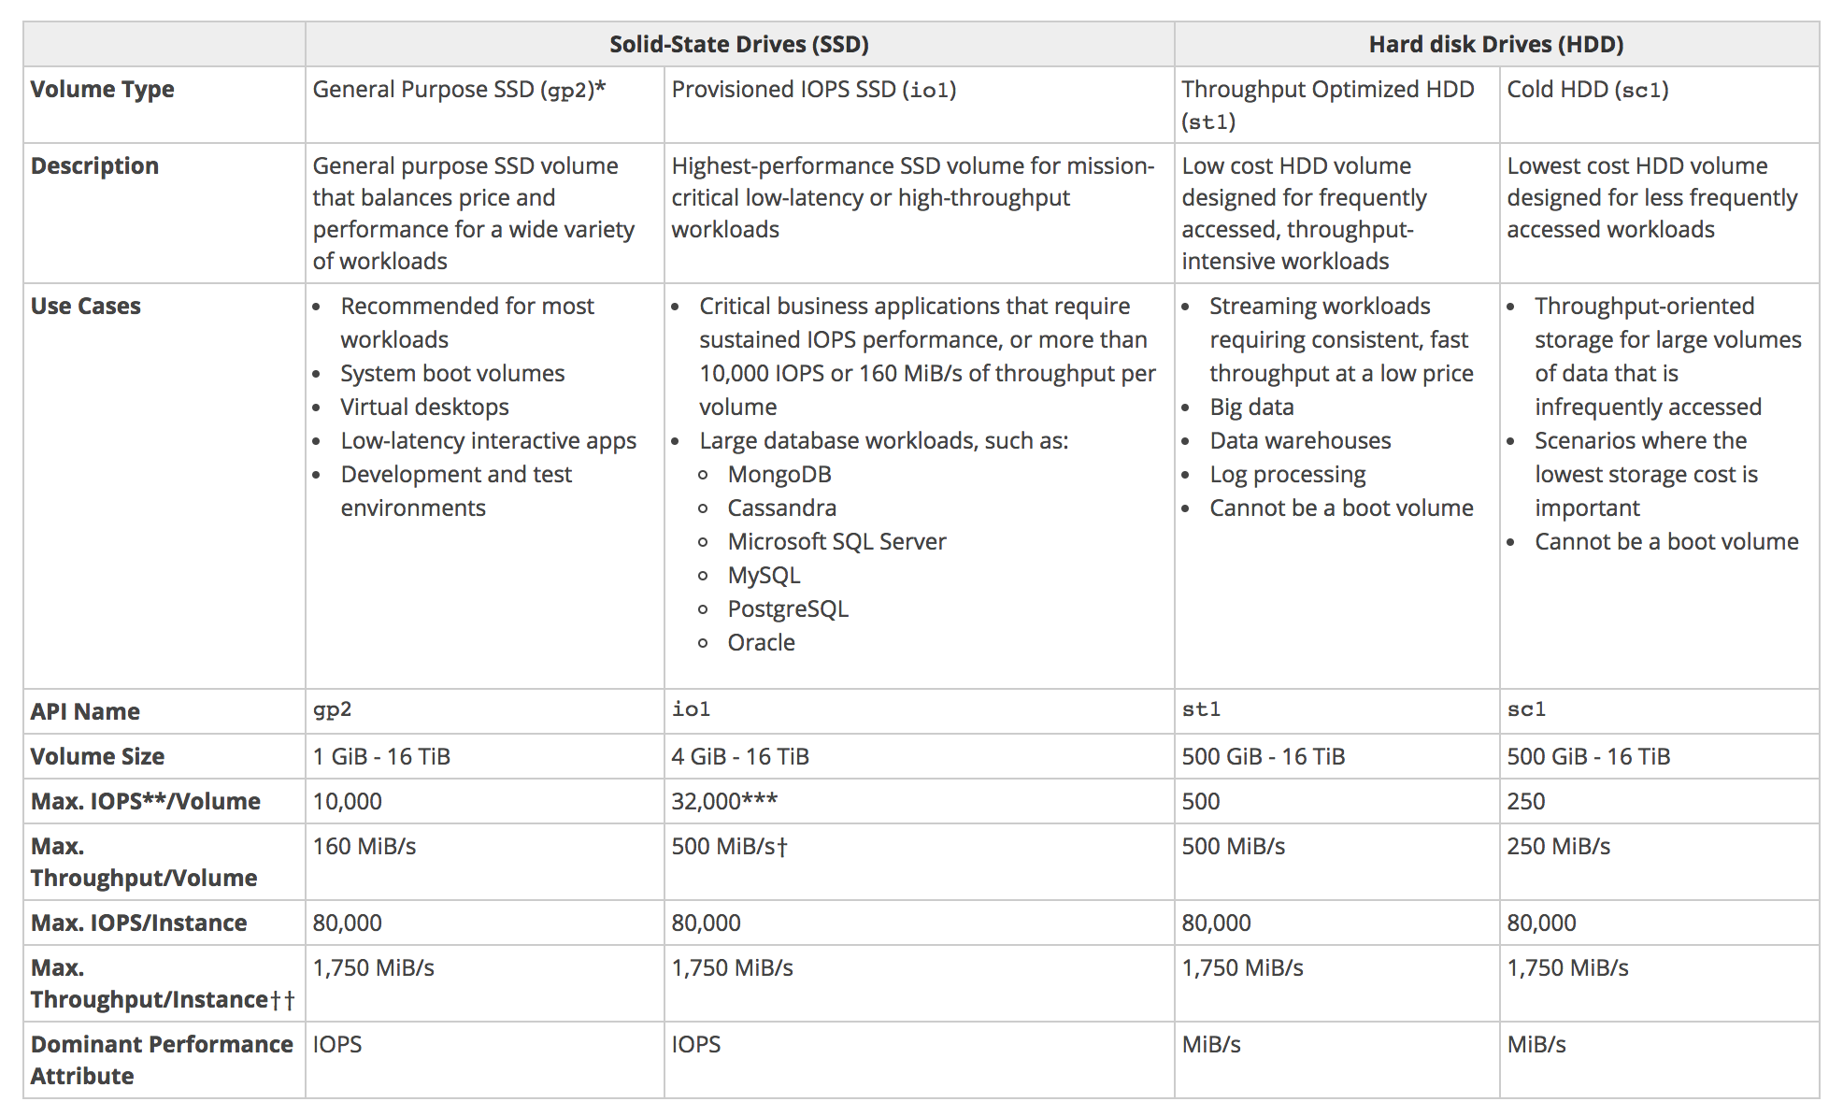

Slide 4
[ec2-user ~]$ lsblk NAME MAJ:MIN RM SIZE RO TYPE MOUNTPOINT xvdf 202:80 0 100G 0 disk xvda1 202:1 0 8G 0 disk /
[ec2-user ~]$ sudo file -s /dev/xvdf /dev/xvdf: data
sudo mkfs -t ext4 device_name
sudo mount device_name mount_pointsudo mount device_name mount_point
/etc/fstab entry
device_name mount_point file_system_type fs_mntops fs_freq fs_passno
When restoring root volumes use
mount -t xfs -o nouuid /dev/xvdf1

Slide 5
Extending the existing volume:
We can increase the volume size with the new EBS Feature Elastic volumes, post that we need to follow the following steps to use the increase size as shown here
Assume your volume was 16G and you increased it to 32GB.
$lsblk NAME MAJ:MIN RM SIZE RO TYPE MOUNTPOINT xvda 202:0 0 32G 0 disk └─xvda1 202:1 0 16G 0 part /
To extend xvda1 from 16GB t0 32GB, we need growpart. growpart is available as part of cloudutils
sudo apt install cloud-utils
Post installation of cloud-utils, execute the growpart command
sudo growpart /dev/xvda1
Now lsblk, will show
$ lsblk NAME MAJ:MIN RM SIZE RO TYPE MOUNTPOINT xvda 202:0 0 32G 0 disk └─xvda1 202:1 0 32G 0 part /
but df -h will show only 16GB
Final command for extending EXT file systems xvda1 to 32GB is
sudo resize2fs /dev/xvda1
for XFS file system xfs_growfs /dev/xvdg

Slide 6
To extend the existing volume of your EBS please use below commands
sudo growpart /dev/xvda 1 sudo resize2fs /dev/xvda1
lsblk -lf
Xfs volumes use below command to increse the volume size
xfs_growfs /dev/xvdg
If you want to extend the root volume of your instance from aws cli 1st configure the aws cli with ec2 access and login to the cli instance and apply below commands
Aws ec2 modify-volume --voulme-id <give your voulume ID> --size <give the size>
Ex: aws ec2 modify-volume --voulme-id vol-8d52sd5s8dfs5d --size 16
To see the progress enter below command
Aws ec2 describe-volumes-modifications --voulem-id vol-8d52sd5s8dfs5d

