Slide 2
Maven
What is Maven?
Maven is a project management and comprehension tool. Maven provides developers a complete build lifecycle framework. Development team can automate the project's build infrastructure in almost no time as Maven uses a standard directory layout and a default build lifecycle.
In case of multiple development teams environment, Maven can set-up the way to work as per standards in a very short time. As most of the project setups are simple and reusable, Maven makes life of developer easy while creating reports, checks, build and testing automation setups.

Slide 3
Maven provides developers ways to manage following:
Builds
Documentation
Reporting
Dependencies
SCMs
Releases
Distribution
mailing list

Slide 4
System Requirement
Maven is Java based tool, so the very first requirement is to have JDK installed on your machine.
JDK
1.5 or above.
Memory
no minimum requirement.
Disk Space
no minimum requirement.
Operating System
no minimum requirement.
wget -c --header "Cookie: oraclelicense=accept-securebackup-cookie" http://download.oracle.com/otn-pub/java/jdk/8u131-b11/d54c1d3a095b4ff2b6607d096fa80163/jdk-8u131-linux-x64.tar.gz
wget -c --header "Cookie: oraclelicense=accept-securebackup-cookie" https://download.oracle.com/otn-pub/java/jdk/11.0.7%2B8/8c7daf89330c48f0b9e32f57169f7bac/jdk-11.0.7_linux-x64_bin.tar.gz
https://download.java.net/java/GA/jdk11/13/GPL/openjdk-11.0.1_linux-x64_bin.tar.gz
All the versions
https://jdk.java.net/archive/

Slide 5
Step 1 - verify Java installation on your machine
Now open console and execute the following java command
Linux : $ java -version
Step 2: Set JAVA environment
Set the JAVA_HOME environment variable to point to the base directory location where Java is installed on your machine.
Linux: export JAVA_HOME=/usr/local/java-current
Append Java compiler location to System Path.
Linux: export PATH=$PATH:$JAVA_HOME/bin/

Slide 6
Step 3: Download Maven archive
Download Maven 3.3.3 from http://maven.apache.org/download.cgi
Step 4: Extract the Maven archive
Extract the archive, to the directory you wish to install Maven 3.3.3. The subdirectory apache-maven-3.3.3 will be created from the archive.
Linux: /usr/local/apache-maven
Step 5: Set Maven environment variables
Add M2_HOME, M2, MAVEN_OPTS to environment variables.

Slide 7
export
Note: M2_HOME copy the directory of your maven folder
export M2=$M2_HOME/binn-3.3.3
M2_HOME=/usr/local/apache-maven/apache-maven
Step 6: Add Maven bin directory location to system path
Now append M2 variable to System Path
export JAVA_HOME=/root/jdk-14/
export M2_HOME=/home/ec2-user/apache-maven-3.6.3
export M2=$M2_HOME/bin
export PATH=$PATH:$JAVA_HOME
export PATH=$PATH:$M2
PATH=$PATH:$HOME/.local/bin:$HOME/bin
Note: Java verification command
$JAVA_HOME/bin/javac -version
If it don’t print the javac 14 or build version some issue with export variables
Step 7: Verify Maven installation
Now open console, execute the following mvn command.
$ mvn --version
→ Creating sample Project
mvn archetype:generate
mvn archetype:generate -DgroupId=com.mycompany.app -DartifactId=my-app -DarchetypeArtifactId=maven-archetype-quickstart -DinteractiveMode=false
export JAVA_HOME=/home/ec2-user/jdk1.8.0_131
export M2_HOME=/home/ec2-user/apache-maven-3.6.3
export M2=$M2_HOME/bin
export PATH=$JAVA_HOME/bin:$PATH
export PATH=$M2:$PATH
PATH=$PATH:$HOME/.local/bin:$HOME/bin

Slide 8
Choose archetype:
1: internal -> org.apache.maven.archetypes:maven-archetype-archetype (An archetype which contains a sample archetype.)
2: internal -> org.apache.maven.archetypes:maven-archetype-j2ee-simple (An archetype which contains a simplifed sample J2EE
application.)
3: internal -> org.apache.maven.archetypes:maven-archetype-plugin (An archetype which contains a sample Maven plugin.)
4: internal -> org.apache.maven.archetypes:maven-archetype-plugin-site (An archetype which contains a sample Maven plugin site.
This archetype can be layered upon an existing Maven plugin project.)
5: internal -> org.apache.maven.archetypes:maven-archetype-portlet (An archetype which contains a sample JSR-268 Portlet.)
6: internal -> org.apache.maven.archetypes:maven-archetype-profiles ()
7: internal -> org.apache.maven.archetypes:maven-archetype-quickstart (An archetype which contains a sample Maven project.)
8: internal -> org.apache.maven.archetypes:maven-archetype-site (An archetype which contains a sample Maven site which demonstrates
some of the supported document types like APT, XDoc, and FML and demonstrates how
to i18n your site. This archetype can be layered upon an existing Maven project.)
9: internal -> org.apache.maven.archetypes:maven-archetype-site-simple (An archetype which contains a sample Maven site.)
10: internal -> org.apache.maven.archetypes:maven-archetype-webapp (An archetype which contains a sample Maven Webapp project.)

Slide 9
Create a sample project
mvn archetype:generate -DgroupId=com.mycompany.app -DartifactId=my-app -DarchetypeArtifactId=maven-archetype-quickstart -DarchetypeVersion=1.4 -DinteractiveMode=false
$mvn package
And the test the package with below command
java -cp target/my-app-1.0-SNAPSHOT.jar com.mycompany.app.App

Slide 10
POM stands for Project Object Model. It is fundamental Unit of Work in Maven. It is an XML file. It always resides in the base directory of the project as pom.xml.
The POM contains information about the project and various configuration detail used by Maven to build the project(s).
POM also contains the goals and plugins. While executing a task or goal, Maven looks for the POM in the current directory. It reads the POM, gets the needed configuration information, then executes the goal. Some of the configuration that can be specified in the POM are following:
project dependencies
plugins
goals
build profiles
project version
developers
mailing list
Before creating a POM, we should first decide the project group (groupId), its name(artifactId) and its version as these attributes help in uniquely identifying the project in repository.

Slide 11
All POM files require the project element and three mandatory fields: groupId, artifactId,version.
Projects notation in repository is groupId:artifactId:version.
Root element of POM.xml is project and it has three major sub-nodes :
groupId
This is an Id of project's group. This is generally unique amongst an organization or a project. For example, a banking group com.company.bank has all bank related projects.
artifact Id
This is an Id of the project.This is generally name of the project. For example, consumer-banking. Along with the groupId, the artifactId defines the artifact's location within the repository.

Slide 12
version
This is the version of the project.Along with the groupId, It is used within an artifact's repository to separate versions from each other. For example:
com.company.bank:consumer-banking:1.0
com.company.bank:consumer-banking:1.1.

Slide 13
MAVEN Build Lifecycle:
Maven is based around the central concept of a build lifecycle.
There are three built-in build lifecycles:
clean ( lifecycle handles project cleaning)
default (lifecycle handles your project deployment)
site (lifecycle handles the creation of your project's site documentation.)
Each Build Lifecycle is Made Up of Phases
Default life cycle Phases:
◾validate - validate the project is correct and all necessary information is available
◾compile - compile the source code of the project
◾test - test the compiled source code using a suitable unit testing framework. These tests should not require the code be packaged or deployed
◾package - take the compiled code and package it in its distributable format, such as a JAR.
◾integration-test - process and deploy the package if necessary into an environment where integration tests can be run
◾verify - run any checks to verify the package is valid and meets quality criteria
◾install - install the package into the local repository, for use as a dependency in other projects locally
◾Deploy - done in an integration or release environment, copies the final package to the remote repository for sharing with other developers and projects.

Slide 14
Clean Lifecycle
When we execute mvn post-clean command, Maven invokes the clean lifecycle consisting of the following phases.
pre-clean
clean
post-clean
Maven clean goal (clean:clean) is bound to the clean phase in the clean lifecycle. Its clean:clean goal deletes the output of a build by deleting the build directory. Thus when mvn clean command executes, Maven deletes the build directory.
We can customize this behavior by mentioning goals in any of the above phases of clean life cycle.
In the following example, We'll attach maven-antrun-plugin:run goal to the pre-clean, clean, and post-clean phases. This will allow us to echo text messages displaying the phases of the clean lifecycle.

Slide 15
Site Lifecycle
Maven Site plugin is generally used to create fresh documentation to create reports, deploy site etc.
Phases
pre-site
site
post-site
site-deploy

Slide 16
What is Build Profile?
A Build profile is a set of configuration values which can be used to set or override default values of Maven build. Using a build profile, you can customize build for different environments such as Production v/s Development environments.
Profiles are specified in pom.xml file using its activeProfiles / profiles elements and are triggered in variety of ways. Profiles modify the POM at build time, and are used to give parameters different target environments (for example, the path of the database server in the development, testing, and production environments).
Types of Build Profile:
Build profiles are majorly of three types
Per Project :Defined in the project POM file, pom.xml
Per User : Defined in Maven settings xml file (%USER_HOME%/.m2/settings.xml)
Global : Defined in Maven global settings xml file (%M2_HOME%/conf/settings.xml)

Slide 17
Lifecycle
Three built-in lifecycles (aka build lifecycles): default, clean, site. (Lifecycle Reference)
Phase
Each lifecycle is made up of phases, e.g. for the default lifecycle: compile, test, package, install, etc.
Plugin
An artifact that provides one or more goals.
Based on packaging type (jar, war, etc.) plugins' goals are bound to phases by default. (Built-in Lifecycle Bindings)
Goal
The task (action) that is executed. A plugin can have one or more goals.
One or more goals need to be specified when configuring a plugin in a POM. Additionally, in case a plugin does not have a default phase defined, the specified goal(s) can be bound to a phase.
Ref url: http://maven.apache.org/guides/introduction/introduction-to-the-lifecycle.html

Slide 18
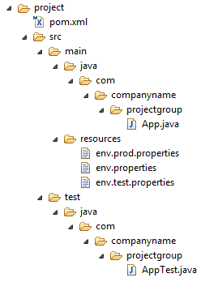
Profile Activation Examples
Let us assume following directory structure of your project:
Now, under src/main/resources there are three environment specific files:

Slide 19
<project xmlns="http://maven.apache.org/POM/4.0.0"
xmlns:xsi="http://www.w3.org/2001/XMLSchema-instance"
xsi:schemaLocation="http://maven.apache.org/POM/4.0.0
http://maven.apache.org/xsd/maven-4.0.0.xsd">
<modelVersion>4.0.0</modelVersion>
<groupId>com.companyname.projectgroup</groupId>
<artifactId>project</artifactId>
<version>1.0</version>
<profiles>
<profile>
<id>test</id>
<build>
<plugins>
<plugin>
<groupId>org.apache.maven.plugins</groupId>
<artifactId>maven-antrun-plugin</artifactId>
<version>1.1</version>
<executions>
<execution>
<phase>test</phase>
<goals>
<goal>run</goal>
</goals>
<configuration>
<tasks>
<echo>Using env.test.properties</echo>
<copy file="src/main/resources/env.test.properties" tofile
="${project.build.outputDirectory}/env.properties"/>
</tasks>
</configuration>
</execution>
</executions>
</plugin>
</plugins>
</build>
</profile>
</profiles>
<dependencies>
<dependency>
<groupId>junit</groupId>
<artifactId>junit</artifactId>
<version>3.8.1</version>
<scope>test</scope>
</dependency>
</dependencies>
</project>

Slide 20
What is SNAPSHOT?
SNAPSHOT is a special version that indicates a current development copy. Unlike regular versions, Maven checks for a new SNAPSHOT version in a remote repository for every build.
Now data-service team will release SNAPSHOT of its updated code every time to repository say data-service:1.0-SNAPSHOT replacing a older SNAPSHOT jar.
Snapshot vs Version
In case of Version, if Maven once downloaded the mentioned version say data-service:1.0, it will never try to download a newer 1.0 available in repository. To download the updated code, data-service version is be upgraded to 1.1.
In case of SNAPSHOT, Maven will automatically fetch the latest SNAPSHOT (data-service:1.0-SNAPSHOT) every time app-ui team build their project.

Slide 21
UI-Project pom.xml:
app-ui project is using 1.0-SNAPSHOT of data-service
<project xmlns="http://maven.apache.org/POM/4.0.0"
xmlns:xsi="http://www.w3.org/2001/XMLSchema-instance"
xsi:schemaLocation="http://maven.apache.org/POM/4.0.0
http://maven.apache.org/xsd/maven-4.0.0.xsd">
<modelVersion>4.0.0</modelVersion>
<groupId>app-ui</groupId>
<artifactId>app-ui</artifactId>
<version>1.0</version>
<packaging>jar</packaging>
<name>health</name>
<url>http://maven.apache.org</url>
<properties>
<project.build.sourceEncoding>UTF-8</project.build.sourceEncoding>
</properties>
<dependencies>
<dependency>
<groupId>data-service</groupId>
<artifactId>data-service</artifactId>
<version>1.0-SNAPSHOT</version>
<scope>test</scope>
</dependency>
</dependencies>
</project>

Slide 22
Dynamic Content pom.xml:
data-service project is releasing 1.0-SNAPSHOT for every minor change
<project xmlns="http://maven.apache.org/POM/4.0.0"
xmlns:xsi="http://www.w3.org/2001/XMLSchema-instance"
xsi:schemaLocation="http://maven.apache.org/POM/4.0.0
http://maven.apache.org/xsd/maven-4.0.0.xsd">
t.build.sourceEncoding>UTF-8</project.build.sourceEncoding>
</properties>
</project>
<modelVersion>4.0.0</modelVersion>
<groupId>data-service</groupId>
<artifactId>data-service</artifactId>
<version>1.0-SNAPSHOT</version>
<packaging>jar</packaging>
<name>health</name>
<url>http://maven.apache.org</url>
<properties>
<projec

Slide 23
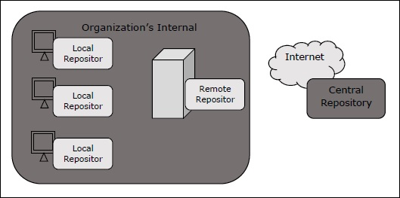
Maven Repositories
In Maven terminology, a repository is a directory where all the project jars, library jar, plugins or any other project specific artifacts are stored and can be used by Maven easily.
Maven repository are of three types. The following illustration will give an idea regarding these three types.
local
central
remote

Slide 24
Local Repository
Maven local repository is a folder location on your machine. It gets created when you run any maven command for the first time.
Maven local repository keeps your project's all dependencies (library jars, plugin jars etc.). When you run a Maven build, then Maven automatically downloads all the dependency jars into the local repository. It helps to avoid references to dependencies stored on remote machine every time a project is build.
Maven local repository by default get created by Maven in %USER_HOME% directory. To override the default location, mention another path in Maven settings.xml file available at %M2_HOME%\conf directory.
<settings xmlns = "http://maven.apache.org/SETTINGS/1.0.0" xmlns:xsi = "http://www.w3.org/2001/XMLSchema-instance" xsi:schemaLocation = "http://maven.apache.org/SETTINGS/1.0.0 http://maven.apache.org/xsd/settings-1.0.0.xsd"> <localRepository>C:/MyLocalRepository</localRepository> </settings>
When you run Maven command, Maven will download dependencies to your custom path.

Slide 25
Central Repository
Maven central repository is repository provided by Maven community. It contains a large number of commonly used libraries.
When Maven does not find any dependency in local repository, it starts searching in central repository using following URL − https://repo1.maven.org/maven2/
Key concepts of Central repository are as follows −
This repository is managed by Maven community.
It is not required to be configured.
It requires internet access to be searched.
To browse the content of central maven repository, maven community has provided a URL − https://search.maven.org/#browse. Using this library, a developer can search all the available libraries in central repository.

Slide 26
Remote Repository
Sometimes, Maven does not find a mentioned dependency in central repository as well. It then stops the build process and output error message to console. To prevent such situation, Maven provides concept of Remote Repository, which is developer's own custom repository containing required libraries or other project jars.
For example, using below mentioned POM.xml, Maven will download dependency (not available in central repository) from Remote Repositories mentioned in the same pom.xml.
<project xmlns = "http://maven.apache.org/POM/4.0.0" xmlns:xsi = "http://www.w3.org/2001/XMLSchema-instance" xsi:schemaLocation = "http://maven.apache.org/POM/4.0.0 http://maven.apache.org/xsd/maven-4.0.0.xsd"> <modelVersion>4.0.0</modelVersion> <groupId>com.companyname.projectgroup</groupId> <artifactId>project</artifactId> <version>1.0</version> <dependencies> <dependency> <groupId>com.companyname.common-lib</groupId> <artifactId>common-lib</artifactId> <version>1.0.0</version> </dependency> <dependencies> <repositories> <repository> <id>companyname.lib1</id> <url>http://download.companyname.org/maven2/lib1</url> </repository> <repository> <id>companyname.lib2</id> <url>http://download.companyname.org/maven2/lib2</url> </repository> </repositories> </project>

Slide 27
Maven Dependency Search Sequence
When we execute Maven build commands, Maven starts looking for dependency libraries in the following sequence −
Step 1 − Search dependency in local repository, if not found, move to step 2 else perform the further processing.
Step 2 − Search dependency in central repository, if not found and remote repository/repositories is/are mentioned then move to step 4. Else it is downloaded to local repository for future reference.
Step 3 − If a remote repository has not been mentioned, Maven simply stops the processing and throws error (Unable to find dependency).
Step 4 − Search dependency in remote repository or repositories, if found then it is downloaded to local repository for future reference. Otherwise, Maven stops processing and throws error (Unable to find dependency).

Slide 28
What are Maven Plugins?
Maven is actually a plugin execution framework where every task is actually done by plugins. Maven Plugins are generally used to :
create jar file
create war file
compile code files
unit testing of code
create project documentation
create project reports
A plugin generally provides a set of goals and which can be executed using following syntax:
mvn [plugin-name]:[goal-name]
For example, a Java project can be compiled with the maven-compiler-plugin's compile-goal by running following command
mvn compiler:compile

Slide 29
Clean --Clean up target after the build. Deletes the target directory.
Compiler --Compiles Java source files.
Surefire --Run the JUnit unit tests. Creates test reports.
Jar --Builds a JAR file from the current project.
War --Builds a WAR file from the current project.
Javadoc --Generates Javadoc for the project.
Antrun --Runs a set of ant tasks from any phase mentioned of the build.
<project xmlns="http://maven.apache.org/POM/4.0.0" xmlns:xsi="http://www.w3.org/2001/XMLSchema-instance" xsi:schemaLocation="http://maven.apache.org/POM/4.0.0 http://maven.apache.org/xsd/maven-4.0.0.xsd"> <modelVersion>4.0.0</modelVersion> <groupId>com.companyname.projectgroup</groupId> <artifactId>project</artifactId> <version>1.0</version> <build> <plugins> <plugin> <groupId>org.apache.maven.plugins</groupId> <artifactId>maven-antrun-plugin</artifactId> <version>1.1</version> <executions> <execution> <id>id.clean</id> <phase>clean</phase> <goals> <goal>run</goal> </goals> <configuration> <tasks> <echo>clean phase</echo> </tasks> </configuration> </execution> </executions> </plugin> </plugins> </build> </project>

Slide 30
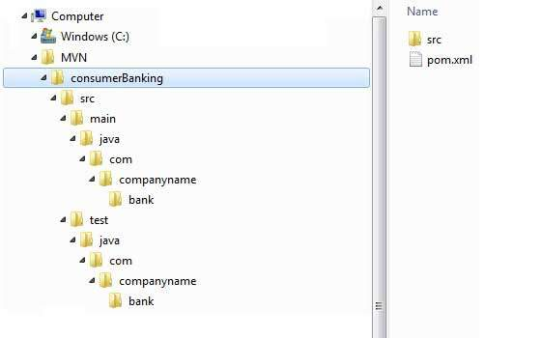

Slide 31
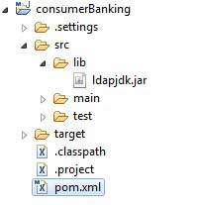
Now as you know Maven does the dependency management using concept of Maven Repositories. But what happens if dependency is not available in any of remote repositories and central repository? Maven provides answer for such scenario using concept of External Dependency.
For an example, let us do the following changes to project created in Maven Creating Project section.
Add lib folder to src folder
Copy any jar into the lib folder. We've used ldapjdk.jar, which is a helper library for LDAP operations.
Now our project structure should look like following:

Slide 32
Look at the second dependency element under dependencies in above example which clears following key concepts about External Dependency.
External dependencies (library jar location) can be configured in pom.xml in same way as other dependencies.
Specify groupId same as name of the library.
Specify artifactId same as name of the library.
Specify scope as system.
Specify system path relative to project location.
Hope now you are clear about external dependencies and you will be able to specify external dependencies in your Maven project.
For Parent child model project
https://www.tutorialspoint.com/maven/maven_manage_dependencies.htm

Slide 33
Here you are having your own library specific to project, which is very usual case and it can contain jars which may not be available in any repository for maven to download from. If your code is using this library with Maven then Maven build will fail because it cannot download or refer to this library during compilation phase.
To handle the situation, let's add this external dependency to maven pom.xml using following way.
<project xmlns="http://maven.apache.org/POM/4.0.0" xmlns:xsi="http://www.w3.org/2001/XMLSchema-instance" xsi:schemaLocation="http://maven.apache.org/POM/4.0.0 http://maven.apache.org/maven-v4_0_0.xsd"> <modelVersion>4.0.0</modelVersion> <groupId>com.companyname.bank</groupId> <artifactId>consumerBanking</artifactId> <packaging>jar</packaging> <version>1.0-SNAPSHOT</version> <name>consumerBanking</name> <url>http://maven.apache.org</url> <dependencies> <dependency> <groupId>junit</groupId> <artifactId>junit</artifactId> <version>3.8.1</version> <scope>test</scope> </dependency> <dependency> <groupId>ldapjdk</groupId> <artifactId>ldapjdk</artifactId> <scope>system</scope> <version>1.0</version> <systemPath>${basedir}\src\lib\ldapjdk.jar</systemPath> </dependency> </dependencies> </project>

Slide 34
<project xmlns="http://maven.apache.org/POM/4.0.0" xmlns:xsi="http://www.w3.org/2001/XMLSchema-instance" xsi:schemaLocation="http://maven.apache.org/POM/4.0.0 http://maven.apache.org/xsd/maven-4.0.0.xsd"> <modelVersion>4.0.0</modelVersion> <groupId>bus-core-api</groupId> <artifactId>bus-core-api</artifactId> <version>1.0-SNAPSHOT</version> <packaging>jar</packaging> <scm> <url>http://www.svn.com</url> <connection>scm:svn:http://localhost:8080/svn/jrepo/trunk/ Framework</connection> <developerConnection>scm:svn:${username}/${password}@localhost:8080: common_core_api:1101:code</developerConnection> </scm> <distributionManagement> <repository> <id>Core-API-Java-Release</id> <name>Release repository</name> <url>http://localhost:8081/nexus/content/repositories/ Core-Api-Release</url> </repository> </distributionManagement> <build> <plugins> <plugin> <groupId>org.apache.maven.plugins</groupId> <artifactId>maven-release-plugin</artifactId> <version>2.0-beta-9</version> <configuration> <useReleaseProfile>false</useReleaseProfile> <goals>deploy</goals> <scmCommentPrefix>[bus-core-api-release-checkin]-< /scmCommentPrefix> </configuration> </plugin> </plugins> </build> </project>
<moduels>fiance</module>
<>

Slide 35
For creating the web-app dynamically
mvn archetype:generate -DgroupId=com.RC.Corporation -DartifactId=Corporation -DarchetypeArtifactId=maven-archetype-webapp -DinteractiveMode=false

Slide 36
mvn clean package -U
-U: You can force maven to download latest snapshot build using -U switch to any maven command
mvn clean package

Slide 37
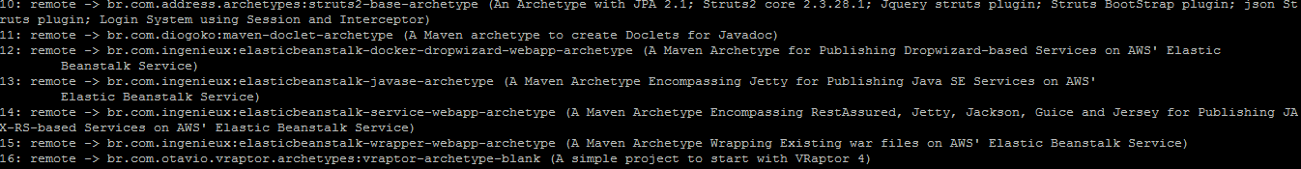
Creating Project:
Step1:
Enter the below command to generate the project
$mvn archetype:generator
At the end it ‘ll ask you for the GroupID, Artifact name, snapshot version and package
Enter those details

Slide 38
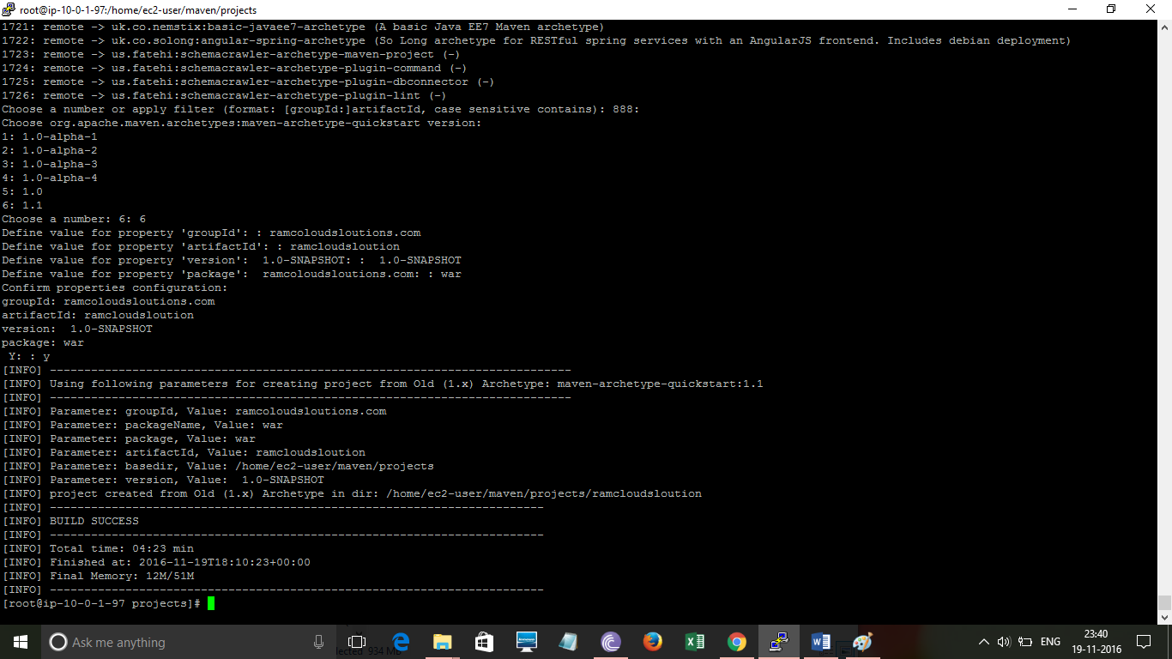

Slide 39
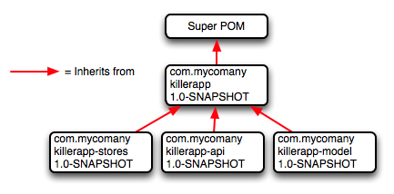
Super POM
All POMs inherit from a parent (despite explicitly defined or not). This base POM is known as the Super POM, and contains values inherited by default.
Maven use the effective pom (configuration from super pom plus project configuration) to execute relevant goal. It helps developer to specify minimum configuration detail in his/her pom.xml. Although configurations can be overridden easily.

Slide 40
Hello world Project
mvn archetype:generate -DgroupId=com.apple.app -DartifactId=apple-app -DarchetypeArtifactId=maven-archetype-quickstart -DarchetypeVersion=1.4 -DinteractiveMode=false

