Slide 1
Sonarqube

Slide 2
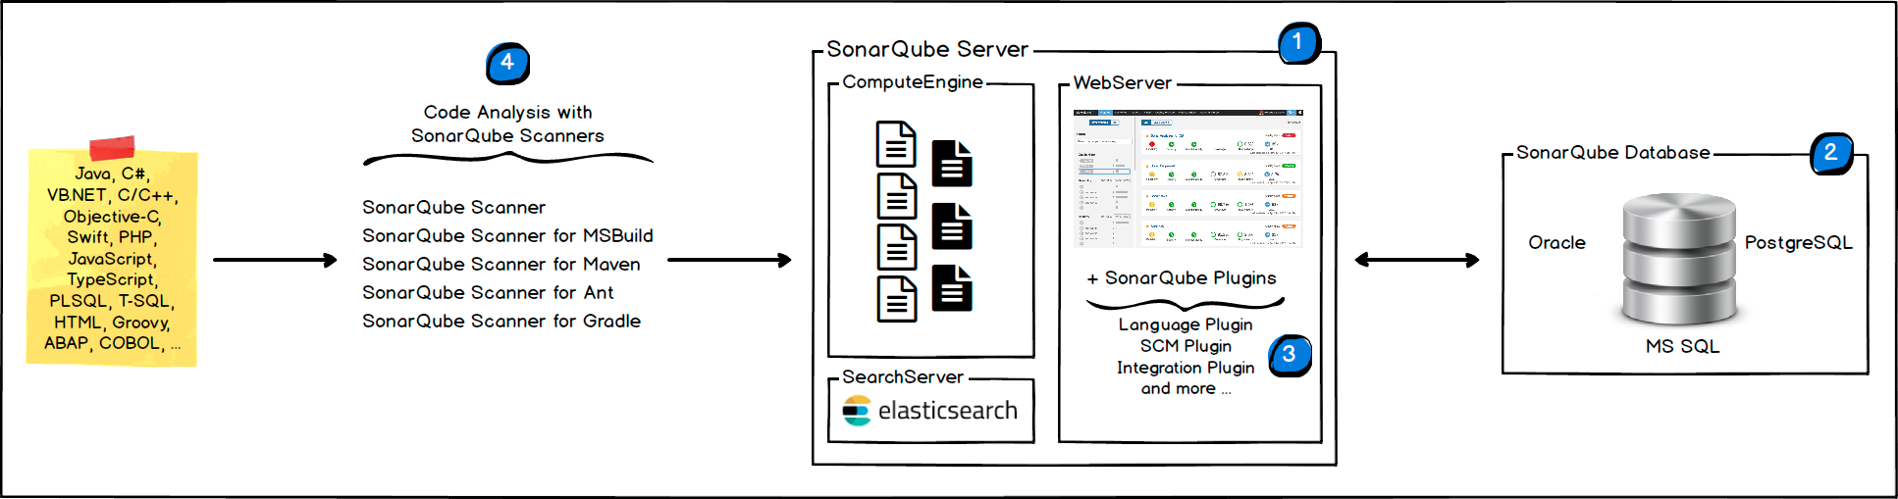
Architecture

Slide 3
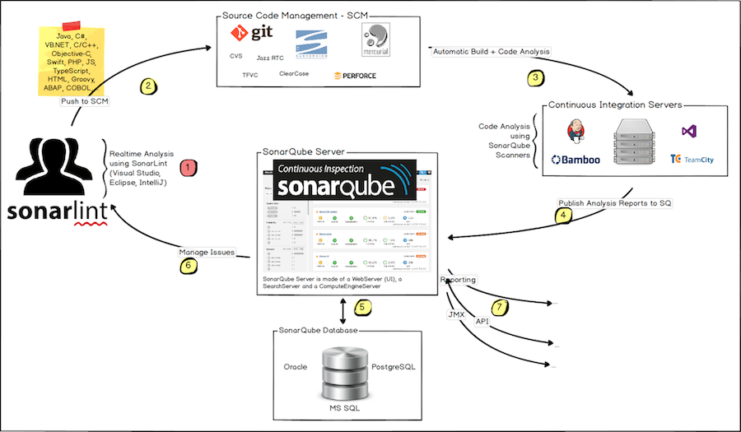
Working of sonar

Slide 4
Requirements
https://docs.sonarqube.org/latest/requirements/requirements/
JDK 11
Min 2 GB of ram
Oracle or postgresql if you want to use for production default database is embedded H2 database
It won’t support 32 bit system
Non-root user in your system

Slide 5
Installation
Download from following link https://www.sonarqube.org/downloads/
Untar to non-root folder
Install jdk11
Make sure the jdk and sonarqube folder are owned by the non-root user
Start service using /home/ec2-user/sonarqube-8.3.0.34182/bin/linux-x86-64/sonar.sh start
Can access web portal by http://<hostname>:9000
Use the default credentials username: admin password: admin

Slide 6
Maven and sonar integration
Create a project in sonar browser and you will be getting command to run your goal against your code in your linux terminal
Mvn clean install sonar:sonar \
-Dsonar.projectKey=maven-app-java \
-Dsonar.host.url=http://35.175.206.222:9000 \
-Dsonar.login=7b126e6e5e93924609356c024d82609f7306cfba
- reports will be published to sonar after this

Slide 7
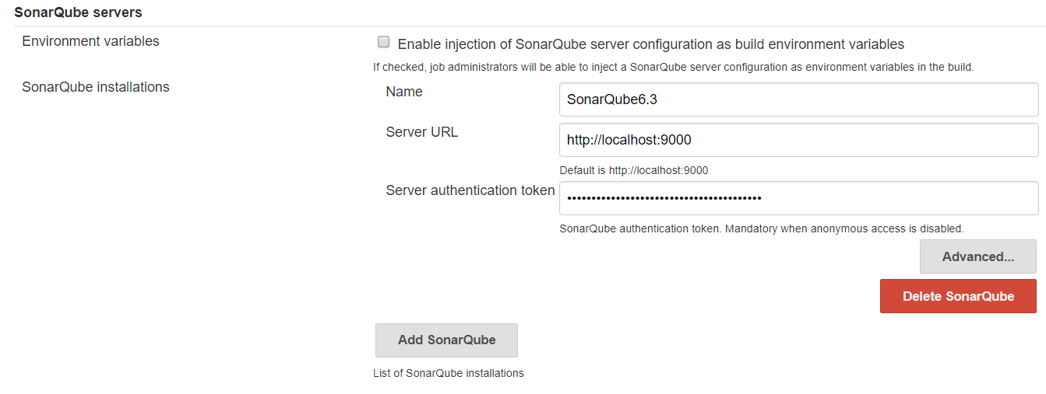
Sonar integration with jenkins
Install SonarQube Scanner & Sonar Quality Gates plugins
Go to configure system and update as suggested below replace server url with your sonar url

Slide 8
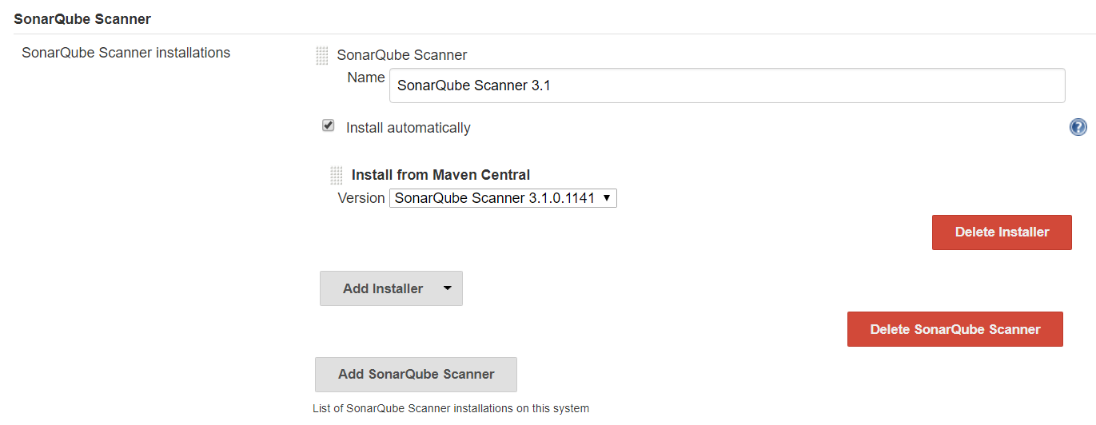
We need sonar scanner to scan the source code, when you install sonar plugins we will be having option to install sonar scanner directly by going into Manage Jenkins -> Global Tool Configuration -> SonarQube Scanner
Else we can install manually and configure the path here

Slide 9
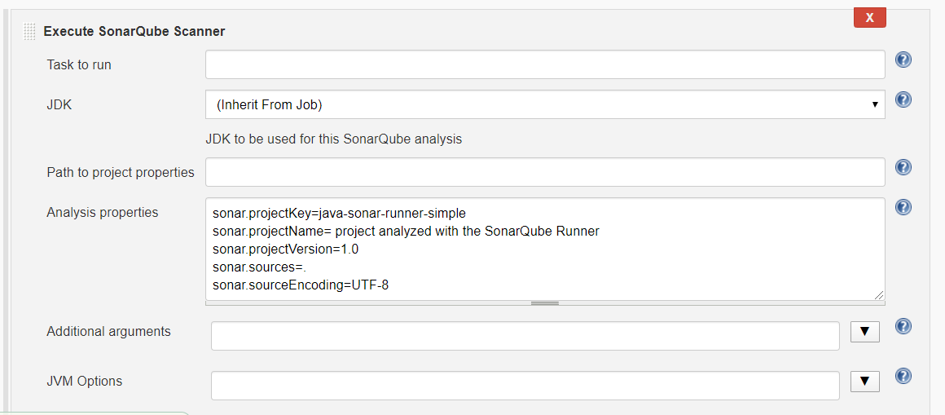
Configure below keys:
sonar.projectKey=java-sonar-runner-simple
sonar.projectName= project analyzed with the SonarQube Runner
sonar.projectVersion=1.0
sonar.sources=$WORKSPACE/WebContent/WEB-INF/classes/org/o7planning/simplewebapp/servlet
sonar.sourceEncoding=UTF-8
To have clear understanding about keys go through this url https://docs.sonarqube.org/latest/analysis/analysis-parameters/

Slide 10
sonar.projectKey=java-sonar-runner-simple
sonar.projectName= project analyzed with the SonarQube Runner
sonar.projectVersion=1.0
sonar.sourceEncoding=UTF-8
sonar.java.binaries=$WORKSPACE/target/

