Slide 1
Dev-Ops Training(VPC)
--Ram Chandra

Slide 2
Agenda
Network basics
What is VPC?
Creating VPC
Creating Subnets
Creating IGW
Customizing the Route Tables
Launch Instance by using created VPC

Slide 3
What is Amazon VPC?
Amazon Virtual Private Cloud (Amazon VPC) enables you to launch Amazon Web Services (AWS) resources into a virtual network that you've defined. This virtual network closely resembles a traditional network that you'd operate in your own data center, with the benefits of using the scalable infrastructure of AWS.
What is Subnet?
A subnet is a range of IP addresses in your VPC. You can launch AWS resources into a subnet that you select. Use a public subnet for resources that must be connected to the Internet, and a private subnet for resources that won't be connected to the Internet.
http://docs.aws.amazon.com/AmazonVPC/latest/UserGuide/images/default-vpc-diagram.png
http://docs.aws.amazon.com/AmazonVPC/latest/UserGuide/images/default-vpc-diagram.png
http://docs.aws.amazon.com/AmazonVPC/latest/UserGuide/VPC_Security.html

Slide 4
Internet Gateways.
An Internet gateway is a horizontally scaled, redundant, and highly available VPC component that allows communication between instances in your VPC and the Internet. It therefore imposes no availability risks or bandwidth constraints on your network traffic.
public subnet
If a subnet has a route to an AWS Internet Gateway it is called a public subnet
private subnet
If there is no route from a subnet to an AWS Internet Gateway it is a private subnet. If an instance in an private subnet wants to access the internet it needs to use a NAT in a public subnet

Slide 5
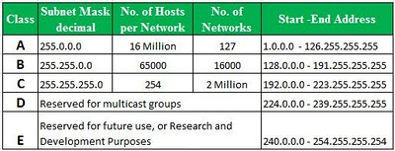

Slide 6
Private IP address ranges
Class
Private IP Address Range
Subnet Mask
A
10.0.0.0 to 10.255.255.255
255.0.0.0 (10/8 prefix)
B
172.16.0.0 to 172.31.255.255
255.240.0.0(172.16/12 prefix)
C
192.168.0.0 to 192.168.255.255
255.255.0.0(192.168/16 prefix)
IP4 Supports 3 types of addressing modes
Unicast addressing mode
Broadcast addressing mode
Multicast addressing mode

Slide 7
10.0.0.0/16 this is network ID and the /16 means CIDR notation
128 64 32 16 8 4 2 1
172.16.0.0/16
Possible Subnets with cidr 17
172.16.128.0/17
Possible Subnets with cidr 18
172.16.128.0/18
172.16.64.0/18
Possible Subnets with cidr 20
172.16.128.0/20
172.16.64.0/20
172.16.32.0/20
172.16.16.0/20
Possible Subnets with cidr 20
172.16.128.0/24
172.16.64.0/24
172.16.32.0/24
172.16.16.0/24
172.16.8.0/24
172.16.4.0/24
172.16.2.0/24
172.16.1.0/24

Slide 8
Reserved Ip’s in AWS
The first four IP addresses and the last IP address in each subnet CIDR block are not available for you to use, and cannot be assigned to an instance. For example, in a subnet with CIDR block 10.0.0.0/24, the following five IP addresses are reserved:
10.0.0.0: Network address.
10.0.0.1: Reserved by AWS for the VPC router.
10.0.0.2: Reserved by AWS. The IP address of the DNS server is always the base of the VPC network range plus two; however, we also reserve the base of each subnet range plus two. For VPCs with multiple CIDR blocks, the IP address of the DNS server is located in the primary CIDR. For more information, see Amazon DNS Server.
10.0.0.3: Reserved by AWS for future use.
10.0.0.255: Network broadcast address. We do not support broadcast in a VPC, therefore we reserve this address.

Slide 9
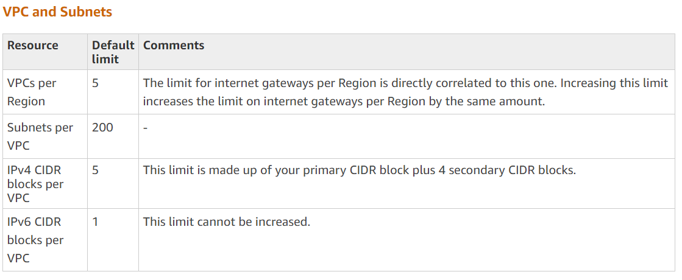
VPC limits

Slide 10
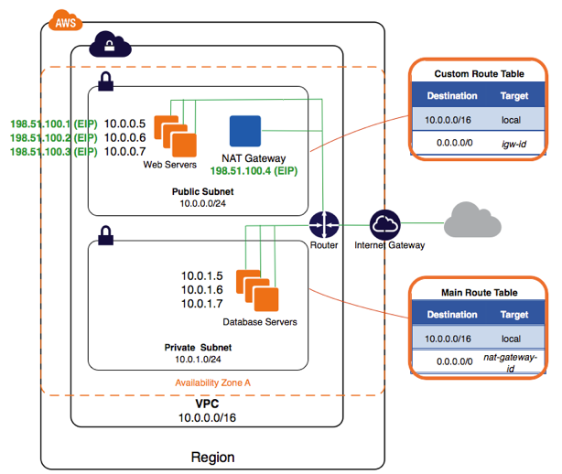
NAT(Network Address translation) Instances

Slide 11
How to create NAT Gateways
Sign in to the AWS Management Console.
Open the Amazon VPC console.
Choose NAT Gateway from the navigation bar on the left.
Choose Create NAT Gateway and then select the public subnet and EIP that you have provisioned for the NAT gateway.
After you create the NAT gateway, make note of the associated ID, which will resemble "nat-xxxxxxx".
Choose the Route Tables link on the left hand side, and then choose the route table associated with your NAT gateway. Update this route table so that 0.0.0.0/0 points to the ID of the NAT gateway that you created.
Attach NAT gateway only to public subnet
From one of the EC2 instances in your private subnet, open a command prompt or shell and ping amazon.com to verify Internet connectivity.

Slide 12
NAT Gateway Rules and Limitations
A NAT gateway has the following characteristics and limitations:
A NAT gateway supports 5 Gbps of bandwidth and automatically scales up to 45 Gbps. If you require more, you can distribute the workload by splitting your resources into multiple subnets, and creating a NAT gateway in each subnet.
You can associate exactly one Elastic IP address with a NAT gateway. You cannot disassociate an Elastic IP address from a NAT gateway after it's created. To use a different Elastic IP address for your NAT gateway, you must create a new NAT gateway with the required address, update your route tables, and then delete the existing NAT gateway if it's no longer required.
A NAT gateway supports the following protocols: TCP, UDP, and ICMP.
You cannot associate a security group with a NAT gateway. You can use security groups for your instances in the private subnets to control the traffic to and from those instances.
You can use a network ACL to control the traffic to and from the subnet in which the NAT gateway is located. The network ACL applies to the NAT gateway's traffic. A NAT gateway uses ports 1024–65535. For more information, see Network ACLs.

Slide 13
When a NAT gateway is created, it receives a network interface that's automatically assigned a private IP address from the IP address range of your subnet. You can view the NAT gateway's network interface in the Amazon EC2 console. For more information, see Viewing Details about a Network Interface. You cannot modify the attributes of this network interface.
A NAT gateway cannot be accessed by a ClassicLink connection associated with your VPC.
You cannot route traffic to a NAT gateway through a VPC peering connection, a Site-to-Site VPN connection, or AWS Direct Connect. A NAT gateway cannot be used by resources on the other side of these connections.
A NAT gateway can support up to 55,000 simultaneous connections to each unique destination. This limit also applies if you create approximately 900 connections per second to a single destination (about 55,000 connections per minute). If the destination IP address, the destination port, or the protocol (TCP/UDP/ICMP) changes, you can create an additional 55,000 connections. For more than 55,000 connections, there is an increased chance of connection errors due to port allocation errors. These errors can be monitored by viewing the ErrorPortAllocation CloudWatch metric for your NAT gateway. For more information, see Monitoring NAT Gateways Using Amazon CloudWatch

Slide 14
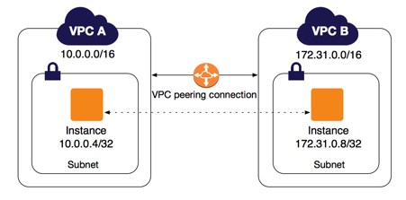
VPC Peering

Slide 15
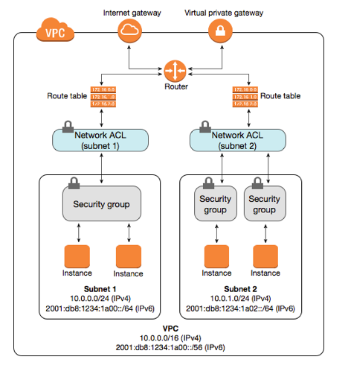
NACL and security groups

Slide 16
State: Stateful vs Stateless
Security groups are stateful: This means any changes applied to an incoming rule will be automatically applied to the outgoing rule. e.g. If you allow an incoming port 80, the outgoing port 80 will be automatically opened.
Network ACLs are stateless: This means any changes applied to an incoming rule will not be applied to the outgoing rule. e.g. If you allow an incoming port 80, you would also need to apply the rule for outgoing traffic.

Slide 17
Allow or Deny rules
Security group support allow rules only (by default all rules are denied). e.g. You cannot deny a certain IP address from establishing a connection.
Network ACL support allow and deny rules. By deny rules, you could explicitly deny a certain IP address to establish a connection example: Block IP address 123.201.57.39 from establishing a connection to an EC2 Instance.

Slide 18
Rule process order
All rules in a security group are applied whereas rules are applied in their order (the rule with the lower number gets processed first) in Network ACL.
i.e. Security groups evaluate all the rules in them before allowing a traffic whereas NACLs do it in the number order, from top to bottom.
Defense order
Security group first layer of defense, whereas Network ACL is second layer of the defense.

