Slide 1

COMPANY PROFILE
PT. LISANI ALAF JAYA

Slide 2
EXECUTIVE SUMMARY
PT. Lisani Alaf Jaya is a dynamic and multifaceted general trading company based in Indonesia. Established in 2014, we specialize in the sourcing, procurement, and distribution of a diverse range of high-quality products across multiple sectors. Our commitment to excellence, strategic partnerships, and deep market understanding allows us to bridge the gap between global suppliers and local/international markets, delivering value and reliability to our clients.

Slide 3
COMPANY OVERVIEW
Establishment : October 2014
Company’s name : PT. Lisani Alaf Jaya
Address : Jl. Tuba II No. 17D, Tegal Sari Mandala III, Medan Denai, Medan, Indonesia. 20227.
Phone : +62 823 84141531
Business Type : Trading and Service Provider
Email : lisani.alafjaya@gmail.com / info@lisanialafjaya.com
Website : www.lisanialafjaya.com

Slide 4
VISION & MISSION
Our Mission
To provide seamless and efficient trading solutions by connecting high-quality suppliers with diverse markets, ensuring exceptional service, competitive pricing, and sustainable growth for our partners and stakeholders.
Our Vision
To be a leading and globally recognized general trading company, known for our integrity, reliability, and unparalleled ability to meet the evolving needs of the international marketplace.

Slide 5
CORE VALUES:
Integrity: Conducting business with the highest ethical standards, transparency, and honesty.
Quality: Uncompromising commitment to sourcing and delivering only the best products.
Reliability: Building trust through consistent performance and dependable service.
Customer Focus: Prioritizing client needs and exceeding expectations in every transaction.
Innovation: Continuously adapting to market trends and optimizing our supply chain solutions.

Slide 6
OUR SERVICES
As a general trading company, we offer a comprehensive suite of services designed to facilitate smooth and efficient commerce:
Sourcing & Procurement: Identifying and vetting reliable suppliers globally to secure the best products at competitive prices.
Import & Export: Managing the complex logistics and documentation required for seamless international trade.
Distribution & Wholesale: Efficiently moving products from origin to destination, ensuring timely delivery to retailers, wholesalers, and end-users.
Supply Chain Management: Optimizing the flow of goods to minimize costs and maximize efficiency for our partners.
Market Analysis & Consulting: Providing insights into market trends and helping partners navigate new territories.

Slide 7
COMPANY STRUCTURE
Muhammad Rais Latif
(Commissioner)
Syis
Samsul Bahri
(Director)

Slide 8
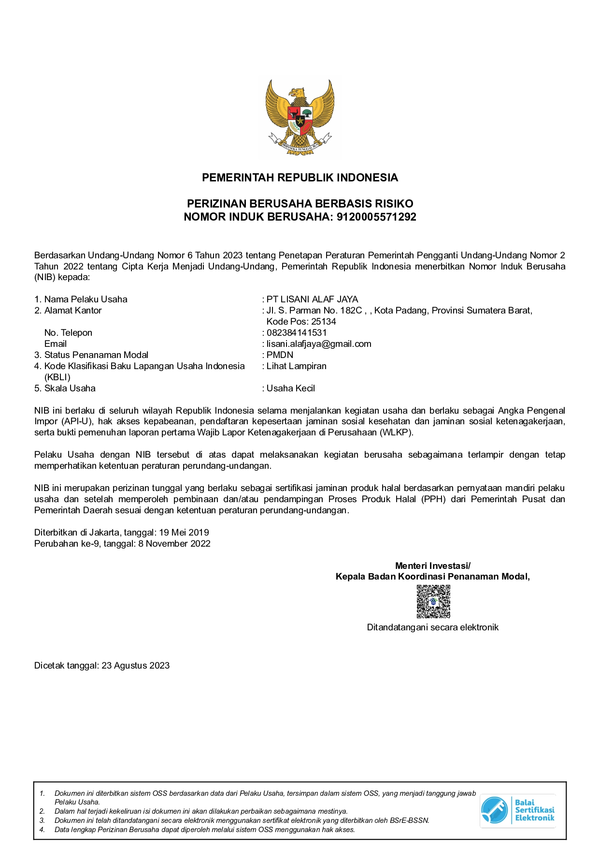
COMPANY’S CREDENTIAL

Slide 9
OUR PORTFOLIO
Food & Beverage Products
Vegetable Oil related Products
Fresh Fruits, Vegetables & Nuts
Natural Spices
Textile and Cloth related Products
Charcoal
Furnitures

Slide 10

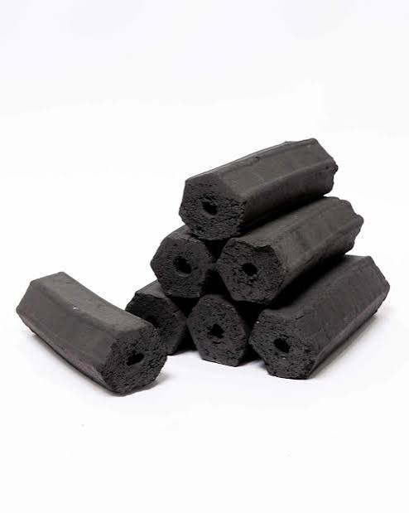
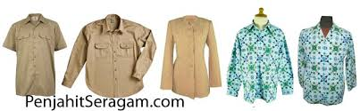

GOODS & PRODUCTS
Dates
Charcoal
Clothes
Spices

Slide 11
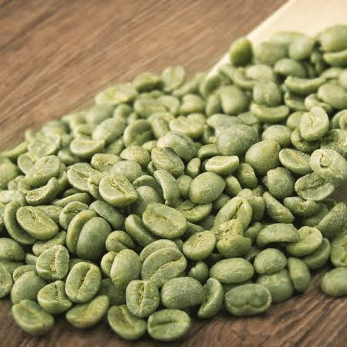

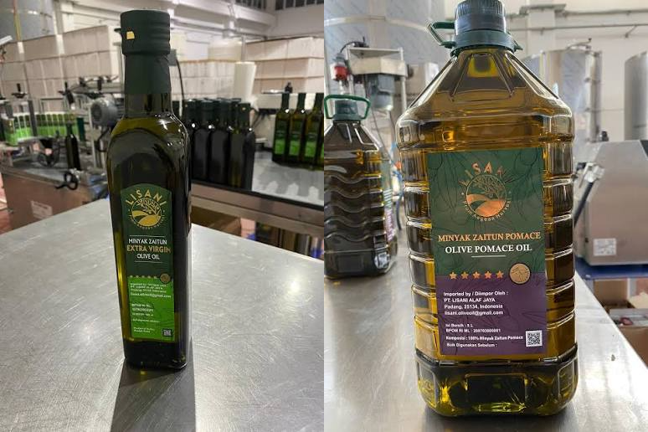
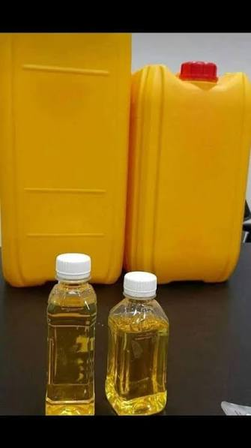
GOODS & PRODUCTS
Coffee Beans
Furniture
Olive Oil
RBD Palm Olein (Cooking Oil)

Slide 12
WHY CHOOSE US?
Our Competitive Advantage
Global Network: Extensive relationships with trusted manufacturers and suppliers worldwide.
Logistical Expertise: Deep understanding of international shipping, customs regulations, and efficient freight forwarding.
Financial Stability: Strong financial backing enabling us to handle large-volume transactions and offer flexible terms.
Agility & Adaptability: Quick response times to market shifts and the ability to pivot to new product lines as opportunities arise.
Quality Assurance: Rigorous quality control processes to ensure all traded goods meet international standards.

Slide 13
TARGET MARKET
Our primary markets include:
Region 1: The Middle East North Africa (MENA)
Region 2: Southeast Asia (ASEAN)
Region 3: East Asia (China, Japan, South Korea)
Region 4: South Asia (India, Pakistan, Bangladesh)
Region 5: Domestic distribution within our home country.

Slide 14
KEY PARTNERSHIPS & CLIENTS
We are proud to collaborate with leading manufacturers globally and serve a diverse clientele ranging from large retail chains to specialized wholesalers and government procurement agencies. Among them are:
Domestic Clients:
PT. Altnoor Global Venture
CV. Saira International
PT. Humaira Inti Natura
Foreign Clients:
Premiere Engineering & Development Sdn.Bhd. Malaysia
Wataru Co. Ltd., Japan
AMAR Holding Group, Russia
Dalil Altawasul, Saudi Arabia
Al Habib for Export, Egypt
Aiza Jaya Trading, Malaysia

Slide 15
CONTACT US
We welcome the opportunity to discuss how PT. Lisani Alaf Jaya can meet your trading needs.
Mobile No. : +6282384141531
E-mail : info@lisanialafjaya.com
lisani.alafjaya@gmail.com

Slide 16
THANK YOU

