Slide 1
INDUSTRY 4.0
Why it matters?

Slide 2
Agenda
Industrial Evolution
4th Industrial Revolution
Building Blocks of Industry 4.0
Potential Industrial Products Implications
Potential Consumer Products Implications
Impact of Industry 4.0

Slide 3
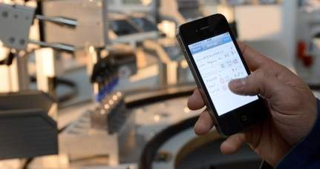
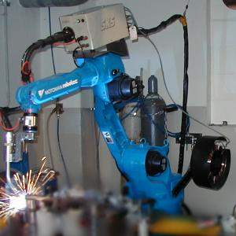
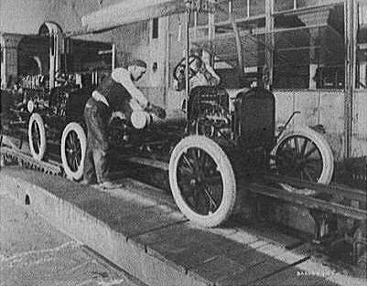
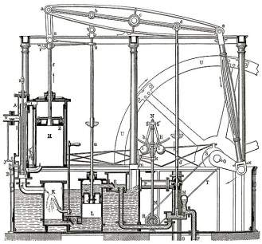
Industrial Evolution
4. Industrial revolution
Based on cyber-physical-
systems
3. Industrial revolution
Through the use of electronics
and IT further progression in
autonomous production
2. Industrial revolution
Introducing mass production
lines powered by electric
energy
Level of complexity
1. Industrial revolution
Introducing mechanical
production machines powered
by water and steam
Industry 1.0
Industry 2.0
Industry 3.0
Industry 4.0
End of the
18th century.
Beginning of the
20th century
Beginning of the
70th
Today
Source: DFKI/Bauer IAO

Slide 4

Phases of earlier 3 Industrial Revolutions
1760 to 1840 - Ushered in Mechanical production; railways and steam engine
1870 to 1940 - Mass production; electricity and assembly line
1960 to 2010 - Computers; semi conductors, main frame computing, personal devices, internet
Notes:
It is possible to apply this template to exiting presentations.
Have the latest presentation template open
Click on the View tab and select Normal
Delete all unwanted slides
Click on the Insert tab from the menu bar and select Slides from Files
Click on Browse. Navigate to the presentation you wish to update with the new template. Highlight the presentation and click Open
Wait for the slides from the presentation to load and click on Insert All. Then click Close
Check the inserted slides to ensure that the most appropriate master slide has been used on each slide
To change the master applied to a slide select the slide you wish to apply a different master to then click on the Format tab from the menu bar and select Slide Design
From the Used in This Presentation section choose the master you wish to apply to the slide and hover over it to reveal a drop-down arrow. Click on the arrow and select Apply to Selected Slides
It is important to thoroughly check the presentation to ensure that no further formatting is needed.

Slide 5
Industry 4.0: Germany Smart Manufacturing Leadership Coalition: INDIA
A collective term for technologies and concepts of value chain organization. Based on the technological concepts of cyber-physical systems, the Internet of Things and the Internet of Services, it facilitates the vision of the Smart Factory.
Within the modular structured Smart Factories of Industry 4.0, cyber-physical systems monitor physical processes, create a virtual copy of the physical world and make decentralized decisions.
Over the Internet of Things, Cyber-physical systems communicate & cooperate with each other & humans in real time. Via the Internet of Services, both internal & cross-organizational services are offered & utilized by participants of the value chain.
Builds on the Digital revolution
Ubiquitous internet
Smaller & powerful sensors
Artificial Intelligence (AI)
Machine Learning
Labor & Energy Cost
Notes:
It is possible to apply this template to exiting presentations.
Have the latest presentation template open
Click on the View tab and select Normal
Delete all unwanted slides
Click on the Insert tab from the menu bar and select Slides from Files
Click on Browse. Navigate to the presentation you wish to update with the new template. Highlight the presentation and click Open
Wait for the slides from the presentation to load and click on Insert All. Then click Close
Check the inserted slides to ensure that the most appropriate master slide has been used on each slide
To change the master applied to a slide select the slide you wish to apply a different master to then click on the Format tab from the menu bar and select Slide Design
From the Used in This Presentation section choose the master you wish to apply to the slide and hover over it to reveal a drop-down arrow. Click on the arrow and select Apply to Selected Slides
It is important to thoroughly check the presentation to ensure that no further formatting is needed.

Slide 6
Did not exist in 2006
iPhone
iPad
Kindle
4G
Uber
Airbnb
Android
Android
Oculus
Instagram
Snapchat
Whatsapp

Slide 7

Time to reach 100 Million customers
Telephone 75 Years
Web 7 Years
Facebook 4 Years
Instagram 2 Years
Pokemon Go 1 Month

Slide 8
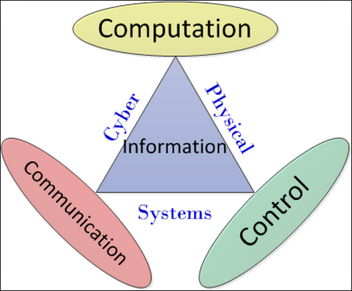
Cyber Physical Systems
A cyber-physical system (CPS) is a system of collaborating computational elements controlling physical entities. CPS are physical and engineered systems whose operations are monitored, coordinated, controlled and integrated by a computing and communication core. They allow us to add capabilities to physical systems by merging computing and communication with physical processes.
Notes:
CPS benefits:
• Safer and more efficient systems
• Reduce the cost of building and operating the systems
• Build complex systems that provide new capabilities
• Reduced cost of computation, networking, and sensing
• Enables national or global scale CPS’s

Slide 9
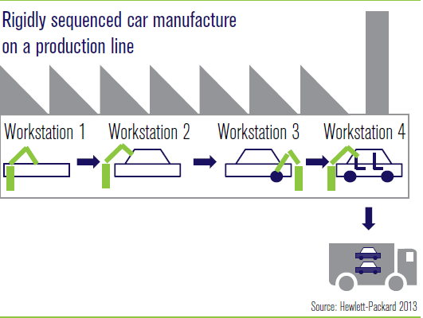
Today’s Factory

Slide 10
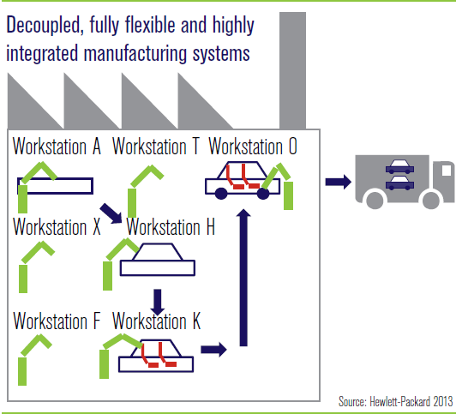
Tomorrow’s Factory

Slide 11
Industry 4.0 Six Design Principles
Interoperability: the ability of cyber-physical systems (i.e. work piece carriers, assembly stations and products), humans and Smart Factories to connect and communicate with each other via the Internet of Things and the Internet of Services
Virtualization: a virtual copy of the Smart Factory which is created by linking sensor data (from monitoring physical processes) with virtual plant models and simulation models
Decentralization: the ability of cyber-physical systems within Smart Factories to make decisions on their own
Real-Time Capability: the capability to collect and analyze data and provide the insights immediately
Service Orientation: offering of services (of cyber-physical systems, humans and Smart Factories) via the Internet of Services
Modularity: flexible adaptation of Smart Factories for changing requirements of individual modules

Slide 12
Building blocks of Industry 4.0
Industry 4.0
Autonomous Robots
Simulation
Horizontal and vertical system integration
Additive Mfg
Industrial Internet of Things
Augmented reality
Big data analytics
Cyber Security

Slide 13
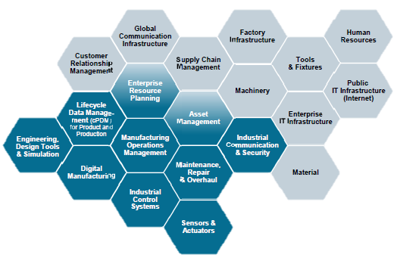
Impacting all aspect of value chain

Slide 14
Potential Implications
Robot Assisted production
Additive manufacturing of complex parts
Machines as a service
Big data drive quality control
Production line simulation
Predictive Maintenance
Smart supply network

Slide 15
Robots working in Amazon WH

Slide 16
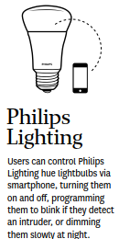

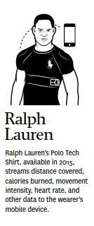
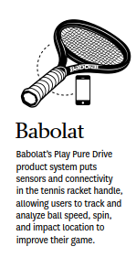
Examples of Product evolution: Connected and smart products

Slide 17
Impact
Economy
Individual
Impact
Business
Society
National & Global
Notes:
It is possible to apply this template to exiting presentations.
Have the latest presentation template open
Click on the View tab and select Normal
Delete all unwanted slides
Click on the Insert tab from the menu bar and select Slides from Files
Click on Browse. Navigate to the presentation you wish to update with the new template. Highlight the presentation and click Open
Wait for the slides from the presentation to load and click on Insert All. Then click Close
Check the inserted slides to ensure that the most appropriate master slide has been used on each slide
To change the master applied to a slide select the slide you wish to apply a different master to then click on the Format tab from the menu bar and select Slide Design
From the Used in This Presentation section choose the master you wish to apply to the slide and hover over it to reveal a drop-down arrow. Click on the arrow and select Apply to Selected Slides
It is important to thoroughly check the presentation to ensure that no further formatting is needed.

Slide 18
Impact Economy
Growth
Ageing
Productivity
Employment
Labour subsititution
The nature of Work
Notes:
It is possible to apply this template to exiting presentations.
Have the latest presentation template open
Click on the View tab and select Normal
Delete all unwanted slides
Click on the Insert tab from the menu bar and select Slides from Files
Click on Browse. Navigate to the presentation you wish to update with the new template. Highlight the presentation and click Open
Wait for the slides from the presentation to load and click on Insert All. Then click Close
Check the inserted slides to ensure that the most appropriate master slide has been used on each slide
To change the master applied to a slide select the slide you wish to apply a different master to then click on the Format tab from the menu bar and select Slide Design
From the Used in This Presentation section choose the master you wish to apply to the slide and hover over it to reveal a drop-down arrow. Click on the arrow and select Apply to Selected Slides
It is important to thoroughly check the presentation to ensure that no further formatting is needed.

Slide 19
Impact Business
Customer expectations
Data enhanced products
Collaborative innovation
New operating models
Notes:
It is possible to apply this template to exiting presentations.
Have the latest presentation template open
Click on the View tab and select Normal
Delete all unwanted slides
Click on the Insert tab from the menu bar and select Slides from Files
Click on Browse. Navigate to the presentation you wish to update with the new template. Highlight the presentation and click Open
Wait for the slides from the presentation to load and click on Insert All. Then click Close
Check the inserted slides to ensure that the most appropriate master slide has been used on each slide
To change the master applied to a slide select the slide you wish to apply a different master to then click on the Format tab from the menu bar and select Slide Design
From the Used in This Presentation section choose the master you wish to apply to the slide and hover over it to reveal a drop-down arrow. Click on the arrow and select Apply to Selected Slides
It is important to thoroughly check the presentation to ensure that no further formatting is needed.

Slide 20
Impact
National & Global
Governments
Countries, regions & cities
International security
Society
Inequality
Community
The Individual
Identity, morality & ethics
Human connection
Notes:
It is possible to apply this template to exiting presentations.
Have the latest presentation template open
Click on the View tab and select Normal
Delete all unwanted slides
Click on the Insert tab from the menu bar and select Slides from Files
Click on Browse. Navigate to the presentation you wish to update with the new template. Highlight the presentation and click Open
Wait for the slides from the presentation to load and click on Insert All. Then click Close
Check the inserted slides to ensure that the most appropriate master slide has been used on each slide
To change the master applied to a slide select the slide you wish to apply a different master to then click on the Format tab from the menu bar and select Slide Design
From the Used in This Presentation section choose the master you wish to apply to the slide and hover over it to reveal a drop-down arrow. Click on the arrow and select Apply to Selected Slides
It is important to thoroughly check the presentation to ensure that no further formatting is needed.

Slide 21
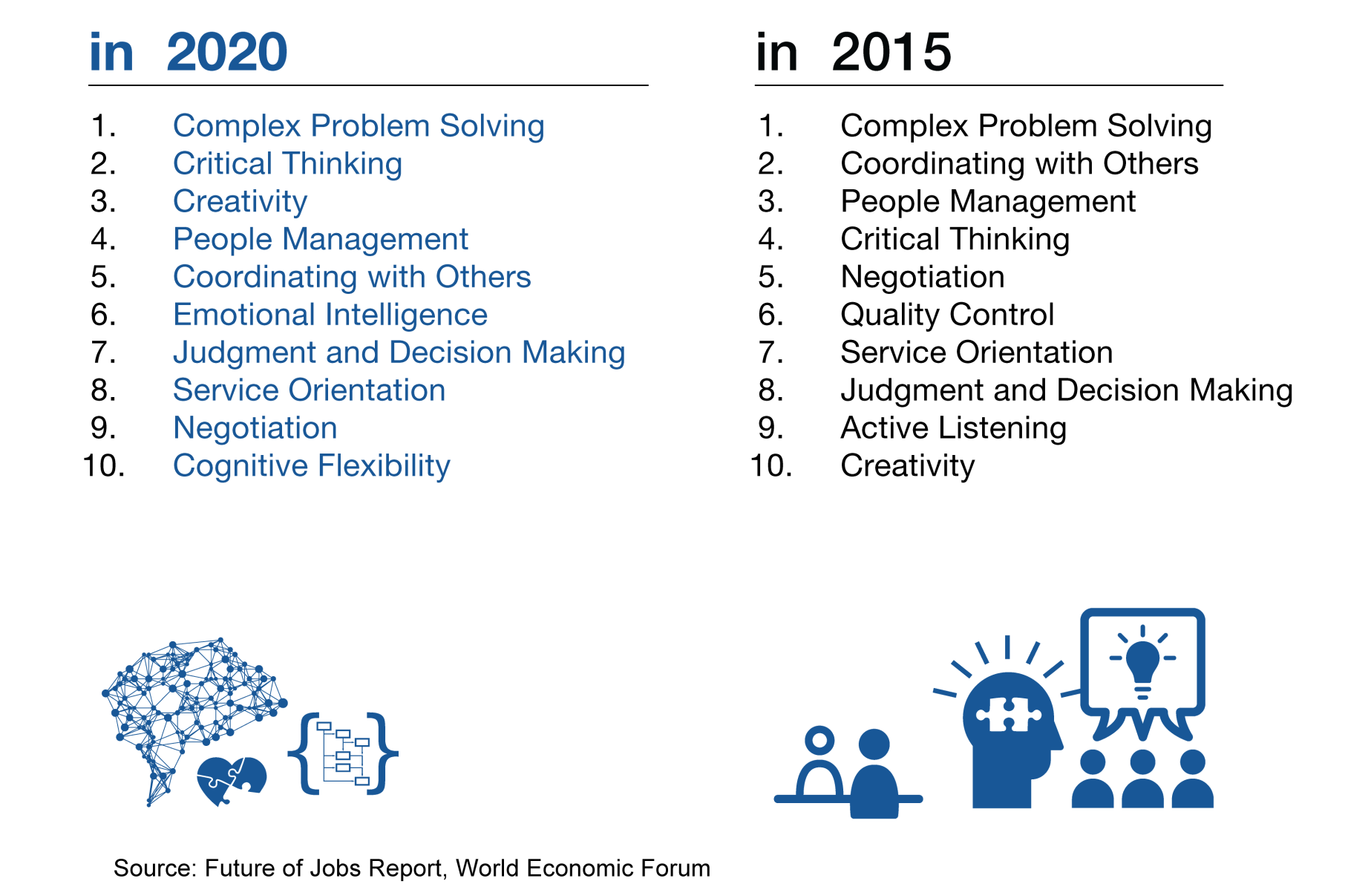
Top 10 Skills to be relevant in Industry 4.0

Slide 22
Thank YOU

