Slide 1




IDEA DECK | STARTUP MISSION
SchoolSphere
Your whole school, in one place
AI-powered
Mobile apps
All modules, one platform
Role-based access
Cloud school management for Kerala and beyond

Slide 2



The Innovation & The Innovator
The Innovation
The Innovator
The Team
Name of the Idea / Product
Innovator (Team Lead)
Core Team
SMS-SchoolSphere
Shameem P K
4 active members
A cloud school management platform that connects management, teachers, parents and students.
Founder and product builder of SchoolSphere.
Shameem, Shabeer, Shabeeb and Favas.

Slide 3



One Platform, Three Superpowers
AI-powered
Mobile-first
All-in-one
Early-warning flags for students at risk
AI-drafted parent messages and report comments
Ask AI assistant inside the product
Student & Parent, Teacher and Staff apps
Push notifications and deep links
Offline attendance for teachers
35+ modules behind one login
Every user sees only what they need
Multi-branch, with your school's brand

Slide 4



The Problem Statement
The Problem
How SchoolSphere Solves It
Schools juggle separate tools for fees, attendance, exams and admissions
Parents chase information by phone calls and paper notes
Management has no real-time view across branches
Data is stored, but never turned into early action
One cloud platform for every school process
Parents and students get their own mobile apps
Real-time dashboards for principals and owners
AI flags at-risk students and drafts the follow-up

Slide 5






35+ Modules, One Platform
Academics
Finance
Campus Operations
Students, Timetable, Exams & Results, Online Exams, Lesson & Portions, Homework, Admissions
Fee management, Online fee payment, Accounting, Staff & Payroll
Attendance, Transport, Hostel, Library, Inventory, Visitors
People & Records
Communication
Activities & Learning
Staff, Teachers, Health records, Certificates, Users & Roles
Announcements, Parent portal, Meetings, Surveys, Help desk, Calendar
Extra-curricular, Talents, Study materials, Online classes

Slide 6






Role-Based Management
Management
Teachers
Parents
Students
Staff
Fees, payroll, accounts
Real-time dashboards
All branches at a glance
Attendance & marks
Homework & lesson plans
Timetable
Attendance & results
Fee dues & payment
Notices & messages
Homework & materials
Online exams
Results & calendar
Library, front desk, gate
Accounts, inventory
Permission-driven screens
One login, one platform: permissions decide what each role sees and can do, on web and mobile.

Slide 7
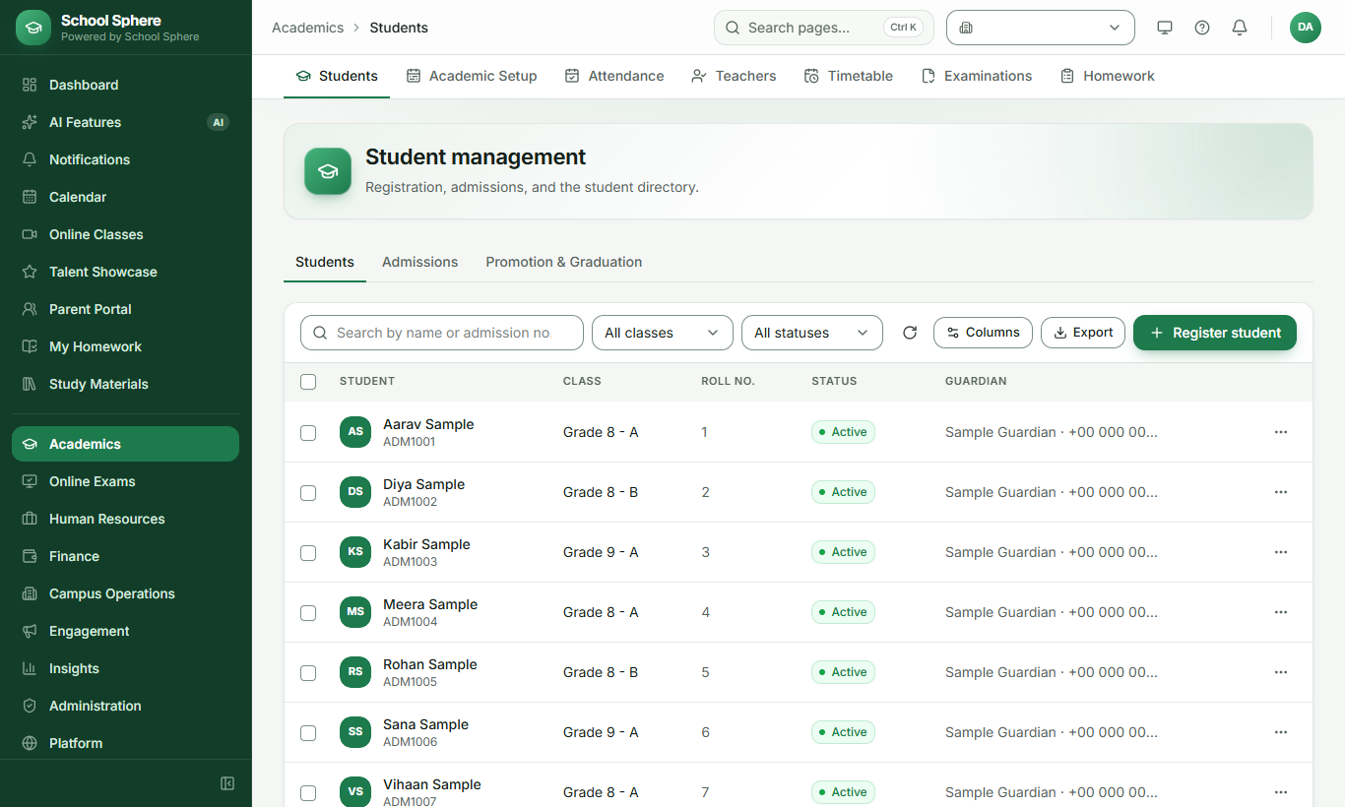
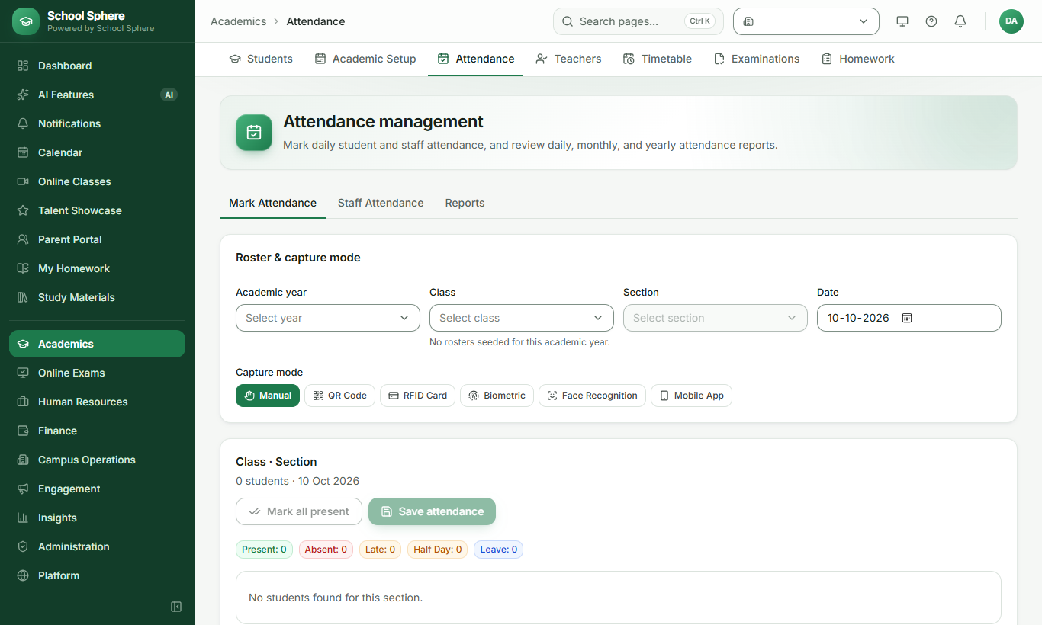
Product: Students & Attendance
Student management: registration, classes, status
Attendance: manual, QR, biometric or mobile capture

Slide 8
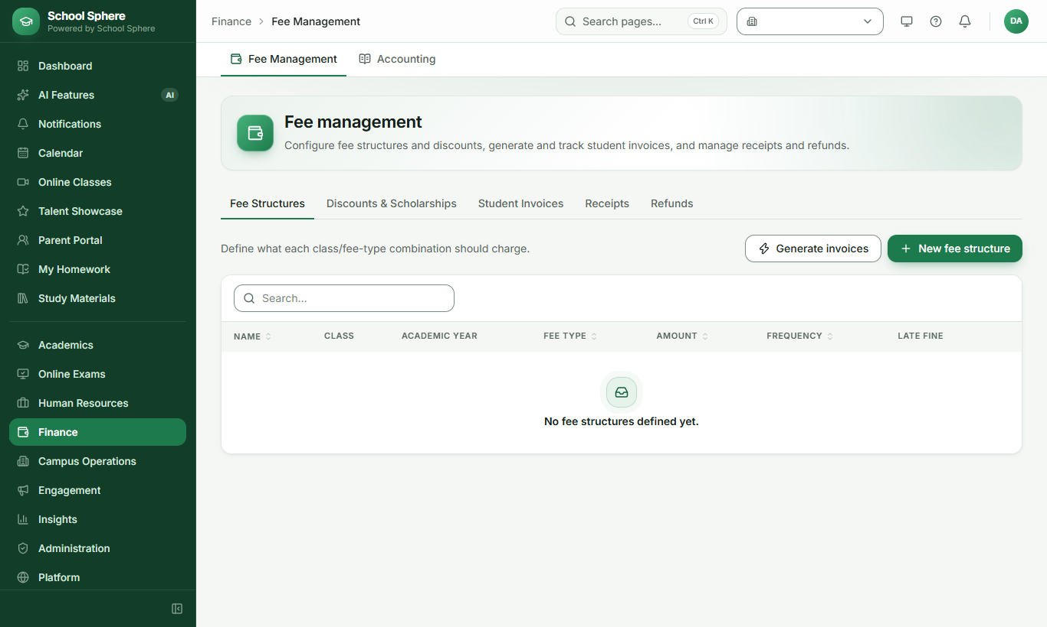
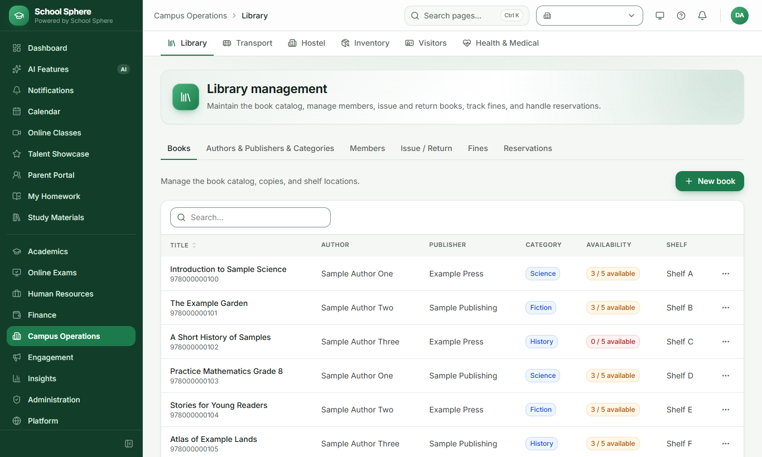
Product: Fees & Library
Fee management: structures, invoices, receipts
Library: catalog, copies, issue and return

Slide 9
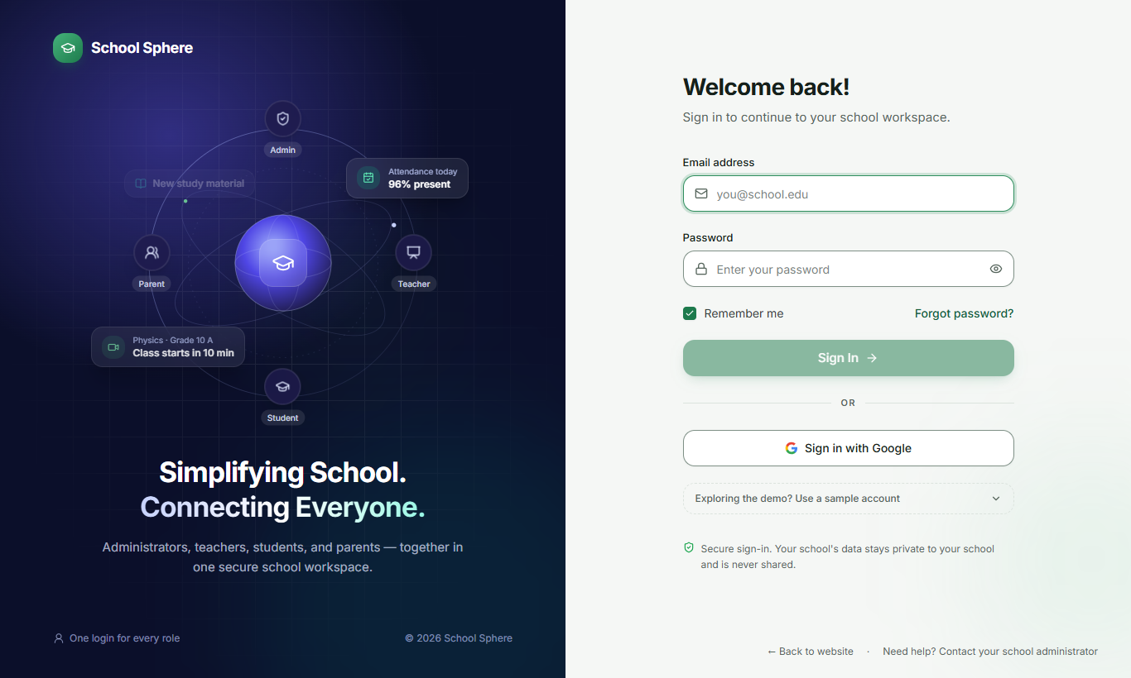
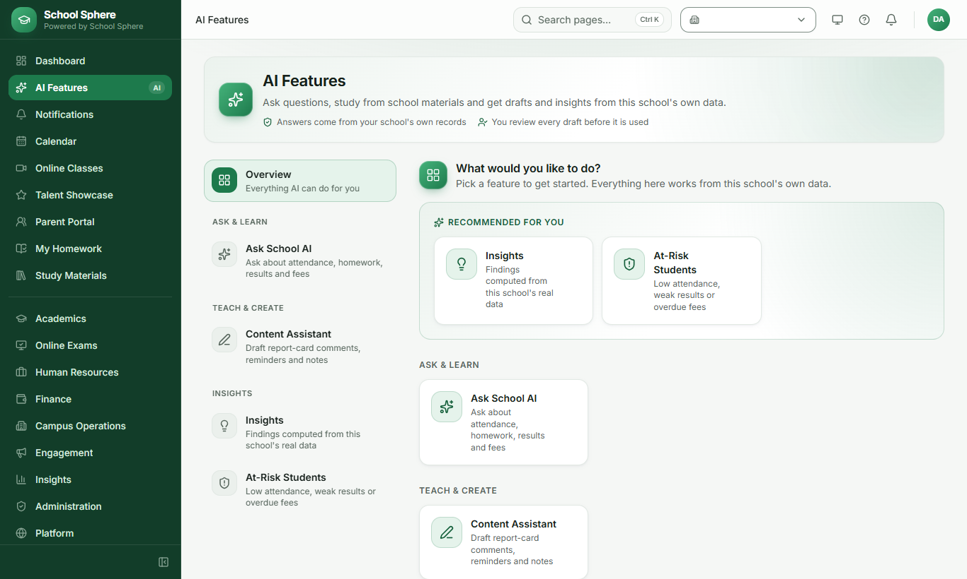
Product: Secure Sign-in & AI
One secure login for every role
AI features: Ask AI, insights, at-risk students

Slide 10






AI That Puts Data to Work
Early Warning
Smart Insights
Parent Messages
Flags students who need attention from attendance, marks and overdue fees
Trends across attendance, academics, fees and admissions
Drafts fee reminders and attendance-concern notes in seconds
Report Comments
Ask AI Assistant
Learning Support
Report-card remarks and recognition notes, written fast
Answers how-to questions right inside the product
AI-generated content, study help and voice input

Slide 11
Mobile Apps for Everyone
Student & Parent
Teacher
Staff
Attendance and results
Homework and online exams
Calendar and notices
Mark attendance, even offline
Mark online exams
Activity attendance
Library, front desk, gate
Accounts and inventory
Screens follow permissions
One codebase for iOS and Android | Push notifications | Secure sign-in with role checks

Slide 12



Market Opportunity
Who is our audience?
Why now
Start: Private and aided schools in Kerala, with English and Malayalam support
Parents expect mobile-first updates
Schools want one system, not five
AI makes data actionable
Cloud removes servers and IT cost
Grow: Multi-branch trusts, management groups and school chains
Scale: Schools across other states and boards

Slide 13



Business Model
SaaS subscription
Onboarding
Premium add-ons
Per school, scaled by students, branches and modules enabled
Setup, data migration, staff training and branded letterheads
AI features, extra mobile apps, messaging and online payments
Recurring revenue, low cost to serve: one cloud platform, every school on the same release.

Slide 14
Current Status of the Product
35+
3
7+
7
Modules built
Mobile apps
Role experiences
Backend services
Built and working
Next
Web platform, live demo available
AI features and Ask AI assistant
Parent portal with online fee payment
Pilot with partner schools
Mobile apps on the app stores
Expand AI and reporting

Slide 15
Team Details
Shameem P K
Shabeer
Shabeeb
Favas
Founder & Team Lead
Developer
Marketing
Developer
4 active members, building and supporting SchoolSphere every day

Slide 16



THANK YOU !
SchoolSphere: school operations made simpler, smarter and more connected
+91 96560 40881 (Phone / WhatsApp)
shameem@sms-schoolsphere.com
www.sms-schoolsphere.com

