Slide 1

ANALYSIS OF INDIAN PREMIER LEAGUE 2008-2017
Presented by
Syed Abadul Rahaman
Raj Pramalick
Syd Abdul Halim
SK Nur Afsar

Slide 2

ANALYSIS OF INDIAN PREMIER LEAGUE
2008-2019

Slide 3
Project Description :-
The project, "Unlocking Insights in the IPL Analysis : A Data-Driven Journey," aims to analyze IPL data from 2008 to 2017 to provide valuable insights for stakeholders. Objectives include evaluating team performances, identifying successful franchises, and analyzing winning strategies. Uncovering top batting and bowling performers, and their impact on matches. Providing strategic insights for team management, sponsors, and fans, including data-driven recommendations. Deliverables include comprehensive reports, interactive dashboards, player performance analytics, and insights for sponsors and fan engagement. The analysis will contribute to a deeper understanding of the IPL, aiding decision-making and driving the tournament's continued success.
Expected OutComes:-
Comprehensive Data Analysis Report
Team Performance Dashboard
Player Performance Analytics
Performance Analysis

Slide 4




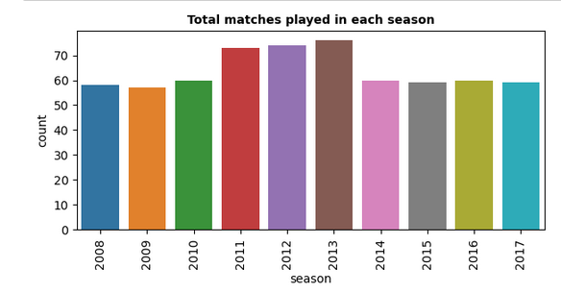
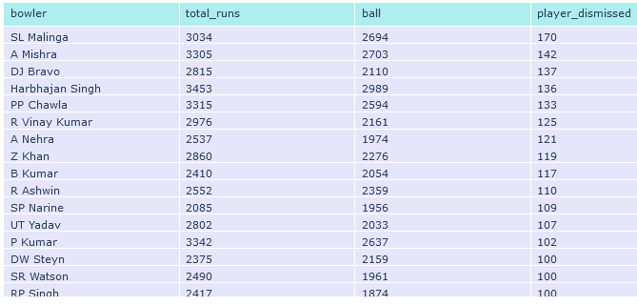
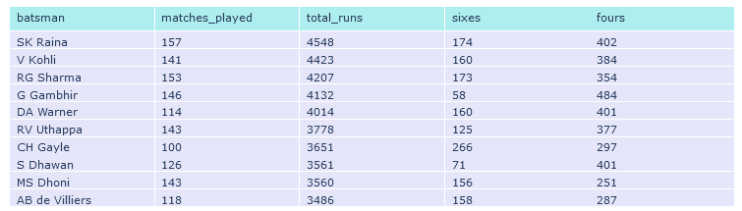
IPL Data Analysis
Orange Cap
Purple Cap
SK Raina
SL Malinga
Bowler Statistics
4548
170
Batsman Statistics

Slide 5

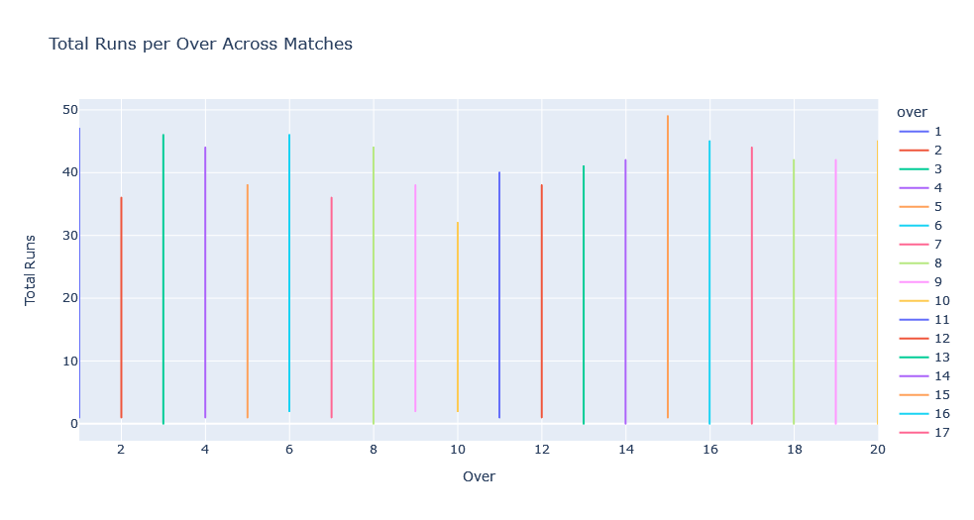
Total Runs per Over Across Matches
Conclusion :-
According data we found Batsman used to secure most of the runs (49) on the 15th over and lowest runs(32) on the 10th over.

Slide 6
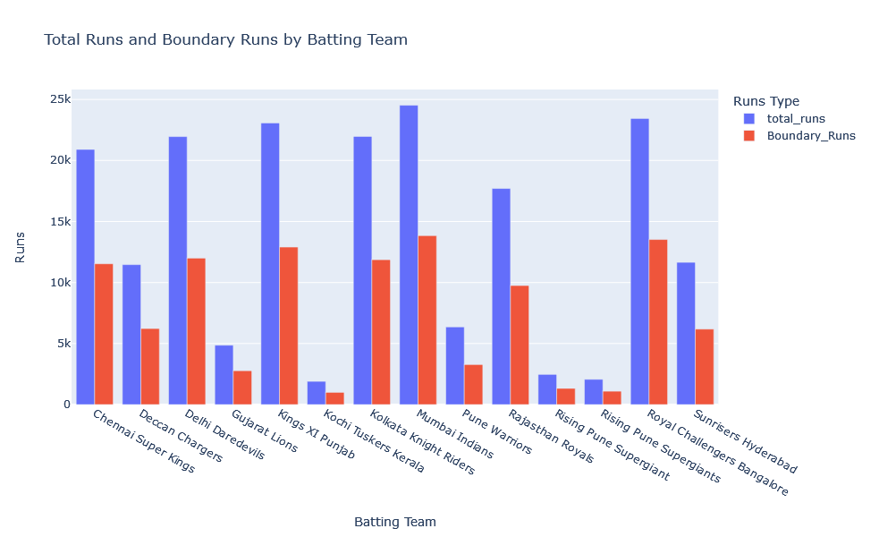
Total Runs and Boundary Runs by Batting Team
Conclusion :-
We have notice Mumbai , Bangalore and Punjab , these three teams were heavily rely on boundaries runs

Slide 7
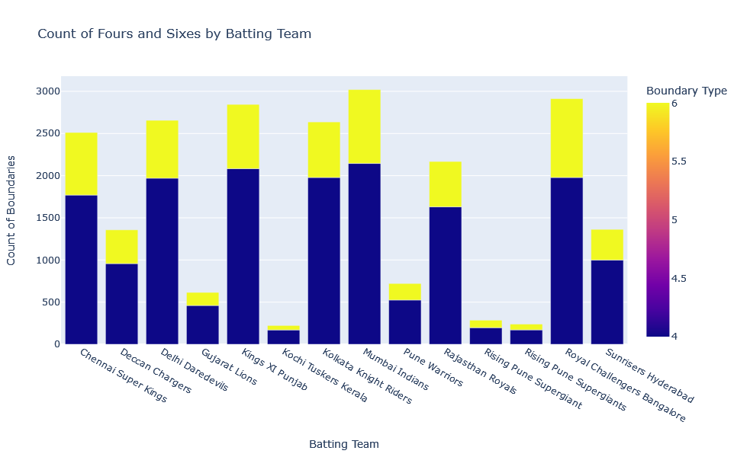
Count of Fours and Sixes by Batting Team :-

Slide 8
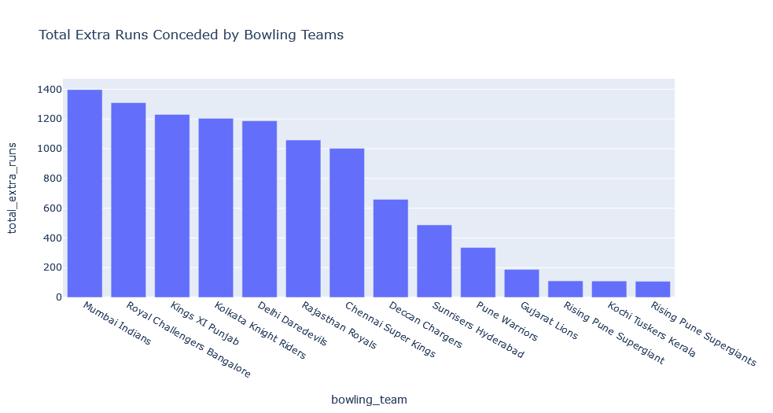
Total Extra Runs Conceded by Bowling Teams :-
In the figure we analyze that Mumbai Indians followed RCB and so on conceded most runs in the form of extra runs during their fielding Innings

Slide 9
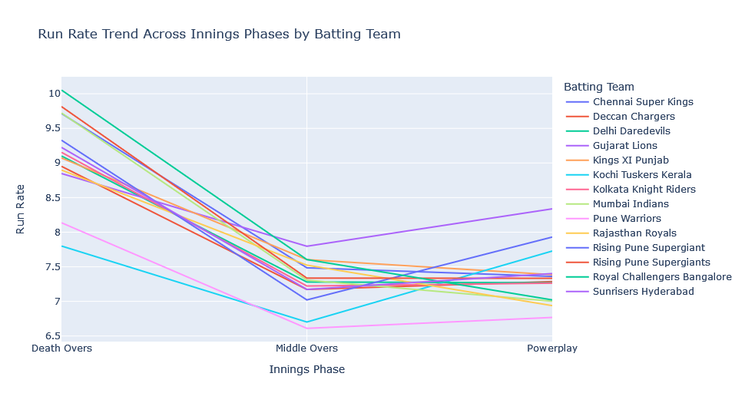
Run Rate Trend Across Innings Phases by Batting Team :-
In the above plot, we can see lower concurrency in terms of run rate in Power play is between average of 8 runs, then goes down in Middle Overs, then again followed up in Death Over

Slide 10
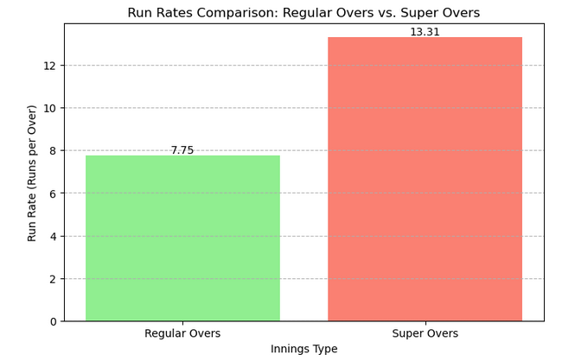
Run Rates Comparison: Regular Overs vs. Super Overs
The Run rate of Super Overs is almost double compared to Regular Overs

Slide 11
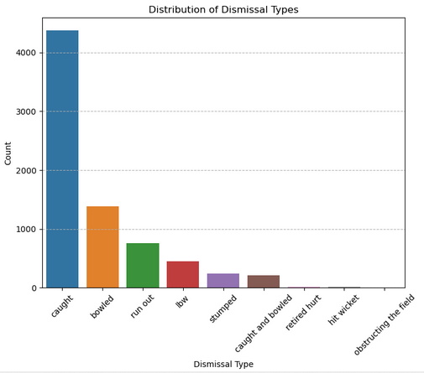
Distribution of Dismissal Types across seasons
We have Notice through the analysis Batsman gets dismissed most of the time through caught

Slide 12
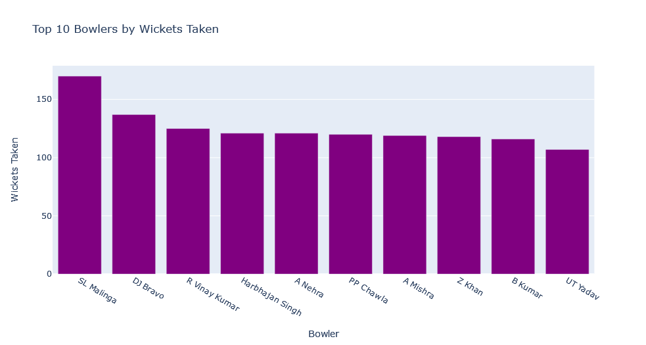
Distribution of Dismissal Types
Top 10 Bowlers by Wickets Taken
Distribution of Dismissal Types
SL Malinga is the best bowler throughout the seasons in terms of wicket Taking (170)

Slide 13
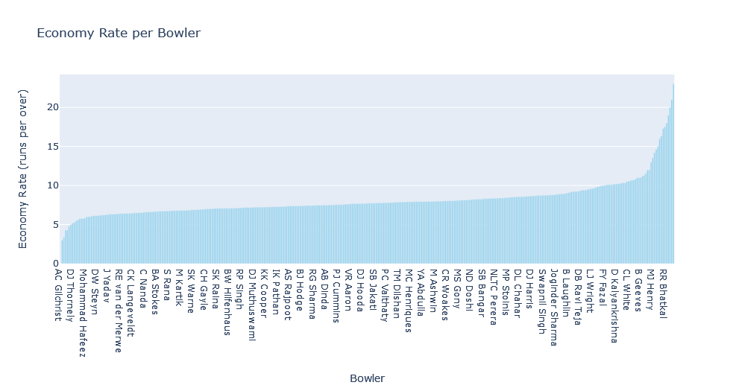
Economy Rate per Bowler
AC Gilchrist is the best bowler throughout the seasons in terms of Economy rate.

Slide 14
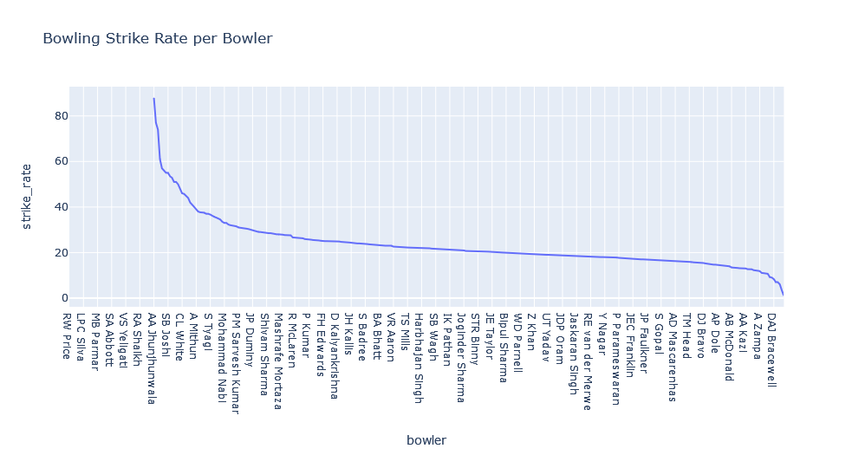
Bowling Strike Rate per Bowler
AA Jhunjhunwala is the best bowler throughout the seasons in terms of Bowling Strike Rate

Slide 15
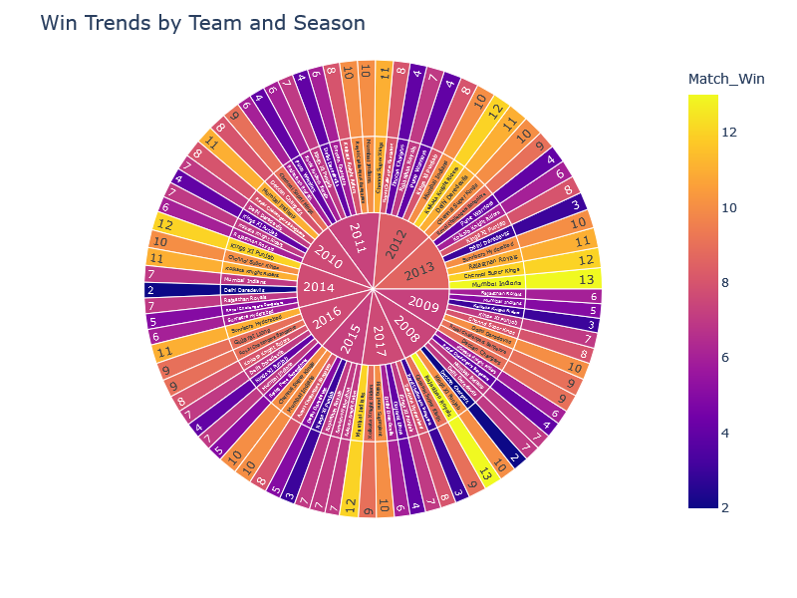
Win Trends by Team and Season

Slide 16
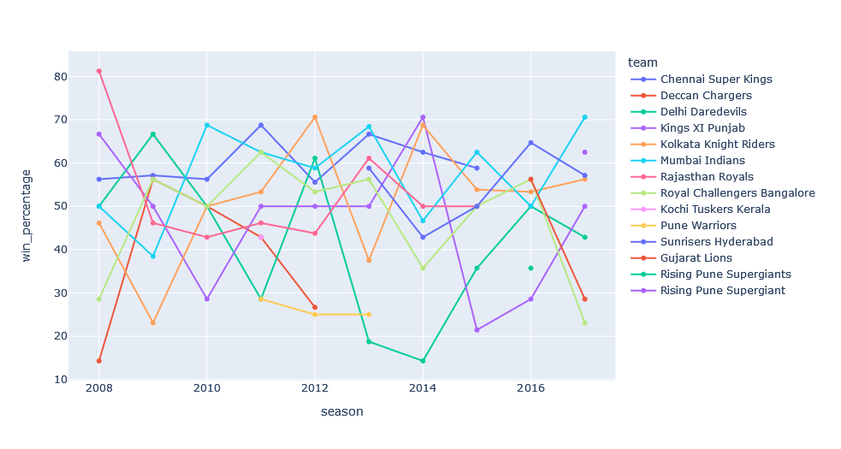
teams that have shown consistent improvement or decline
In the above segment we can see the growth of the teams like MI has the 50% win percentage as we see it has simultaneously improve their performance , now they are in 70% win percentage

Slide 17
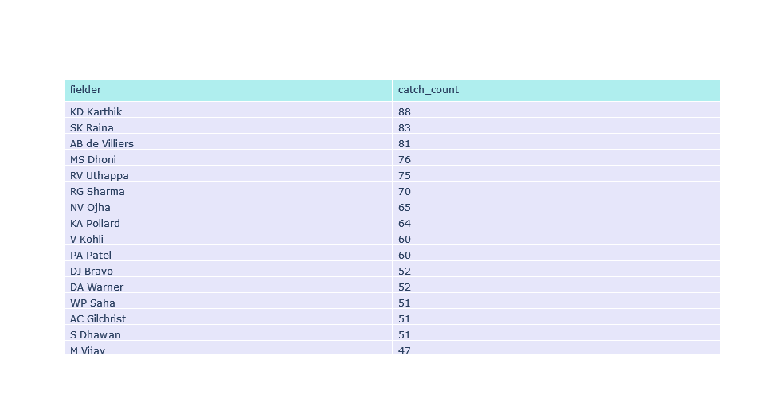
Catch Count By Fielder

Slide 18
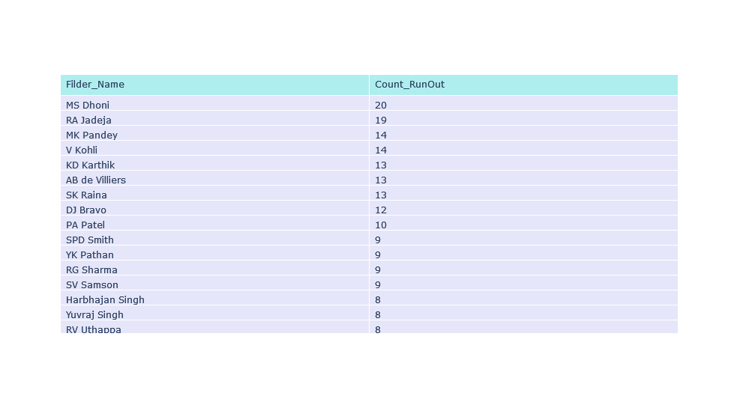
Run Out Count By Fielder

Slide 19
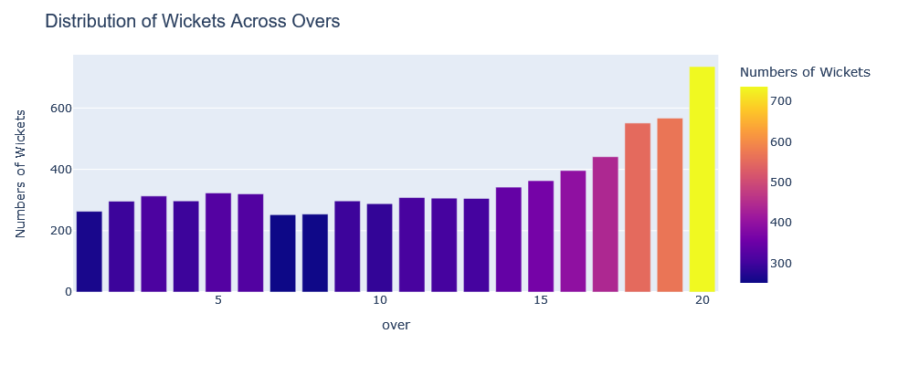
Distribution of Wickets Across Overs
In death over (16-20) most number of wickets has been fallen

Slide 20
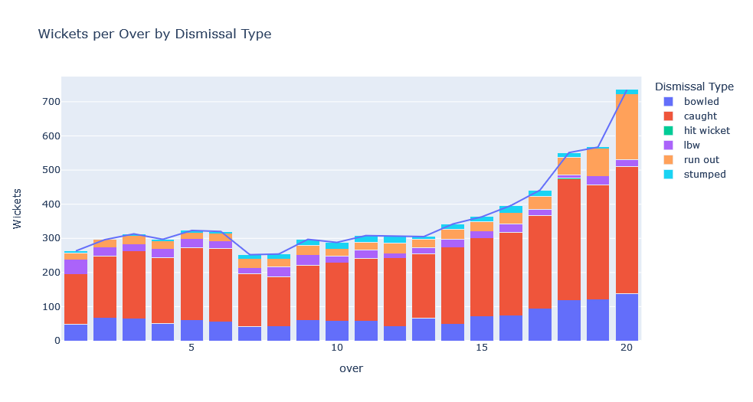
Wickets per Over by Dismissal Type

Slide 21
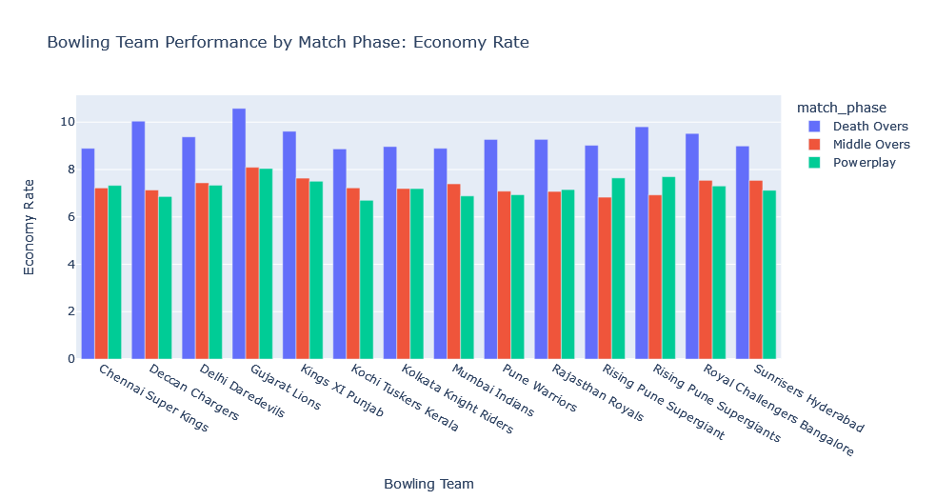
Bowling Team Performance by Match Phase: Economy Rate

Slide 22
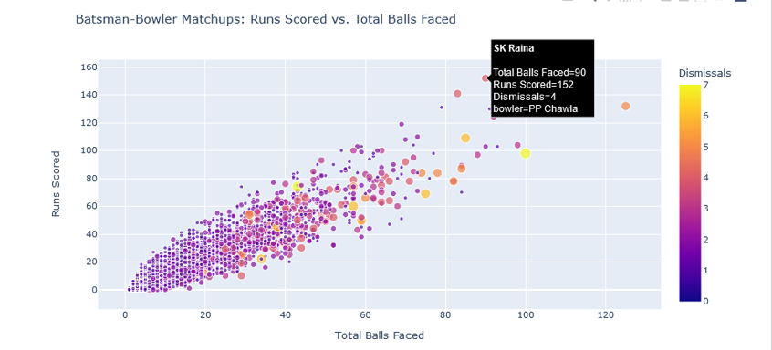
Batsman-Bowler Matchups: Runs Scored vs. Total Balls Faced

Slide 23
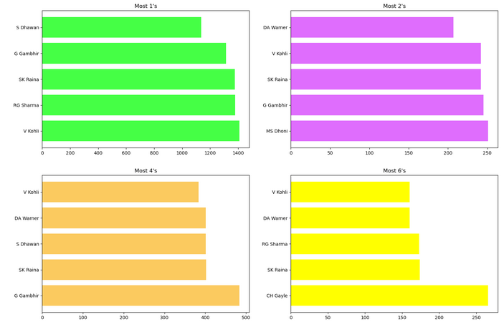
Which batsman scored most 1’s, 2’s, 4’s and 6's runs?
Batsman Scored 1’s , 2’s , 4’s , 6’s
Which batsman scored most 1’s, 2’s, 4’s and 6's run

Slide 24


