Slide 1
College Consignment Hub
Group No: 11
Presented By
Aniket Jawale & Pratik Bhadale

Slide 2
Introduction
College Consignment Hub will be an online platform where college students can buy, sell and donate items such as second hand furniture,study materials,electronic device and other college related items.The objective is to provide a user-friendly,secure and efficient marketplace that promotes sustainability and affordability within the college community.Key features of the platform will include secure user registration and authentication.

Slide 3
Architecture
Front End :- React JS (Version 18) ,CSS,JavaScript
Back End :- Java 11, Spring Boot REST API, JPA
Database :- MySQL 8.0. 34

Slide 4
Reason for selecting the specific technology
React allows developers to create large web applications that can change data, without reloading the page. The main purpose of React is to be fast, scalable, and simple. It works only on user interfaces in the application.
Spring Boot provides a flexible way to configure Java Beans, XML configurations, and Database Transactions. It provides a powerful batch processing and manages REST endpoints. In Spring Boot, everything is auto configured; no manual configurations are needed.

Slide 5
Objective
Sustainability: Promote eco-friendly exchange of goods.
Affordability: Provide cost-effective options for students.
Community Building: Foster campus connections through shared resources.
Ease of Use: Simplify buying, selling, and donating processes.
Charitable Giving: Encourage donations to support those in need.

Slide 6
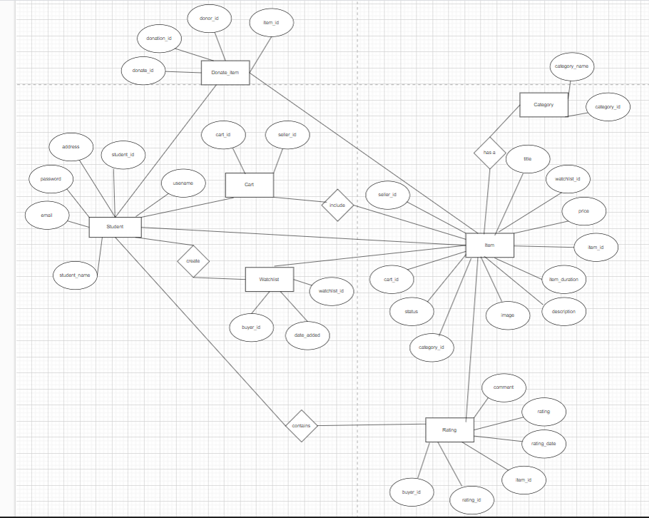
Entity Relationship Diagram

Slide 7
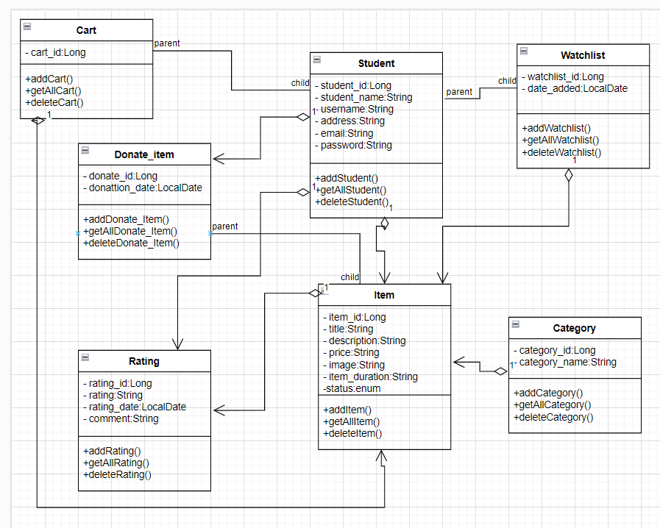
Class Diagram

Slide 8
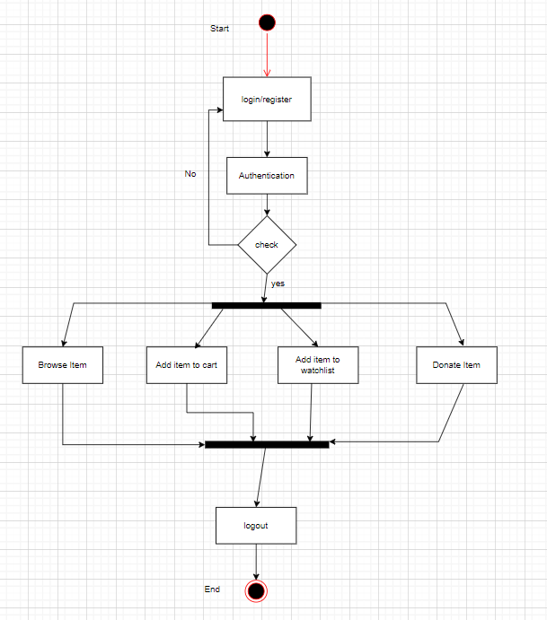
Student Activity Diagram

Slide 9
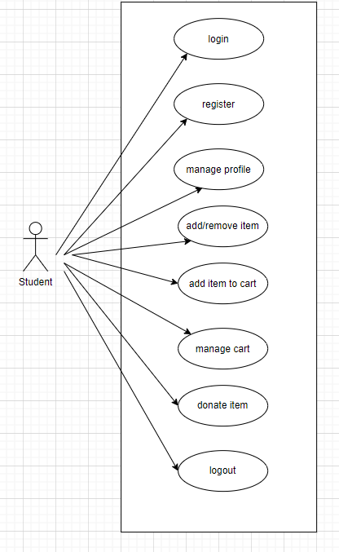
Use Case Diagram

Slide 10
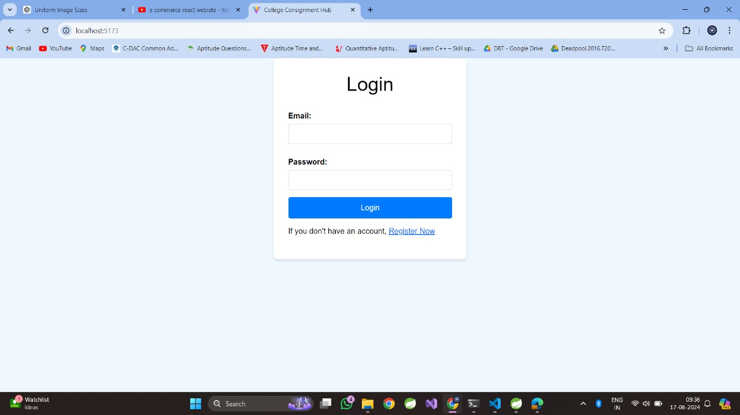
Snapshots : Login

Slide 11
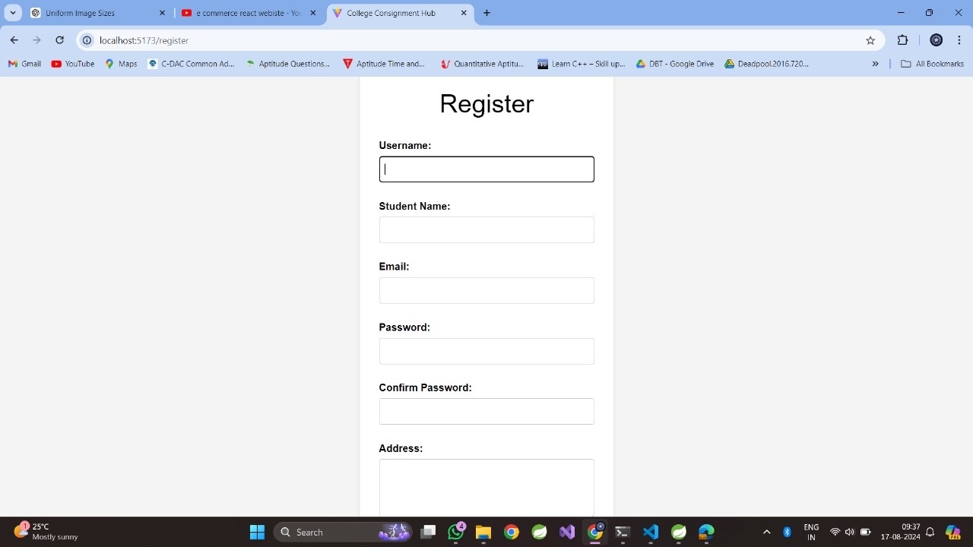
Register:

Slide 12
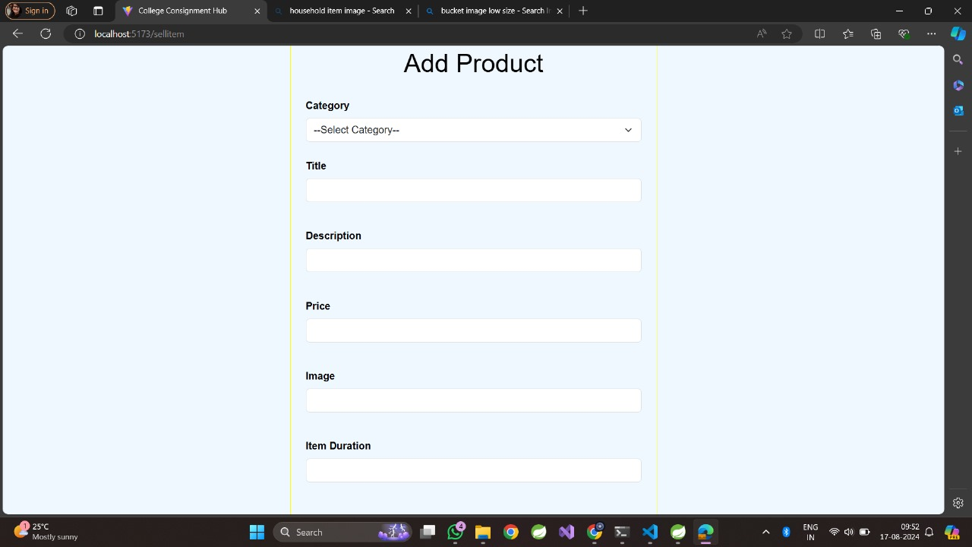
Add Item

Slide 13
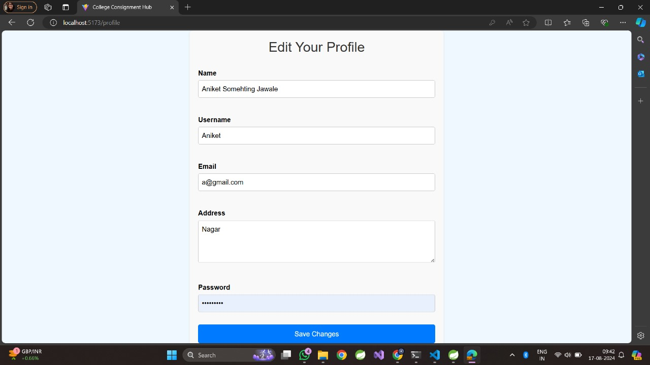
Edit Profile

Slide 14
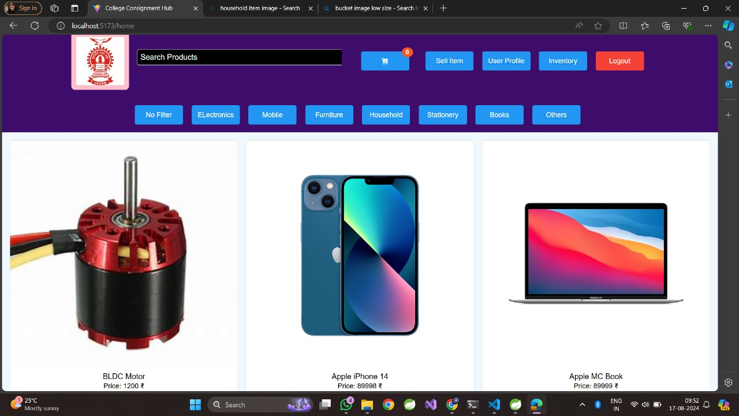
Student Dashboard

Slide 15
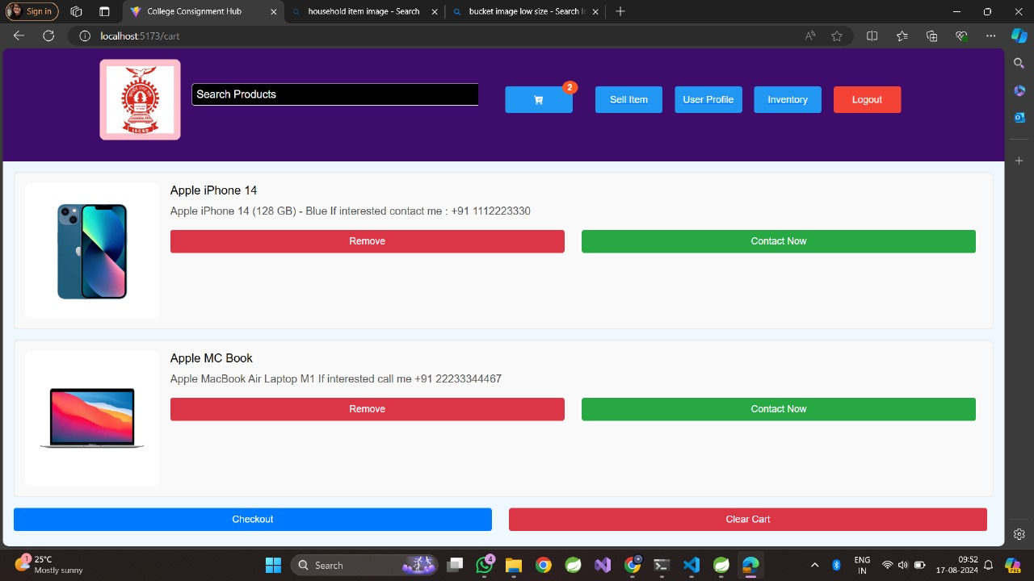
Add To Cart

Slide 16
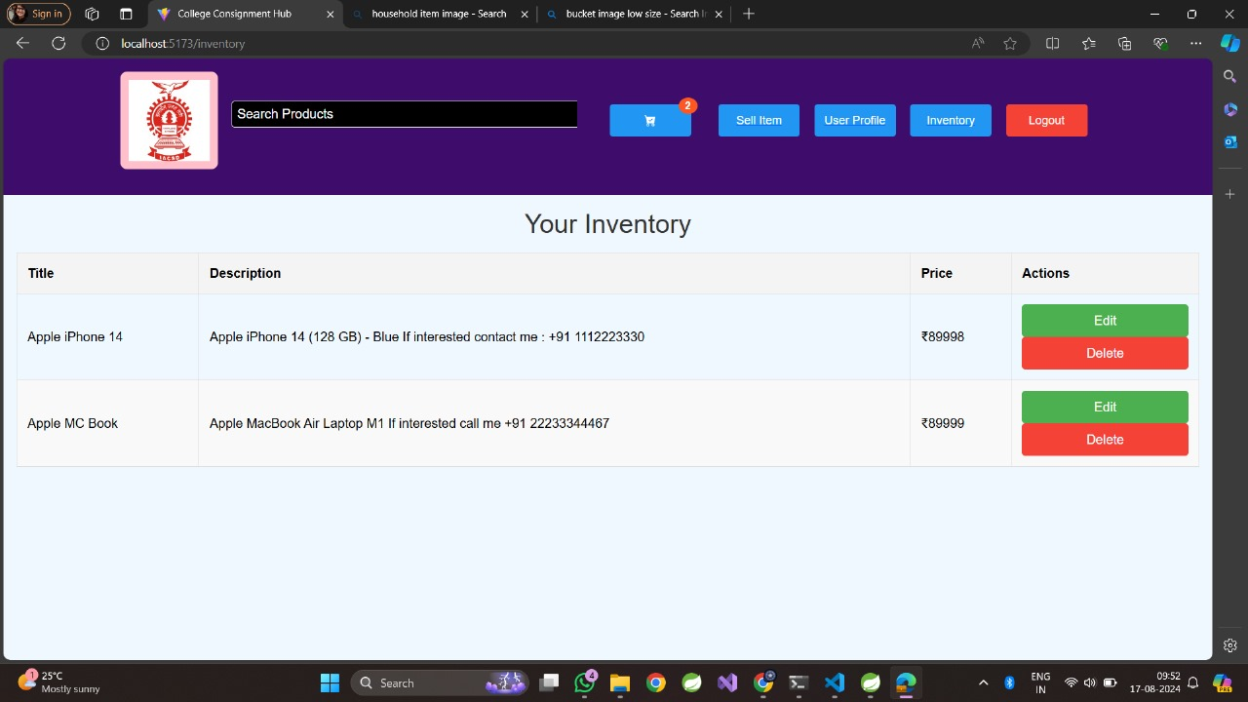
Watchlist

Slide 17
Future Scope
The College Consignment Hub has vast potential for growth and enhancement, with several avenues for future development. One key area of expansion is the creation of a dedicated mobile application, allowing users to conveniently access the platform from their smartphones, enhancing usability and engagement. The integration of artificial intelligence could further personalize the user experience, offering tailored recommendations based on individual preferences and behaviors. As security remains a top priority, the incorporation of advanced technologies like blockchain for transaction verification and multi-factor authentication would strengthen data protection and user trust.

Slide 18
Conclusion
The College Consignment Hub is a transformative platform designed to address the unique needs of college communities, fostering a sustainable, secure, and user-friendly environment for the exchange of goods. By leveraging modern web technologies like Spring Boot and React, the system provides an intuitive interface and reliable back-end support, enabling students, faculty, and staff to easily buy, sell, donate, and manage items within their campus.

Slide 19
References
1. Smith, J. & Davis, A. (2022). Sustainable Practices in College Campuses: A Focus on Consignment and Reuse. Journal of Environmental Education, 45(3), 123-135.
2. Green, R. (2023). The Role of Online Marketplaces in Student Communities. Digital Innovation in Education, 12(4), 78-90.
3. Williams, K. (2021). Building Community through Campus Initiatives: The Impact of Shared Resources. College Student Affairs Journal, 39(2), 56-67.

Slide 20


