Slide 1
iBudget (Phase III)
The iTeam:
Churk Leung
Vanya Dineva
Quan Pham
Jonathan Reimels
Laurene Assayah
Vladimir Velev
Keeping your information private while letting us make sense of your expenses.

Slide 2
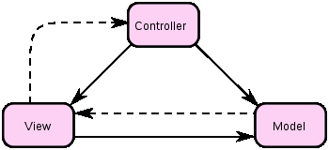
System Architecture

Slide 3
Design Patterns
Factory
Singleton

Slide 4
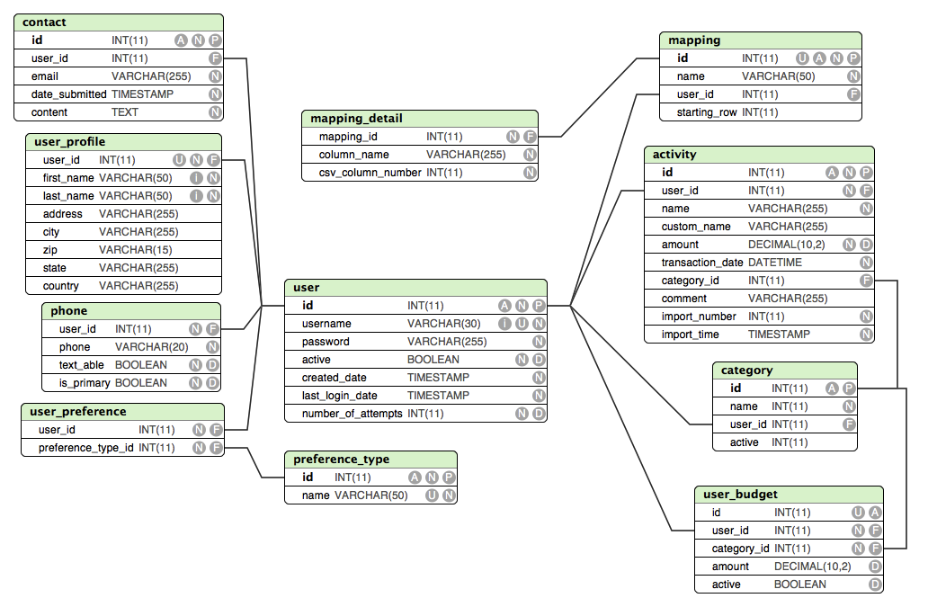
Data Description
A = Auto Increment; N = NOT NULL; P = Primary Key
U = Unique; I = Indexed; D = Has default value assigned
F = Foreign Key

Slide 5
Data Dictionary
Source Objects: activitySource, budgetSource, categorySource, commonSource, ContactSource, mappingDetailSource, mappingSource, phoneSource, preferenceTypeSource, userPreferenceSource, userSource.
General Methods: read(), insert(), update(), delete()

Slide 6
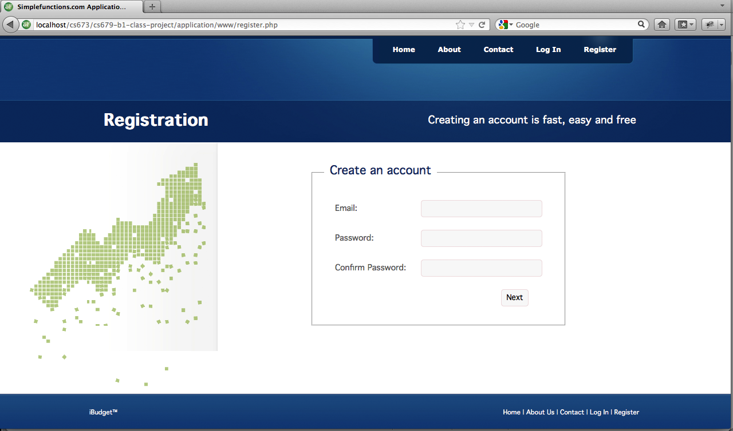
Human Interface Design

Slide 7
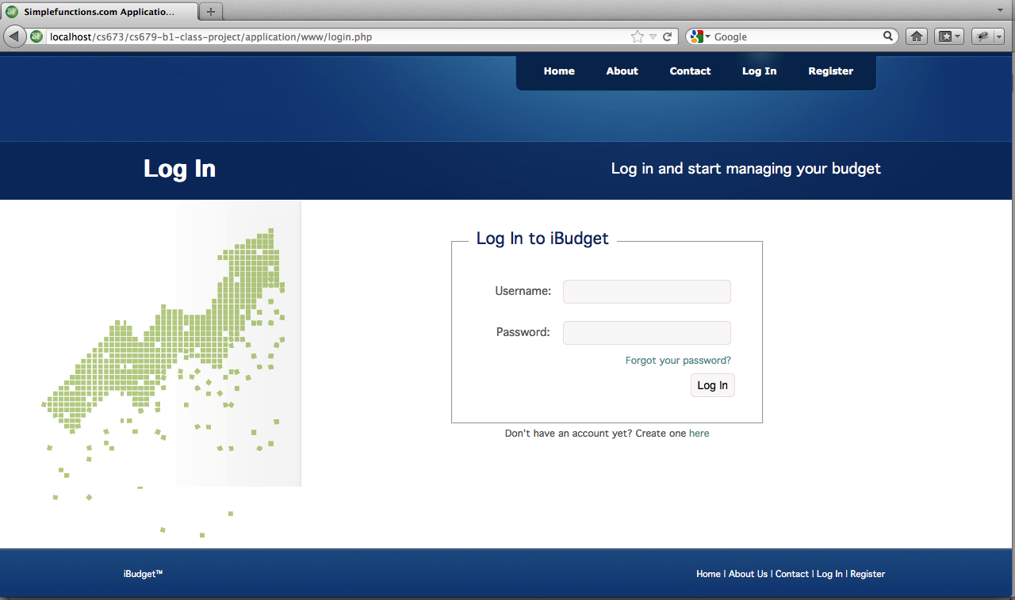
Human Interface Design

Slide 8
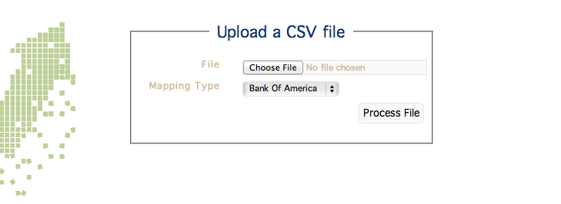
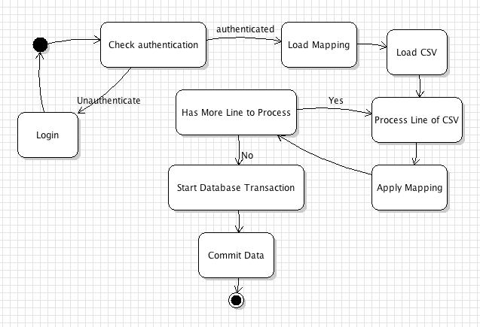
Human Interface Design

Slide 9
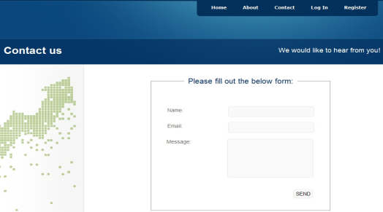
Human Interface Design

Slide 10
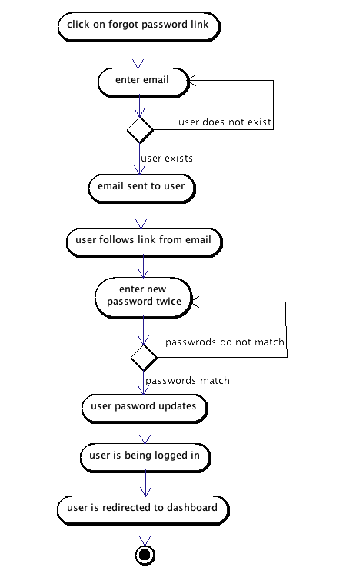
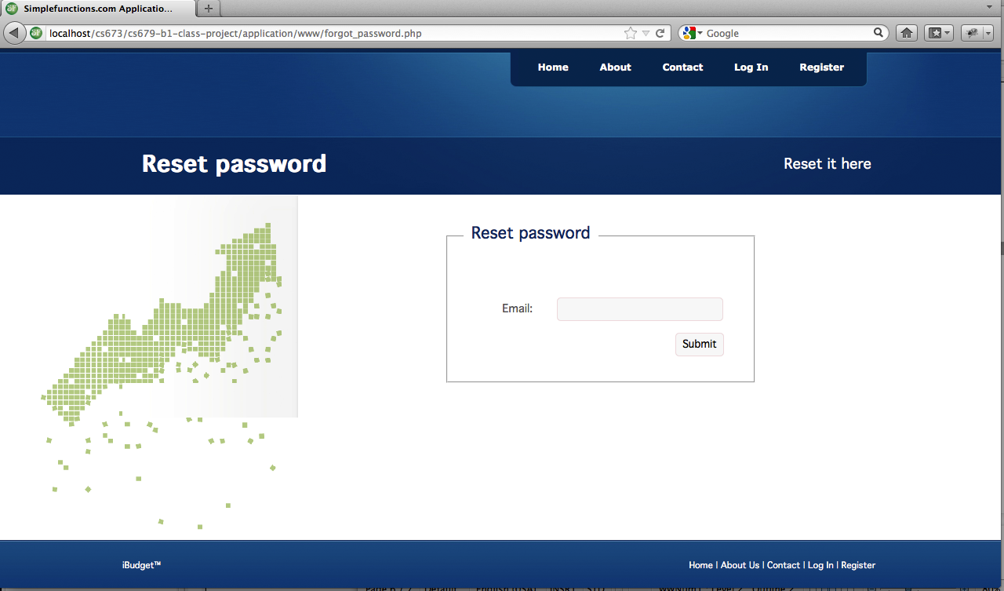
Human Interface Design

Slide 11
Q & A

