Slide 1
iBudget (Phase II)
Keeping your information private while letting us make sense of your expenses.
Churk Leung
Vanya Dineva
Quan Pham
Jonathan Reimels
Laurene Assayah
Vladimir Velev

Slide 2
Requirements
Functoinal
Non-Functional

Slide 3
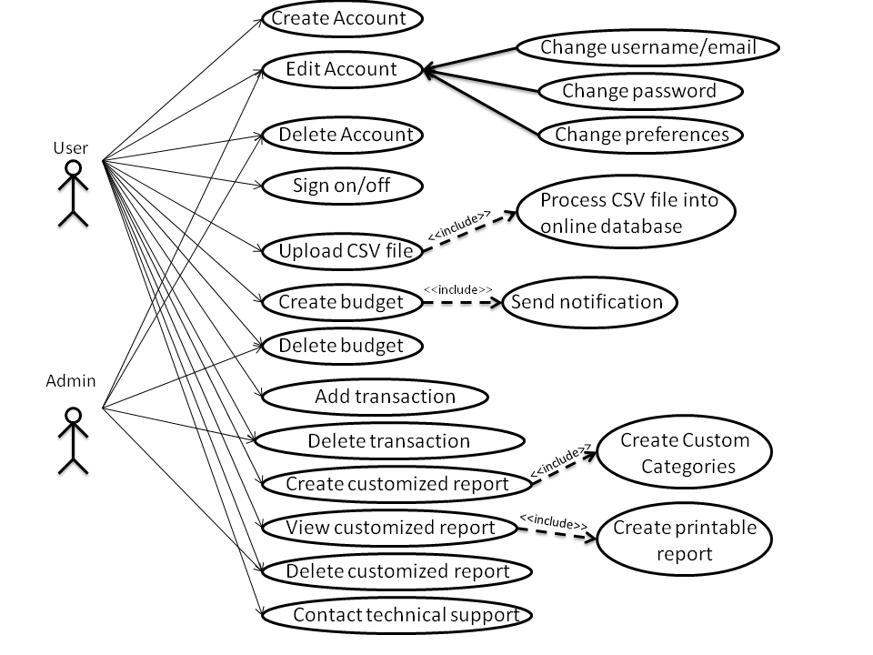
UCase

Slide 4
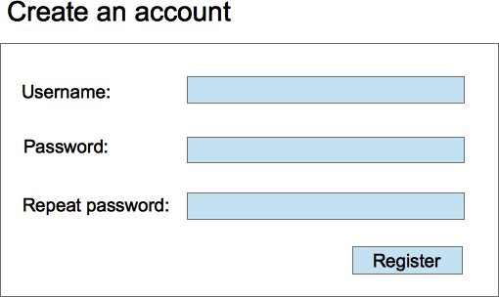
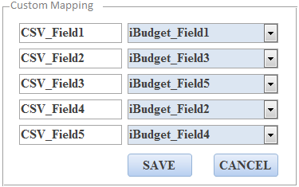
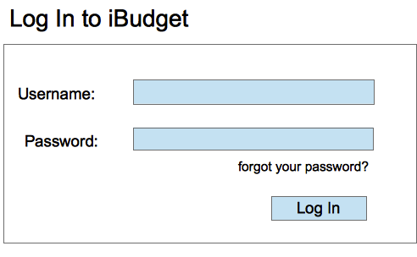
GUI Mock-Ups

Slide 5
Scheduling Impact
Focus on main features.
Team communication to achieve consensus on issues is critical.
Avoid Scope Creep.
Avoid Code & Fix

