Slide 1
iBudget
Keeping your information private while letting us make sense of your expenses.
Churk Leung
Vanya Dineva
Quan Pham
Jonathan Reimels
Laurene Assayah
Vladimir Velev

Slide 2
Privacy
Load only the data you want
Even when your account is compromised you loose nothing
We don’t store any of your banking information
Create anonymous account and no one will know it

Slide 3
Features
Customize your expense categorizations
Load data from any financial institution
Set up budgets
Visualize your expenses and incomes
Set up customize alerts / reminders

Slide 4
Configuration Management
Google Project Hosting
Contain all project documents
Configuration summary will be managed in the project wiki
http://code.google.com/p/cs679-b1-class-project/w/list

Slide 5
Version Control
svn (from Google Project Hosting)
Used to control versions of all project documents
All project documents will be managed in trunk/Documents

Slide 6
SPMP - Overview
The iTeam uses Microsoft Project to show how the project is to be formed as well as when milestones and deliverables should be done.
The Team Leader is responsible for maintaining and updating this documents. All iTeam members refer to this document on a regular basis as well as updating it when necessary.

Slide 7
SPMP – Keeping Track Of:
Project Deliverables
Budget and Schedule
Roles and Responsibilities
Requirements Control Plan
Schedule Control Plan
Quality Control Plan
Risk Management Plan

Slide 8
Software Quality
and SQAP for the iBudget project
Software quality metrics?
A measure of some property of a piece of software or its specifications
Three categories:
● product metrics
● process metrics
● project metrics
Can be divided into:
- end-product quality metrics
- in-process quality metrics.

Slide 9
SQAP
defect density (number of defects per KLOC)
defect removal effectiveness
DRE = 100% x (Defects removed during a development phase /
Defects latent in the product)
quality self-assessment
time spent by individuals on subtasks
We can only control what we can
measure.

Slide 10
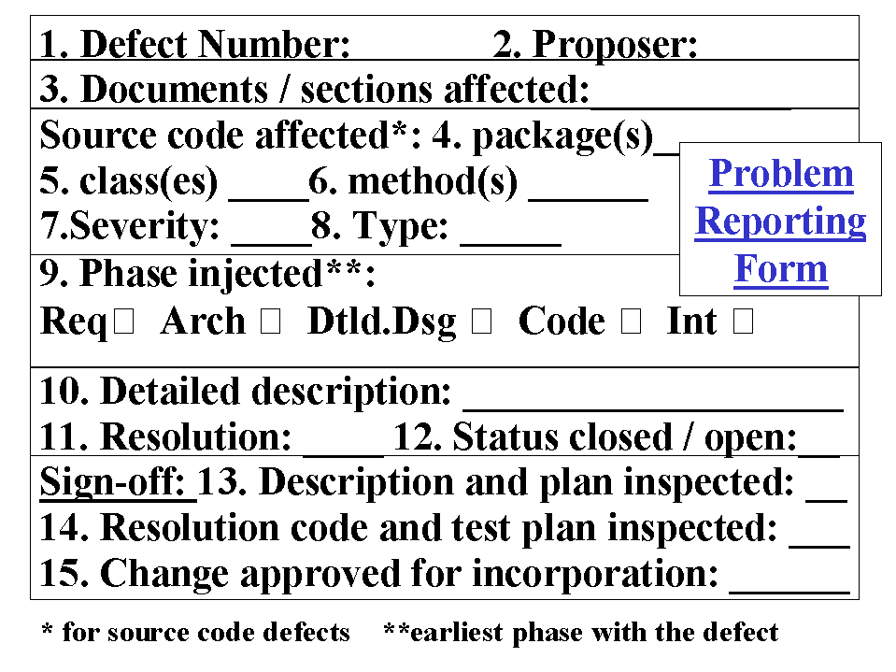
SQAP
Use of checklists to control quality of documents and code
Form to fill when a defect is found:

