Slide 1
Code Liberation Foundation
Physical Games: Class 2
Kinect Introduction

Slide 2
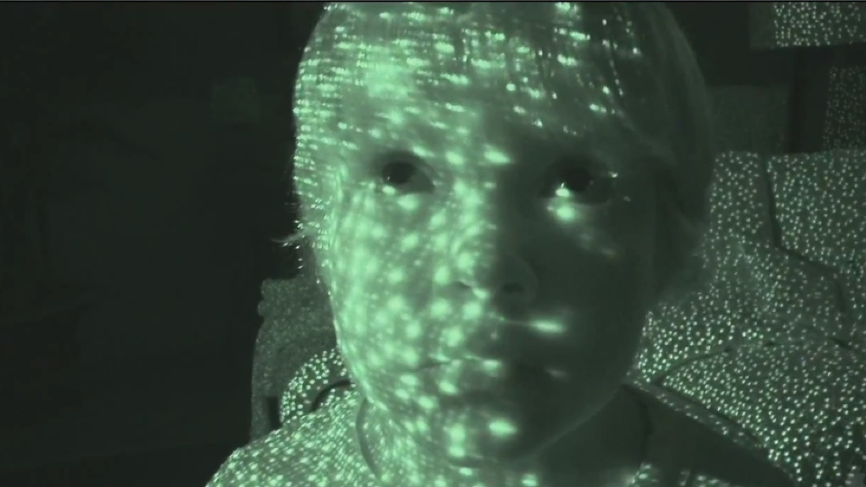
The Kinect
The Kinect 1 uses a reflected light IR grid to track distortion of a grid projected out in IR light into physical space.

Slide 3
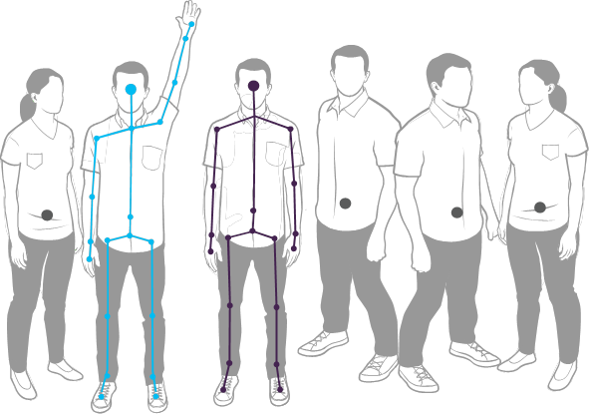
Kinect One Skeleton tracking

Slide 4
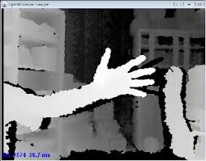
Kinect One Depth Map

Slide 5
Kinect two
Updated the number of users, added orientation, reduced latency, upped the number a joints and changed the tracking methodology to time of flight.
Time of flight is a process of sending an IR blast signal into the world and measuring the bounce back time the light takes to return to the camera. This is FAR more accurate than the first way of tracking and will allow for muscle tracking, as well as skeleton tracking
The Kinect 2 is 1080p where as the Kinect 1 is 640x480

Slide 6
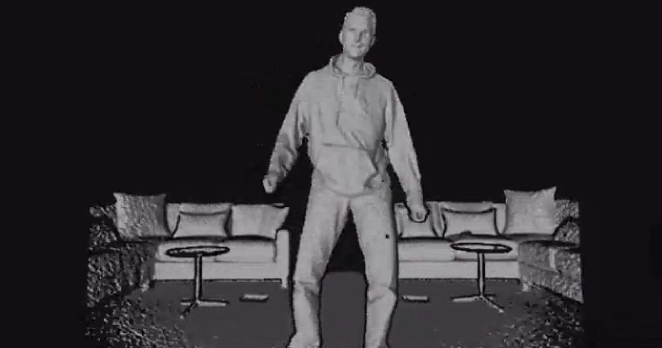
Time of Flight in action

Slide 7
Kinect SDK options
Mac –
Very limited options in ofxKinect which comes with open frameworks has no skeleton tracking but can do video and depth map
OpenNI is dying. It’s very popular still but it’s days are numbered.
https://github.com/gameoverhack/ofxOpenNI
Open NI was an initiative started by Prime Sense, the developers of the first Kinect. It has been slowly losing support as Microsoft has moved to systems that allow for faster, better tracking.
WARNING: You can not use a Kinect that has been plugged into an xbox on a mac ever again. It installs a firmware update that breaks the open source implementation

Slide 8
Bootcamp
Bootcamp is the process of installing Windows on your Mac. It’s highly encouraged if you want to work with modern releases of the Kinect SDK
It does require wiping and reformatting your hard disk to have 2 partitions
http://support.apple.com/kb/ht1461

Slide 9
The windows sdk
The best way to go
The v1 sensor sdk is open source and works with open frameworks
You must download a few things to make this possible:
https://github.com/joshuajnoble/ofxKinectCommonBridge
the of addon. Place this in your addons folder
The Kinect sdk itself
http://www.microsoft.com/en-us/kinectforwindowsdev/Downloads.aspx

Slide 10
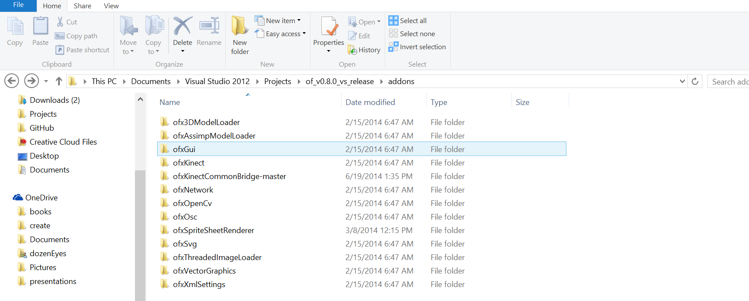
Once you have all of that installed you can add code into your project
Kinect does video, skeleton tracking and depth map tracking
Also you are going to want to use the 8.0 release of open frameworks:
http://openframeworks.cc/download/older.html

Slide 11
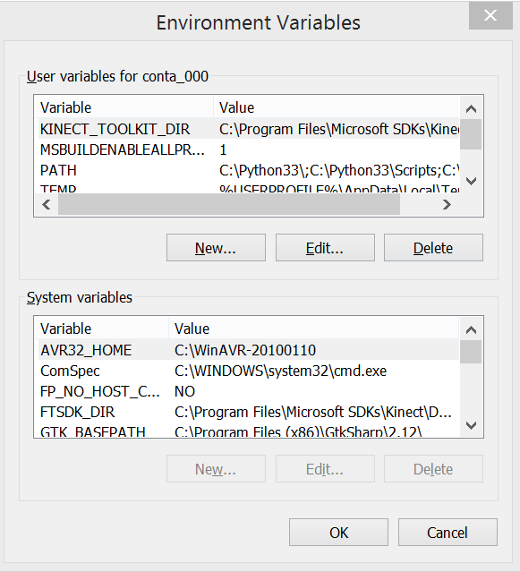
And there’s a bit of setup
You need to add 1 environmental variable to do this hit the windows key and s and search for environmental variables. Choose edit environmental variables…
KINECT_TOOLKIT_DIR
C:\Program Files\Microsoft SDKs\Kinect\Developer Toolkit v1.8.0

Slide 12
Also you need to load a property sheet
In visual studio
Open the Property Manager for your Solution (View > Other Windows > Property Manager)
Right click on your project (e.g. emptyExample) and select Add Existing Property Sheet...
Select the file addons\ofxKinectCommonBridge\ofxKinectCommonBridge.props

Slide 13
Getting started!
It’s very easy to use the open Kinect bridge
We’ll cover the basics but know the sdk is here:
http://msdn.microsoft.com/en-us/library/microsoft.kinect.jointtype.aspx

