Slide 1
Textile Design and code
Or what does math have to do with it

Slide 2
Programming and fiber arts
Both share a history of being “womens’ work”
The fiber arts have long attracted women who were interested in the sciences yet bared out by their male counter parts
Both have contributed extremely expressive ideas into human culture

Slide 3
Women have had a long linage of contributing to the field of mathematics using fiber arts
The same principles you need to code you need to knit
You create a pattern using repeating steps
This is much like running a loop in an algorithm
This tradition has been under documented and needs further academic exploration
The first modern examples I know of start with the Bauhaus

Slide 4
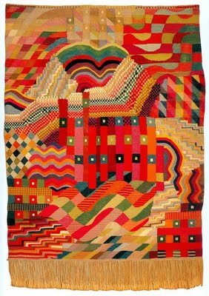
Gunta Stölzl
She applied mathematical principles as well as artistic expression in her work
She led the Bauhaus school of weaving and transitioned it from individual pictorial works to modern industrial designs
Under her guidance the school flourished

Slide 5
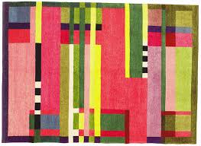
Other examples

Slide 6
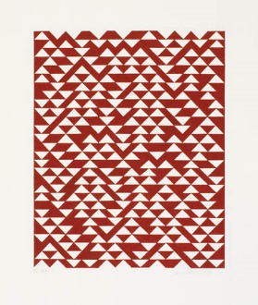
Anni Albers
At Bauhaus she began her first year under Georg Muche and then Johannes Itten. Women were barred from certain disciplines taught at the school, especially architecture, and during her second year, unable to get into a glass workshop with future husband Josef Albers, Anni Albers deferred reluctantly to weaving.

Slide 7
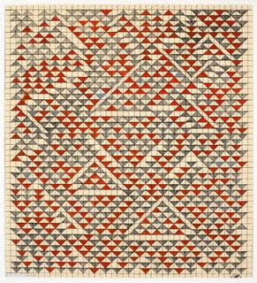
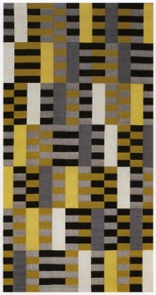

Slide 8
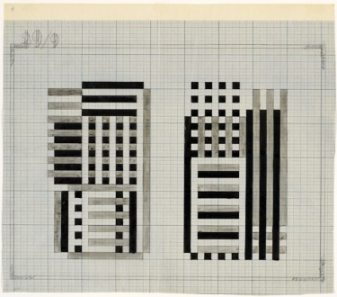

Slide 9
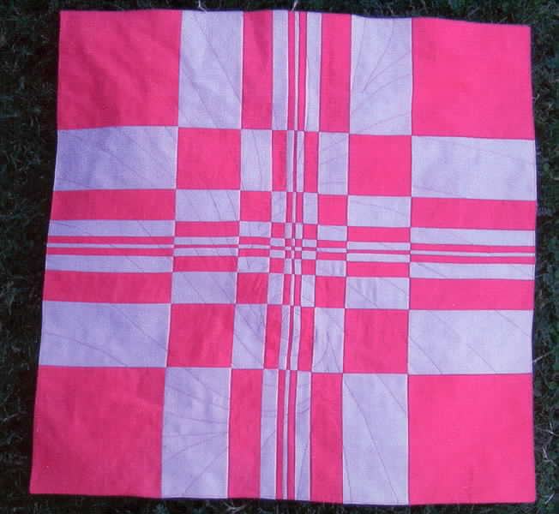
Irena Swanson
Fiber artist who quilts mathematical formulas

Slide 10
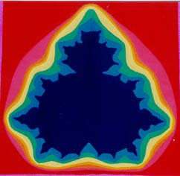

Slide 11
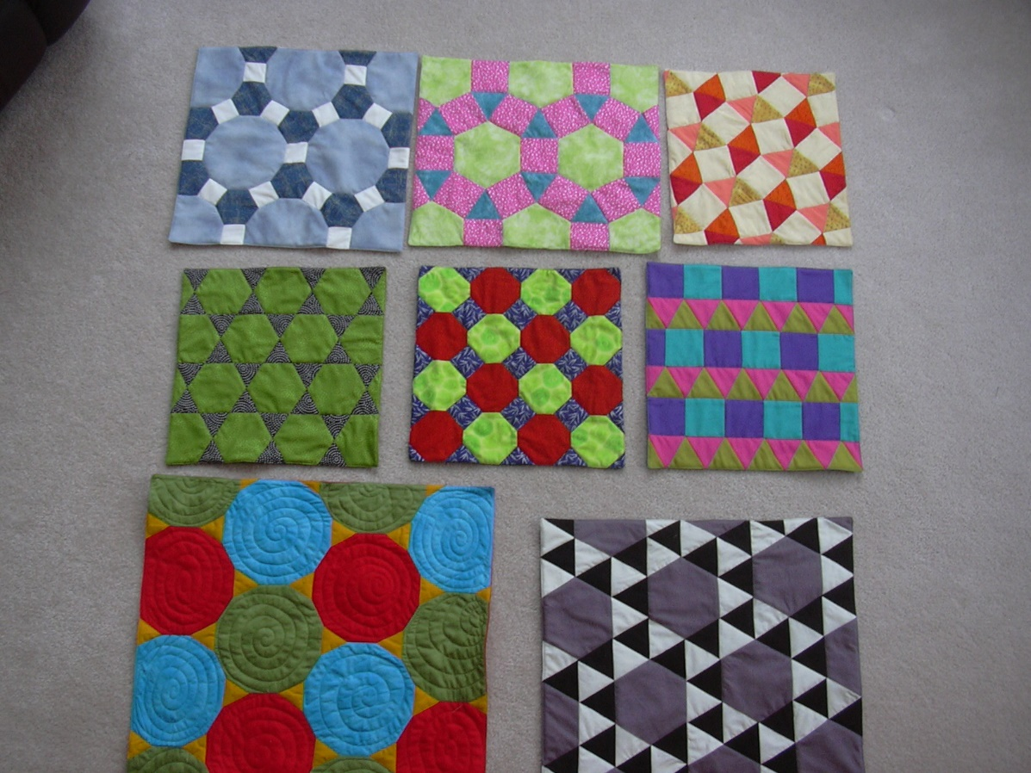

Slide 12
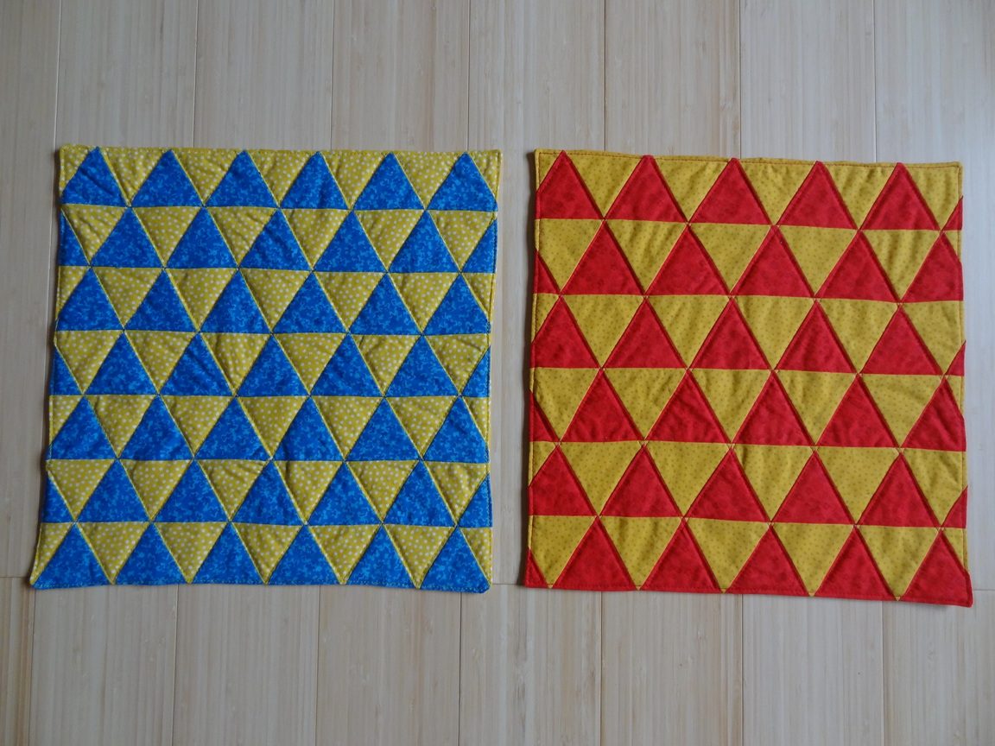

Slide 13
However this has been gong on for a VERY long time
There are "legends" of Hungarian noblewomen practicing the craft of sewing Bargello patterns , including a Hungarian princess marrying into the de Medici family, and a princess Jadwiga (Hedwig) of Hungary who married into the Jagiełło dynasty of Poland.
Bargello is considered particularly challenging, as it requires very precise counting of squares for the mathematical pattern connected with the various motifs to accurately execute designs.
I like to think of them as the first pixel artists

Slide 14
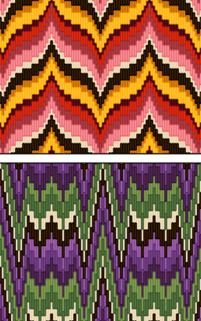

Slide 15
How many undiscovered female mathematicians lurk in our history?

Slide 16
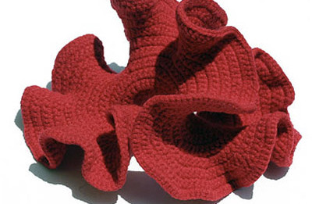
You can even knit 3D geometry
Crocheting Hyperbolic Planes
Here’s a rad class on it by Daina Taimina

Slide 17
And this ask the question….
Can you do it easily? What’s the dirty hack?
Now let’s talk about Splunky….
How do you make a tile map

Slide 18
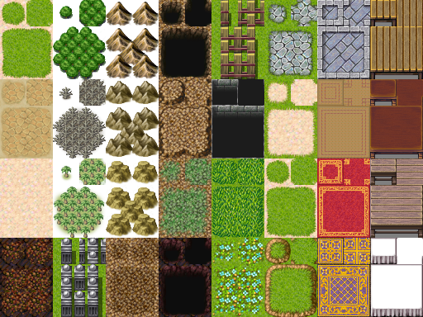
Tile map

Slide 19
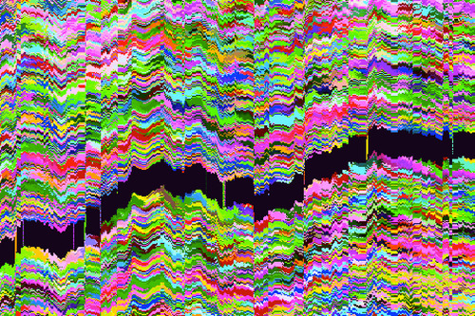
Fun glitch

Slide 20
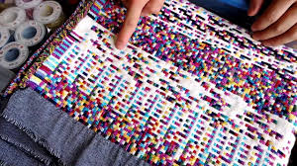
Philip Sterns

