Slide 1


Slide 2
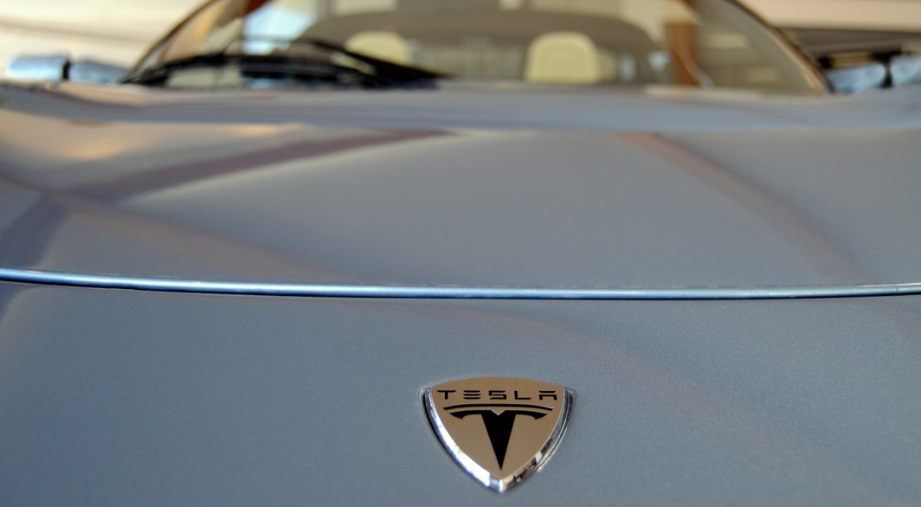
Why does Tesla Motors™ open up the company's patents?
All rights reserved © 2015 Christian Holzl CC BY NC SA 4.0

Slide 3
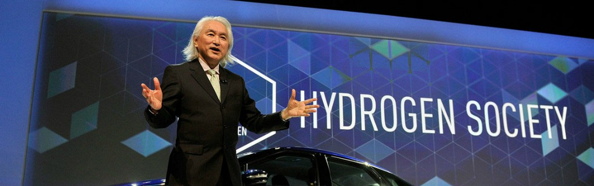
Why did Toyota™ open up its
Hydrogen Patents ?
All rights reserved © 2015 Christian Holzl CC BY NC SA 4.0

Slide 4
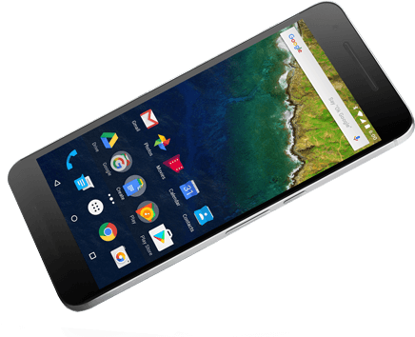

Why does Google™ freely distribute Android™ ?

Slide 5


Why did GlaxoSmithKline™ and Novartis™ submit 300,000 malaria drug leads to public ?

Slide 6

Why does WordPress distribute its software to everybody for free?
All rights reserved © 2018 Christian Holzl CC BY NC SA 4.0

Slide 7

Have they all
Gone Crazy?
All rights reserved © 2018 Christian Holzl CC BY NC SA 4.0

Slide 8

Some Simple Math
All rights reserved © 2018 Christian Holzl CC BY NC SA 4.0

Slide 9
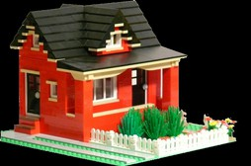
Competitive Paradigm
100 bricks, 1 hour work
100 bricks, 1 hour work
100 bricks, 1 hour work
Cost = 300 bricks, 3 hours work

Slide 10
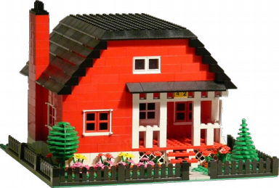
Collaborative Paradigm
Cost = 300 bricks, 3 hours work

Slide 11

Open Source Paradigm!
Cost = 300 bricks, 3 hours work

Slide 12

The Community’s Interest is:
Build around Freely Shared Knowledge

Slide 13

What if I shared all my knowledge for FREE?
Free usage
Free distribution
Free further study
Free modifications
All rights reserved © 2018 Christian Holzl CC BY NC SA 4.0

Slide 14

No, No, No!
If I share my knowledge
I’ll lose all protection
and others will just
steal it!
I want my rights!
All rights reserved © 2018 Christian Holzl CC BY NC SA 4.0

Slide 15
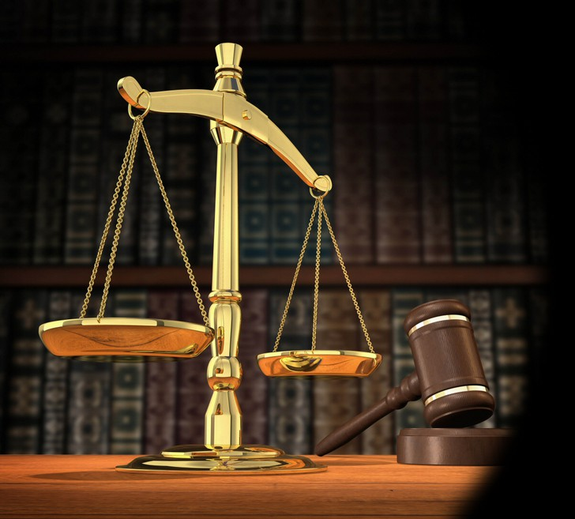
Let’s talk Law
All rights reserved © 2018 Christian Holzl CC BY NC SA 4.0

Slide 16

We need a rule:
That encourages
creators to freely
share their Work
That protects the
integrity of every
single creator
All rights reserved © 2018 Christian Holzl CC BY NC SA 4.0

Slide 17

1. Use Copyrights
Copyright automatically restricts all usages of my work to anyone in more than 200 countries until fifty years after my death!
It is an exclusive Right I can subject to any conditions

Slide 18

2. Set Freedoms
Free Usage
Free Distribution
Free Study
Free Modifications

Slide 19

3. Create a Legal Virus
Obligation to Inherit the license
Obligation to keep all References
Obligation to Share
Irrevocable Acceptance
of all terms and conditions

Slide 20
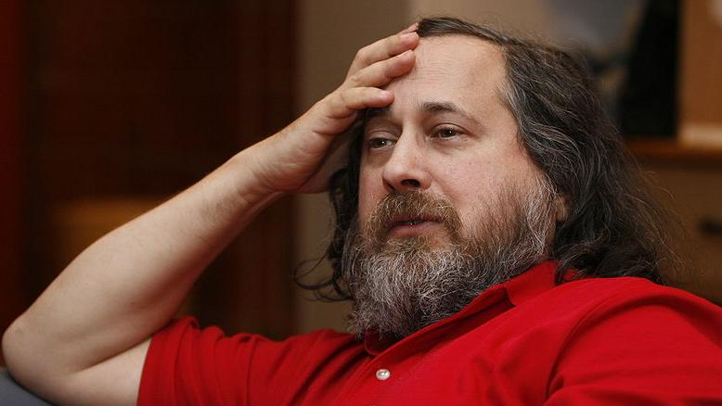

Richard Stallman gnu.org
All rights reserved © 2018 Christian Holzl CC BY NC SA 4.0

Slide 21
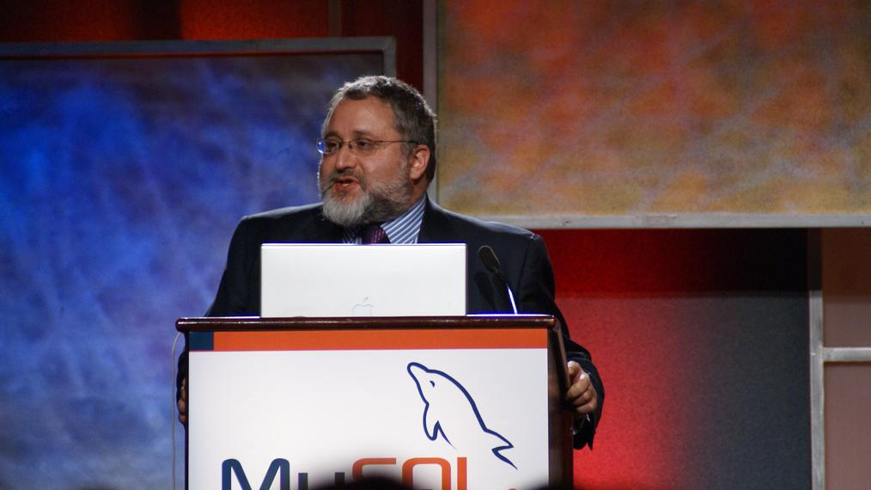
Eben Moglen
Free Software Foundation www.fsf.org
All rights reserved © 2018 Christian Holzl CC BY NC SA 4.0

Slide 22
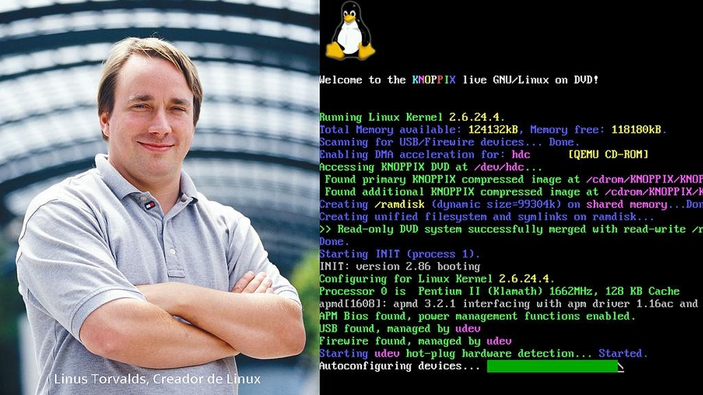
Linus Torvalds
All rights reserved © 2018 Christian Holzl CC BY NC SA 4.0

Slide 23
Examples of Licenses
Software Licenses
GPL1, GPL2, GPL3, LGPL, AGPL, BSD, MIT, Mozilla, Apache, etc.
Hardware Licenses
CERN-OHL, TAPR Open Hardware License, Opencores, Hardware Design Public License, etc.
Document Licenses
Creative Common Licenses: BY, BY-NC, BY-SA, BY-ND BY-NC-SA, BY-NC-ND

Slide 24

Why shoud you use Open Source?
All rights reserved © 2018 Christian Holzl CC BY NC SA 4.0

Slide 25




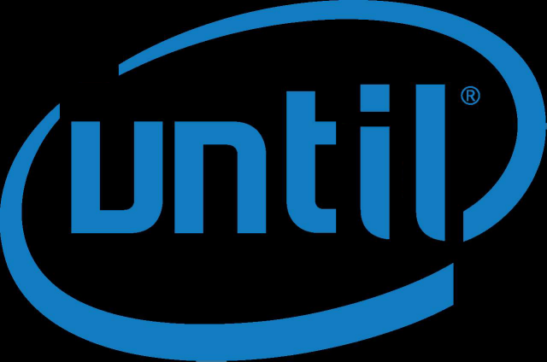

Protected or not, you’ll be copied!

Slide 26
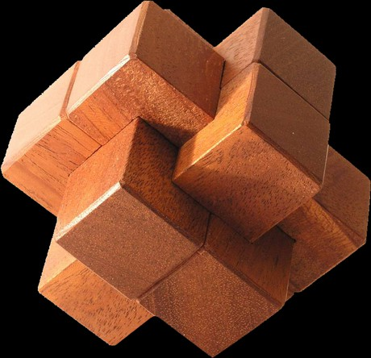
Open Source is not a better protection
It’s just the Best Solution!

Slide 27
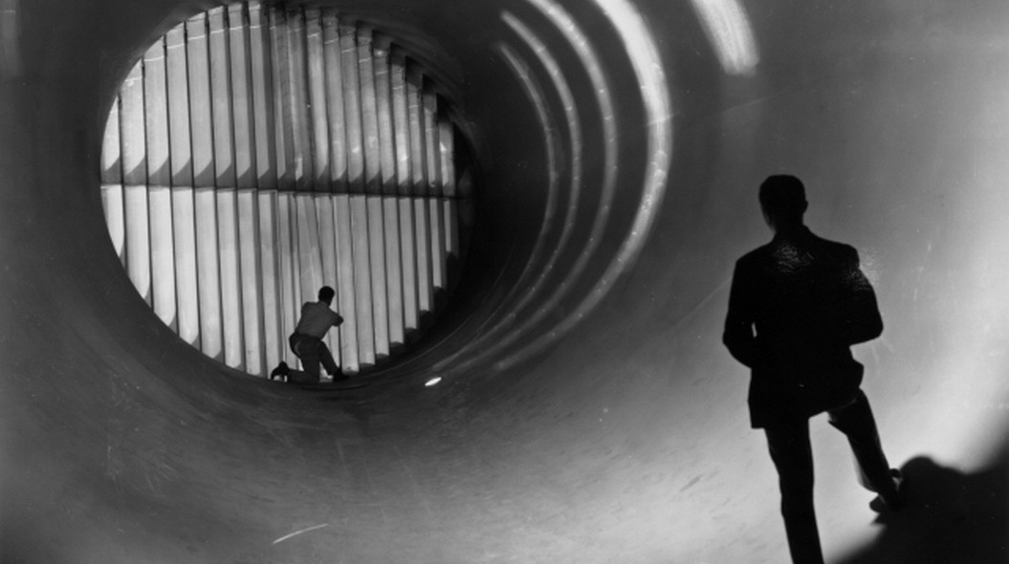
Expertise is Your Asset!
Ideas are free
Sharing them will boost your career
All rights reserved © 2018 Christian Holzl CC BY NC SA 4.0

Slide 28
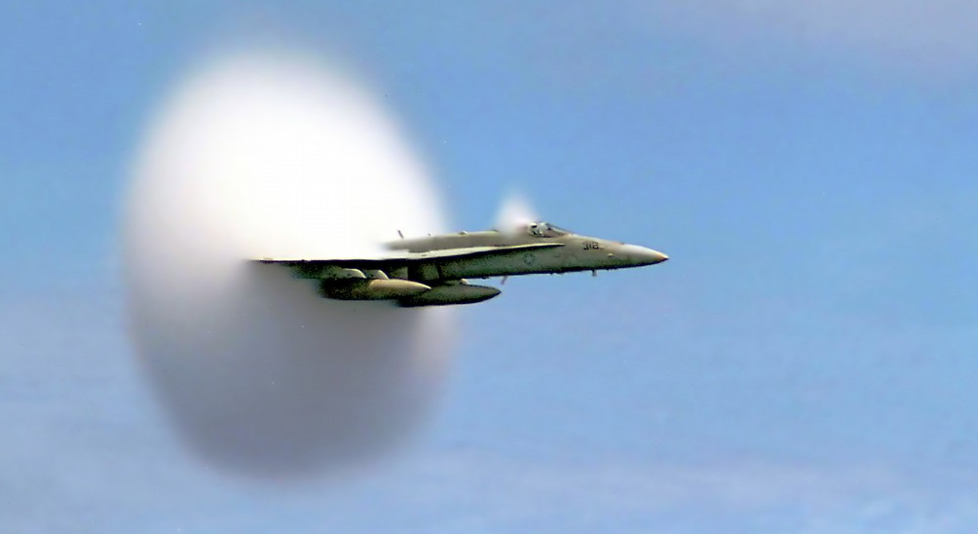
Speed is Your Key!
Sharing will allow you
to reach the market
with the right idea
within the right time
All rights reserved © 2018 Christian Holzl CC BY NC SA 4.0

Slide 29

When will you
Start Sharing?

Slide 30
Thank you for Your Attention
Your remarks and contributions are most welcome at christian@holzl.net
All rights reserved © 2018 Christian Holzl
This document is licensed under Creative Commons Attribution-ShareAlike 4.0 International
Credentials:
Thanks to Erik van der Bij, CERN, Switzerland, for his kind contribution.
Thanks to Victor Kuipers, Switzerland for his accurate questioning.
Thanks to Javier Serrano, CERN Switzerland, for his legal help.
Thanks to David Mazur, CERN Switzerland for his accurate feedback
Images sources: www.yahoo.com under “Public Domain” or “Free to modify share and use commercially” licenses.
Please report possible concerns.

