Slide 1



The Tidyverse!

Slide 2
Overview
This is going to be a ‘play as we learn’ lecture!
Intro to tidyverse – WHY?!
Data import
Data wrangling
Functional programming (escape the for loop)
Visualisation?? (coming up soon)

Slide 3
Install the Tidyverse
WHILE WE ARE TALKING…
install.packages('tidyverse’)
library(tidyverse)
data(starwars)

Slide 4
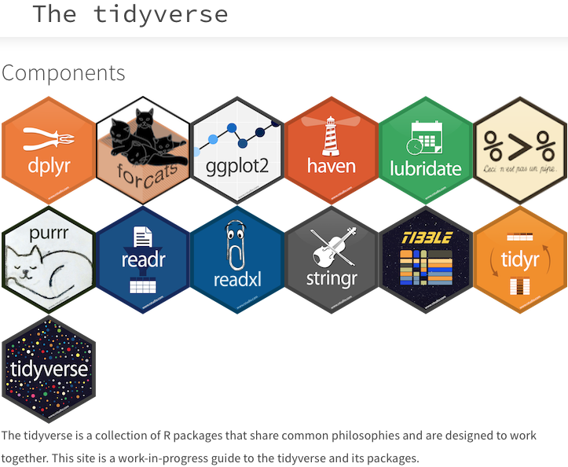
What is the tidyverse

Slide 5
Why?
Why use tidyverse instead of base R??
When importing data, tidyverse functions are FASTER, SMARTER (imports dates, etc…), and do not convert strings to factors
Pipelines (‘%>%’) make code faster to write (and ‘tidier’) and allows for logical stringing of tasks (more EFFICIENT)
tidyverse tables allow for users to more efficiently import and work with BIG DATA
tidyverse is a verified R library (long-term support by Rstudio team guaranteed)

Slide 6
Importing data
Let’s get into it!... Data import
TASK 1: IMPORT the csv ‘tidyverse_dummy_import.csv’ in base R
- Using: sapply(x,class) – what are the column classes?
TASK 2: IMPORT the csv ‘tidyverse_dummy_import.csv’ with the readr::read_csv function
- What are the column classes??
TASK 3: IMPORT the xlsx ‘tidyverse_dummy_import.xslx’ with the readxl::read_xlsx function
- What are the column classes??

Slide 7
Importing data
Let’s get into it!... Data import
TASK 1:
Occurrence_field Number_field Integer_field Text_field Date_field
"integer" "numeric" "integer" "factor" "factor"
TASK 2:
cols(
Occurrence_field = col_double(),
Number_field = col_double(),
Integer_field = col_double(),
Text_field = col_character(),
Date_field = col_character()
)
TASK 3:
# A tibble: 16 x 5
Occurrence_field Number_field Integer_field Text_field Date_field
<dbl> <dbl> <dbl> <chr> <dttm>

Slide 8
Importing data
Let’s get into it!... Data import
you can set column types from the import
readr::read_csv(‘tidyverse_dummy_import.csv’,
col_types=list(Occurrence_field=col_factor()))
readxl::read_xlsx(‘tidyverse_dummy_import.xlsx’,
col_types=c(“guess”,”numeric”,”numeric”,”text”,”date”)))

Slide 9
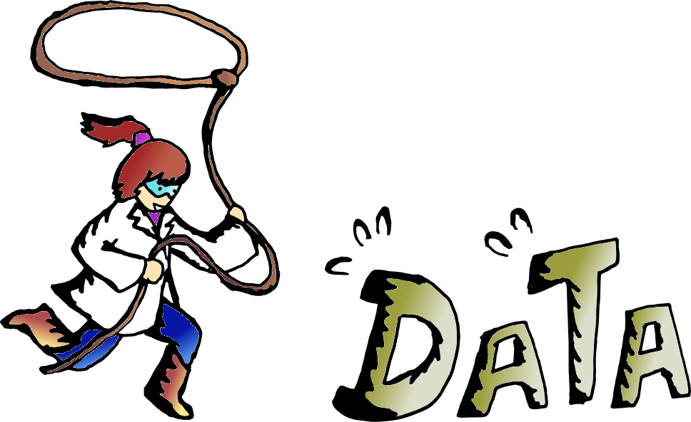
Data wrangling
Data wrangling = the process of cleaning, organizing and structuring data for use in analysis and visualization

Slide 10

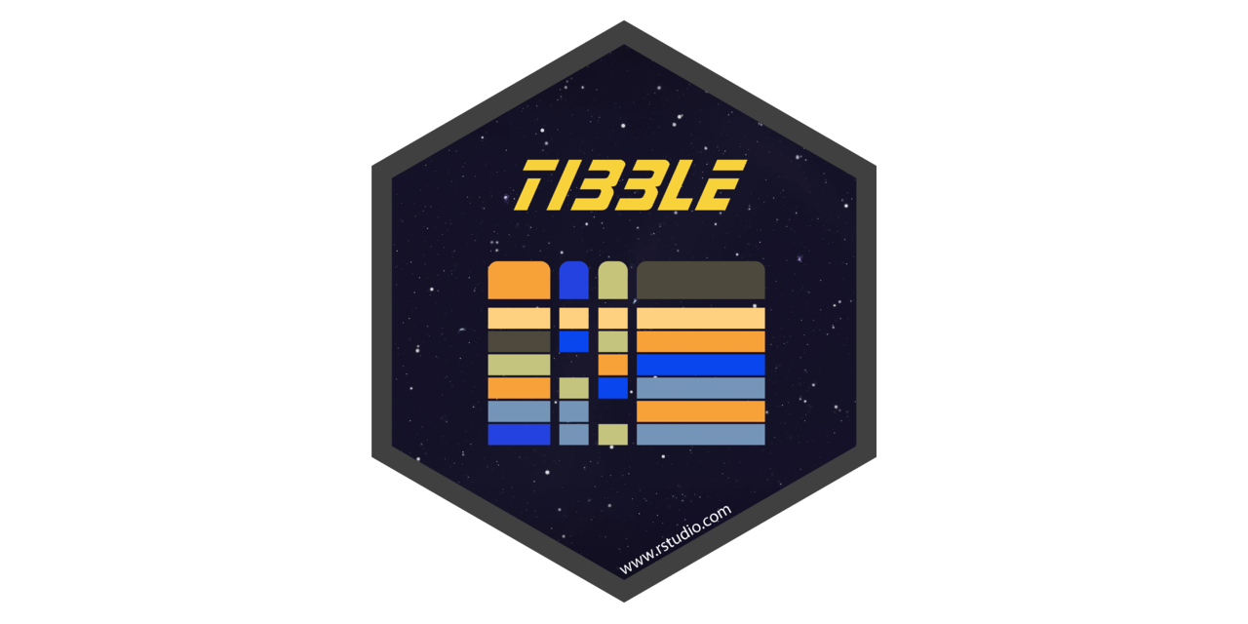
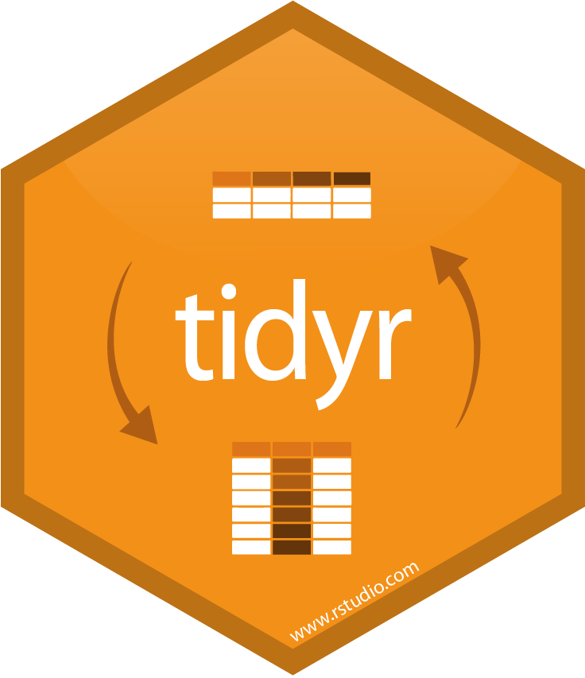
Data wrangling
dplyr: Handles much of the data cleaning (filtering, selecting columns, summarizing, etc..)
Tibble: Table types used by most tidyverse libraries/functions
tidyr: Handles restructuring tibbles (tables) ; pivot tables, etc…

Slide 11
Data wrangling
THE PIPELINE
the key to the tidyverse
%>%
TIBBLE OBJECT %>%
Function1 %>%
Function2 %>%
Function3

Slide 12
Data wrangling
select(): Select columns from your dataset
filter(): Filter out certain rows that meet your criteria(s)
group_by(): Group different observations together such that the original dataset does not change. Only the way it is represented is changed in the form of a list
summarise(): Summarise data based on arguments
arrange(): Arrange your column data in ascending or descending order
join(): Perform left, right, full, and inner joins in R
mutate(): Create new columns by preserving the existing variables

Slide 13
Data wrangling
starwars %>% dplyr::select(name,gender,homeworld)
starwars %>% dplyr::filter(homeworld=='Tatooine’)
starwars %>%
dplyr::select(name,gender,homeworld) %>%
dplyr::filter(homeworld==‘Tatooine’)
What are the r base equivalents?

Slide 14
Data wrangling
Namespace prefixes
some function names are used in multiple packages, e.g. both the dplyr and raster packages have a "select" function
if we have both the raster and dplyr packages loaded, and we just write:
starwars %>% select(name,gender,homeworld)
we can't be certain which "select" function will be used. It will depend on the order in which the packages were loaded
for such functions, it can therefore be useful to use the namespace prefix:
starwars %>% dplyr::select(name,gender,homeworld)

Slide 15
Data wrangling
starwars %>%
group_by(homeworld)
summarise(mean_height = mean(height))
%>%
starwars %>%
group_by(homeworld) %>%
summarise(mean_height = mean(height),
sample_size = n())
starwars %>%
group_by(homeworld,gender) %>%
summarise(mean_height = mean(height),
sample_size = n())
starwars %>%
group_by(homeworld,gender) %>%
summarise(mean_height = mean(height),
sample_size = n()) %>%
dplyr::filter(!is.na(mean_height))

Slide 16
Data wrangling - tasks
YOUR MISSION, should you choose to accept it…
Tasks:
What is the average mass of brown-haired humans in the Star Wars universe? Median mass? Standard deviation?
Who is the tallest non-human character? The shortest?
How many droids (in this dataset) were in “Attack of the clones”? ** Bonus

Slide 17
Data wrangling - tasks
What is the average mass of brown-haired humans in the Star Wars universe? Median mass? Standard deviation?
Who is the tallest non-human character? The shortest?
How many droids (in this dataset) were in “Attack of the clones”? ** Bonus
starwars %>%
group_by(hair_color,species) %>%
summarise(meanmass=mean(mass,na.rm = T),
medmass=median(mass,na.rm = T),
sdmass=sd(mass,na.rm = T)) %>%
filter(species == 'Human',hair_color=='brown')
Mean = 75.5
Med = 78
Sd = 20.8
starwars %>%
filter(species != 'Human') %>%
arrange(height)
starwars %>%
filter(species != 'Human') %>%
arrange(-height)
Yoda
Yarael Poof
starwars %>%
unnest(films) %>%
count(species,films) %>%
filter(species=='Droid',films=='Attack of the Clones')
2

Slide 18
Data wrangling
starwars %>% count(homeworld,gender)
count() is equivalent to: group_by + summarise(n())
starwars %>% unnest(films)
unnest() is a TIDYR function that expands list columns
starwars %>% mutate(hm_ratio = height/mass)
mutate() is a way to add new columns to a tibble

Slide 19
Data wrangling
df1 <- tibble(
category = c('a','a','b','c','c','a','b'),
id = c(1,2,3,4,5,6,7)
)
df2 <- tibble(
category = c('b','a','b','a','a','c','c'),
id = c(7,6,5,4,3,2,1)
)
df1 %>% left_join(df2,by='id’)
# A tibble: 7 x 3
category.x id category.y
<chr> <dbl> <chr>
1 a 1 c
2 a 2 c
3 b 3 a
4 c 4 a
5 c 5 b
6 a 6 a
7 b 7 b

Slide 20
Data wrangling
gather(): The function “gathers” multiple columns from your dataset and converts them into key-value pairs
spread(): This takes two columns and “spreads” them into multiple columns
separate(): As the name suggests, this function helps in separating or splitting a single column into numerous columns
unite(): Works completely opposite to the separate() function. It helps in combining two or more columns into one
nest(): Takes a dataset with a repeating key and condenses the data into a column
unnest(): The opposite of nest(); will split out a list column into its elements

Slide 21
Data wrangling
Gather: Going from WIDE to LONG
sst_data <- data.frame(
time = as.Date('2009-01-01') + 0:9,
unit_A = round(runif(10, 6, 9),2),
unit_B = round(runif(10, 7, 10),2),
unit_C = round(runif(10, 6, 10),2)
)
sst_data %>%
gather(unit,sst,-time)
time unit sst
1 2009-01-01 unit_A 7.61
2 2009-01-02 unit_A 6.87
3 2009-01-03 unit_A 8.65
4 2009-01-04 unit_A 6.59
5 2009-01-05 unit_A 8.17
6 2009-01-06 unit_A 6.09
7 2009-01-07 unit_A 6.66
8 2009-01-08 unit_A 8.72
9 2009-01-09 unit_A 8.28
10 2009-01-10 unit_A 7.09
11 2009-01-01 unit_B 8.61
12 2009-01-02 unit_B 8.67
13 2009-01-03 unit_B 8.42
14 2009-01-04 unit_B 7.55
15 2009-01-05 unit_B 9.06
time unit_A unit_B unit_C
1 2009-01-01 7.61 8.61 7.51
2 2009-01-02 6.87 8.67 8.53
3 2009-01-03 8.65 8.42 6.47
4 2009-01-04 6.59 7.55 6.78
5 2009-01-05 8.17 9.06 9.36
6 2009-01-06 6.09 7.93 9.02

Slide 22
Data wrangling
Spread: Going from LONG to WIDE
sst_data %>%
gather(unit,sst,-time) %>%
spread(unit,sst)
time unit sst
1 2009-01-01 unit_A 7.61
2 2009-01-02 unit_A 6.87
3 2009-01-03 unit_A 8.65
4 2009-01-04 unit_A 6.59
5 2009-01-05 unit_A 8.17
6 2009-01-06 unit_A 6.09
7 2009-01-07 unit_A 6.66
8 2009-01-08 unit_A 8.72
9 2009-01-09 unit_A 8.28
10 2009-01-10 unit_A 7.09
11 2009-01-01 unit_B 8.61
12 2009-01-02 unit_B 8.67
13 2009-01-03 unit_B 8.42
14 2009-01-04 unit_B 7.55
15 2009-01-05 unit_B 9.06
time unit_A unit_B unit_C
1 2009-01-01 7.61 8.61 7.51
2 2009-01-02 6.87 8.67 8.53
3 2009-01-03 8.65 8.42 6.47
4 2009-01-04 6.59 7.55 6.78
5 2009-01-05 8.17 9.06 9.36
6 2009-01-06 6.09 7.93 9.02

Slide 23
Data wrangling
The nest: dataframes in columns??
nested_sst <- sst_data %>%
gather(unit,sst,-time) %>%
nest(unit,sst)
# A tibble: 10 x 2
time data
<date> <list>
1 2009-01-01 <tibble [3 x 2]>
2 2009-01-02 <tibble [3 x 2]>
3 2009-01-03 <tibble [3 x 2]>
nested_sst$data[[1]]
# A tibble: 3 x 2
unit sst
<chr> <dbl>
1 unit_A 7.61
2 unit_B 8.61
3 unit_C 7.51
unnest() is the reverse
Why would we do this?? – functional programming :D

Slide 24
Data wrangling - tasks
Another mission!
film.rankings <- tibble(
films = c('The Phantom Menace','Attack of the Clones','Revenge of the Sith',
'A New Hope','The Empire Strikes Back','Return of the Jedi',
'The Force Awakens'),
rank = c(7,6,5,3,4,1,2)
)
What films does the character Plo Koon appear in, ordered by rank? The final result should be a single table drawn from a list column. (hint: use these functions in order: select(), unnest(), left_join(),arrange(),nest(),filter() -> store in a variable called ‘Plo.Koon’)
Create a table that nests height and mass data for only humans in a column nested by film name. (hint: you will need unnest(), nest(), filter() and select() ) -> store in a variable called ‘nested.mass.height’

Slide 25
Data wrangling - tasks
What films does the character Plo Koon appear in, ordered by rank? The final result should be a single table drawn from a list column. (hint: use these functions in order: select(), unnest(), left_join(),arrange(),nest(),filter() -> store in a variable called ‘Plo.Koon’)
Plo.Koon <-starwars %>%
select(name,films) %>%
unnest(films) %>%
left_join(film.rankings,by='films') %>%
arrange(name,rank) %>%
nest(films,rank) %>%
filter(name == 'Plo Koon’)
Plo.Koon$data[[1]]
# A tibble: 3 x 2
films rank
<chr> <dbl>
1 Revenge of the Sith 5
2 Attack of the Clones 6
3 The Phantom Menace 7

Slide 26
Data wrangling - tasks
Create a table that nests height and mass data for only humans in a column nested by film name. (hint: you will need unnest(), nest(), filter() and select() ) -> store in a variable called ‘nested.mass.height’
nested.mass.height <- starwars %>%
unnest(films)%>%
select(name,height,mass,films,species) %>%
filter(species=='Human')%>%
nest(name,height,mass)
# A tibble: 7 x 3
films species data
<chr> <chr> <list>
1 Revenge of the Sith Human <tibble [14 x 3]>
2 Return of the Jedi Human <tibble [11 x 3]>
3 The Empire Strikes Back Human <tibble [10 x 3]>
4 A New Hope Human <tibble [12 x 3]>
5 The Force Awakens Human <tibble [6 x 3]>
6 Attack of the Clones Human <tibble [17 x 3]>
7 The Phantom Menace Human <tibble [8 x 3]>

Slide 27

Functional programming
Functional programming through the tidyverse means we can quickly explore patterns in datasets!
For this last bit, we’re going to work together! So code along.
Our task is going to be to look at the relationship between mass and height for humans in each of the 7 Star Wars films. (we’ll keep it simple and use a linear model!)
map()-> This function will ‘map’ a function across a list! Essentially replaces the for-loop inside of tidyverse (similar to lapply).
X <- c(list(seq(1,50,5)),list(seq(40,100,2)))
lapply(X,mean) # in base R
map(X,mean) # in tidyverse

Slide 28
Functional programming
# The tibble we created in the last task
nested.mass.height$data[[1]]
# A tibble: 14 x 3
name height mass
<chr> <int> <dbl>
1 Luke Skywalker 172 77
2 Darth Vader 202 136
3 Leia Organa 150 49
4 Owen Lars 178 120
5 Beru Whitesun lars 165 75
6 Obi-Wan Kenobi 182 77
7 Anakin Skywalker 188 84
8 Wilhuff Tarkin 180 NA
9 Palpatine 170 75

Slide 29
Functional programming
nested.mass.height %>%
mutate(
model = map(
data,~lm(mass~height,data=.x)
),
slope = map_dbl(
model, ~coef(.x)['height']
),
r.sq = map_dbl(
model,~glance(.x)$'r.squared'
),
sample_size = map_dbl(
data,~nrow(.x)
),
tallest = map(
data,~.x[which.max(.x$height),'name']
),
heaviest = map(
data,~.x[which.max(.x$mass),'name']
)
) %>%
unnest(tallest,heaviest) %>%
rename(tallest=name,heaviest=name1)
Create new columns to store output
Run a linear model function over lists
Extract some model information (r squared, slope, sample size)
How would we get the tallest human in each film?
Now we tidy up the output

Slide 30
Functional programming
# A tibble: 7 x 9
films species data model slope r.sq sample_size tallest heaviest
<chr> <chr> <list> <list> <dbl> <dbl> <dbl> <chr> <chr>
1 Revenge of the Sith Human <tibble [14 x 3]> <S3: lm> 1.21 0.494 14 Darth Vader Darth Vader
2 Return of the Jedi Human <tibble [11 x 3]> <S3: lm> 1.48 0.820 11 Darth Vader Darth Vader
3 The Empire Strikes Back Human <tibble [10 x 3]> <S3: lm> 1.48 0.820 10 Darth Vader Darth Vader
4 A New Hope Human <tibble [12 x 3]> <S3: lm> 1.38 0.557 12 Darth Vader Darth Vader
5 The Force Awakens Human <tibble [6 x 3]> <S3: lm> 1.08 0.971 6 Han Solo Han Solo
6 Attack of the Clones Human <tibble [17 x 3]> <S3: lm> 0.718 0.157 17 Dooku Owen Lars
7 The Phantom Menace Human <tibble [8 x 3]> <S3: lm> 1.25 0.771 8 Qui-Gon Jinn Qui-Gon Jinn

Slide 31
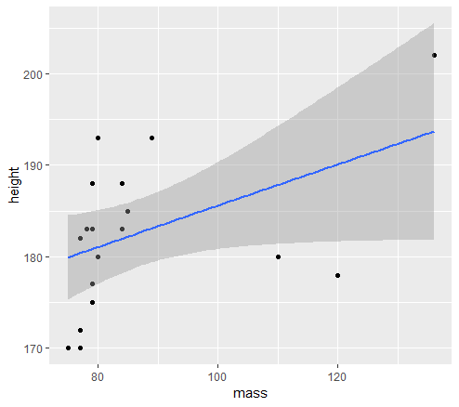
Briefly: Visualisation
%>% usage looks very similar to the usage in ggplot2!
That’s because it is!! You can pipe ggplot2 directly from any tidyverse tibbles!
starwars %>%
filter(species=='Human',gender=='male') %>%
ggplot(aes(x=mass,y=height))+
geom_point()+
geom_smooth(method=lm)
MORE ON VISUALISATIONS LATER!!!

Slide 32

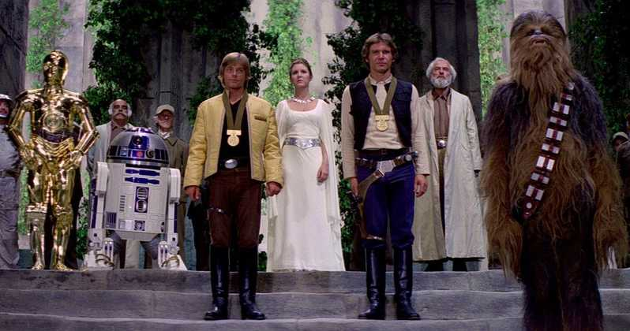
THANKS
QUESTIONS?

