Slide 1

Machine Learning Project
Liu Diwei Zhang Yuankun Li Sirui XU Weiqin | 1155180373 1155179170 1155180231 1155180197
Notes:
根据姓名首字母排序

Slide 2

1
Dataset Processing
2
models
3
Training and Testing

Slide 3

1.1 Dataset Processing
In Rdata set, there are data of cpi, ppi, X and fake.testing.X. In order to do coding conveniently, I load Rdata in R and output 4 dataframe to csv files and read such csv files in python.
After that, I use cpi and ppi data to compute inflation rate separately, which are the target values we need to predict.

Slide 4
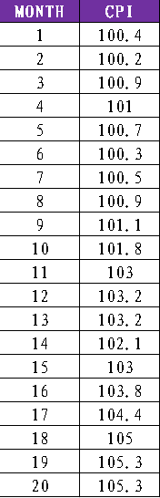
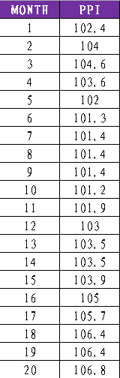
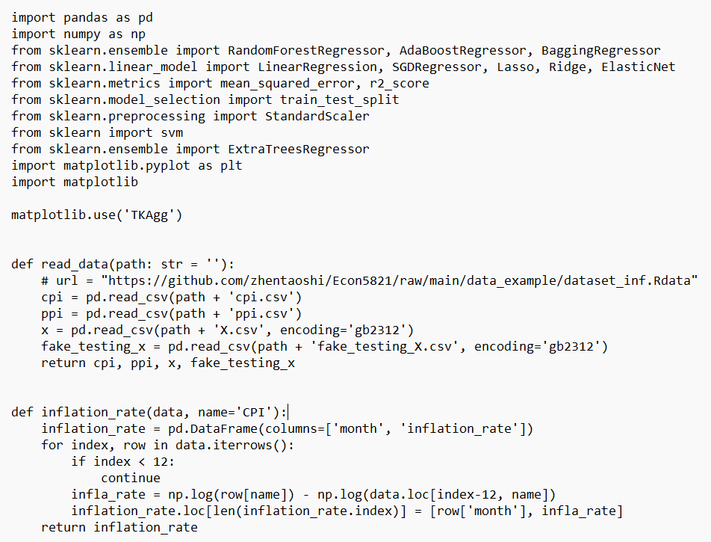
1.2 The dataset of CPI&PPI
CPI
In economics, CPI is an index of price changes that reflects the prices of products and services related to residents' lives.
PPI
PPI is the relative number of price changes when the products of industrial enterprises are sold for the first time in a certain period of time.
……
……

Slide 5
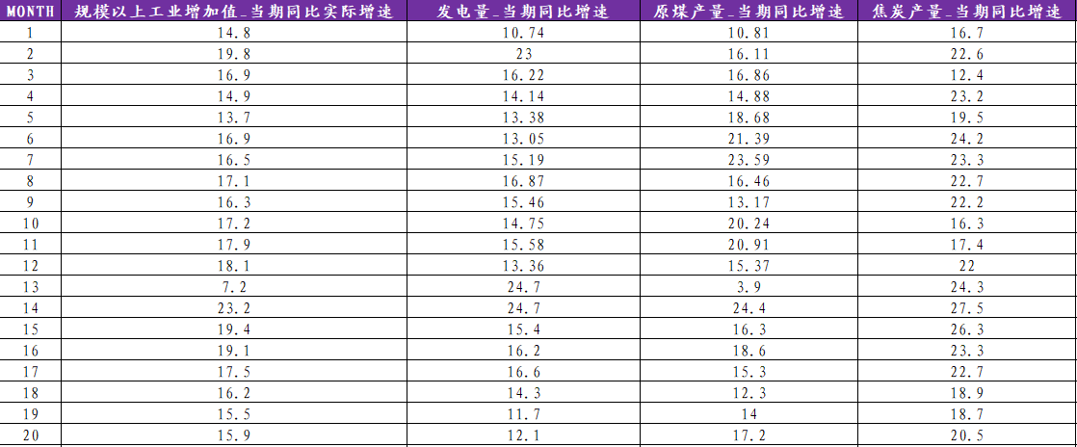
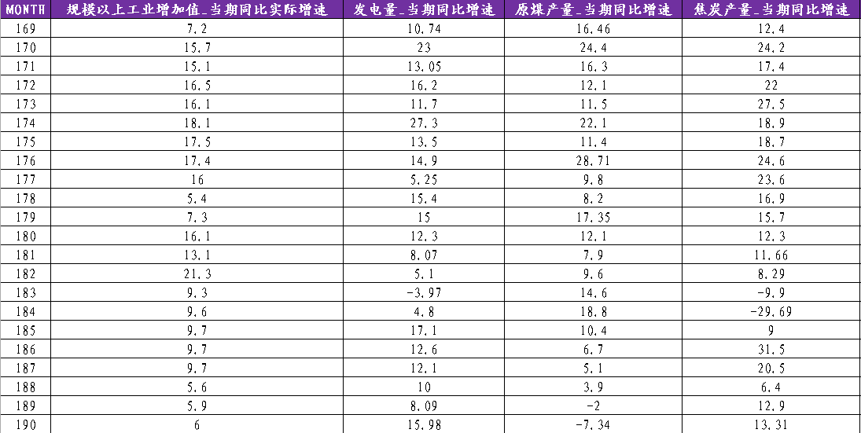
1.2 The dataset of X&fake.testing.X
The dataset of X
……
The dataset of fake.testing.X
……

Slide 6
2
Models

Slide 7
2.1 Inflation rate by cpi
What is CPI
The Consumer Price Index (CPI), also known as the consumer price index (CPI), is a measure of the price of a fixed basket of consumer goods, mainly reflecting the change in the price paid by consumers for goods and services. It is also a tool to measure inflation, expressed as a percentage change.
Consumer price statistics survey is the final price of social products and services. On the one hand, it is closely related to the people's life, and at the same time, it also plays an important role in the price system of the whole national economy. It is an important indicator for economic analysis and decision-making, general price level monitoring and regulation and national economic accounting. Its rate of change reflects, to some extent, the degree of inflation or deflation. Generally speaking, an overall, contrasting and sustained rise in prices is considered to be inflation.

Slide 8
2.1 Inflation rate by cpi
Decision tree algorithm
Decision tree is a prediction model, which represents a mapping relationship between object attributes and object values. Each node in the tree represents an object, each fork path represents a possible attribute value, and each leaf node represents the value of the object on the path taken from the root node to that leaf node.
An advantage of the decision tree algorithm is that it does not require any transformation of the features if we are dealing with nonlinear data.
Random forest algorithm
The random forest algorithm is an ensemble technique that combines multiple decision trees. A random forest usually has a better generalization performance than an individual decision tree due to randomness, which helps to decrease the model's variance. Other advantages of random forests are that they are less sensitive to outliers in the dataset and don't require much parameter tuning. The only parameter in random forests that we typically need to experiment with is the number of trees in the ensemble.
To be more specific, Extra Trees are the improved method to solve a large number of features.
This method adds an extra level of randomization. It not only selects for each tree a different, random subset of features, but also randomly selects the threshold for each decision.
.

Slide 9
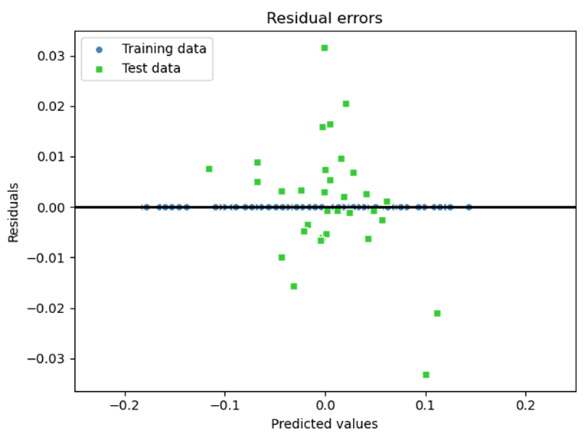
2.1 Inflation rate by cpi
Result
MSE train: 0.00000
test: 0.00015
R^2 train: 1.00000
test: 0.90553
Explaination
Number of the variables=151 (except Month), too many predictors may cause overfitting and provide extremely close results for testing data, thus the MSE for this extra random forest model is pretty small.
R^2 of out of sample data is 0.90553, which means the model has provided enough information for further prediction.

Slide 10
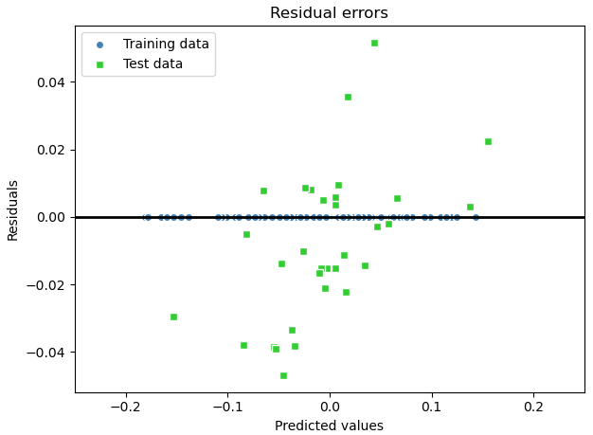
2.2 First try by ppi
2.2.1 First try by linear regression
ppi:
The Producer Price Index (PPI) measures the average change over time in the prices domestic producers receive for their output. It is a measure of inflation at the wholesale level that is compiled from thousands of indexes measuring producer prices by industry and product category.
Method:
Try OLS linear regression to predict inflation rate by ppi. The cost function is Gradient Descent.
Result:
MSE train: 0.000, test: 0.001
R^2 train: 1.000, test: 0.789
We can see that R^2 of training data is very well but test data is 0.789, which is overfitting. To solve the problem, we try to use regularized methods for regression.

Slide 11
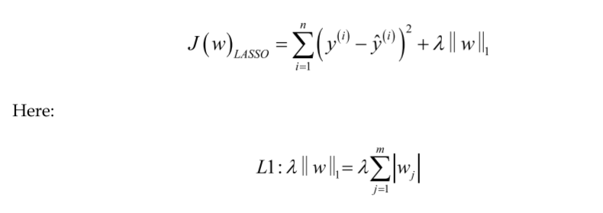
2.2 First try by ppi
2.2.2 Tackle overfitting by LASSO
How to tackle:
Regularization is one approach to tackle the problem of overfitting by adding additional information, and thereby shrinking the parameter values of the model to induce a penalty against complexity. The most popular approaches to regularized linear regression are the so-called Ridge Regression, Least Absolute Shrinkage and Selection Operator (LASSO), and Elastic Net.
Because of up to 167 features in x, LASSO is a better approaches. Depending on the regularization strength, certain weights can become zero, which also makes LASSO useful as a supervised feature selection technique.

Slide 12
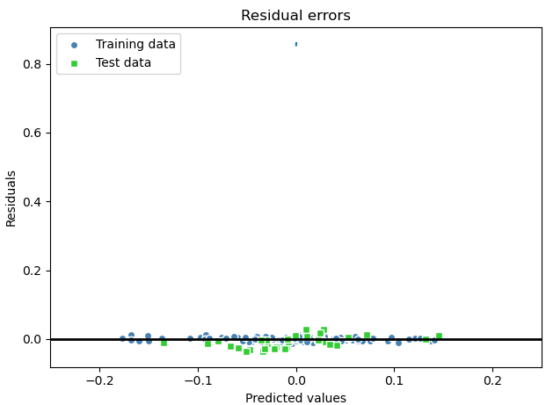
2.2 First try by ppi
2.2.2 Tackle overfitting by LASSO
Result:
The best alpha for Lasso is 0.0002.
MSE train: 0.000, test: 0.000
R^2 train: 0.992, test: 0.860
We can see that R^2 of out of sample data is 0.86, which is better than linear regression. The overfitting problem can be improved.

Slide 13
3
Training and Testing

Slide 14
3. Training and Testing
To test the model, we use train_test_split to split dataset to 80% of training data and 20% of test data. Features that are fitted by linear regression models will be scaled to normalized values in order to fit the model requirement.
To achieve the ultimate output of the exercise, we can use TestingFinal function, which is updated with best machine learning model, with the input fake.testing.X and will return 30 values as its forecast of the inflation rates according to CPI and another 30 values as its forecast of inflation rates according to PPI.
Since the true.testing.X will be shared with us in the early morning of May 19, to replace fake.testing.X. Then we will update the 60 forecast values.
^{Code：}
^{import pandas as pd}
^{import numpy as np}
from sklearn.ensemble import RandomForestRegressor, AdaBoostRegressor, BaggingRegressor
from sklearn.linear_model import LinearRegression, SGDRegressor, Lasso, Ridge, ElasticNet
from sklearn.metrics import mean_squared_error, r2_score
from sklearn.model_selection import train_test_split
from sklearn.preprocessing import StandardScaler
^{from sklearn import svm}
from sklearn.ensemble import ExtraTreesRegressor
import matplotlib.pyplot as plt
^{import matplotlib}
^{matplotlib.use('TKAgg')}

Slide 15
3. Training and Testing
^{def read_data(path: str = ''):}
# url = "https://github.com/zhentaoshi/Econ5821/raw/main/data_example/dataset_inf.Rdata"
cpi = pd.read_csv(path + 'cpi.csv')
ppi = pd.read_csv(path + 'ppi.csv')
x = pd.read_csv(path + 'X.csv', encoding='gb2312')
fake_testing_x = pd.read_csv(path + 'fake_testing_X.csv', encoding='gb2312')
return cpi, ppi, x, fake_testing_x
def inflation_rate(data, name='CPI'):
inflation_rate = pd.DataFrame(columns=['month', 'inflation_rate'])
for index, row in data.iterrows():
^{if index < 12:}
^{continue}
infla_rate = np.log(row[name]) - np.log(data.loc[index-12, name])
inflation_rate.loc[len(inflation_rate.index)] = [row['month'], infla_rate]
^{return inflation_rate}
def evaluate_training_data(y_train, y_train_pred, y_test, y_test_pred, **kwargs):
plt.scatter(y_train_pred, y_train_pred - y_train, c='steelblue', marker='o', edgecolor='white',
^{label='Training data')}
plt.scatter(y_test_pred, y_test_pred - y_test, c='limegreen', marker='s', edgecolor='white', label='Test data')
^{plt.xlabel('Predicted values')}
^{plt.ylabel('Residuals')}
^{plt.legend(loc='upper left')}
^{plt.title('Residual errors')}
plt.hlines(y=0, xmin=-1, xmax=1, color='black', lw=2)
^{plt.xlim([-0.25, 0.25])}
^{plt.tight_layout()}
^{plt.show()}
def train_and_evaluate(model, x_train, x_test, y_train, y_test, plot=False, **kwargs):
^{model.fit(x_train, y_train)}
y_train_pred, y_test_pred = model.predict(x_train), model.predict(x_test)
^{if plot:}
evaluate_training_data(y_train, y_train_pred, y_test, y_test_pred, **kwargs)
print('MSE train: %.3f, test: %.3f' % (mean_squared_error(y_train, y_train_pred),
mean_squared_error(y_test, y_test_pred)))
print('R^2 train: %.3f, test: %.3f' % (r2_score(y_train, y_train_pred), r2_score(y_test, y_test_pred)))

Slide 16
3. Training and Testing
def RegularizedRegression(x_train, x_test, y_train, y_test, model='lasso', begin=0.01, end=1.0, seq=0.01, plot=True,
^{l1_ratio=0.5, **kwargs):}
krange = np.arange(begin, end, seq)
train_scores, test_scores = [], []
^{if model == 'lasso':}
^{api = Lasso}
^{elif model == 'ridge':}
^{api = Ridge}
^{else:}
^{api = ElasticNet}
^{for k in krange:}
model_ = api(alpha=k, l1_ratio=l1_ratio) if model == 'elasticnet' else api(alpha=k)
^{model_.fit(x_train, y_train)}
y_train_pred = model_.predict(x_train)
y_test_pred = model_.predict(x_test)
train_score, test_score = model_.score(x_train, y_train), model_.score(x_test, y_test)
train_scores.append(train_score)
^{test_scores.append(test_score)}
index = test_scores.index(max(test_scores))
best_alpha = index * seq + begin
^{if plot:}
^{plt.plot(krange, test_scores)}
^{plt.xlabel('Alpha values')}
plt.ylabel('R^2 of Lasso regression')
plt.title('R^2 with different alpha value using Lasso regression')
^{plt.xlim([-end / 10, end])}
^{plt.show()}
print('Lasso:Best alpha=', best_alpha, ' R^2=', '%.3f' % max(test_scores))
best_model = api(alpha=best_alpha, l1_ratio=l1_ratio) if model == 'elasticnet' else api(alpha=best_alpha)
^{return api(alpha=best_alpha)}
def Training(x_train, y_train, model, scale=True, **kwargs):
^{if scale:}
^{scaler = StandardScaler()}
x_train = scaler.fit_transform(x_train)
^{model.fit(x_train, y_train)}
^{return model}
def Testing(fake_testing_x, model, **kwargs):
x_test = fake_testing_x.iloc[:, 1:]
^{scaler = StandardScaler()}
x_test_std = scaler.fit_transform(x_test)
y_test_pred = model.predict(x_test_std)
^{return y_test_pred}
def TestingFinal(fake_testing_x, path=''):
^{# read_data}
cpi, ppi, x, _ = read_data(path)
x_train = x.iloc[12:, 1:].values

Slide 17
3. Training and Testing
def TestingFinal(fake_testing_x, path=''):
^{# read_data}
cpi, ppi, x, _ = read_data(path)
x_train = x.iloc[12:, 1:].values
^{# inflation by cpi}
^{# Train by Extra Trees}
inflation_rate_by_cpi = inflation_rate(cpi, 'CPI')
y_train = inflation_rate_by_cpi['inflation_rate'].values
model = ExtraTreesRegressor(n_estimators=100, random_state=1)
model = Training(x_train, y_train, model, scale=False)
cpi_pred = Testing(fake_testing_x, model)
^{# inflation by ppi}
^{# Train by Lasso Regression}
inflation_rate_by_ppi = inflation_rate(ppi, 'PPI')
y_train = inflation_rate_by_ppi['inflation_rate'].values
^{model = Lasso(alpha=0.0002)}
model = Training(x_train, y_train, model)
ppi_pred = Testing(fake_testing_x, model)
^{# outcomes}
outcomes = pd.DataFrame(columns=['CPI', 'PPI'])
outcomes['CPI'], outcomes['PPI'] = cpi_pred, ppi_pred
^{return outcomes}
^{def test():}
_, _, _, fake_testing_x = read_data()
ans = TestingFinal(fake_testing_x, path='')
^{if __name__ == '__main__':}
^{# Load all data}
^{path = ''}
cpi, ppi, x, fake_testing_x = read_data(path)
inflation_rate_by_cpi = inflation_rate(cpi, 'CPI')
inflation_rate_by_ppi = inflation_rate(ppi, 'PPI')
^{# Choose predictors}
x_train = x.iloc[12:, 1:].values
^{# Inflation rate by cpi}
y_train = inflation_rate_by_cpi['inflation_rate'].values
^{# Inflation rate by ppi}
y_train = inflation_rate_by_ppi['inflation_rate'].values
^{# Train Test Split}
x_train, x_test, y_train, y_test = train_test_split(x_train, y_train, test_size=0.2, random_state=1)
^{# Training}
^{scaler = StandardScaler()}
x_train_std, x_test_std = scaler.fit_transform(x_train), scaler.fit_transform(x_test)
^{# RandomForest Model}
forest = RandomForestRegressor(n_estimators=51, criterion='mse', random_state=1, n_jobs=-1, max_depth=5)
train_and_evaluate(forest, x_train, x_test, y_train, y_test)

Slide 18
3. Training and Testing
^{# Linear Regression}
^{linear = LinearRegression()}
train_and_evaluate(linear, x_train_std, x_test_std, y_train, y_test)
^{# SVM Model}
^{# rbf}
rbf = svm.SVR(kernel="rbf", C=1)
train_and_evaluate(rbf, x_train_std, x_test_std, y_train, y_test)
^{# poly}
^{poly = svm.SVR(kernel="poly")}
train_and_evaluate(poly, x_train_std, x_test_std, y_train, y_test)
^{# linear}
svm_linear = svm.SVR(kernel="linear")
train_and_evaluate(svm_linear, x_train_std, x_test_std, y_train, y_test)
^{# Adaboosting for RandomForest}
ada = AdaBoostRegressor(base_estimator=forest, n_estimators=100, learning_rate=0.2, random_state=1)
train_and_evaluate(ada, x_train_std, x_test_std, y_train, y_test)
# Bagging for Linear Regression
bag = BaggingRegressor(base_estimator=linear, n_estimators=50, max_samples=75, max_features=100, bootstrap=True,
bootstrap_features=False, n_jobs=-1, random_state=1)
train_and_evaluate(bag, x_train_std, x_test_std, y_train, y_test)
^{# SGD regressor}
^{sgd = SGDRegressor()}
train_and_evaluate(sgd, x_train_std, x_test_std, y_train, y_test)
^{# Lasso -- best for ppi}
lasso = RegularizedRegression(x_train_std, x_test_std, y_train, y_test, begin=0.0001, end=0.0003, seq=0.00001)
train_and_evaluate(lasso, x_train_std, x_test_std, y_train, y_test)
^{# Ridge}
ridge = RegularizedRegression(x_train_std, x_test_std, y_train, y_test, model='ridge', begin=0.01, end=2, seq=0.01)
train_and_evaluate(ridge, x_train_std, x_test_std, y_train, y_test)
^{# ElasticNet}
elastic = RegularizedRegression(x_train_std, x_test_std, y_train, y_test, model='elasticnet', begin=0.01, end=2,
^{seq=0.01)}
train_and_evaluate(elastic, x_train_std, x_test_std, y_train, y_test)
^{# Extra Trees -- best for cpi}
extra_trees = ExtraTreesRegressor(n_estimators=100, random_state=1)
train_and_evaluate(extra_trees, x_train, x_test, y_train, y_test)

Slide 19
Machine Learning Project
Liu Diwei Zhang Yuankun Li Sirui XU Weiqin | 1155180373 1155179170 1155180231 1155180197
Notes:
根据姓名首字母排序

