Slide 1
Solution to the task list of NOI 2011
Sung Wing Kin, Ken

Slide 2
Questions
Task 1: Change
Task 2: Paint
Task 3: Tour
Task 4: Tutor
Task 5: Sequence
Notes:
Tutor and Sequence have not finished.

Slide 3
Change

Slide 4
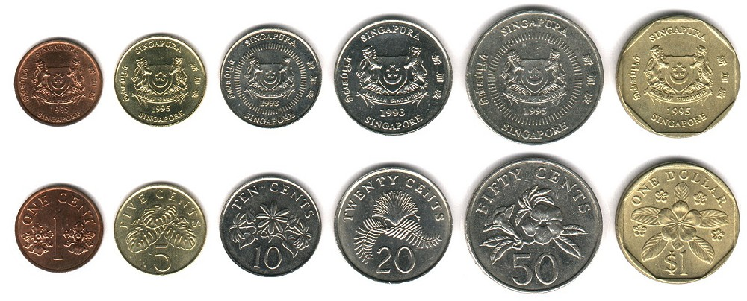
Change Example (I)
Minimum number of coins to pay $0.35:

Slide 5
Change Example (II)
Minimum number of coins to pay $0.45:
Impossible!

Slide 6
Simple heuristics (I)
Always use the biggest coin first.
E.g. Pay $0.35

Slide 7
Simple heuristics (II)
Always use the biggest coin first.
E.g. Pay $0.45
Impossible!

Slide 8
Does the simple heuristics always work?
If you present this simple heuristics, you will get 50 out of 70 marks.
7 contestants were awarded 70/70. 45 contestants scored 50/70 and 19 contestants scored 40/70.
The simple heuristics cannot work in the example below.
E.g. you have 10 x 20₵, and 10 x 50₵.
You need to pay $0.6.
Using the scheme, you pay 1 x 50₵ first, then fail to pay the remaining 10₵.
However, the correct solution is 3 x 20₵, which include 3 coins.
The problem is that 20₵ is not a factor of 50₵.

Slide 9
How about another problem?
Consider a’s 5₵ , b’s 10₵, c’s 20₵, d’s 100₵.
Find the minimum number of coins whose sum is t.
Note that
5₵ is a factor of 10₵,
10₵ is a factor of 20₵, and
20₵ is a factor of 100₵.
The simple heuristics “use the biggest coin first” can work in this case.

Slide 10
The correct solution for CHANGE
Input:
a’s 5₵ , b’s 10₵, c’s 20₵, d’s 50₵
An amount t
The optimal solution should be either one of the following solutions.
If we use even number of 50₵,
Consider a’s 5₵ , b’s 10₵, c’s 20₵, d/2’s 100₵ and the amount t.
Using the simple heuristics, we get the optimal solution w’s 5₵ , x’s 10₵, y’s 20₵, z’s 100₵.
Then, we report w’s 5₵ , x’s 10₵, y’s 20₵, 2z’s 50₵.
If we use odd number of 50₵,
Consider a’s 5₵ , b’s 10₵, c’s 20₵, d/2’s 100₵ and the amount (t-50).
Using the simple heuristics, we get the optimal solution w’s 5₵ , x’s 10₵, y’s 20₵, z’s 100₵.
Then, we report w’s 5₵ , x’s 10₵, y’s 20₵, (2z+1)’s 50₵.

Slide 11
Another solution for CHANGE
This problem can also be solved by dynamic programming.
However, this solution is too slow for large datasets.

Slide 12
Statistics for CHANGE
110 contestants submited answer to this question.
45 contestants scored 50/70
19 contestants scored 40/70.
75 contestants scored 70/70.

Slide 13
Paint

Slide 14
Paint Example
Suppose we want to paint a ship with 7 blocks.
We can paint one block per day (since we need to wait for the paint to dry).
The cost of paint increases everyday.
Aim: Find the minimum cost sequence.
Soln:
Day 1: Block 7 ($100+0*$50 = $100)
Day 2: Block 3 ($500+1*$45 = $545)
Day 3: Block 5 ($400+2*$40 = $480)
Day 4: Block 4 ($300+3*$35 = $405)
Day 5: Block 2 ($200+4*$22 = $288)
Day 6: Block 1 ($100+5*$20 = $200)
Day 7: Block 6 ($200+6*$20 = $320)
Total cost = $2338
6
4
5
3
7
1
2
Block | Cost on day i
1 | 100 + 20(i-1)
2 | 200 + 22(i-1)
3 | 500 + 45(i-1)
4 | 300 + 35(i-1)
5 | 400 + 40(i-1)
6 | 200 + 20(i-1)
7 | 100 + 50(i-1)

Slide 15
Brute-force Solution
Try all possible permutations of the 7 blocks (7!=5040 in total).
Compute the cost for each permutation.
Select the one with the lowest cost.
6
4
5
3
7
1
2
Block | Cost on day i
1 | 100 + 20(i-1)
2 | 200 + 22(i-1)
3 | 500 + 45(i-1)
4 | 300 + 35(i-1)
5 | 400 + 40(i-1)
6 | 200 + 20(i-1)
7 | 100 + 50(i-1)

Slide 16
Observation
 | Block | Fixed cost | Variable cost
Day 1 | b₁ | f(b₁) | 0 * v(b₁)
Day 2 | b₂ | f(b₂) | 1 * v(b₂)
Day 3 | b₃ | f(b₃) | 2 * v(b₃)
Day 4 | b₄ | f(b₄) | 3 * v(b₄)
Day 5 | b₅ | f(b₅) | 4 * v(b₅)
Day 6 | b₆ | f(b₆) | 5 * v(b₆)
Day 7 | b₇ | f(b₇) | 6 * v(b₇)
Total
6
4
5
3
7
1
2
Block | Cost on day i
1 | 100 + 20(i-1)
2 | 200 + 22(i-1)
3 | 500 + 45(i-1)
4 | 300 + 35(i-1)
5 | 400 + 40(i-1)
6 | 200 + 20(i-1)
7 | 100 + 50(i-1)
$1800
This number is fix.
It is independent of the order.
This number depends on the order. If we want to minimize it, we should
ensure v(b₇) < v(b₆) < … < v(b₁).

Slide 17
Algorithm
Sort b₁, b₂, …, b_{n} such that v(b₁) ≤ … ≤ v(b_{n});
Report ∑f(b_{i}) + ∑ (i * v(b_{i})).
6
4
5
3
7
1
2
 | Block | Fixed cost | Variable cost
Day 1 | b₁=7 | f(b₁)=100 | 0 * v(b₁) = 0*50
Day 2 | b₂=3 | f(b₂)=500 | 1 * v(b₂) = 1*45
Day 3 | b₃=5 | f(b₃)=400 | 2 * v(b₃) = 2*40
Day 4 | b₄=4 | f(b₄)=300 | 3 * v(b₄) = 3*35
Day 5 | b₅=2 | f(b₅)=200 | 4 * v(b₅) = 4*22
Day 6 | b₆=1 | f(b₆)=100 | 5 * v(b₆) = 5*20
Day 7 | b₇=6 | f(b₇)=200 | 6 * v(b₇) = 5*20
Total |  | $1800
Block | Cost on day i
1 | 100 + 20(i-1)
2 | 200 + 22(i-1)
3 | 500 + 45(i-1)
4 | 300 + 35(i-1)
5 | 400 + 40(i-1)
6 | 200 + 20(i-1)
7 | 100 + 50(i-1)

Slide 18
Statistics for PAINT
101 contestants submit answer to this question.
75 contestants were awarded 70/70.

Slide 19
Tour

Slide 20
Tour example (I)
~ | . | ~ | . | ~
6 | . | ~ | 5 | .
~ | . | . | C | ~
~ --- water
C --- Changi
[1..9] are attractive spots
The tourist arrive at Changi and he wants to visit the attractive spots and goes back to Changi. (Note that he cannot travel over sea.)
Each move reduces the happiness by 2.
Visiting a spot i increases happiness by i.
Scenario 1: C → 6 → 5 → C.
The score is 4*(-2) + 6 + 5*(-2) + 5 + 1*(-2) = -9.

Slide 21
Tour example (II)
~ | . | ~ | . | ~
6 | . | ~ | 5 | .
~ | . | . | C | ~
~ --- water
C --- Changi
[1..9] are attractive spots
Scenario 1 has negative gain.
In fact, the optimal plan is to visit spot 5 only.
Scenario 2: C → 5 → C.
The score is 1*(-2) + 5 + 1*(-2) = 1.

Slide 22
Brute-force solution
~ | . | ~ | . | ~
6 | . | ~ | 5 | .
~ | . | . | C | ~
Generate all possible tours.
E.g. C→C, C→5→C, C→6→C, C→5→6→C, C→6→5→C
For each tour, compute its score.
E.g. score(C→C)=0, score(C→5→C)=1, score(C→6→C)=-10, score(C→5→6→C)=-9, score(C→6→5→C)=-9.
Among all scores, report the one with the highest score.
E.g. report “C→5→C” with score 1.
This solution can solve small cases.

Slide 23
A fast solution
Compute the distance between all pairs of spots.
Compute the score gain we move from spot i to spot j.
Find the optimal path by breath-first-search.

Slide 24
1. Compute distance between all spots
E.g.
To compute the distance, we transform it into a graph.
Then, by the shortest path algorithm, we can compute the distance matrix.
. | 9 | . | 8 | ~
~ | . | . | . | .
~ | 7 | ~ | C | ~
When we move from one spot to another spot, we need to avoid water.
E.g. D(C,7) = 4 (not 2).
9
8
7
C
D | C | 7 | 8 | 9
C | 0 | 4 | 2 | 4
7 | 4 | 0 | 4 | 2
8 | 2 | 4 | 0 | 2
9 | 4 | 2 | 2 | 0

Slide 25
2. Compute Score matrix
Compute the score gain when we move from spot i to spot j.
D | C | 7 | 8 | 9
C | 0 | 4 | 2 | 4
7 | 4 | 0 | 4 | 2
8 | 2 | 4 | 0 | 2
9 | 4 | 2 | 2 | 0
. | 9 | . | 8 | ~
~ | . | . | . | .
~ | 7 | ~ | C | ~
Score(i,j) = -2*D(i,j) + S_{j}
E.g. Score(7,9) = -2*D(7,9) + 9 = 5
Score | C | 7 | 8 | 9
C | 0 | -8+7=-1 | -4+8=4 | -8+9=1
7 | -8 | 0 | -8+8=0 | -4+9=5
8 | -4 | -8+7=-1 | 0 | -4+9=5
9 | -8 | -4+7=3 | -4+8=4 | 0

Slide 26
3. Breath-First Search
Score | C | 7 | 8 | 9
C | 0 | -1 | 4 | 1
7 | -8 | 0 | 0 | 5
8 | -4 | -1 | 0 | 5
9 | -8 | 3 | 4 | 0
C
C
7
8
9
S = 0
S = -1
S = 4
S = 1
C
8
9
C
7
9
C
7
8
S = -9
S = -1
S = 4
S = 0
S = 3
S = 9
S = -7
S = 4
S = 5
C
9
C
8
C
9
C
7
C
8
C
7
S = -5
S = 4
S = -4
S = 8
S = -5
S = 8
S = 1
S = 12
S = -4
S = 4
S = 1
S = 4
C
C
C
C
C
C
S = -4
S = 4
S = 0
S = 4
S = 0
S = -4

Slide 27
3. Breath-First Search with pruning
Score | C | 7 | 8 | 9
C | 0 | -1 | 4 | 1
7 | -8 | 0 | 0 | 5
8 | -4 | -1 | 0 | 5
9 | -8 | 3 | 4 | 0
C
C
7
8
9
S = 0
S = -1
S = 4
S = 1
C
8
9
C
7
9
C
7
8
S = -9
S = -1
S = 4
S = 0
S = 3
S = 9
S = -7
S = 4
S = 5
Perform breath-first search. For each spot x, prune all branches end with x, the path contains the same set of spots, and with smaller score.
Path comparison can be done using a bitmask.
C
9
C
8
C
9
C
7
C
8
C
7
X
X
X
S = -5
S = 4
S = -4
S = 8
S = -5
S = 8
S = 1
S = 12
S = -4
S = 4
S = 1
S = 4
C
C
C
S = 4
S = 0
S = 4
Notes:
N is the number of spots. For level 0, there is 1 node. For level i, there are at most N^2*{N \choose (i-1)} nodes (before pruning) and N*{N \choose i} (after prunning).
The total number of nodes of all level is upper bounded by N^2*2^N.

Slide 28
Answer
C→7→9→8→C
The score is 4*(-2) + 7 + 2*(-2) + 9 + 2*(-2) + 8 + 2*(-2) = 4.
. | 9 | . | 8 | ~
~ | . | . | . | .
~ | 7 | ~ | C | ~

Slide 29
Statistics for TOUR
67 contestants submited answer to this question.
7 contestants were awarded 70/70.

Slide 30
TUTOR

Slide 31
Tutor simulation game
You are a tutor. You allows to perform
TEACH: Give 2-hour tutorial.
Your tuition income depends on your knowledge and the paybackRate.
TRAIN: Cost $20 and improve your knowledge by 1.
Maximum knowledge is 20.
Training time depends on your learningRate.
Books can reduce your training time.
BUY (Book): There are 4 books for 4 levels.
Higher level book costs more.
Buy i-th book takes i hours.
Aim: Given maxTimeUnits (and other parameters), you need to determines the best possible sequence of actions maximizing your income.

Slide 32
TUTOR (example)
maxTimeUnits = 11
learningRate = 8, paybackRate = 20.
Costs of 4 books: $5, $50, $100, and $200.
Aim: Gain more money.
A naïve tutor will TEACH all the time.
t | cash | knowledge | book | remarks
0 | 0 | 0 | 0 | Start of simulation
2 | 10 | 0 | 0 | TEACH (income = 10)
4 | 20 | 0 | 0 | TEACH (income = 10)
6 | 30 | 0 | 0 | TEACH (income = 10)
8 | 40 | 0 | 0 | TEACH (income = 10)
10 | 50 | 0 | 0 | TEACH (income = 10)

Slide 33
TUTOR (example)
maxTimeUnits = 11
learningRate = 8, paybackRate = 20.
Costs of 4 books: $5, $50, $100, and $200.
The optimal solution can gain $65.
t | cash | knowledge | book | remarks
0 | 0 | 0 | 0 | Start of simulation
2 | 10 | 0 | 0 | TEACH (income = 10)
2 | 5 | 0 | 1 | BUY (the 0-th book is $5, no change in t)
4 | 15 | 0 | 1 | TEACH (income = 10)
6 | 25 | 0 | 1 | TEACH (income = 10)
7 | 5 | 1 | 1 | TRAIN (have 1 book, trainingTime =1)
8 | 35 | 0 | 1 | TEACH (income = 30)
10 | 65 | 0 | 1 | TEACH (income = 30)

Slide 34
Solution 1: Best-First-Search
T=0, C=0, K=0, B=0
BUY
TEACH
TRAIN
X
X
T=2, C=10, K=0, B=0
BUY
TEACH
TRAIN
X
T=2, C=5, K=0, B=1
T=4, C=20, K=0, B=0
BUY
TEACH
TRAIN
T=4, C=15, K=0, B=1
T=6, C=30, K=0, B=0
T=12, C=0, K=0, B=0
………….
This method takes exponential time. It only works for small datasets.

Slide 35
Solution 2: Dynamic Programming
Define S(c, t, k, b) = 1 if it is feasible to have c dollors, k knowledges, and b books at time t; 0 otherwise.
Then, we have:
Base case: S(0,0,0,0)=1
Recursive case:
Based on the value ranges of the variables, we know that t≤1000, k≤20, b≤4, and c≤205000.
This method can solve small and medium datasets.

Slide 36
Solution 3: A*
C’ (predicted cash) = C (current cash) +
MaxTuitionIncome * remainingTime.
Note: A* guarantees to find optimal solution!
T=0, C=0, K=0, B=0, C’=410*9=3690
BUY
TEACH
TRAIN
X
X
T=2, C=10, K=0, B=0, C’=10+410*8=3290
BUY
TEACH
TRAIN
X
T=2, C=5, K=0, B=1, C’=5+410*8=3285
T=4, C=20, K=0, B=0, C’=20+410*7=2890
BUY
TEACH
TRAIN
X
X
T=4, C=15, K=0, B=0, C’=15+410*7=2885
………….
This method can run within 10 seconds for all our datasets.

Slide 37
Solution 4: DFS (Depth-First-Search) + Purning by Table-lookup
Cash(0,0,0)=0
Perform DFS with the table Cash(t, k, b) for pruning, where t is time, k is knowledge and b is book.
Since t≤1000, k≤20, and b≤4, the table Cash is small.
Initally, we set all entries Cash(t,k,b)=-1.
We perform DFS and update Cash(t, k, b).
Whenever new Cash(t,k,b) is smaller than the original Cash(t,k,b), we prune the execution.
BUY
TRAIN
TEACH
X
X
Cash(2,0,0)=10
BUY
Cash(2,0,1)=5
BUY
TEACH
X
X
TRAIN
Cash(4,0,1)=15
BUY
TRAIN
TEACH
X
X
Cash(6,0,1)=25
BUY
TRAIN
TEACH
X
Cash(7,1,1)=5
Cash(8,0,1)=35
X
BUY
TRAIN
TEACH
BUY
TRAIN
TEACH
X
X
Cash(9,1,1)=35
Cash(9,1,1)=15
Cash(10,1,1)=15
BUY
TRAIN
TEACH
Prune!
X
………….
Cash(10,2,1)=15
Cash(11,1,1)=65
This method can run within 0.1 seconds for all our datasets.

Slide 38
Statistics for TUTOR
67 contestants submit answer to this question.
11 contestants were awarded 70/70.

Slide 39
Sequence

Slide 40
Task: Sequence
A sequence is a₀, a₁, a₂, a₃, …
This task considers 3 types of sequences.
Eventually constant sequence,
Periodic sequence, and
Polynomial sequence.

Slide 41
Definition
A sequence is a₀, a₁, a₂, a₃, …
A sequence is a degree-d eventually constant sequence if a_{n} equals to a constant for all n≥d.
E.g. 4, 8, 10, 5, 21, 7, 7, 7, 7, …
Since a_{n}=7 for n≥5, this sequence is of degree 5
A sequence is a degree-d periodic sequence if a_{n} = a_{n-d-1} for n≥d.
E.g. 1, 2, 3, 4, 1, 2, 3, 4, 1, 2, …
Since a_{n} = a_{n-4}, this sequence is of degree 3.
A sequence is a degree-d polynomial sequence if a_{n} is a polynomial of degree d.
E.g. 1, 2, 5, 10, 17, 26, …
Since a_{n} = n²+1, this sequence is of degree 2.
Given a sequence,
we aims to find its minimum degree, then predict the next entry of the sequence.

Slide 42
Predicting the next entry of a eventually constant sequence
E.g. 10, 4, 9, 22, 5, 5, 5
The minimum degree is 4.
The next entry is 5.
Suppose the sequence is a₀, a₁, …, a_{n-1}.
The degree q is the smallest q such that a_{q}=a_{q+1}=…=a_{n-1}.
The next entry a_{n} equals a_{n-1}.

Slide 43
Predicting the next entry of a periodic sequence
E.g. 0, 1, 1, 0, 1, 1, 0;
The minimum degree is 2 with seed “0 1 1”.
The next entry is 1.
Note: If we assume the degree is 6 with seed “0 1 1 0 1 1 0”, then we will predict the next entry is 0.
To find the minimum degree d, we just shift the sequence.
Then, the next entry a₇ equals a_{7-1-d} = a₇₋₁₋₂ = 1.
0 1 1 0 1 1 0
0 1 1 0 1 1 0 (d=0)
0 1 1 0 1 1 0 (d=1)
0 1 1 0 1 1 0 (d=2)

Slide 44
Predicting the next entry of a polynomial sequence
E.g. 0, 1, 4, 9, 16;
a_{n} = n²; Hence, the minimum degree is 2.
The next entry is 25.

Slide 45
Computing the degree of a polynomial sequence
Observation: a degree-d sequence can be transformed to a degree-(d-1) sequence by subtracting adjacent entries.
E.g. a[n] = n².
Hence, the degree can be found by checking how many rounds is enough to convert the input sequence to a deg-0 sequence.
a = (0 1 4 9 16 25 36 49 ) --- deg-2 a[n]=n²
1 3 5 7 9 11 13 --- deg-1 a[n]=2n+1
2 2 2 2 2 2 --- deg-0 a[n]=2

Slide 46
Predicting the next entiry of a polynomial sequence
E.g. a[n] = n².
a = (0 1 4 9 16 25 36 49 ) --- deg-2 a[n]=n²
1 3 5 7 9 11 13 --- deg-1 a[n]=2n+1
2 2 2 2 2 2 --- deg-0 a[n]=2
64
15
2

Slide 47
Predicting the next entry of any sequence
E.g. 1 1 0 1
If the sequence is “Ec”, degree is 3 and the next entry is 1.
If the sequence is “Pe”, degree is 2 with seed “1 1 0” and the next entry is 1.
If the sequence is “Po”, degree is 3 with a_{n} = (2n³-8n²+6n+4)/4. The next entry is 7.
Since 2 is the lowest degree, the sequence is a periodic sequence with seed “1 1 0”.
Thus, the next entry is 1.
The algorithm just find the lowest degree among “Ec”, “Pe”, and “Po”. Then, obtain the next entry.

Slide 48
Statistics for SEQUENCE
42 contestants submit answer to this question.
3 contestants were awarded 70/70.

Slide 49
Acknowledgement
Tan Tuck Choy Aaron
Ooi Wei Tsang
Chan Mun Choon and his technical committee
Scientific Committee
Frank STEPHAN
Golam Ashraf
Martin Henz
Steven Halim
Tan Keng Yan, Colin
A special thanks to Felix who helps to validate TUTOR and Koh Zi Chun who generates the statistics.

Slide 50
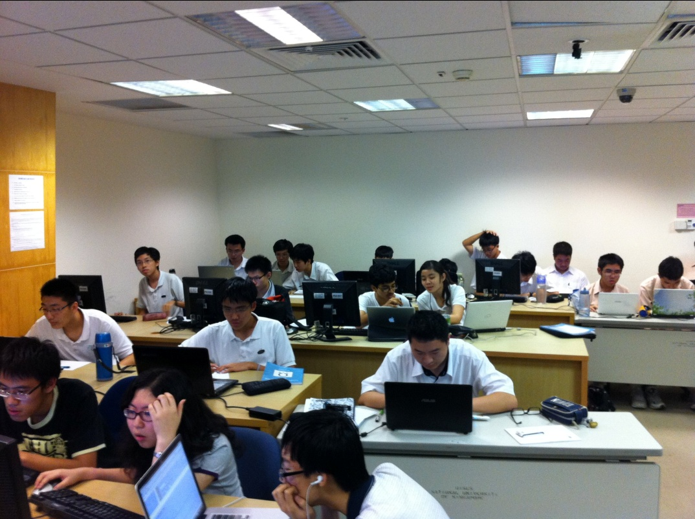

Want to Get Gold @ NOI 2012?
Competitive Programming Book
Few (<5) copies are available now
CS3233 – Competitive Programming (see the next slide)
Every Wednesday night, 6-9pm @ COM1, SoC, NUS
Hwa Chong Institution
Raffles Institution
NUS High School
Anglo Chinese JC
SM2/3

Slide 51

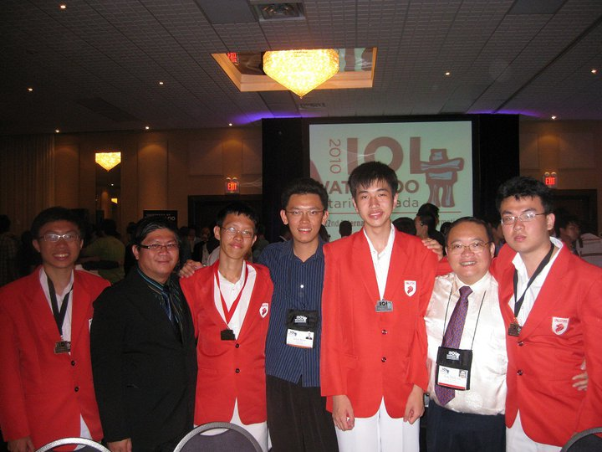
Training for IOI 2011 @ Pattaya, Thailand
SG IOI 2010:
1G 1S 2B
Currently ongoing as CS3233 class @ SoC, NUS
http://algorithmics.comp.nus.edu.sg/wiki/training/ioi_workshop
Ex SG IOI 2010 medalists who are still eligible: RI (3)
Delegations from RI (+5), HCI (6), NUSH (8), ACJC (1)
Now also open to:
NOI 2011 Gold/Silver medalists not currently in the CS3233 class
Must be Singaporean/ Singapore Permanent Resident
If you are in this category, please contact me (Dr Steven Halim, stevenhalim@gmail.com) after the award ceremony
L-to-R: Daniel (HCI/B); Mr Cheong (MOE); Raymond (RI/G); Dr Steven; Zhanxiong (RI/S); A/P Roland (NUS); Chuanqi (RI/B)

Slide 52
END!

Slide 53
Algorithm for CHANGE
Input:
Let c₁=5, c₂=10, c₃=20, and c₄ =50.
Let t₁, t₂, t₃, t₄ be the number of 5₵, 10₵, 20₵, and 50₵ coins available.
Let s be the amount Jack needs to pay
Output:
n₁, n₂, n₃, n₄ be the number of coins Jack need to pay such that c₁n₁ + c₂n₂ + c₃n₃ + c₄n₄ = s and n_{i}≤t_{i} for i = 1, 2, 3, 4.
Algorithm
r=s;
for i = 4 to 1,
set n_{i} = min(t_{i}, ⎣r/50⎦); set r = r – c_{i}*n_{i};
if r == 0, then
report answer;
exit;
set r=s;
set n₄ = min(t₄, ⎣r/50⎦-1); set r = r – c₄*n₄;
for i = 3 to 1,
set n_{i} = min(t₄, ⎣r/50⎦); set r = r – c_{i}*n_{i};
if r == 0, then
report answer;
else
report fail;

