Slide 1
IBM University Engagement Project Submission
“Exploring the Power of Agentic AI with IBM Granite and IBM BOB”

Slide 2

Project Tile – GrantPilot AI – AI Grant & Funding Finder for Startups
“AI-Powered Grant Discovery, Matching & Proposal Assistant”
Domain of Project – Business Automation
Student Name | Recent Passport Photo | Email ID | Mobile number [WhatsApp]
Paridhi Sharma |  | paridhis529@gmail.com | 7489583934

Slide 3
Problem Statement -
Problem Statement – GrantPilot AI
The Challenge
Grant opportunities for startups are scattered across different websites, documents, and platforms.
Finding relevant grants based on domain, startup stage, location, and funding requirement is time-consuming.
Eligibility criteria, funding amounts, deadlines, and required documents are often difficult to compare manually.
Preparing a suitable grant proposal also requires significant time and effort.
The Objective
To develop an AI-powered system for discovering and ranking suitable grants.
To analyze grant eligibility based on the startup profile.
To use IBM Granite and RAG for intelligent grant matching and information retrieval.
To assist startups in generating an initial funding proposal draft.

Slide 4
Proposed Solution -
Proposed Solution – GrantPilot AI
Startup Profile: Collects startup domain, stage, location, funding requirement, and description.
Grant Discovery: Uses a structured grant knowledge base to find relevant funding opportunities.
RAG + IBM Granite: Retrieves relevant grant information and uses IBM Granite 4 H Small for intelligent analysis.
Grant Matching & Ranking: Ranks grants based on domain, location, startup stage, funding requirement, and eligibility.
Eligibility Analysis: Identifies eligible, partially eligible, and not-eligible opportunities while highlighting requirements that need verification.
Proposal Assistant: Generates an initial funding proposal draft for the selected grant.
Human Review: Final grant eligibility and proposal are verified by the user before application.
“GrantPilot AI transforms scattered grant information into personalized, AI-powered funding recommendations and proposal assistance.”

Slide 5
Technology Used
Technology Used
IBM Bob – AI-powered development partner used to build and structure the application.
IBM Granite 4 H Small – For natural language understanding, reasoning, grant analysis, and proposal generation.
IBM watsonx.ai – For accessing and deploying IBM Granite models.
IBM Cloud – Provides the cloud infrastructure and IBM AI services.
RAG (Retrieval-Augmented Generation) – Retrieves relevant grant information from the knowledge base before generating responses.
Vector Store / TF-IDF Retrieval – Used for retrieving relevant grant records from the grant knowledge base.
Python & Streamlit – Used to develop the application and interactive dashboard.

Slide 6
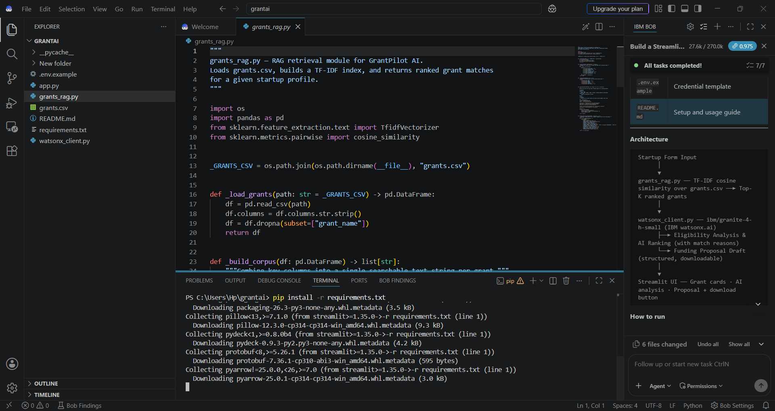
REQUIRED FILES CREATED USING IBM BOB

Slide 7
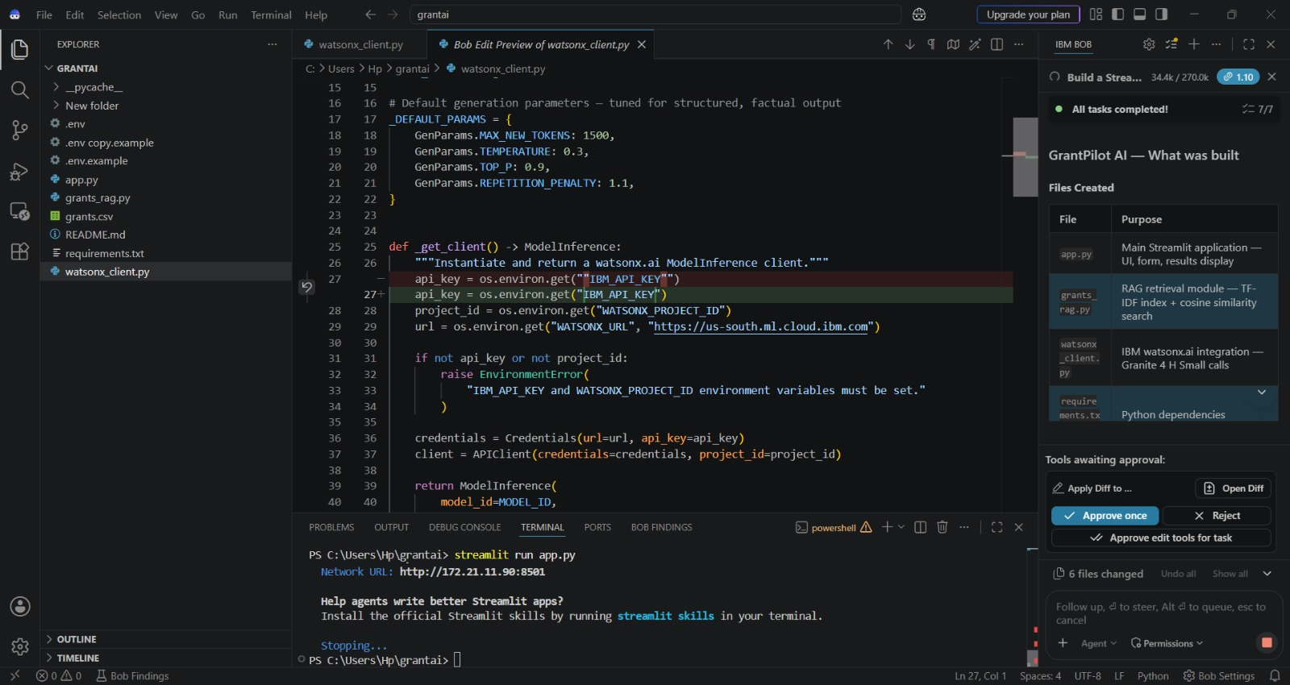
IBM BOB SCREENSHOTS:

Slide 8
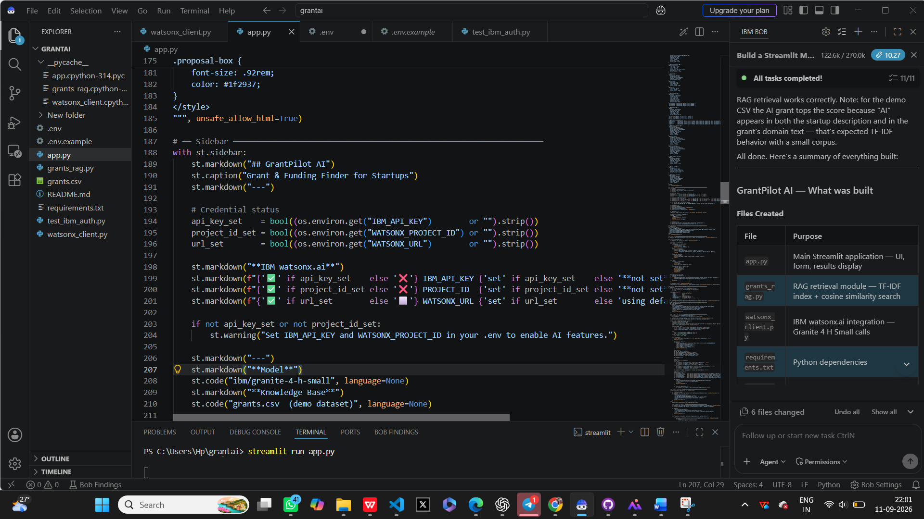
app.py

Slide 9
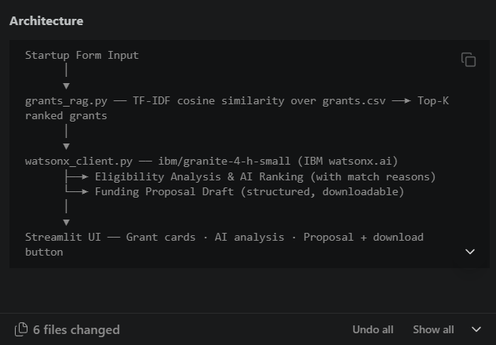
Architecture blueprint

Slide 10

Role of Agentic AI in the solution
Role of Agentic AI in GrantPilot AI
Grant Discovery Agent – Finds relevant grant opportunities from the available knowledge base.
Grant Matching Agent – Compares startup requirements with grant criteria and ranks the best matches.
Eligibility Agent – Checks eligibility conditions and highlights requirements that need verification.
Proposal Assistant Agent – Generates an initial funding proposal draft based on the selected grant and startup profile.
Human-in-the-Loop – User reviews and verifies AI-generated results before applying.
“Agentic AI enables GrantPilot AI to perform grant discovery, matching, eligibility analysis and proposal assistance as a coordinated workflow.”

Slide 11
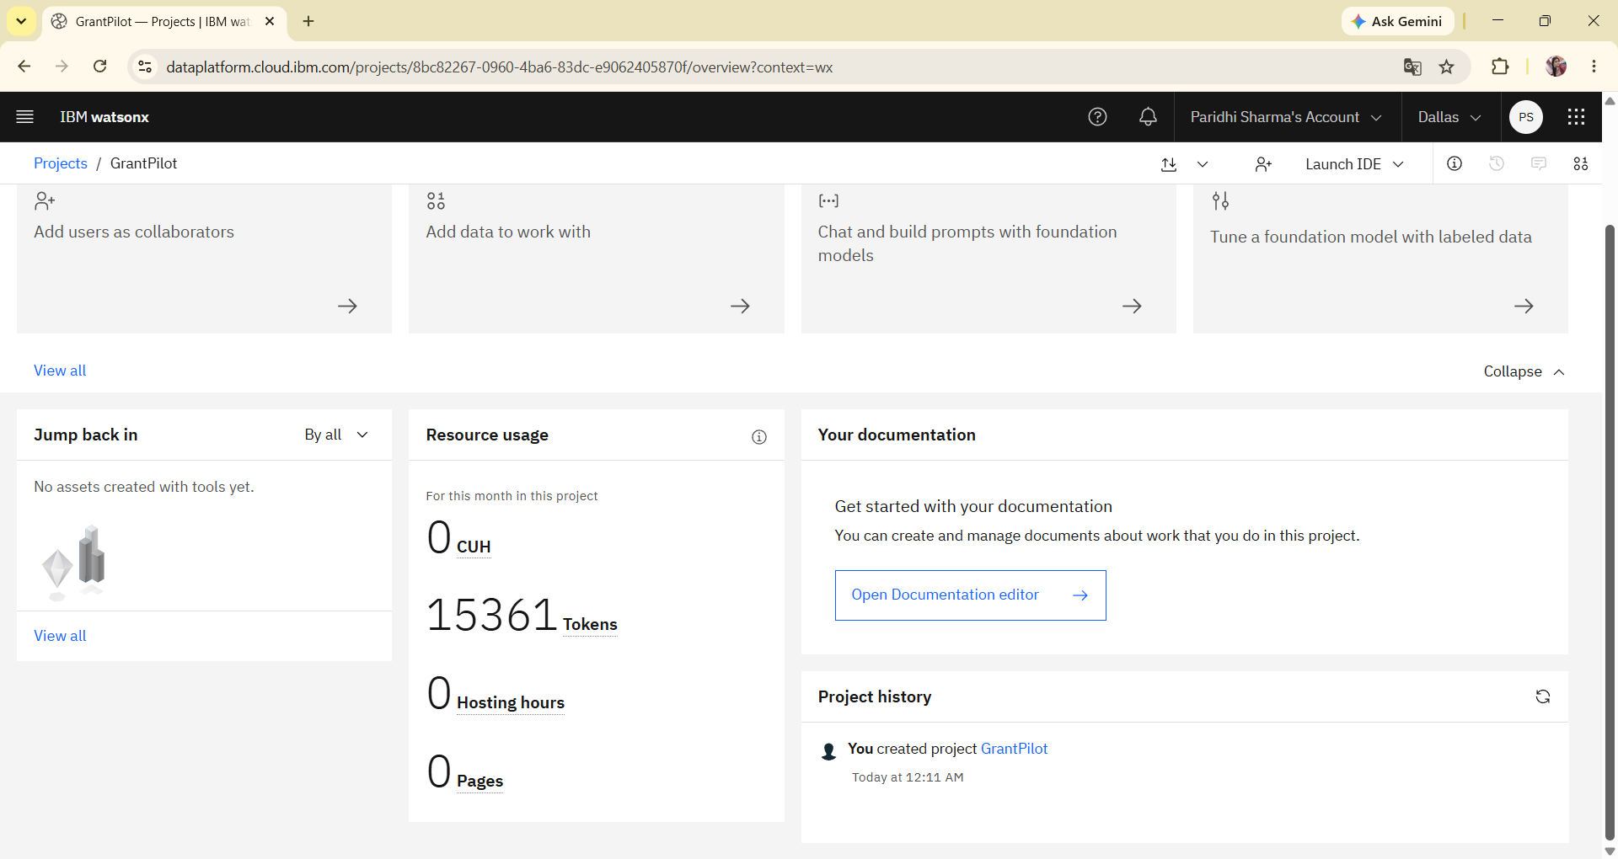
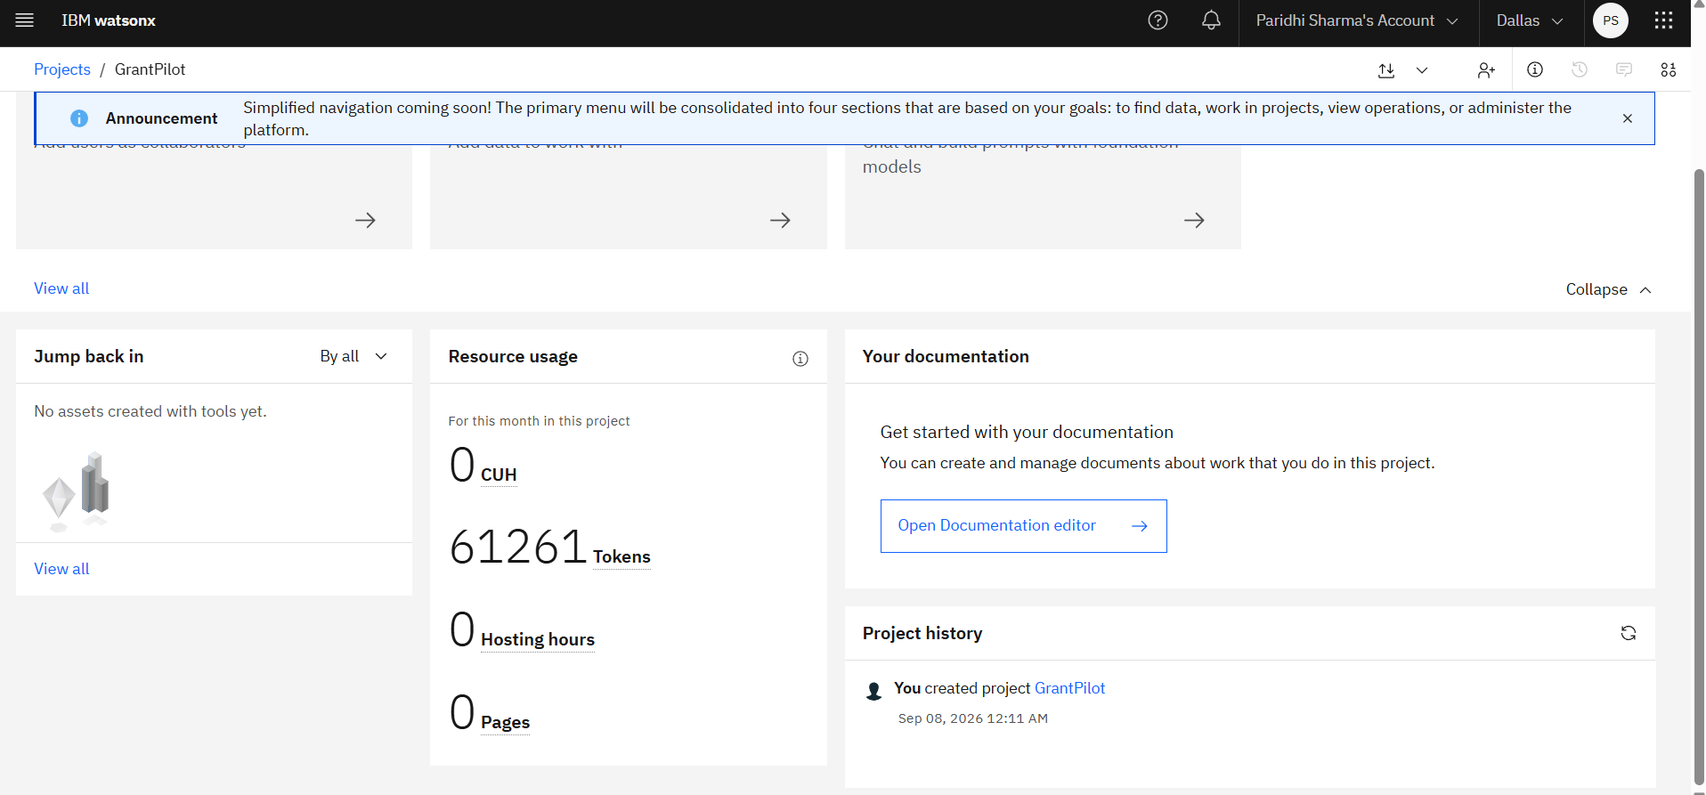
Token Usage
45,900. token are used
Before Prompt
After the Prompt
·
·
·

Slide 12
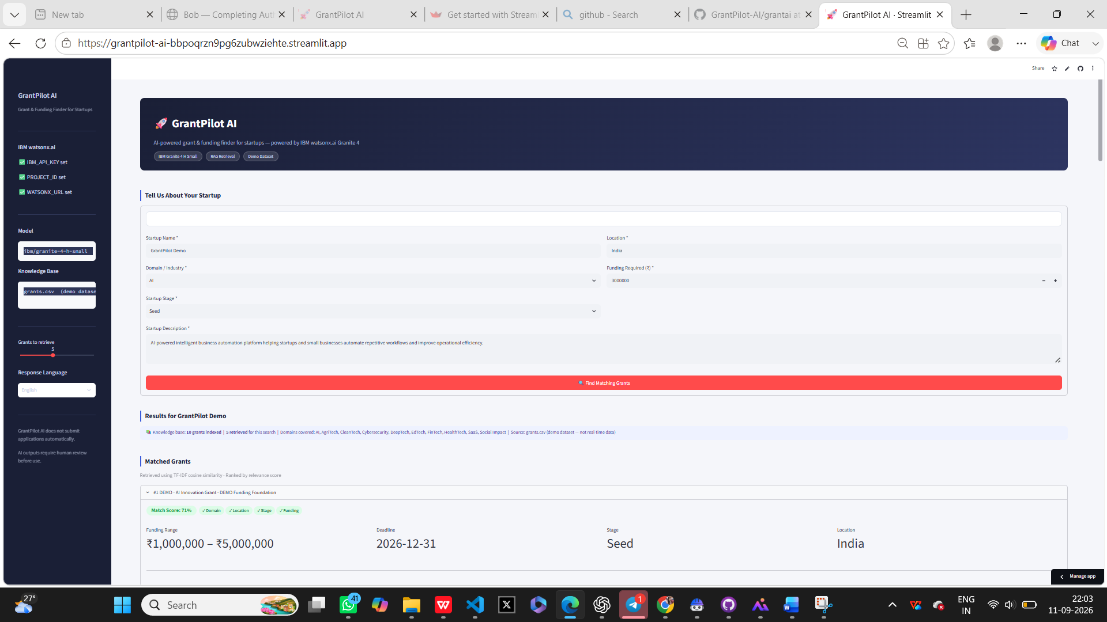
Your title here
Project Output Screenshot

Slide 13
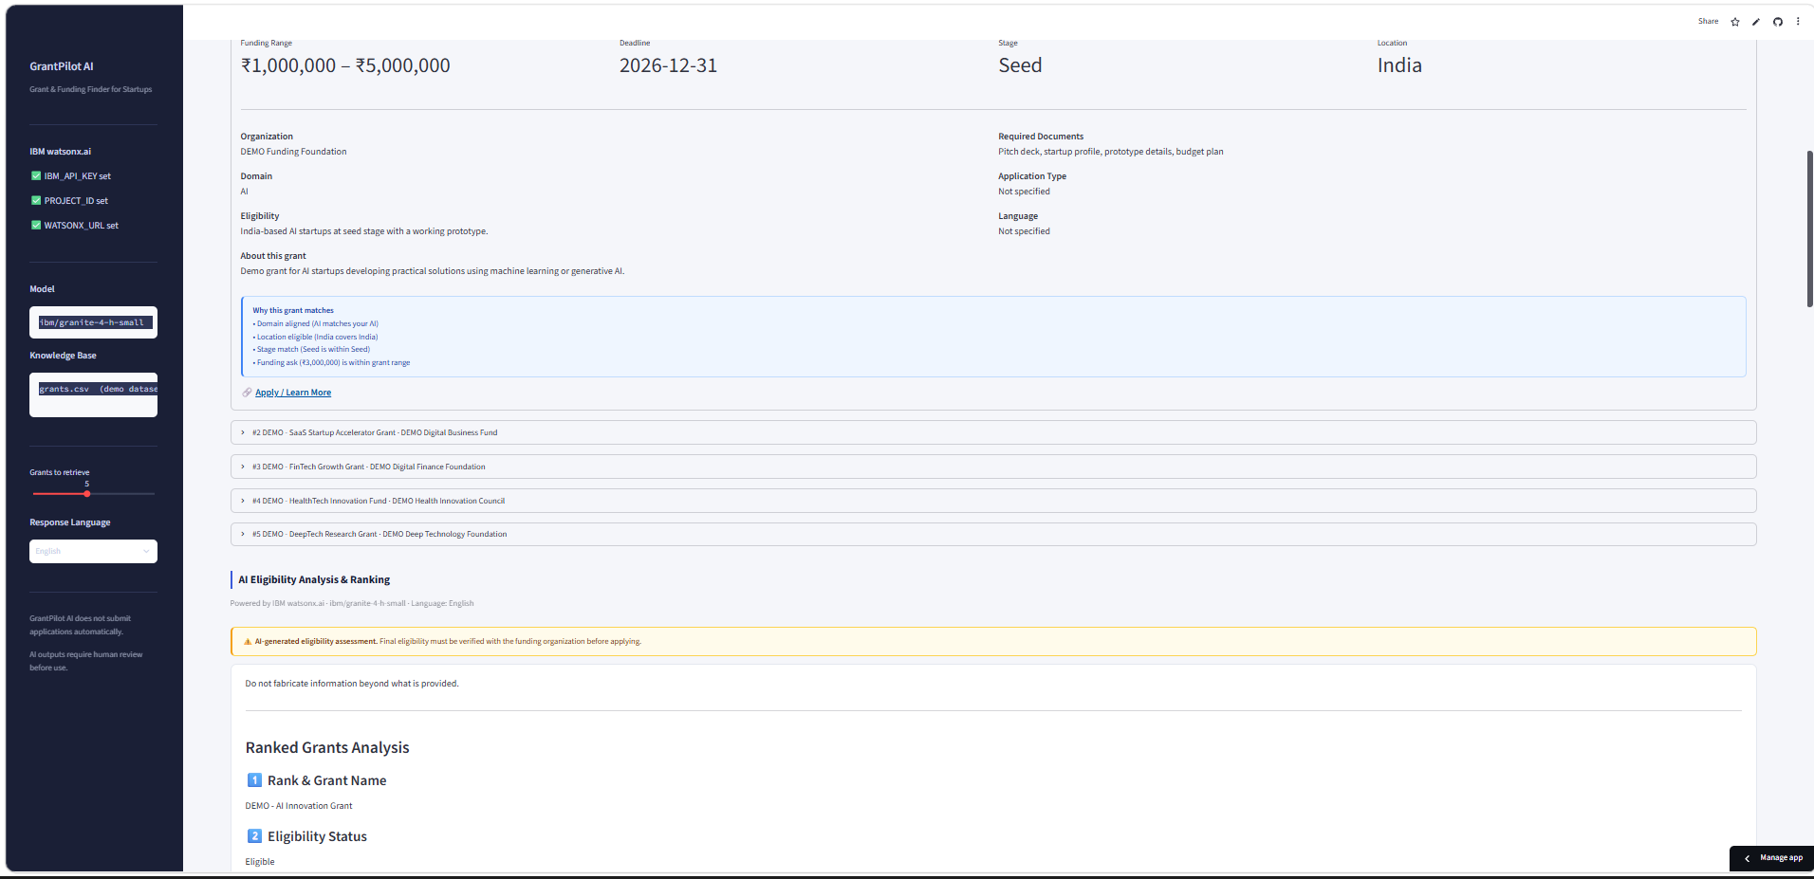
Your title here

Slide 14
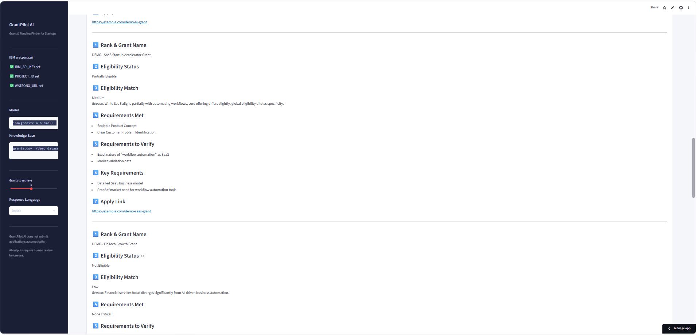
Your title here

Slide 15
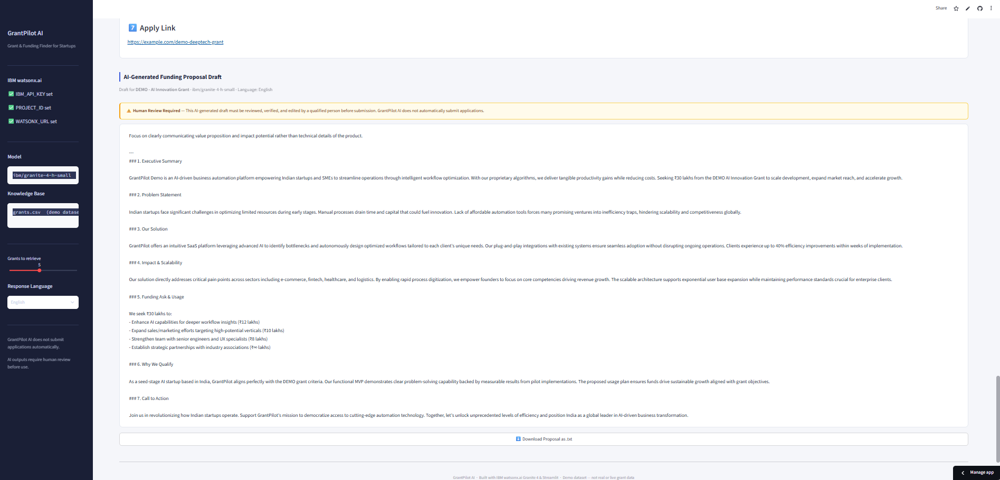
Your title here

Slide 16
Novelty and Uniqueness
Novelty and Uniqueness of GrantPilot AI
Personalized Grant Matching: Matches funding opportunities with the startup’s domain, stage, location, and funding requirement.
AI-Based Eligibility Analysis: Evaluates eligibility and highlights requirements that need further verification.
RAG + IBM Granite: Uses relevant grant information from the knowledge base before generating AI responses.
Grant Ranking: Provides match scores to help startups prioritize the most suitable opportunities.
AI Proposal Assistance: Generates an initial grant proposal draft based on the selected funding opportunity.
Human-in-the-Loop: Keeps final eligibility verification and application decisions under the user’s control.
Key Innovation:
“GrantPilot AI combines grant discovery, personalized matching, eligibility analysis, and proposal assistance into a single AI-powered workflow.”

Slide 17
Git Hub Link
Github URL –https://github.com/799PARIDHISHARMA/GrantPilot-AI
·
·
·

Slide 18
Future Scope
Future Scope
Real-Time Grant Aggregation: Integrate public APIs, RSS feeds, and verified grant portals for regularly updated opportunities.
Multi-Language Support: Provide grant information and proposal assistance in multiple languages.
Advanced Personalization: Improve recommendations using startup profiles, past applications, and funding preferences.
Automated Deadline Alerts: Notify users about upcoming grant deadlines and important updates.
More Grant Sources: Expand the knowledge base to include government, private, national, and international funding programs.
Improved AI Agents: Enhance agents with better reasoning, verification, and source validation.
Application Assistance: Provide step-by-step guidance for completing grant applications while keeping final submission under user control.
.
·
·
·

Slide 19
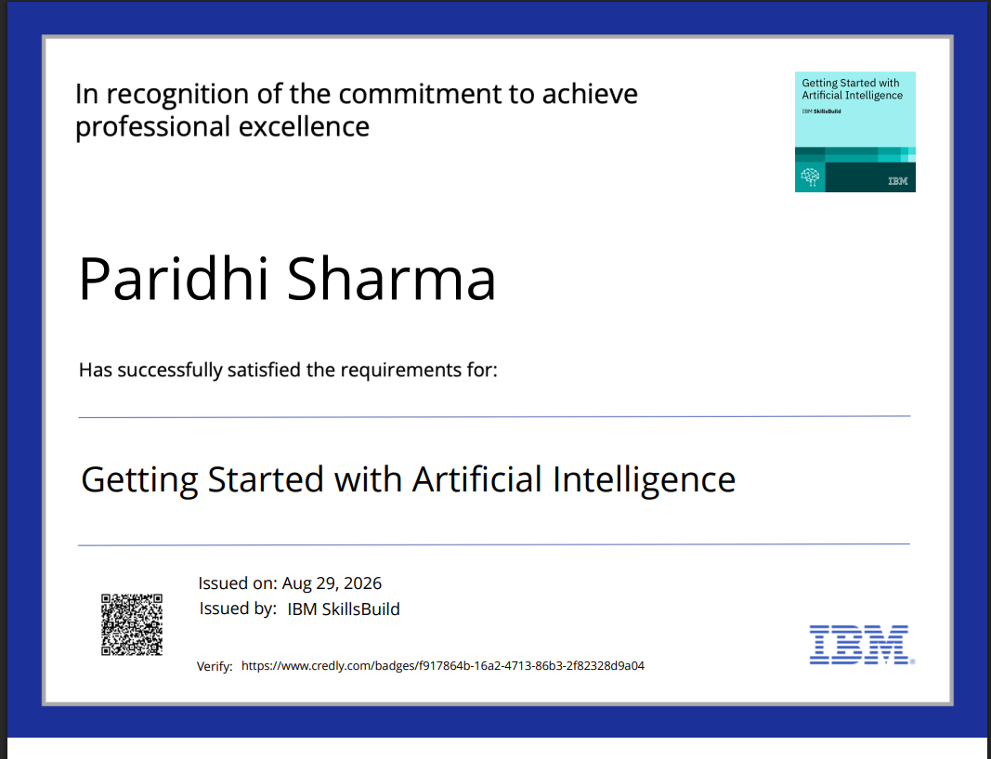
Certificates Earned:
Please add your credly certificate

Slide 20
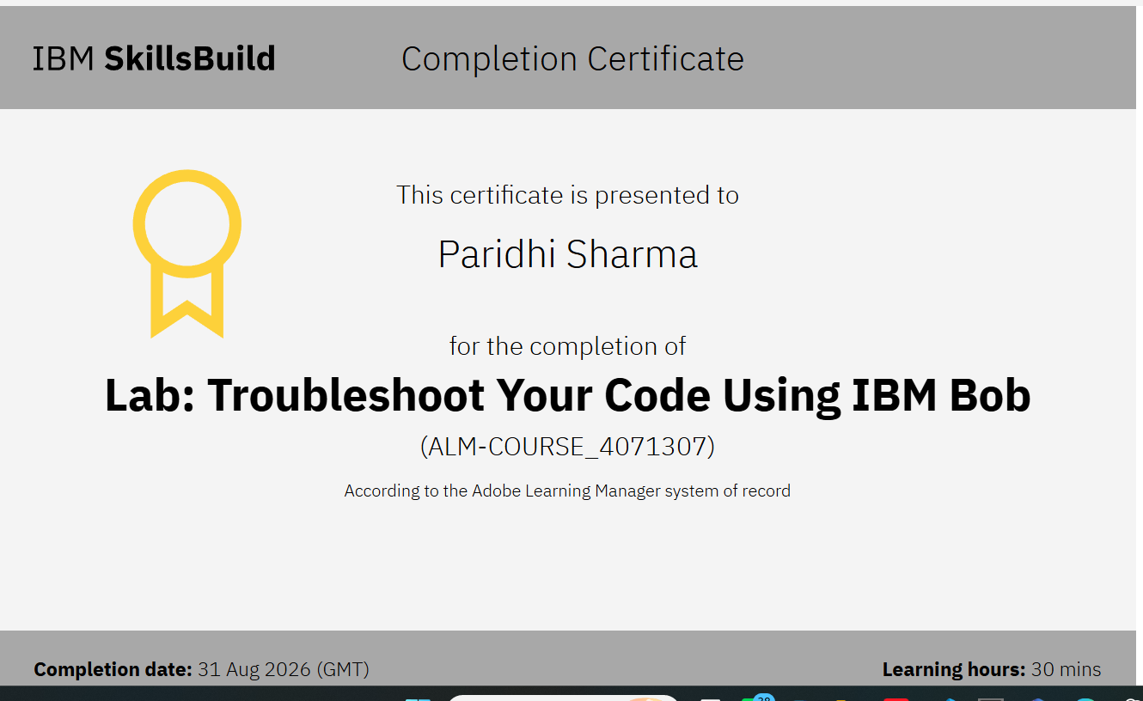
Certificates Earned:​
Add your IBM BOB Certificate

Slide 21


