Slide 1
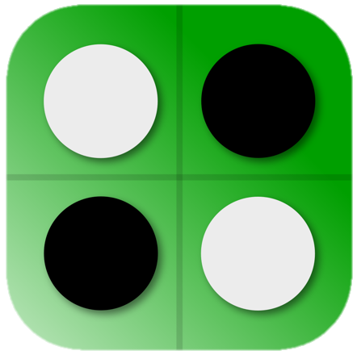
REVERSI
Klim Sadov, Ilya Stubarev, Maxim Zaugolnikov

Slide 2
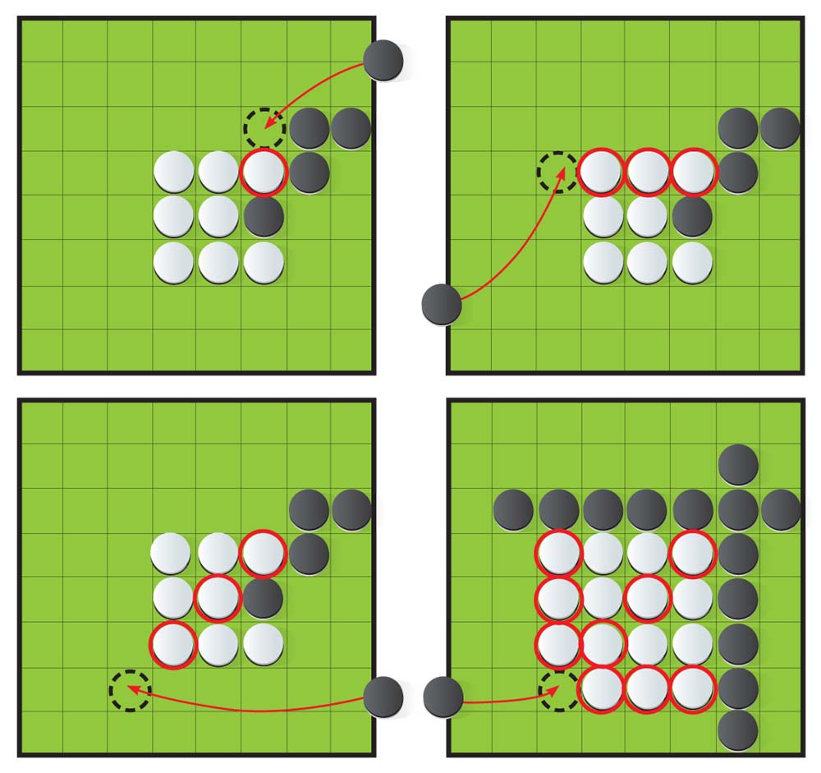

Rules of the game
Goal: to capture more of the opponent's chips, turning them into your own.
Start: 6×6 board, 4 center chips (2 white, 2 black).
Move:
Place a chip of your color so that there is a line of opponent's chips between it and your other chip (horizontally, vertically or diagonally).
All opponent's chips in this line are flipped to your color.
End of game: when both players have no moves. The one with more pieces on the board wins.

Slide 3
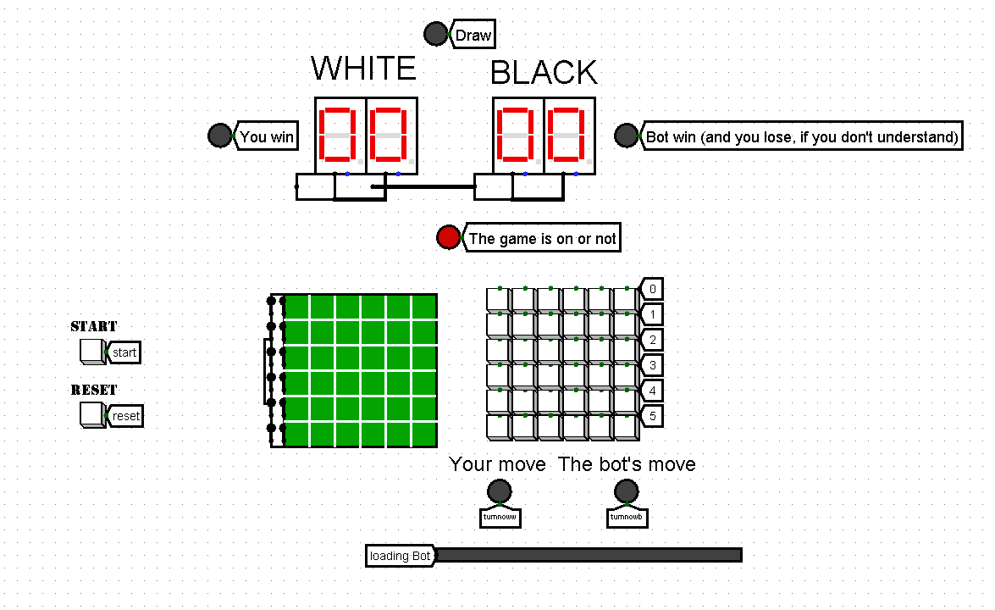
User interface

Slide 4
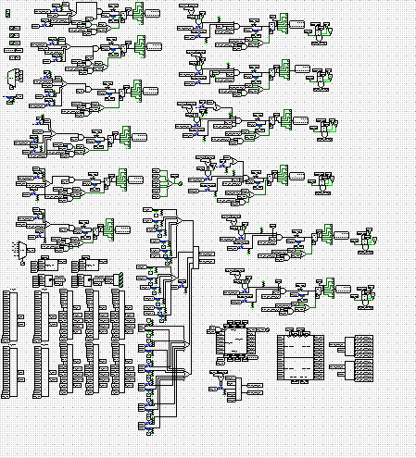
Under the hood

Slide 5
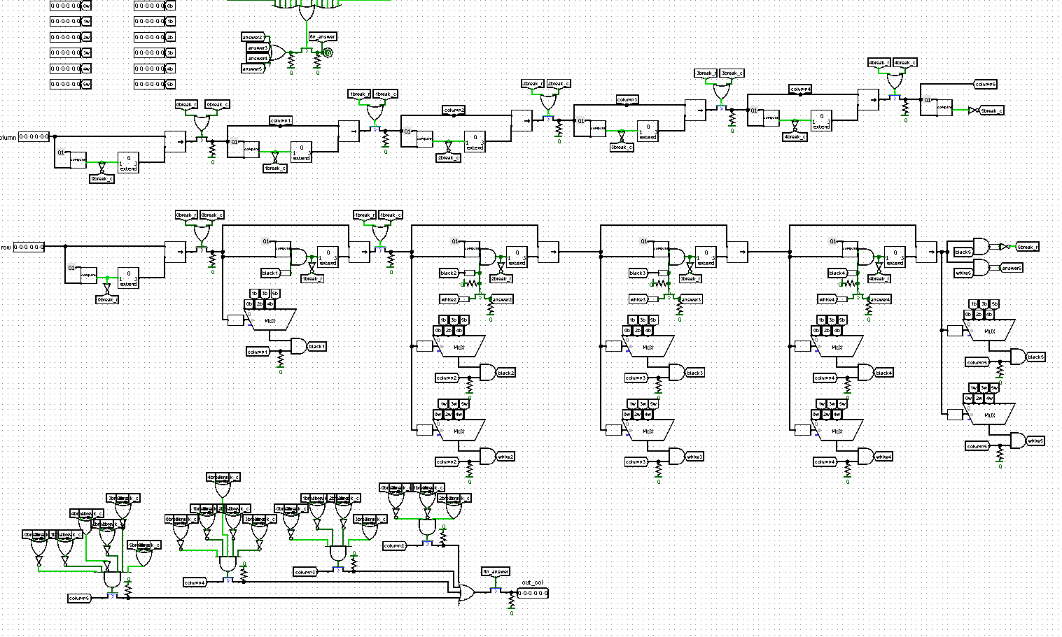
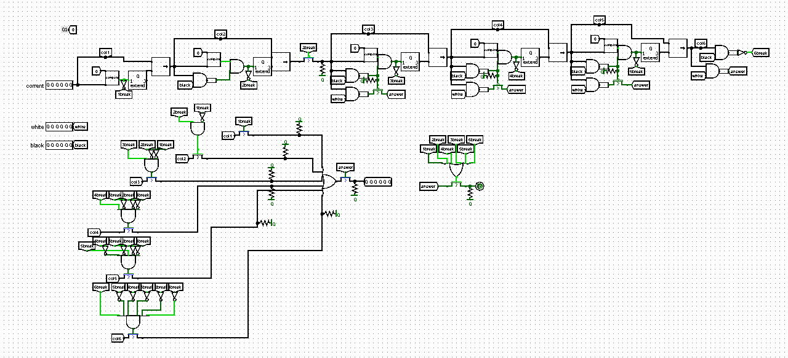
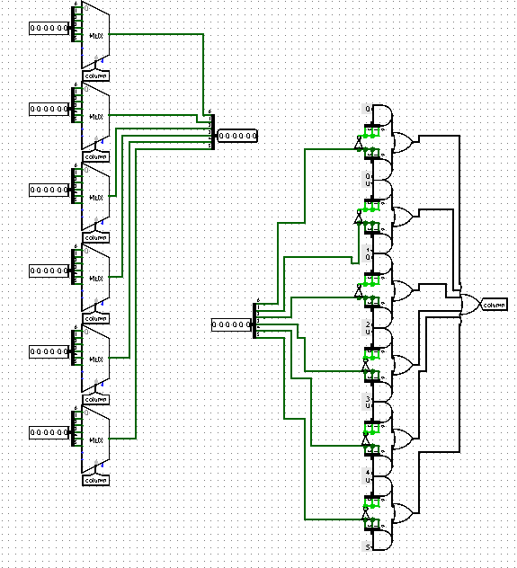
Checking for a valid move

Slide 6
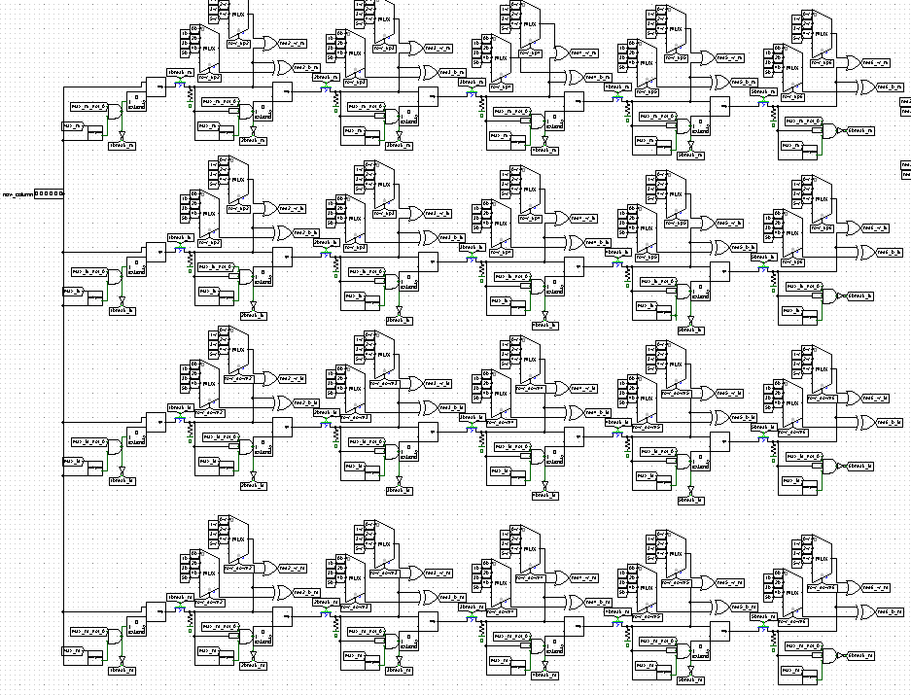
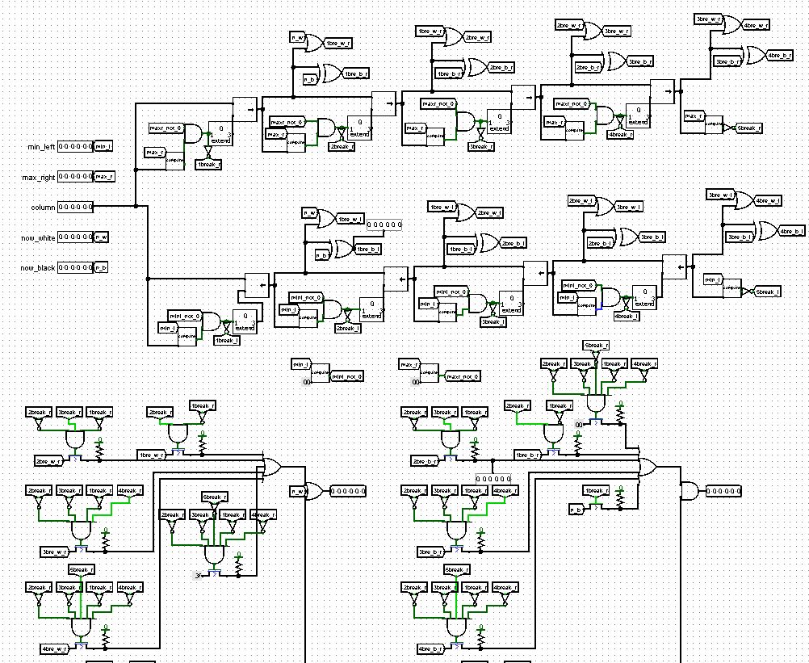
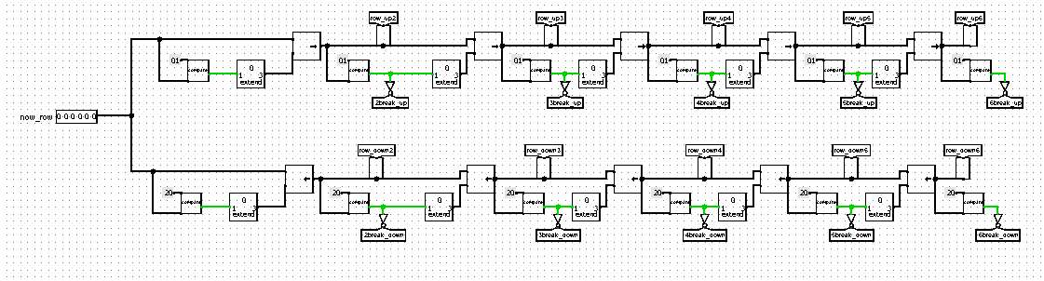
Coloring

Slide 7
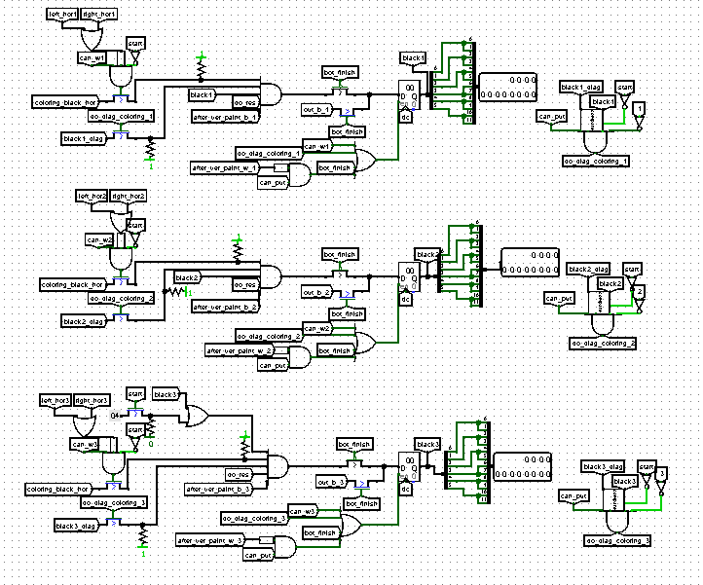
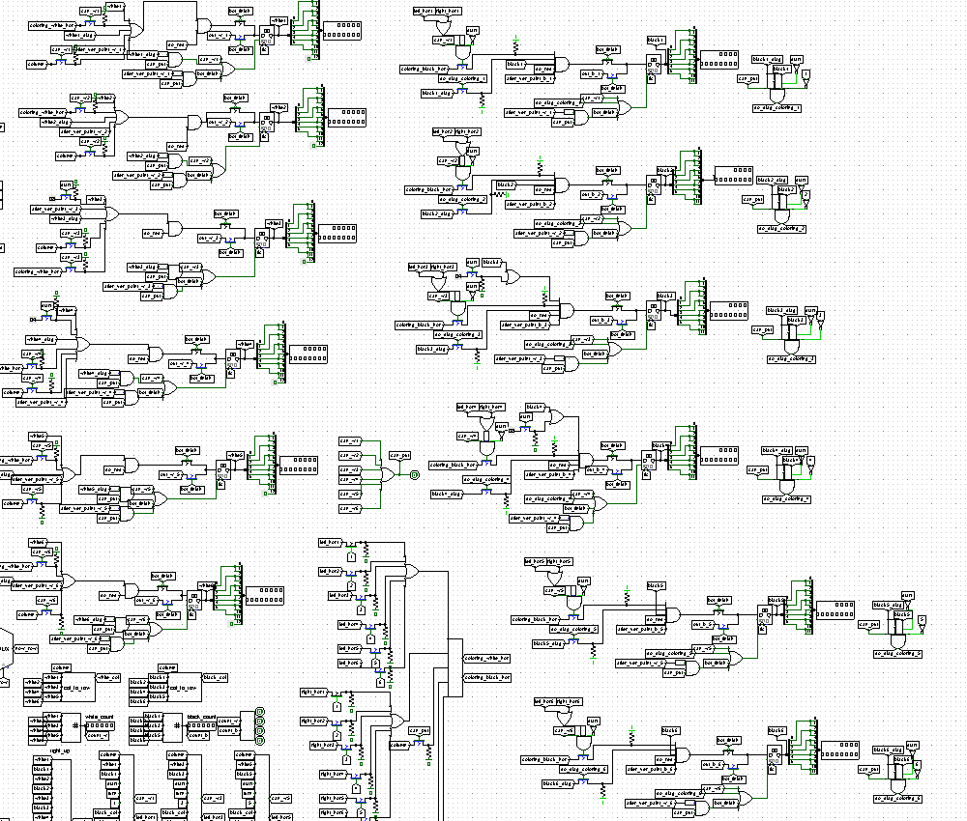
The schematic that connects it all

Slide 8
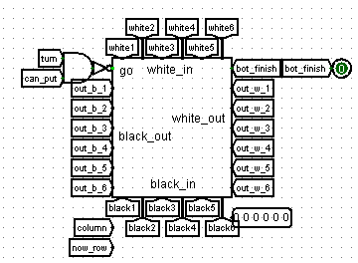
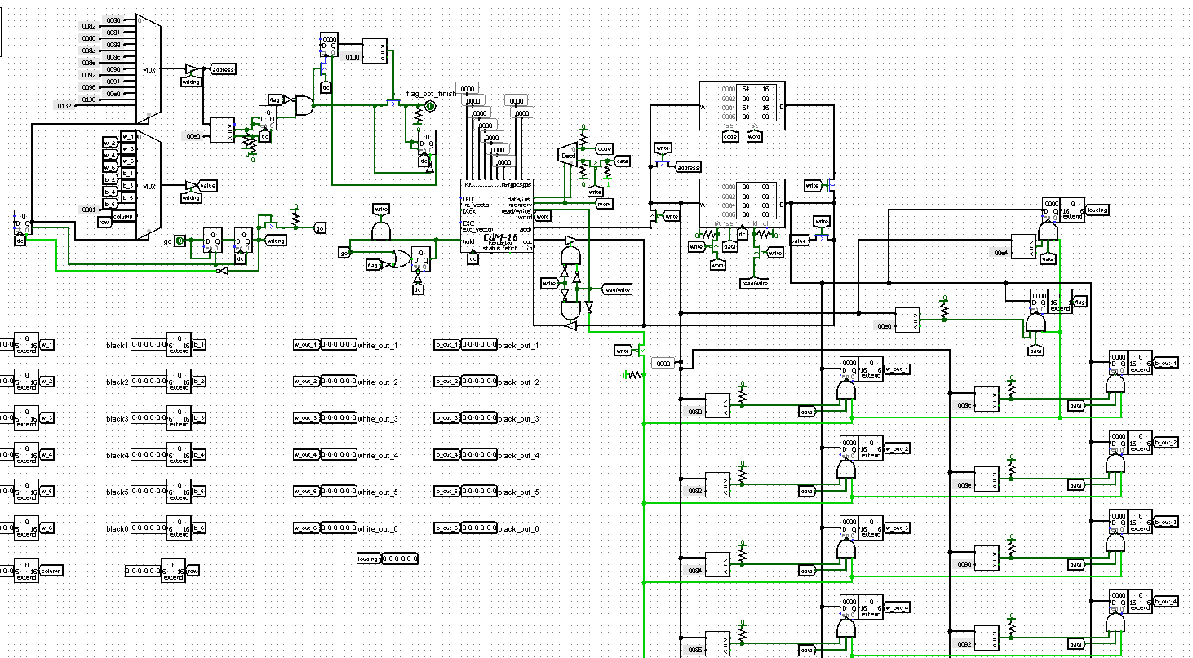
Processor schematics

