Slide 1
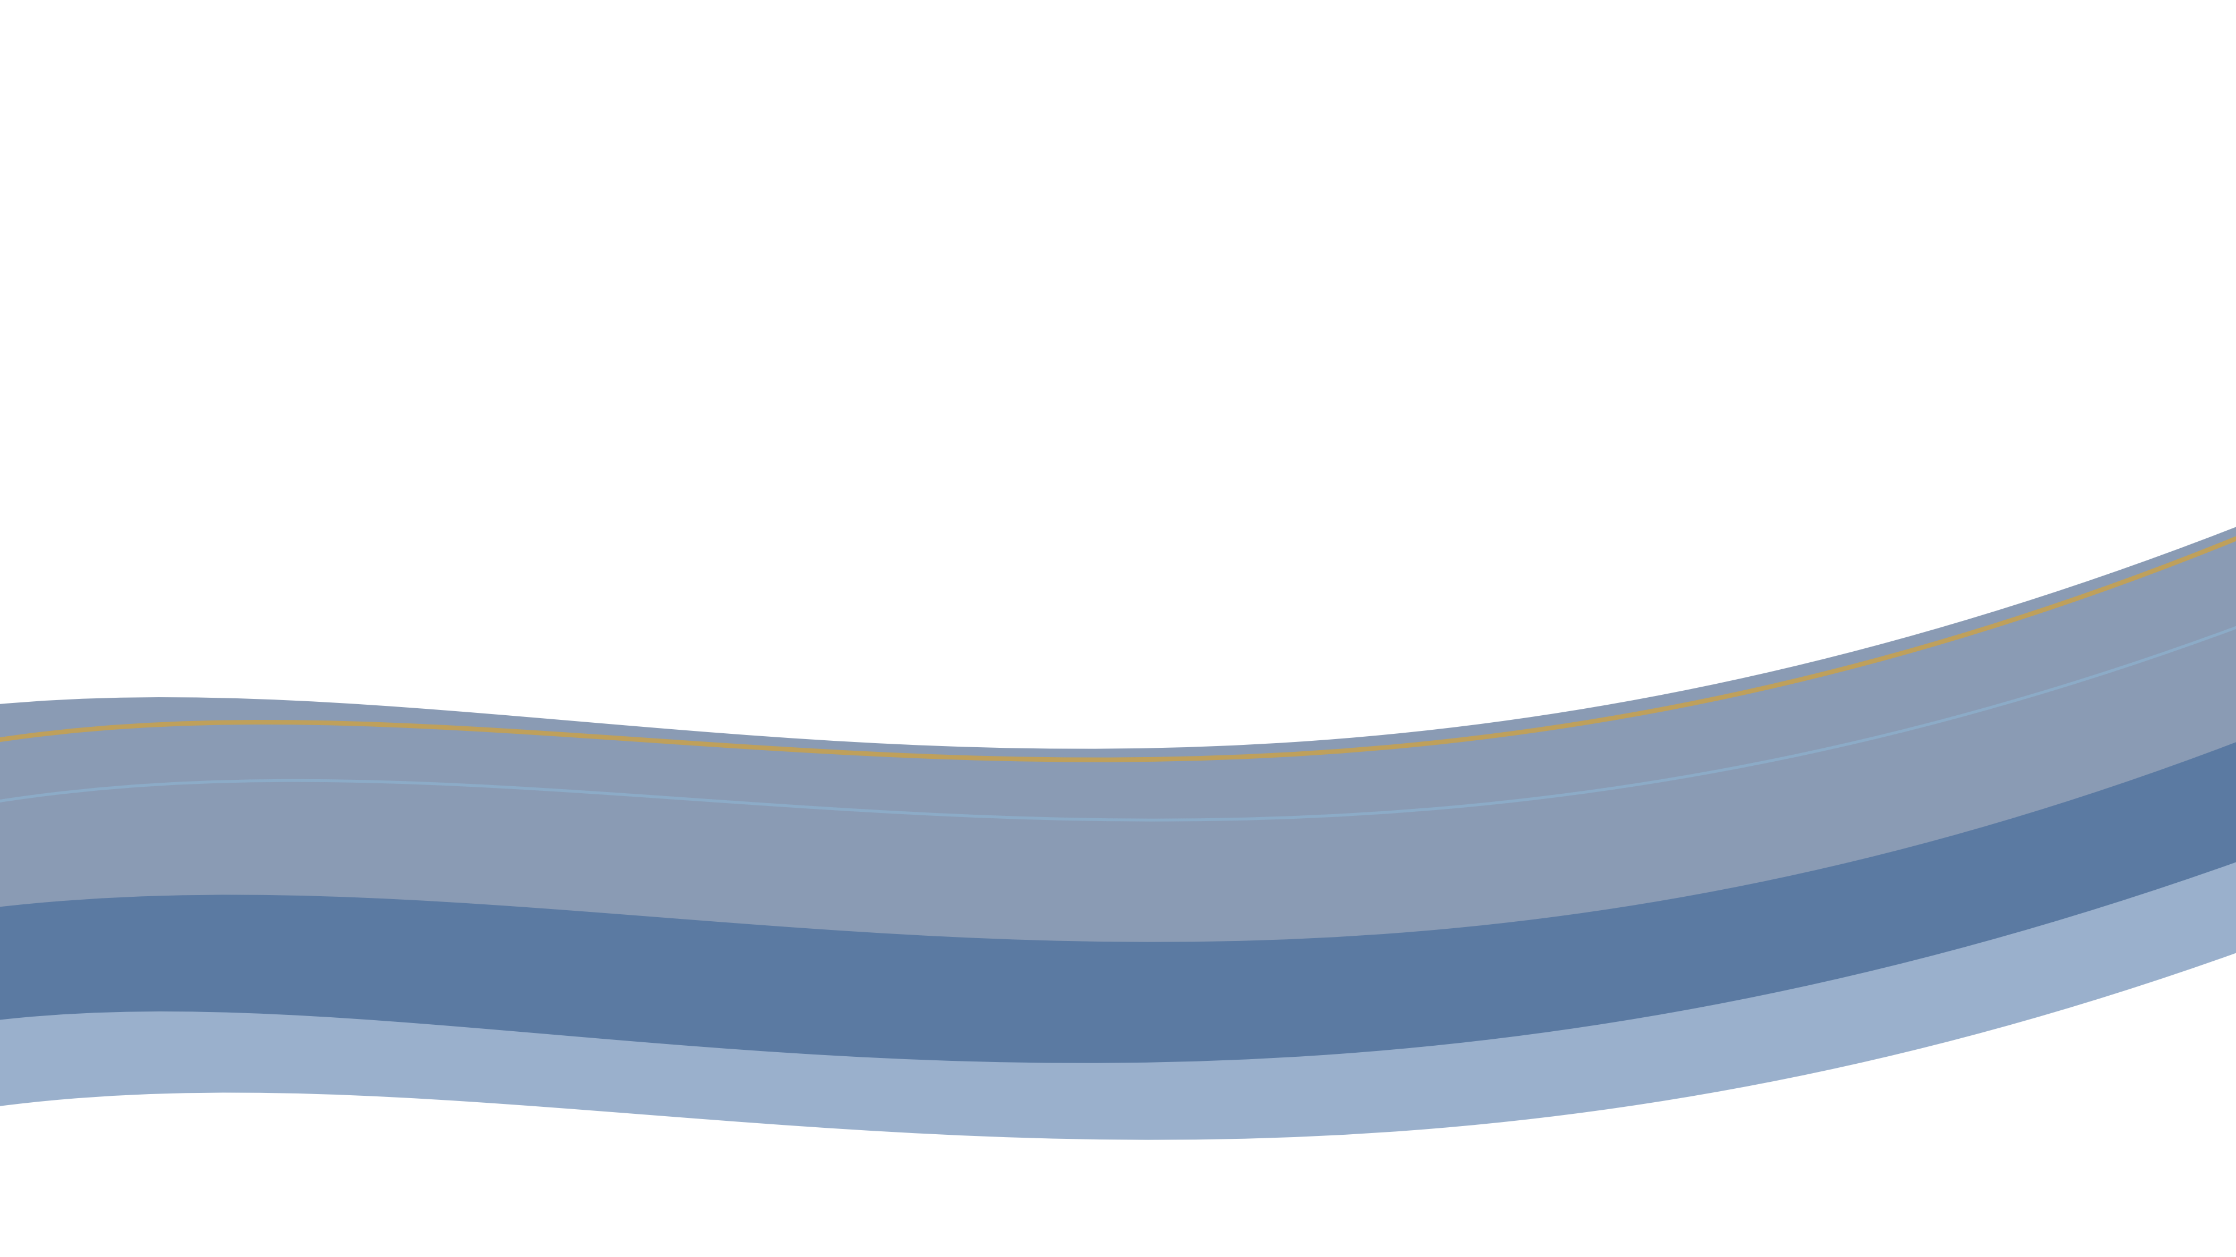
RBC CARDS POD · ANALYTICS WORKING GROUP
DRAFT — INTERIM · FOR WORKING-GROUP DISCUSSION
as of June 16, 2026
PCQ · CREDIT-CARD ACQUISITION
PCQ Sales Model — Interim Read (Draft)
Does the new Sales Model placement lift completed-application rate vs Champion?
Descriptive only — no control
2 waves, different maturity
Early — nothing called yet
Interim read · June 2026
DESCRIPTIVE · DIRECTIONAL ONLY — NOT CAUSAL
Notes:
Frame this as draft, interim, descriptive-only work for the working group to pressure-test. The question is whether adding the Sales Model placement lifts completed-app rate vs Champion. Stress: no control, two waves at different ages, nothing called yet.

Slide 2
PCQ SALES MODEL · INTERIM
Draft — interim · as of June 16, 2026
What we tested — two arms, two waves
Champion
NG3_CHMP
Sales Model Challenger
NG3_CHLN / NG3_CHLD
Existing placements
Same placements + the new Sales Model placement
Dashboard
Dashboard
Account Summary
Account Summary
Offers Hub
Offers Hub
Sales Model placement
NEW
TWO WAVES · BY TREATMENT-START
METRIC
Wave 1 ≈ Jun 1 · ~14 days mature
Completed-application rate by days since treatment (vintage curve)
Wave 2 ≈ Jun 9 · ~8 days, still maturing
Descriptive only — no control group; directional, not causal.
PCQ SALES MODEL · INTERIM · 02
Notes:
Champion is existing placements only. The Sales Model challenger adds one new placement on top of the same three. Two deployment waves by treatment-start date, at different ages. We read it as a vintage curve — completed-app rate by days since treatment — because the waves are at different maturities.

Slide 3
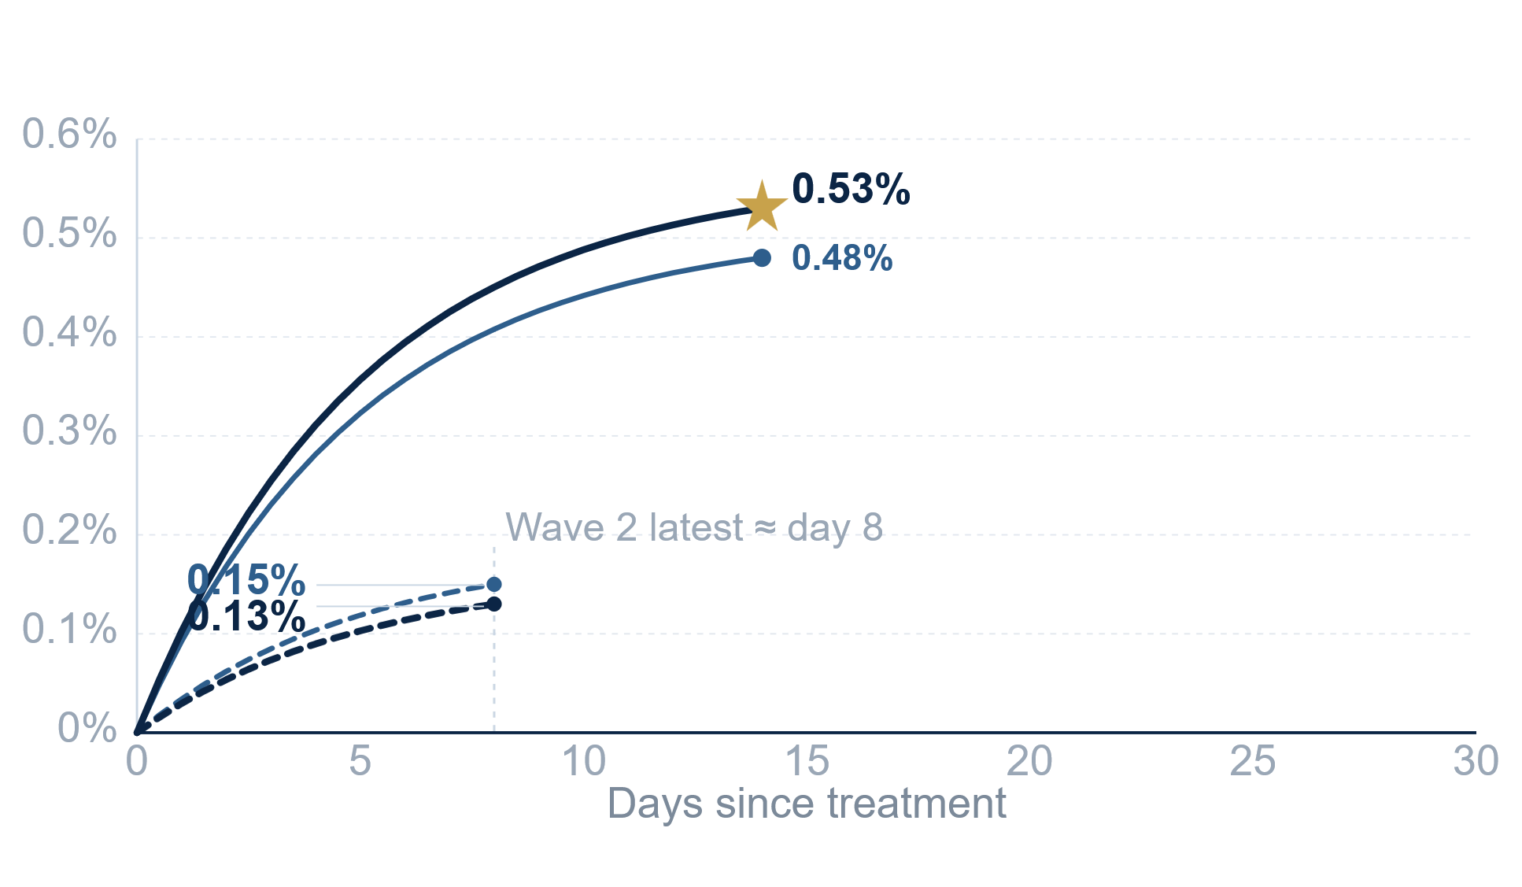
PCQ SALES MODEL · INTERIM
Draft — interim · as of June 16, 2026
What we see so far — wave-dependent, not yet stable
Sales Model
Champion
Wave 1 (~14d)
Wave 2 (~8d, censored)
POOLED TO DATE
effectively a tie
Champion
0.31%
433 / 139,394
Sales Model
0.32%
433 / 139,686
BY WAVE
Wave 1
~14d mature
0.53% SM vs 0.48% Champ +10% rel.
Wave 2
~8d, young / right-censored
0.15% Champ vs 0.13% SM SM behind
READ
Signal is wave-dependent and not yet stable. The vintage curve is the right lens — compare at equal vintage day, not latest rate.
(1) Rate = completed apps / population. Wave 2 right-censored at ~day 8 — not directly comparable to Wave 1's latest rate.
PCQ SALES MODEL · INTERIM · 03
Notes:
Pooled is effectively a tie — 0.31% vs 0.32%, label both with denominators. By wave it splits: Wave 1 Sales Model is ahead (0.53 vs 0.48, +10% relative), Wave 2 Sales Model is behind but Wave 2 is young and right-censored. The vintage curve is the right lens because the waves are at different ages — compare at equal vintage day, not latest rate.

Slide 4
PCQ SALES MODEL · INTERIM
Draft — interim · as of June 16, 2026
Open questions — what the room will ask
01
Targeting vs design — both arms appear across all 10 deciles; design intended Champion = top-5 only.
PENDING · PARMESHAR
Pending Parmeshar: intended, or a deployment variance? Pooled rate is decile-mix dependent.
02
Decile mix — conversion effectively dies after decile 2.
METHOD
Fair comparison is decile-by-decile (matched), not pooled.
03
Two challenger codes — NG3_CHLN vs NG3_CHLD.
TBD
Channels look identical — why two? Distinction TBD.
04
Maturity — Wave 2 still right-censored.
METHOD
Compare at equal vintage day, not latest rate.
05
No control group — directional only.
CAVEAT
We can describe, not attribute cause. Nothing here is causal.
Descriptive only — no control group; directional, not causal.
PCQ SALES MODEL · INTERIM · 04
Notes:
These are the things the room will press on. Targeting vs design is the big one — both arms appear across all 10 deciles but design intended Champion = top-5 only; pending Parmeshar whether that's intended or a deployment variance, and it matters because pooled rate is decile-mix dependent. Conversion dies after decile 2, so the fair comparison is decile-by-decile matched, not pooled. Open: why two challenger codes. Wave 2 still censored — compare at equal vintage day. And no control group, so directional only.

