Slide 1
VVD Campaign Measurement Results
Virtual Visa Debit — v2 Analysis | 6 Campaigns | 2024-2026
5,020,727
Total Clients (Action)
+1.10pp
Avg Lift
5 / 6
Campaigns Significant
6
Campaigns Measured
Campaign | Clients (Action) | Action Rate | Control Rate | Lift (pp) | p-value | Sig.
VCN | 2,166,516 | 0.59% | 0.39% | +0.20 | 0.0001 | ***
VDA | 59,211 | 0.80% | 0.48% | +0.32 | 0.0001 | ***
VDT | 385,000 | 58.20% | 54.10% | +4.10 | 0.0001 | ***
VUI | 1,200,000 | 12.50% | 11.80% | +0.70 | 0.0230 | *
VUT | 890,000 | 3.10% | 3.40% | -0.30 | 0.1500 | ns
VAW | 320,000 | 5.80% | 4.20% | +1.60 | 0.0001 | ***
Key Findings
VCN & VDA (acquisition): Consistent positive lift — continue campaigns
VDT (activation): Strong lift but small addressable population (~5% need activation)
VUI (usage): Marginal lift — optimization opportunity
VUT (tokenization): Negative ROI — recommend discontinuation
VAW (add to wallet): Positive lift at scale — expand

Slide 2
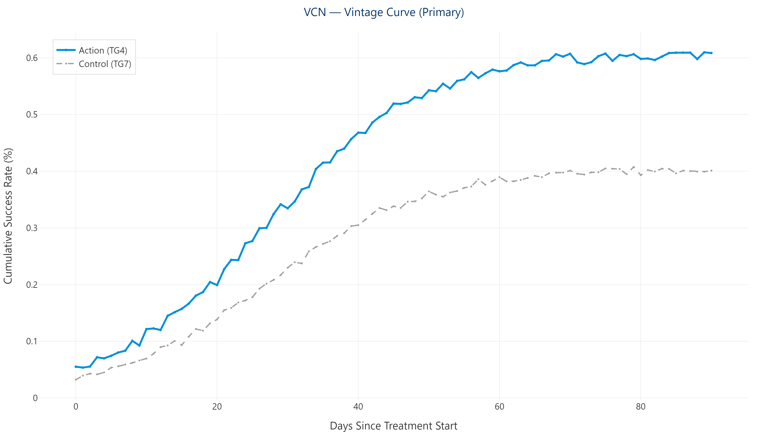
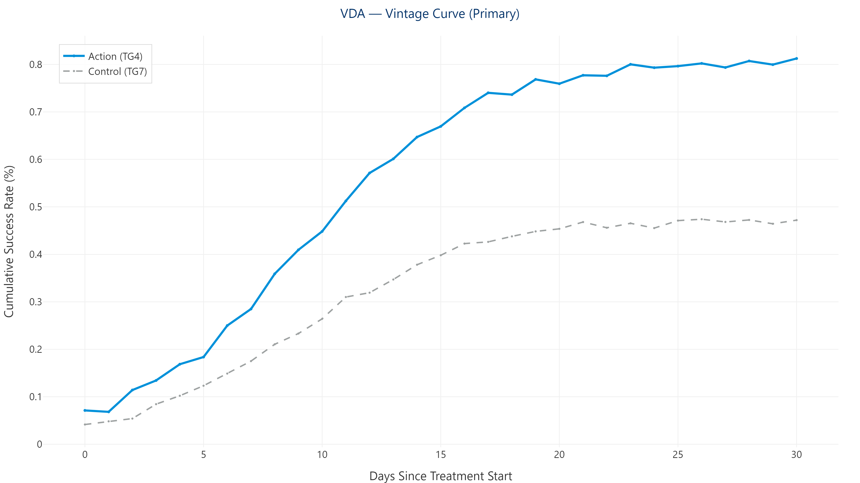
Card Acquisition
VCN — Contextual Notification | VDA — Black Friday
VCN — Contextual Notification
+0.20pp
Lift
0.59%
Action Rate
0.39%
Control Rate
0.0001
p-value
***
2,166,516
Clients (Action)
Statistically significant lift of +0.20pp
Persistent SRM warnings (p=0.0000) across all cohorts
Largest campaign by volume — consider SRM investigation
VDA — Black Friday
+0.32pp
Lift
0.80%
Action Rate
0.48%
Control Rate
0.0001
p-value
***
59,211
Clients (Action)
Statistically significant lift of +0.32pp
Seasonal campaign (Black Friday) — strong but time-limited
Highest lift among acquisition campaigns

Slide 3
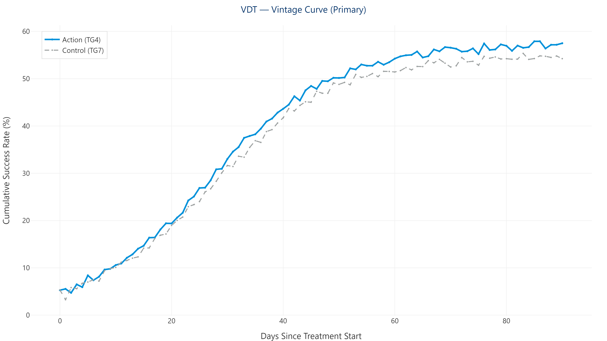
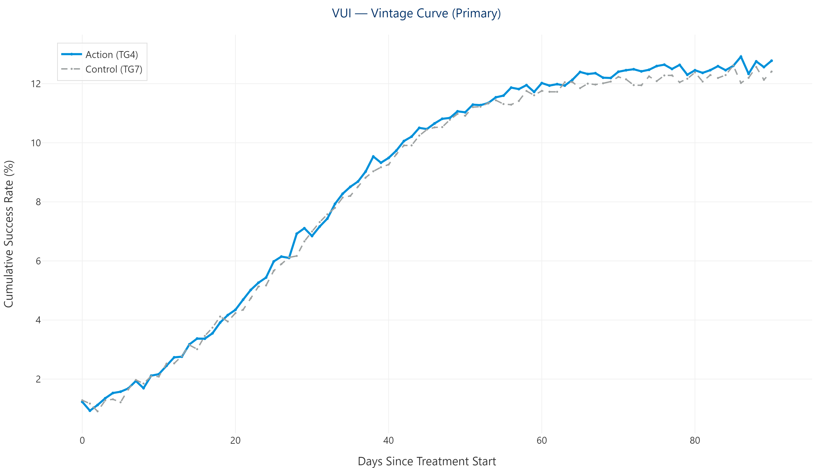
Activation & Usage
VDT — Activation Trigger | VUI — Usage Trigger
VDT — Activation Trigger
+4.10pp
Lift
58.20%
Action Rate
54.10%
Control Rate
0.0001
p-value
***
385,000
Clients (Action)
Statistically significant lift of +4.10pp
Only ~5% of cards need manual activation (95% auto-activate)
High lift but small addressable market
VUI — Usage Trigger
+0.70pp
Lift
12.50%
Action Rate
11.80%
Control Rate
0.0230
p-value
*
1,200,000
Clients (Action)
Statistically significant lift of +0.70pp
Broad reach — largest usage population
Marginal lift suggests optimization needed

Slide 4
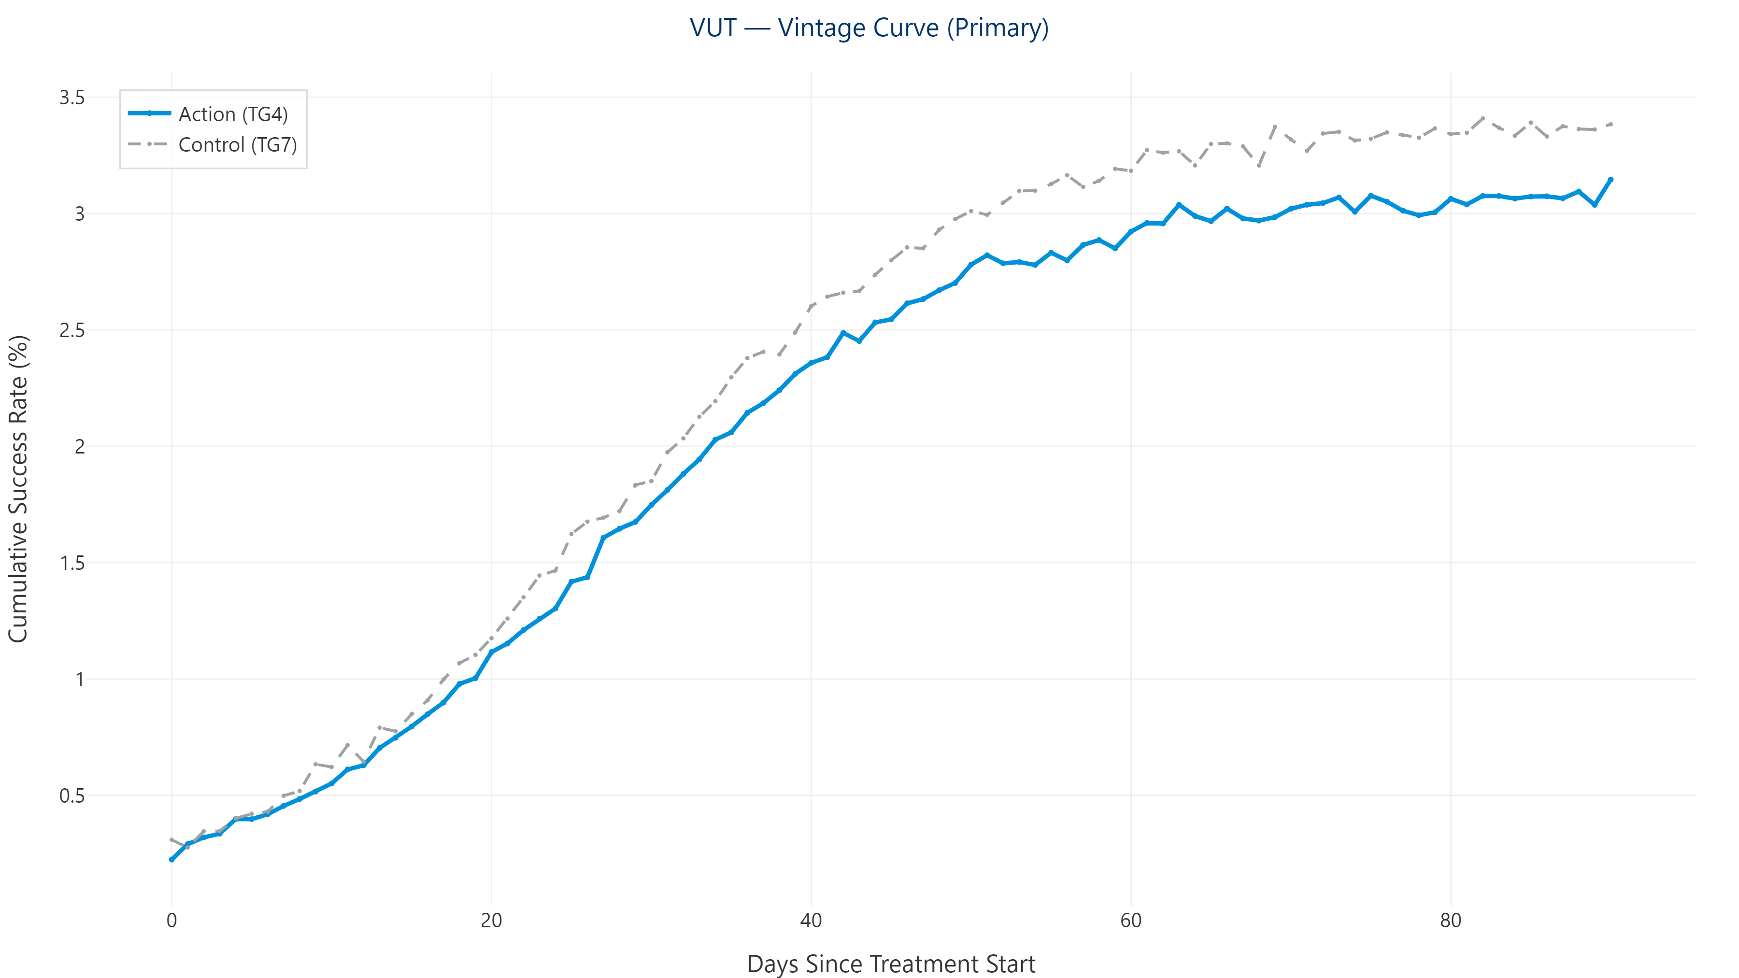
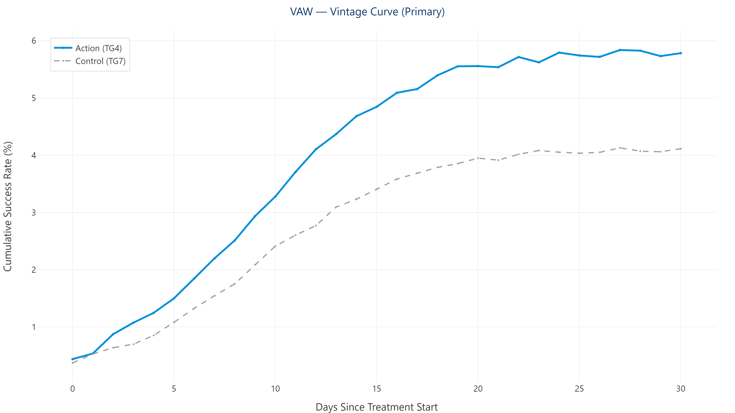
Wallet Provisioning
VUT — Tokenization Usage | VAW — Add To Wallet
VUT — Tokenization Usage
-0.30pp
Lift
3.10%
Action Rate
3.40%
Control Rate
0.1500
p-value
ns
890,000
Clients (Action)
Lift of -0.30pp — NOT statistically significant
Negative ROI — recommend discontinuation
Control performs equal or better than Action
VAW — Add To Wallet
+1.60pp
Lift
5.80%
Action Rate
4.20%
Control Rate
0.0001
p-value
***
320,000
Clients (Action)
Statistically significant lift of +1.60pp
Positive lift at scale
Consider expanding budget allocation

