Slide 1
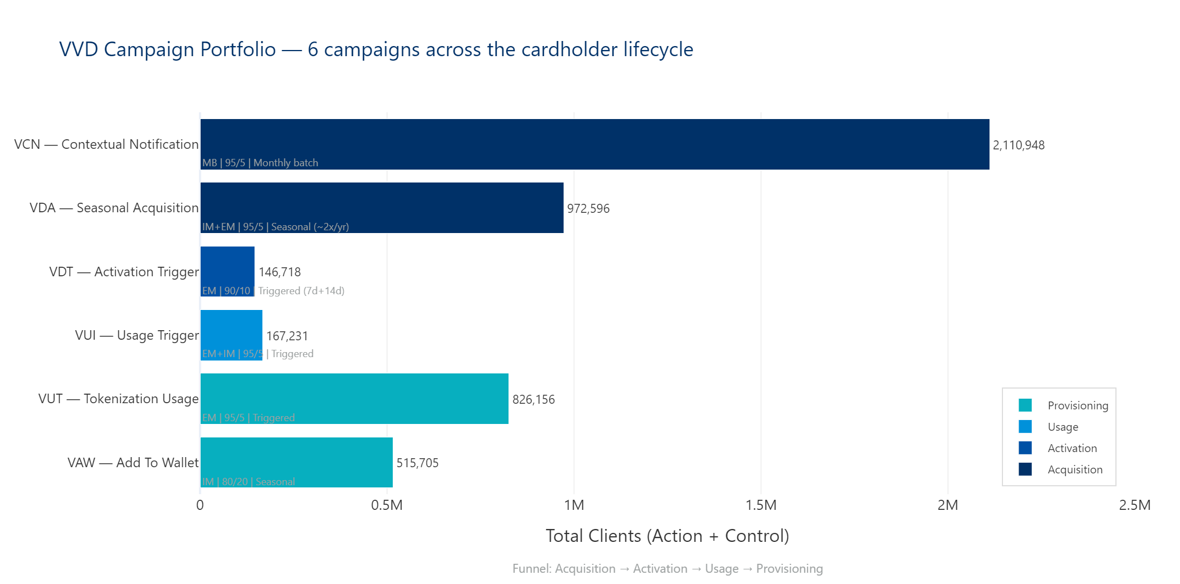
Campaign: Virtual Visa Debit — VVD
| 1

Slide 2
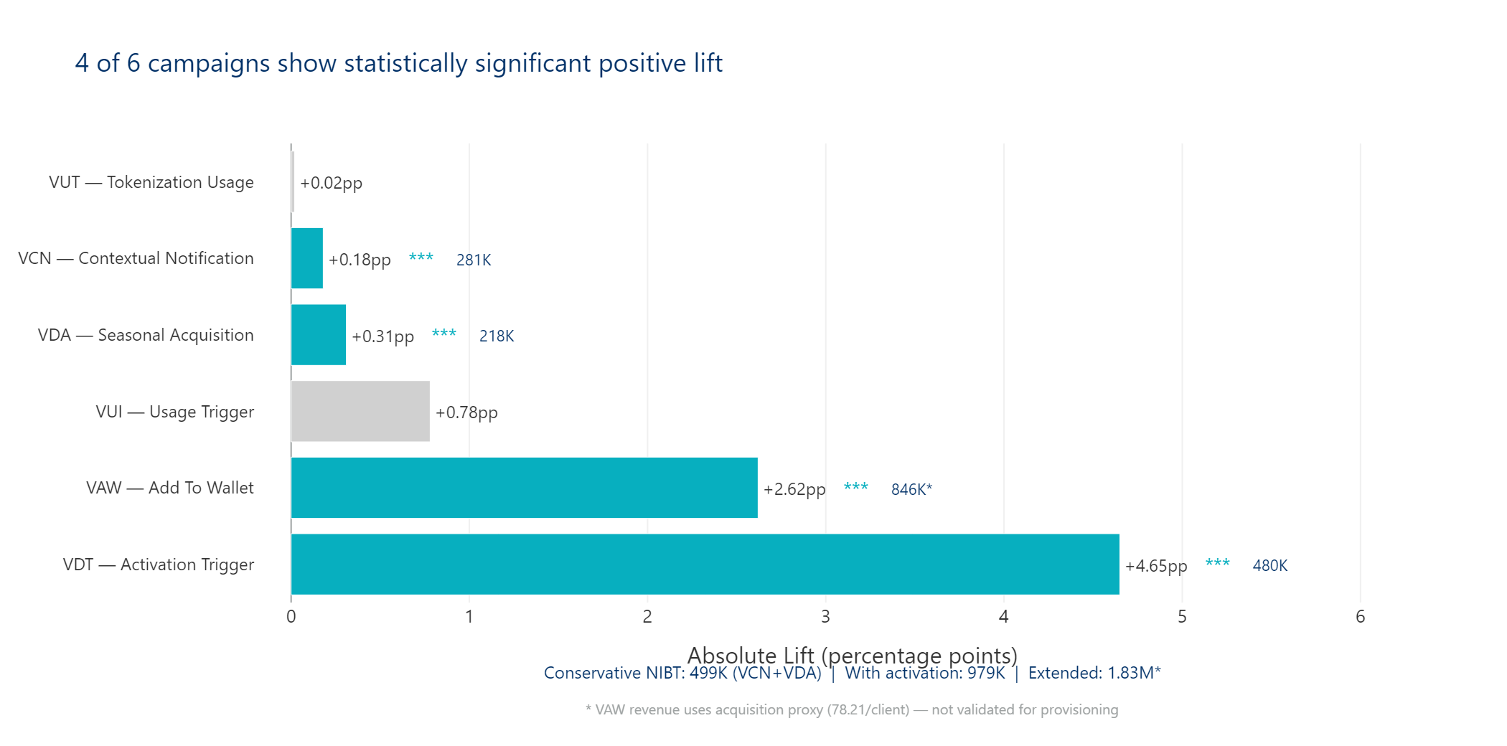
Campaign: Virtual Visa Debit — VVD
| 2

Slide 3
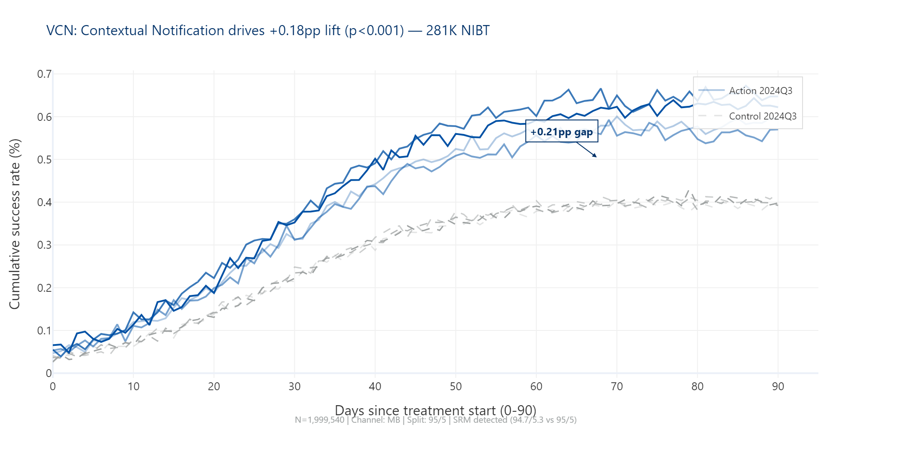
Campaign: Virtual Visa Debit — VVD
| 3

Slide 4
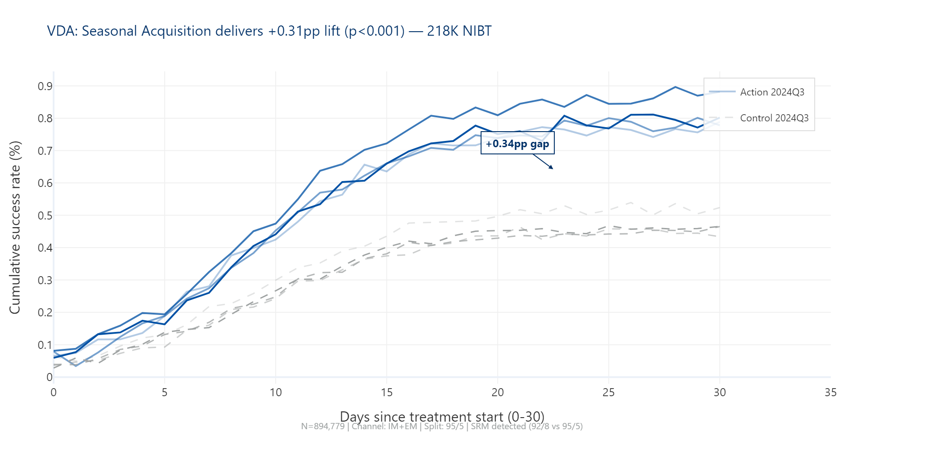
Campaign: Virtual Visa Debit — VVD
| 4

Slide 5
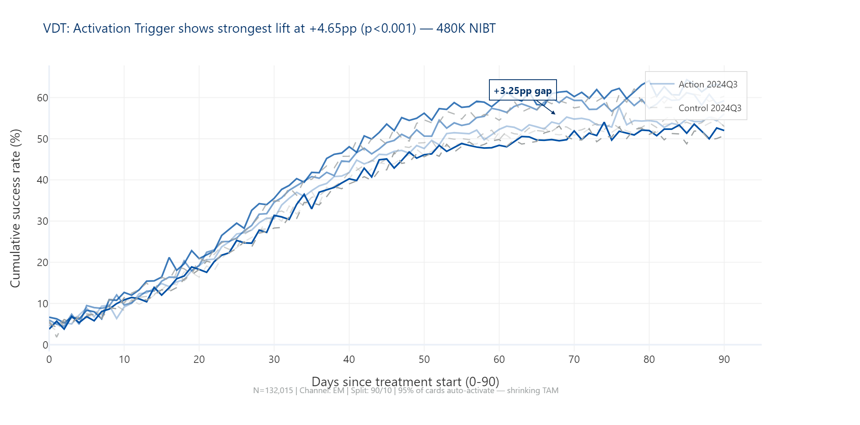
Campaign: Virtual Visa Debit — VVD
| 5

Slide 6
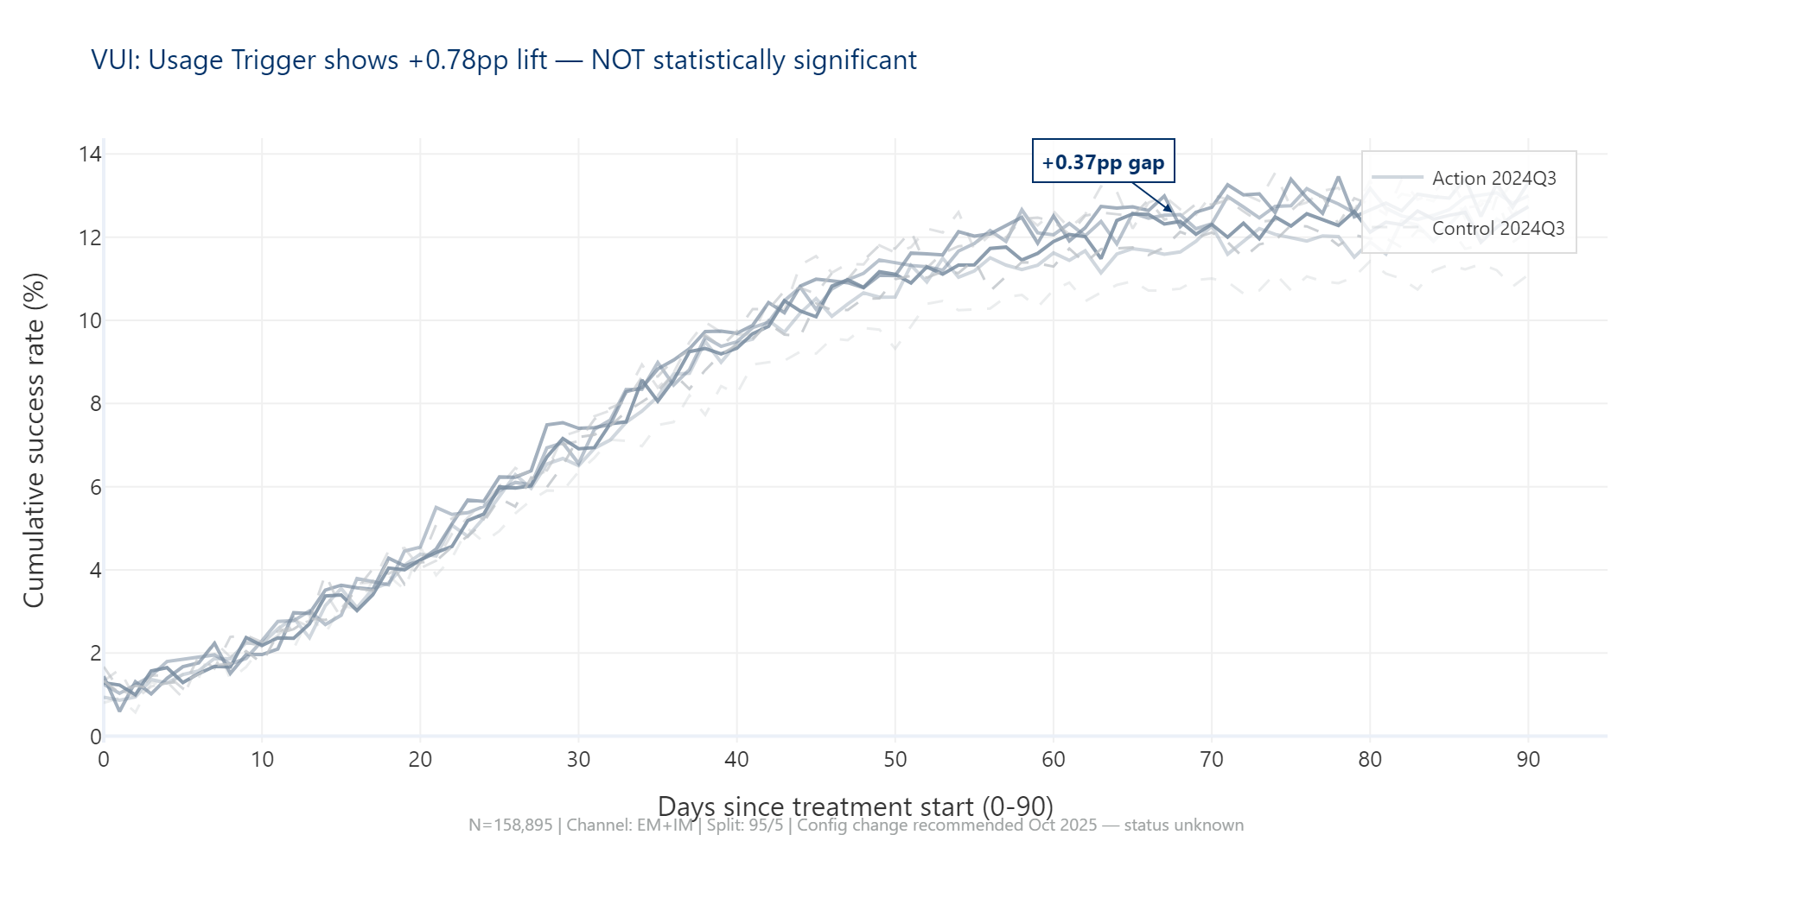
Campaign: Virtual Visa Debit — VVD
| 6

Slide 7
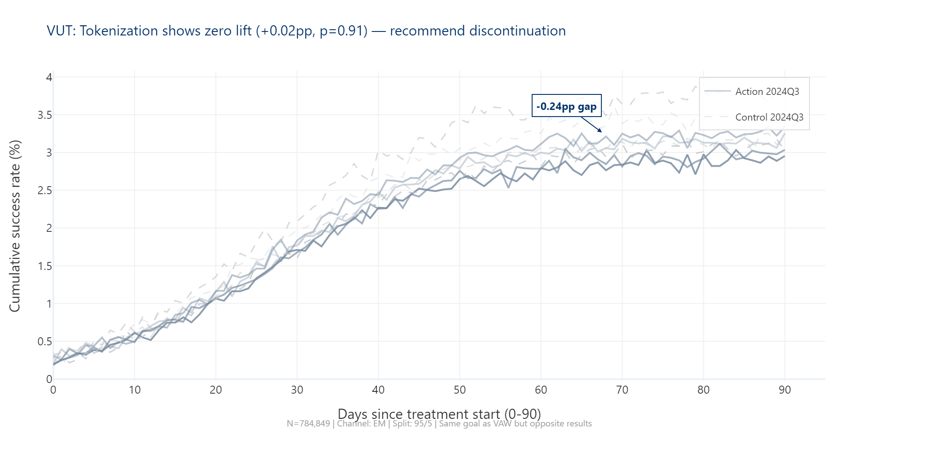
Campaign: Virtual Visa Debit — VVD
| 7

Slide 8
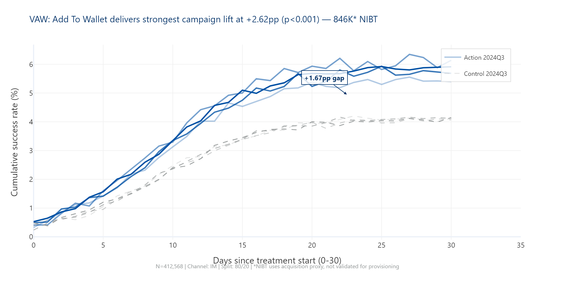
Campaign: Virtual Visa Debit — VVD
| 8

Slide 9
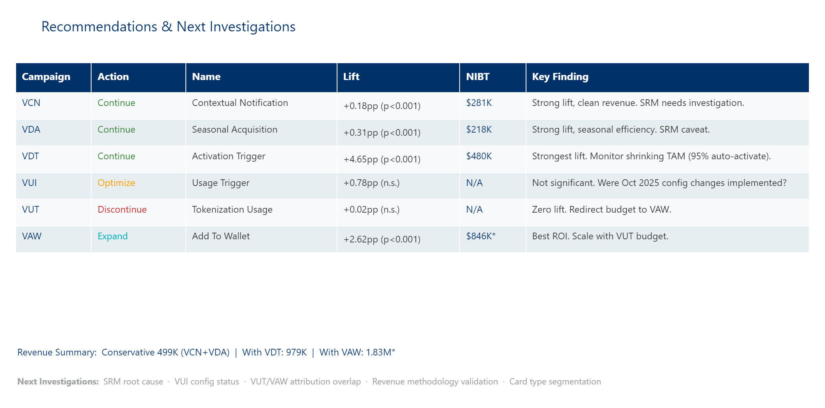
Campaign: Virtual Visa Debit — VVD
| 9

