Slide 1


ADIDAS US SALES
ANALYSIS
DASHBOARD
PRESENTED BY
ANJANA SABU

Slide 2
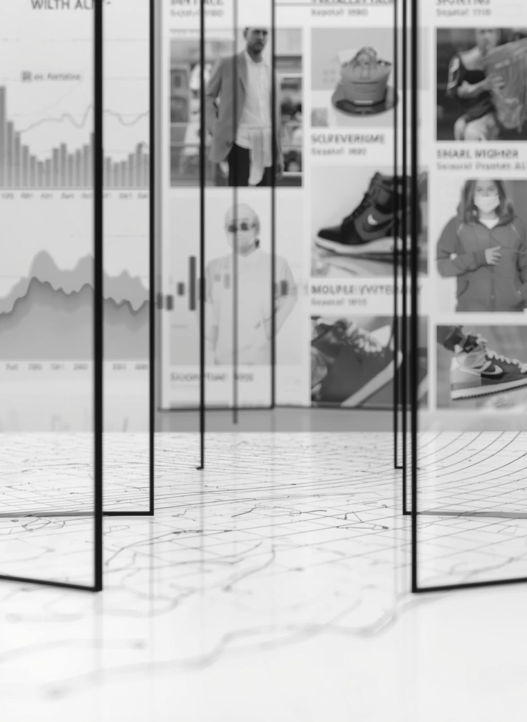
INTRODUCTION
• The Adidas US Sales dataset provides insights into product categories, pricing, ratings, reviews, and availability.
• It enables analysis of customer engagement, product popularity, and market preferences.
• The dataset supports identification of best-performing categories, target audience segments, and color trends.
• This dashboard helps in understanding product performance and strategic business decision-making.
PRESENTED BY

Slide 3
OBJECTIVES
• Analyze overall product portfolio and key performance metrics.
• Identify dominant product categories and target audience segments.
• Examine customer engagement through ratings and reviews.
• Study pricing distribution and mid-tier performance.
• Provide strategic recommendations for inventory and marketing.
PRESENTED BY

Slide 4
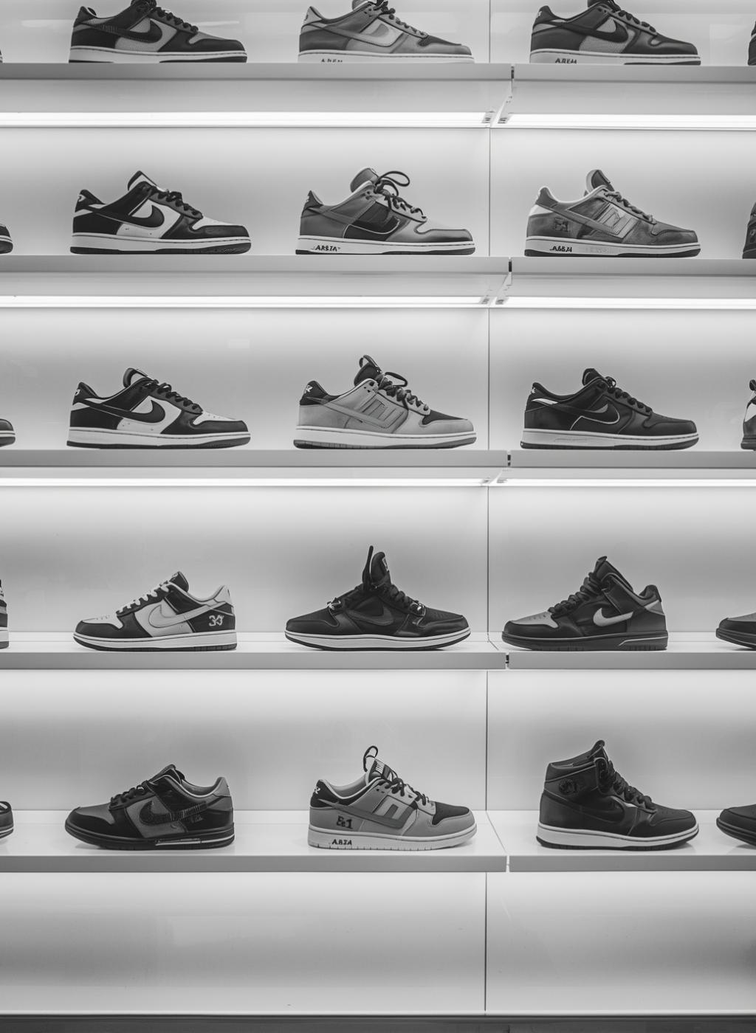
DATASET
• Retail Product Sales Dataset – Adidas US
• Total Products: 845
•Total columns: 21
• Includes: Category, Price, Rating, Review Count,
Color, Availability
• Structured for interactive dashboard analysis

Slide 5
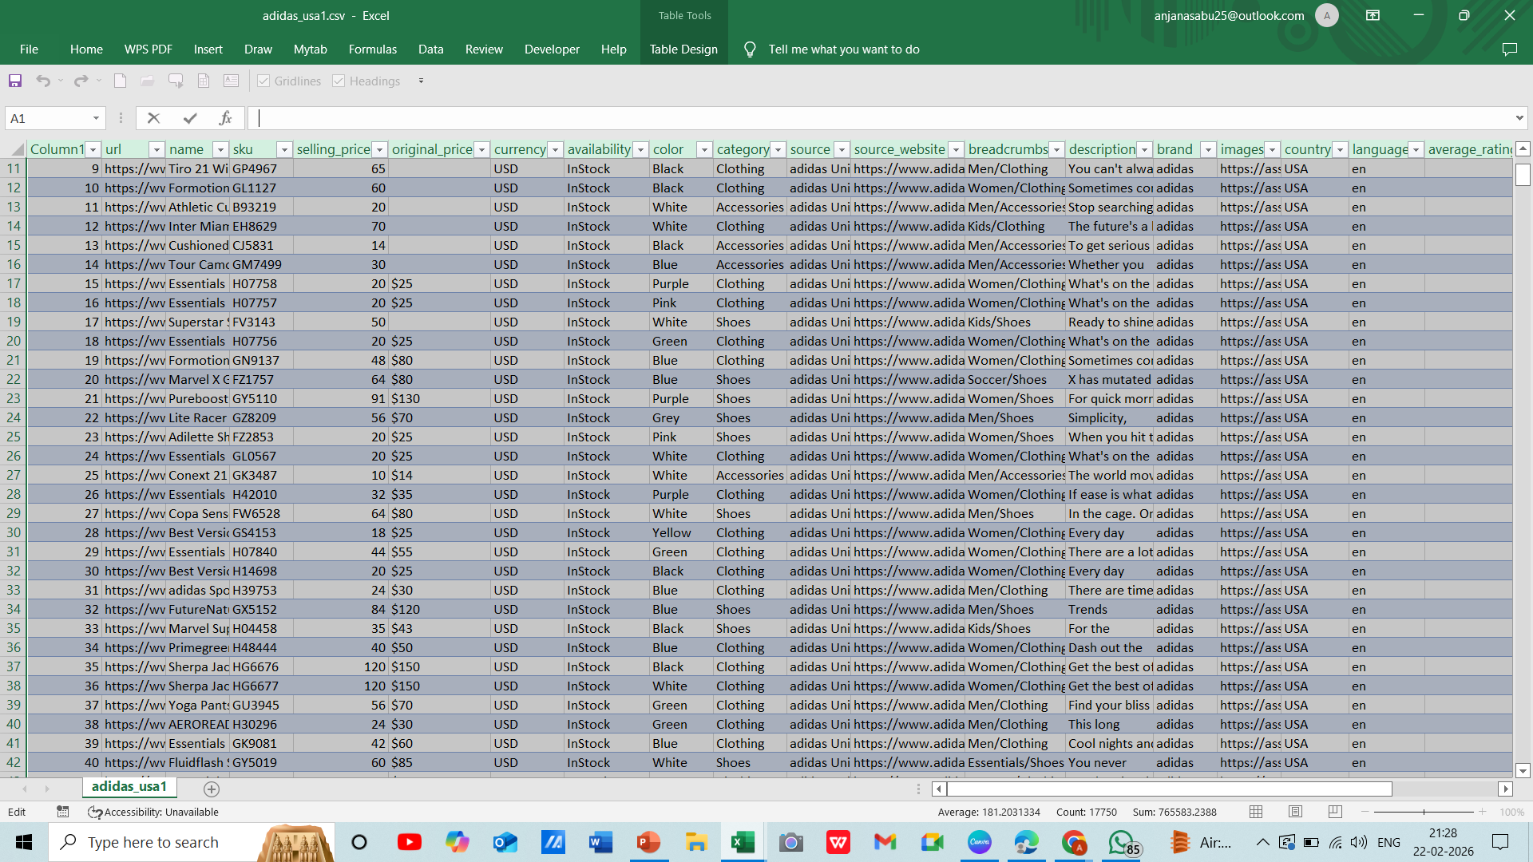
DATASET
DATASET

Slide 6
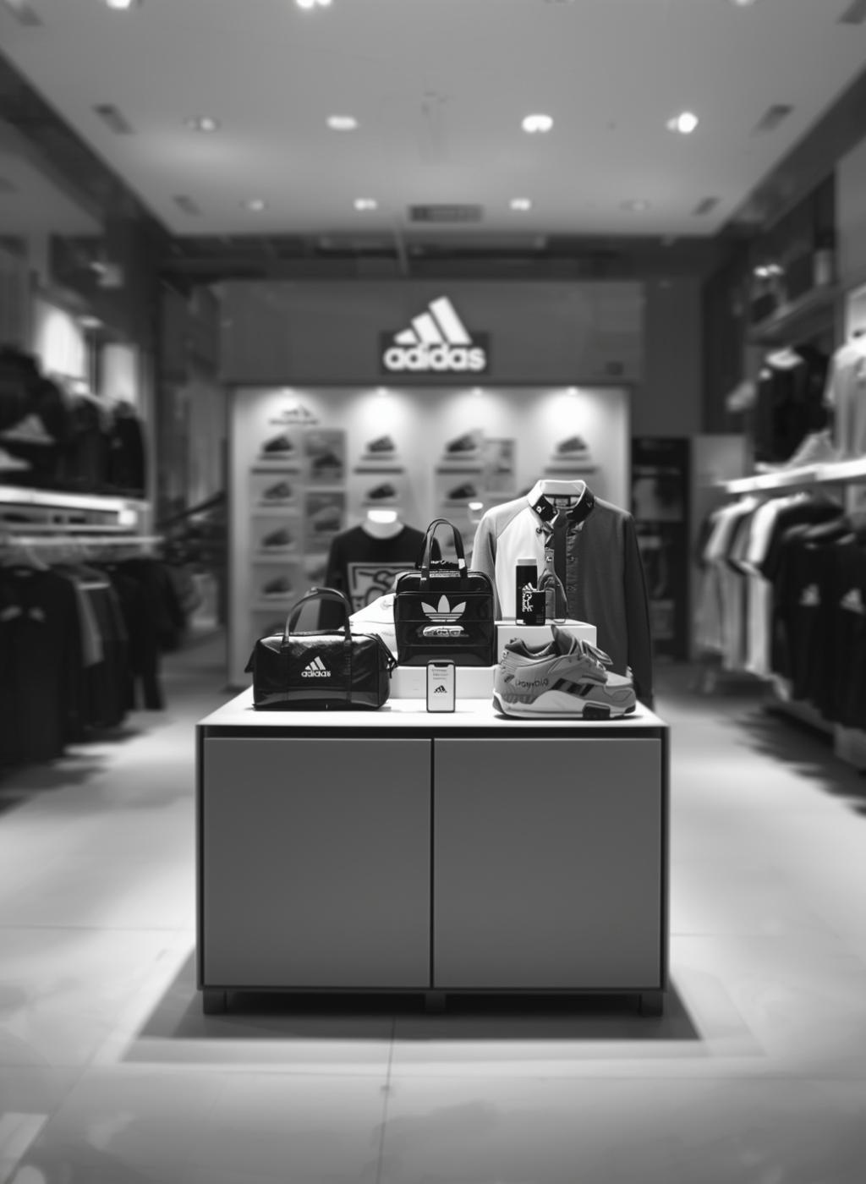
CRITERIA USED
• Total Products – KPI Card • Total Reviews – KPI Card • Average Price – KPI Card • Average Rating – KPI Card • Category Distribution – Bar Chart • Target Audience Distribution – Donut Chart • Color Distribution – Horizontal Bar Chart • Price Distribution – Histogram • Availability Status – Pie Chart • Top Selling Products – Bubble Chart • Filters (Slicers): Category,
Calculated Field-
Target audience:
IF CONTAINS([Products], "Women") THEN "Women"
ELSEIF CONTAINS([Products], "Men") THEN "Men"
ELSEIF CONTAINS([Products], "Kids") THEN "Kids"
ELSE "Unisex"
END
PRESENTED BY

Slide 7
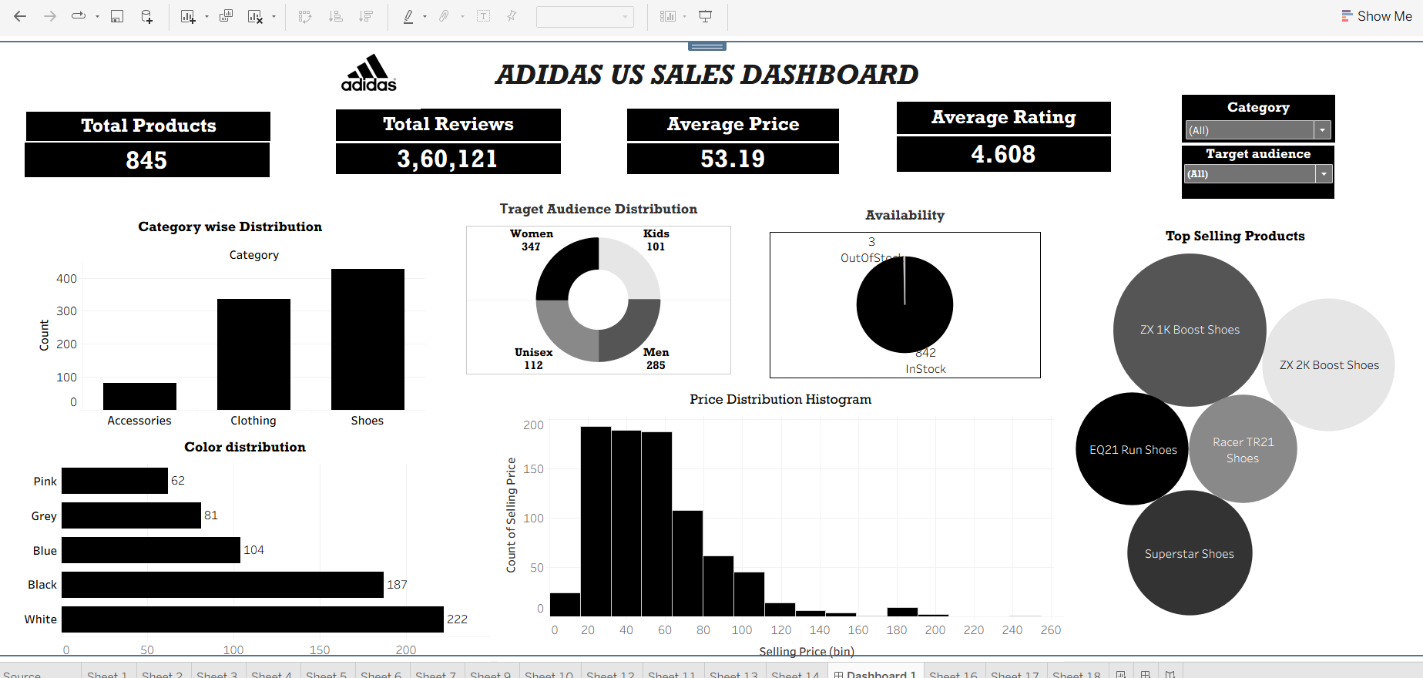
DASHBOARD

Slide 8
CONCLUSION
• Provides a complete view of Adidas US product performance
.
• Shoes and Women segments lead portfolio dominance.
• White and Black drive strongest color preference.
• Products concentrate in the mid-price range, supporting mass appeal.
• 4.6+ average rating reflects strong customer satisfaction.
• Review insights reveal high-engagement products and growth potential.
• Enables data-driven decisions in inventory, pricing, and marketing.
PRESENTED BY

Slide 9
RECOMMENDATION
• Expand top-performing color variants.
• Strengthen inventory control in Shoes & Clothing.
• Promote high-rated, low-visibility products.
• Focus on competitive mid-tier pricing.
• Leverage customer satisfaction for targeted marketing.
PRESENTED BY

Slide 10
REFERENCE
• Adidas US Sales Dataset -Kaggle • Tableau Public
PRESENTED BY

Slide 11

THANK YOU

