Slide 1
Introduction and Description of the Project
Theme:Social Good
Project Title: House Rent Prediction Model Overview: The House Rent Prediction System is an AI-based solution designed to predict house rental prices in India. The system aims to assist tenants, landlords, and real estate agents in making informed decisions regarding property rentals. By leveraging machine learning algorithms, the system analyzes historical rent data and property features to estimate accurate rental prices.
Objectives: Predict accurate rental prices, enhance market transparency, and streamline rental processes. Target Audience: Tenants, landlords, and real estate stakeholders.

Slide 2
Concept and Theory Used
AI and ML: Utilizing Artificial Intelligence and Machine Learning for rent prediction. Regression Algorithms: Implementing regression models (e.g., Linear Regression) for data analysis. Feature Selection: Identifying relevant features (e.g., area, bathrooms, furnished status) for rent estimation.

Slide 3
Impact of this Idea
Benefits: Empowering users with accurate rent estimates, leading to better decision-making. Market Impact: Improving market efficiency, fairness, and trust in the real estate sector. Social Impact: Contributing to housing affordability and supporting fair rental practices.

Slide 4
Timelines, Approach, and Implementation Flow
Project Initiation
Data Collection
Data Preprocessing
Data Exploration and Analysis
Model Selection
Model Training
Model Evaluation
Web Interface Development
Integration and Testing

Slide 5
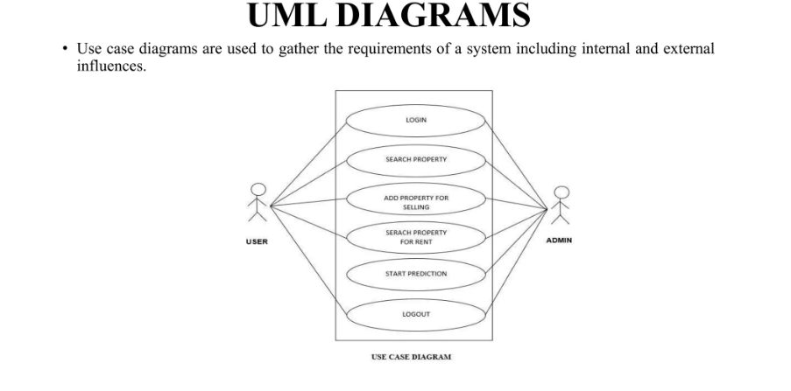
Workflow of the Project

Slide 6
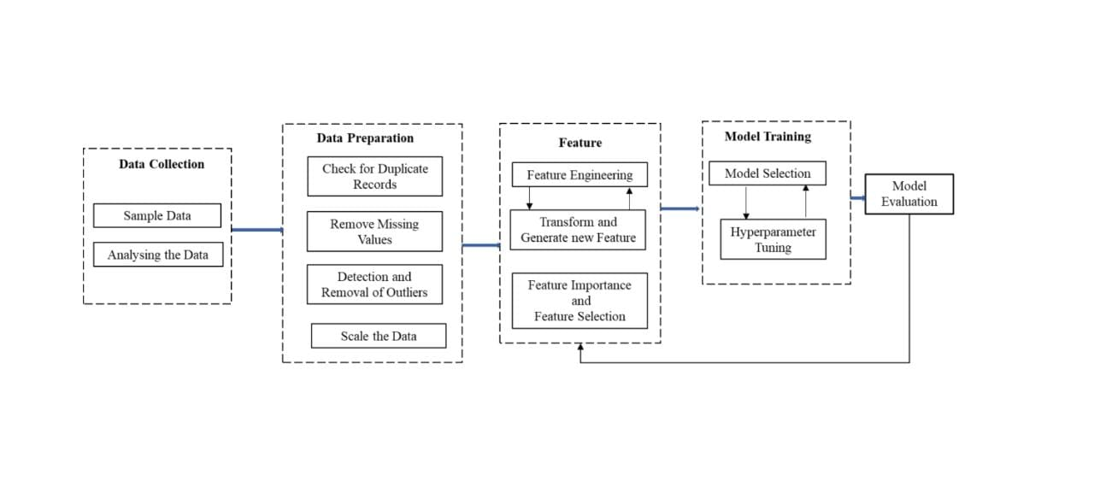
Data Flow Diagram(DFD)

Slide 7
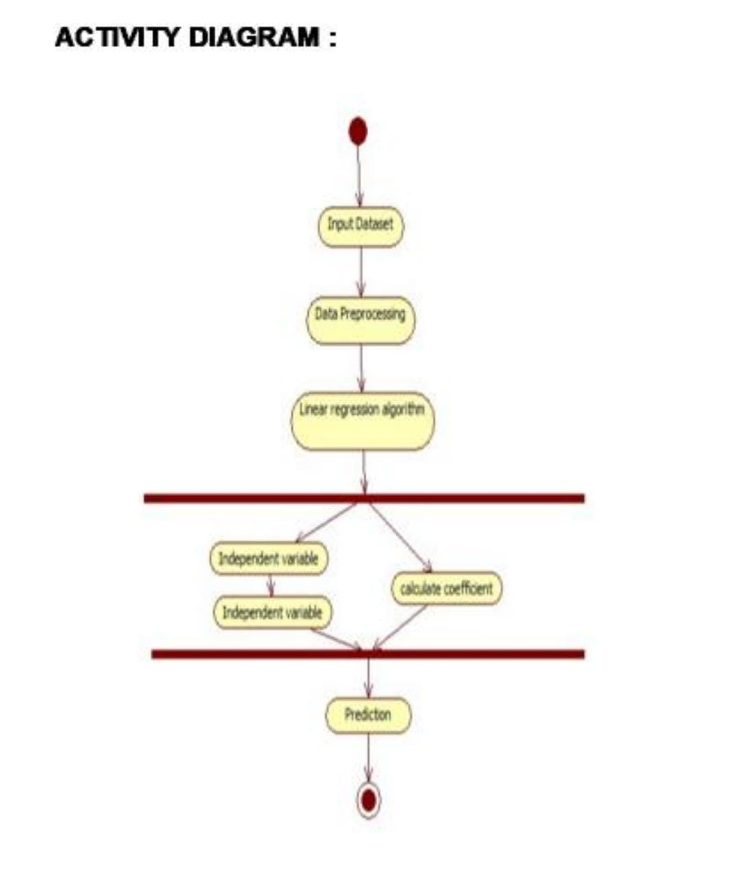
Activity Diagram

Slide 8
Features
1. Area
2. Bathroom
3. Furnished Status
4. Air Conditioning
5. Stories
6. Bedrooms
7. Basement
8. Parking
9. Hot Water
10. Guestroom
11. Main Road

