Slide 1

Linux Process Tree Visualizer
Live process hierarchy using the Linux /proc filesystem
Operating Systems and Systems Programming (25CS2104E)
Faculty: Dr. Muniraju Naidu
Team Members:
Teja Hasini Reddy - 2520030048
Hansika Reddy - 2520030237
Simran Jangid - 2520030166
Anthony Nissy - 2520030064

Slide 2
Project Overview
A compact systems tool that turns Linux process metadata into a live, readable hierarchy.
Reads process metadata exposed by the Linux kernel through /proc.
Collects each process's PID, parent PID (PPID), name, and state, then displays parent-child links as a tree.
The live view refreshes periodically so newly started or terminated processes can be noticed.
WHAT IT DISPLAYS
WHY IT MATTERS
PID, parent PID, command name, state, and depth — arranged as parent → child relationships.
Hierarchy helps diagnose runaway jobs, inspect shells and services, and understand how Linux creates and manages processes.

Slide 3
Problem Statement
Linux exposes process data - but not as an immediately understandable tree.
The /proc directory contains many numeric entries, each representing a process, and the list can change while it is being read.
A flat process list makes it harder to see which shell, service, or task started another process.
The program must tolerate entries disappearing during a scan and still produce readable output.
RAW INPUT
ENGINEERING NEED
USEFUL OUTPUT
Hundreds of numeric /proc directories and status files.
Safely scan changing data and reconstruct parent–child links.
A refreshed terminal tree that remains clear and interruptible.

Slide 4
Objectives
Design priority: show parent-child relationships clearly, keep refresh behavior predictable, and stop cleanly when the user interrupts the program.
01
02
03
Discover active processes from /proc
Parse PID, PPID, name, and state
Build correct parent–child relationships
04
05
06
Render a stable, readable terminal tree
Support one-shot and live refresh modes
Exit cleanly on SIGINT or SIGTERM

Slide 5
Technologies Used
TECHNOLOGY
PURPOSE
HOW IT IS USED
C
Core implementation
Scanning, parsing, sorting, and rendering
Linux
Execution platform
Provides processes and POSIX behaviour
/proc
Process data source
Reads numeric directories and status metadata
POSIX APIs
System interface
Directory, file, process, and timing calls
Signals
Safe shutdown
Handles SIGINT and SIGTERM with a flag
ANSI codes
Terminal refresh
Clears screen and restores cursor position
GCC / compatible
Build tool
Compiles with warnings enabled

Slide 6
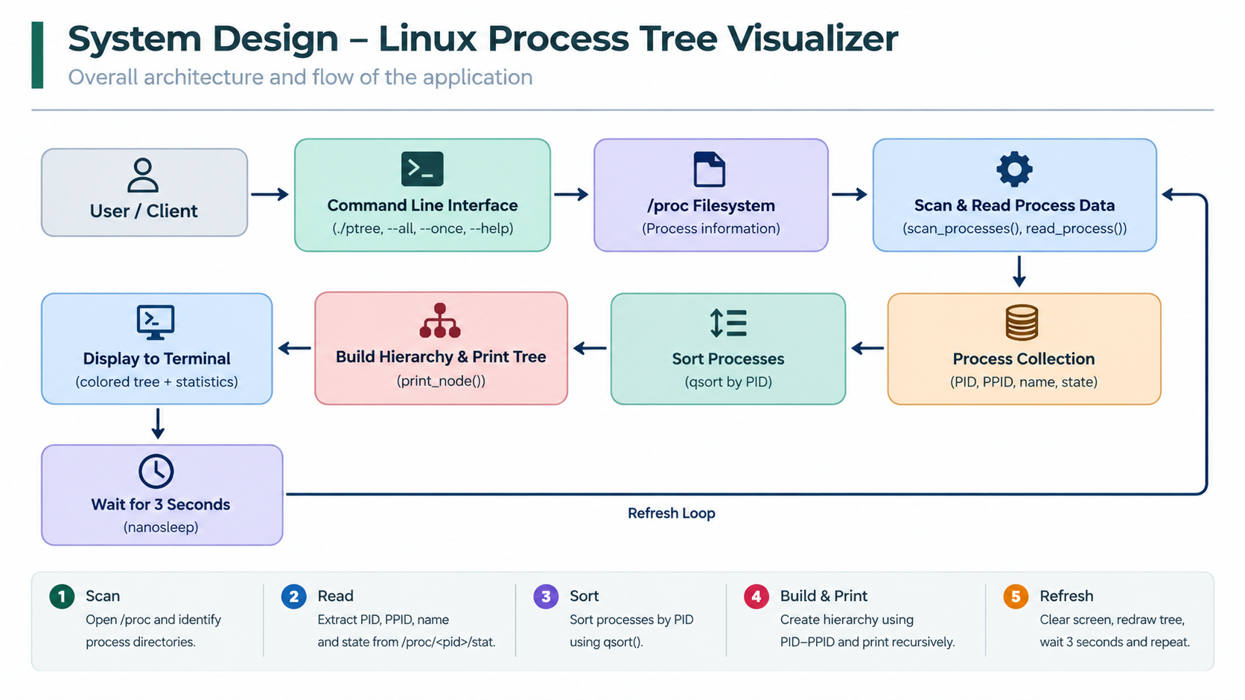
System Design / Architecture

Slide 7
How the Program Works
1
Read options
Set display mode, interval, and one-shot behavior.
2
Install handlers
Register SIGINT and SIGTERM; keep handlers minimal.
3
Scan /proc
Visit numeric entries and ignore transient read failures.
4
Build + render
Sort records, link children, clear terminal, print tree.
5
Wait or exit
Sleep for the refresh interval, or stop after --once / signal.

Slide 8
Process Information
Example record assembled from /proc/<pid>/status or stat
PID
PPID
NAME
STATE
DEPTH
1642
731
bash
S
2
Unique process identifier
Identifier of the parent process
Readable command / process name
Kernel state code
Derived indentation level
State indicators: R running • S sleeping • D uninterruptible wait • T stopped • Z zombie

Slide 9
Core Implementation
Filter directory names to digits only
Open process files defensively; entries may disappear
Parse fixed fields with bounded buffers
Sort by PID for deterministic output
Use a signal-safe flag; clean up in normal control flow
Accept only numeric directory names under /proc as process IDs.
Open process files defensively because a process may exit during scanning.
Parse PID, PPID, name, and state using bounded buffers and checked reads.
Store records, then sort by PID to make output order predictable.
volatile sig_atomic_t stop = 0;
static void on_signal(int sig) {
(void)sig;
stop = 1;
}
while (!stop) {
scan_proc(&records);
render_tree(&records);
if (once) break;
sleep(interval);
}

Slide 10
Data Structures and Tree Rendering
Process record
init (1)
pid_t pid;
pid_t ppid;
char name[256];
char state;
int depth;
sshd (731)
logger (412)
Rendering logic
bash (1642)
Find records whose PPID matches the current PID, print branch glyphs, then recurse with increased depth.
A process record stores PID, PPID, name, state, and derived depth.
PID sorting provides deterministic ordering, but the hierarchy comes from PID/PPID matching.
Recursive rendering prints each child beneath its parent and increases indentation for deeper levels.
ptree (1740)

Slide 11
Command-Line Usage
$ ./ptree
$ ./ptree --all
$ ./ptree --once
$ ./ptree --interval 2
$ ./ptree --help
Live view with default filtering
Include all visible processes
Scan and render once, then exit
Refresh every 2 seconds
Show options and usage
Build example gcc -std=c11 -Wall -Wextra -O2 -o ptree ptree.c

Slide 12
Testing and Validation
Planned validation — record evidence before claiming a pass.
TEST
ACTION
EXPECTED BEHAVIOUR
EVIDENCE TO CAPTURE
Help path
Run --help
Usage text; exit cleanly
Captured terminal text
One-shot
Run --once
Single scan and render
Exit code + screenshot
Hierarchy
Start child shell
Child shown below parent
PID/PPID cross-check
Refresh
Create / end process
View changes next cycle
Before / after capture
Signals
Send SIGINT / SIGTERM
Loop stops cleanly
Exit observation
Permissions
Restrict / race an entry
Skip unreadable entry
Warning / stable output

Slide 13
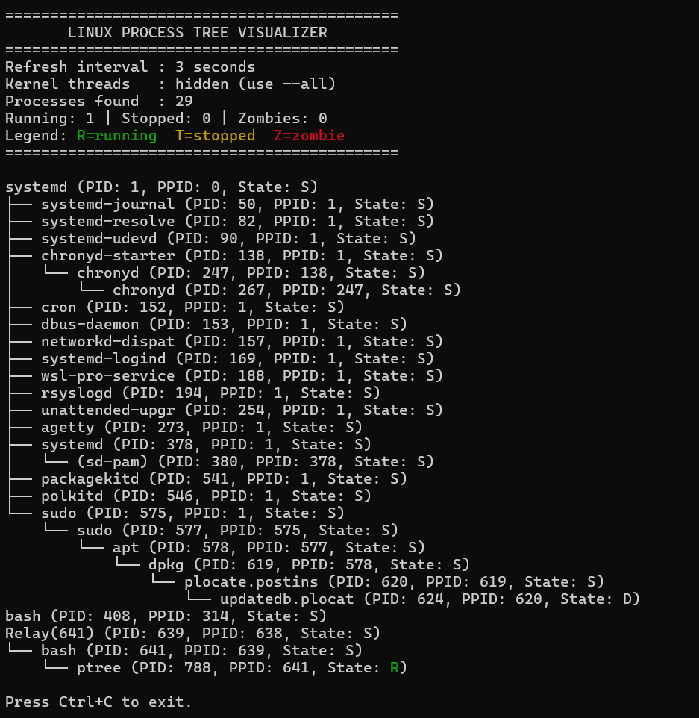
Output and Results
WHAT SHOULD BE VISIBLE
• Process name and PID
• Clear branch indentation
• Parent before children
• State indicators, if enabled
• Stable refresh without scroll spam
Result reporting remains evidence-based: add the actual screenshot and observed behavior after running on Linux.

Slide 14
Limitations, Impact, and Future Scope
CURRENT LIMITATIONS
POTENTIAL IMPROVEMENTS
• Linux-specific /proc dependency
• Snapshot races as processes start or exit
• Permissions can hide selected metadata
• Very large trees may exceed terminal height
• ANSI behavior varies across terminals
• Search, filtering, and collapsed branches
• Configurable columns and refresh rate
• Color only when terminal capability allows
• Export a snapshot to text or JSON
• Add automated fixtures for parser edge cases
Impact: a small, inspectable tool that connects operating-systems theory with real kernel-exposed process data.

Slide 15
Linux Process
Tree Visualizer
From /proc records to a live hierarchy: scan safely, link accurately, render clearly, and exit cleanly.
VIVA TAKEAWAY
The project demonstrates practical Linux systems programming through filesystem parsing, POSIX control flow, signal handling, and tree traversal.

