Slide 1
Debugging MPI Programs

Slide 2
Debugging MPI programs
Debugging parallel programs can be more difficult than debugging serial programs
Often need to navigate remote systems
Determining what went wrong (and where) can be tricky
We will show tools and techniques to help guide you
MPICH supports various debugging methods
Basic print statements
Serial debuggers (gdb)
Parallel debuggers (Totalview, DDT)

Slide 3
Debugging 101
Compile your code for debugging
Add compiler flag to disable optimizations (-O0)
Add compiler flag to enable debug symbols (-g)
Reduce the complexity, if possible
Run with fewer nodes/processes
Use a reduced dataset

Slide 4
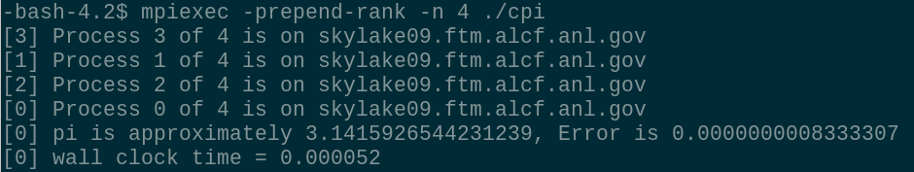
Basic Debugging
Print statements! ☺
Print to determine if this part of the program being executed
What is the value of this variable at a point in the execution?
How do I know which statements came from which process?
Most MPI implementations provide a way to prepend the process rank to the output
E.g., with MPICH, MVAPICH and Intel MPI, you can use -prepend-rank to add identifier to stdout/stderr

Slide 5
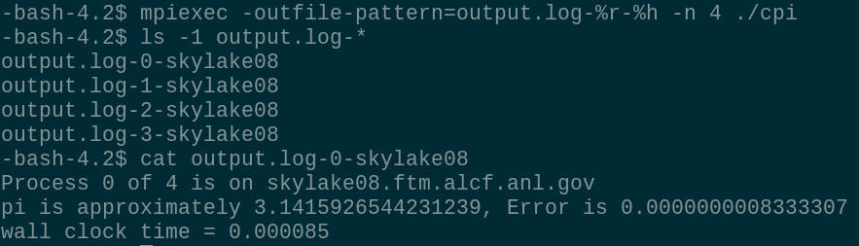
Basic Debugging
Make sense of *lots* of output by directing to files
Most MPI implementations allow output to be redirected to files
MPICH, MVAPICH, Intel MPI provide options to use patterns to filter and direct output.
-outfile-pattern: Send stdout to this file
-errfile-pattern: Send stderr to this file
Substitutions include %r: Process rank, %g: Process group ID, %p: Proxy ID, %h: Hostname

Slide 6
Example: Simple Isend/Irecv
debug/simple.c
Each process sends one integer to its neighbor
Example print statements
When communication operations are issued
Contents of receive buffer before and after communication
Practice identifying output and filtering into separate files

Slide 7
Serial Debugging
You can debug individual MPI processes with serial debuggers, such as gdb. For example:
Attach to already running processes
mpiexec –n 4 ./test
ps or pgrep to find a particular pid
gdb –p <pid>
Launch one or more processes under gdb in separate xterms
mpiexec –n 3 ./test : -n 1 xterm –e gdb ./test
mpiexec -n 4 xterm -e gdb ./test
If running on multiple nodes, make sure to enable X forwarding
mpiexec –enable-x -n 4 xterm -e gdb ./test
Use the ddd graphical frontend for gdb
mpiexec –enable-x -n 4 ddd ./test

Slide 8
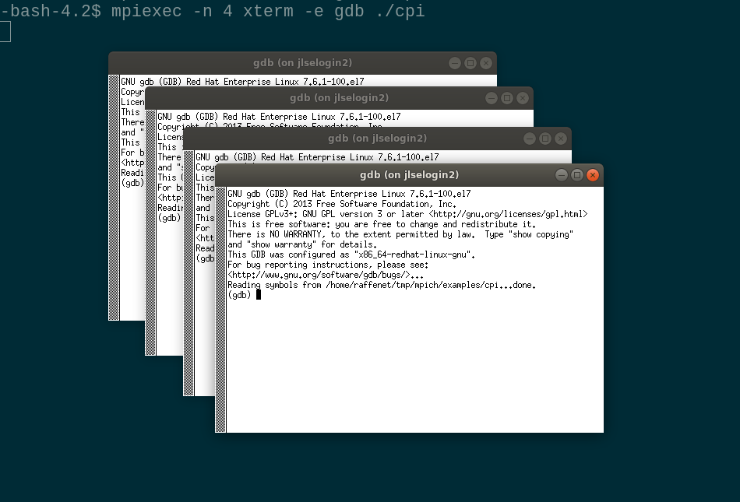
Serial Debugging

Slide 9
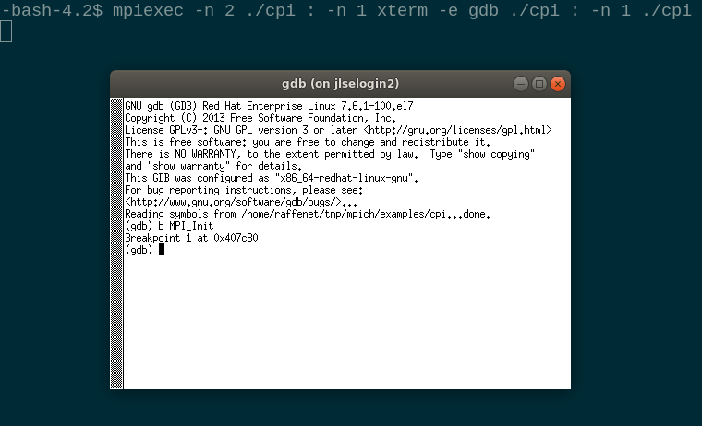
Serial Debugging
To debug a single process in a job, use the colon separated notation for mpiexec

Slide 10
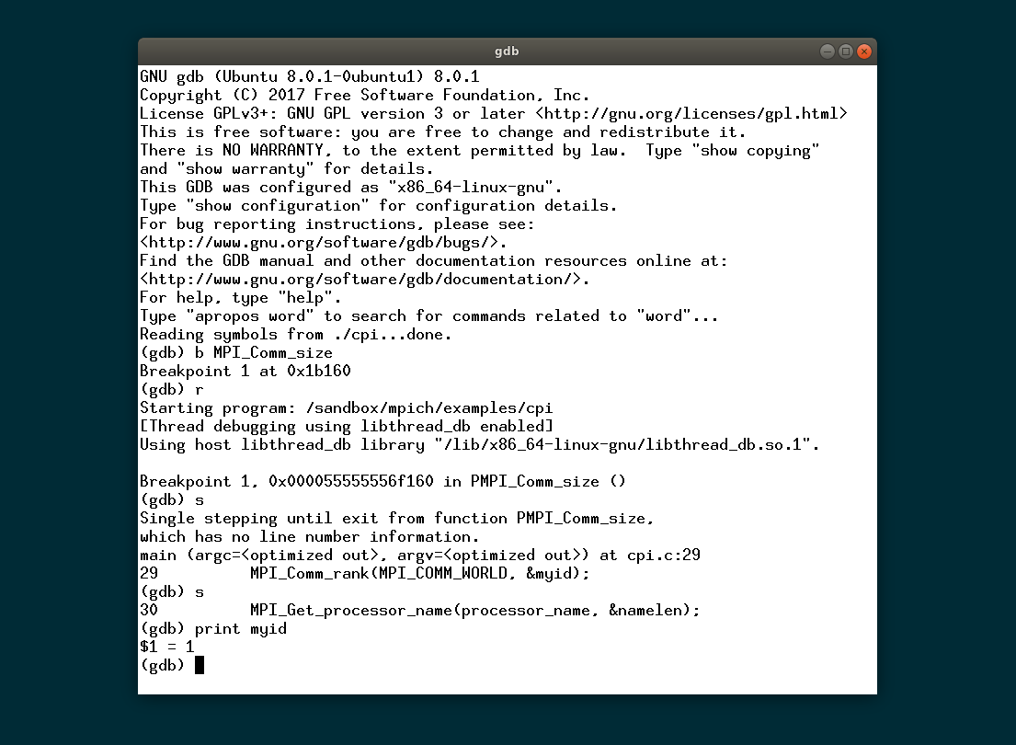
Serial Debuggers
Debug as you would a normal program using breakpoints, stepping through code

Slide 11
Example: Deadlock
debug/deadlock.c
Point to point communication results in application hang
Practice attaching to running processes to determine where they are stuck
Practice launching one or more processes under GDB

Slide 12
MPI Debugging Tips
Double check that all requests, communicators, windows, etc. are properly freed according to MPI semantics
If MPI crashes, look for a core file that can help understand why
gdb –c <corefile> ./test
Your MPI vendor may provide special debug builds or tools that can assist in debugging large codes
Intel MPI Checker https://software.intel.com/en-us/itc-user-and-reference-guide-correctness-checking-of-mpi-applications
IBM Platform MPI Diagnostics Library https://www.ibm.com/support/knowledgecenter/en/SSF4ZA_9.1.4/pmpi_guide/diagnostics_library.html
Cray Debugging https://pubs.cray.com/content/S-2529/17.05/xctm-series-programming-environment-user-guide-1705-s-2529/debugging-code

Slide 13
Parallel Debuggers
Parallel debuggers offer more sophisticated tools for debugging MPI applications
Control processes in one or more groups
Memory profiling
Data visualization
Support for hybrid applications (OpenMP, pthreads)
Internal MPI information
Debug at large scale
Most MPI implementations provide in-built support for commercial parallel debuggers like Totalview and DDT

Slide 14
Parallel Debuggers
Tighter integration with the MPI library and runtime
The MPIR Process Acquisition Interface is defined to allow tools to discover information about the running application
Parallel debuggers can launch and attach to an MPI application, either from the command line or GUI
Integrate with cluster job schedulers to seamlessly submit your debug job into the queue and attach once it starts
The Message Queue Dumping Interface is defined to allow inspection of internal MPI message queues
See operations in progress at a given execution point
Visualize communication patterns

Slide 15
MPIR Process Acquisition Interface
Data structure defined at the “starter process” to expose information about all processes in a job
Hostnames
Executables
PIDs
Debugger can use to attach to processes once they are running

Slide 16
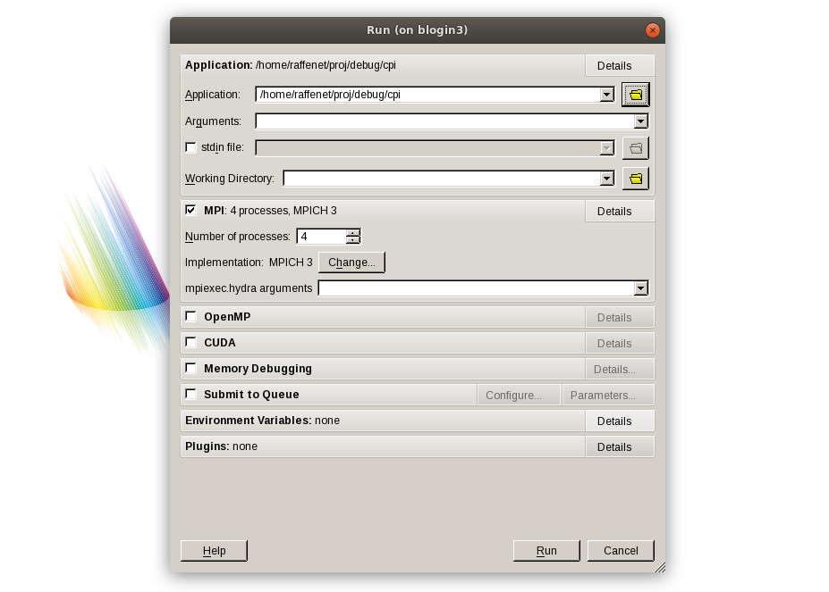
DDT: Launching your MPI Application

Slide 17
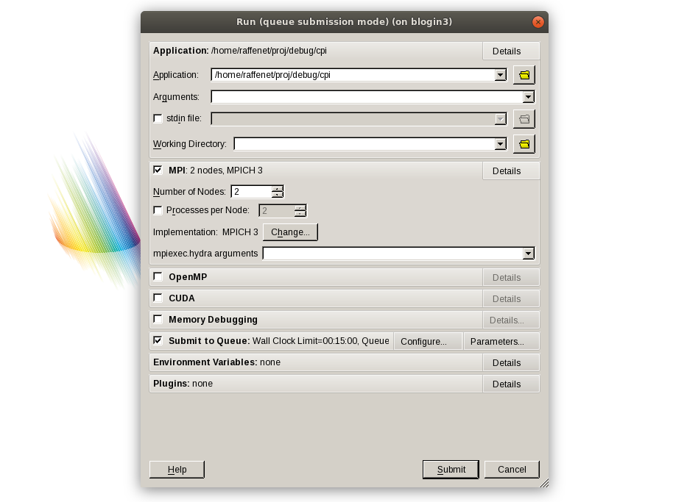
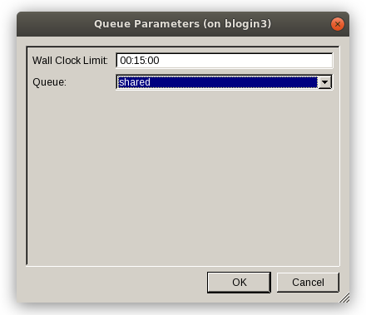
DDT: Submit your MPI Application to the Job Queue

Slide 18
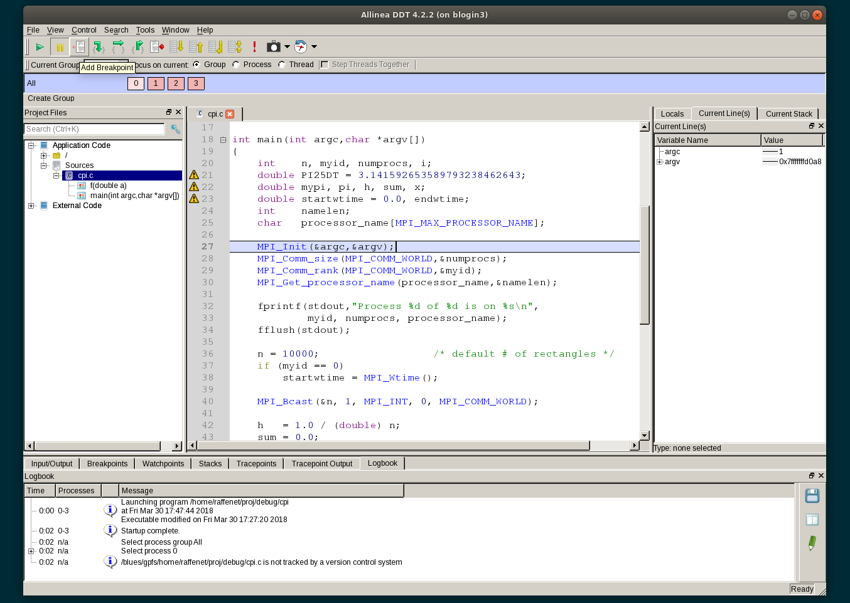
Parallel Debugger Execution
Processes are held at MPI_Init for further inspection

Slide 19
Message Queue Dumping Interface
Tool processes load a shared library that provides routines to access internal MPI state
Active communicators
Pending receives
Pending sends
Unexpected messages
You might need a nondefault build of your MPI library
E.g., MPICH needs to be configured with --enable-debuginfo
Exposed MPI internals give insight into application behavior
E.g. unexpected messages indicate extra copies, which can negatively impact application performance

Slide 20
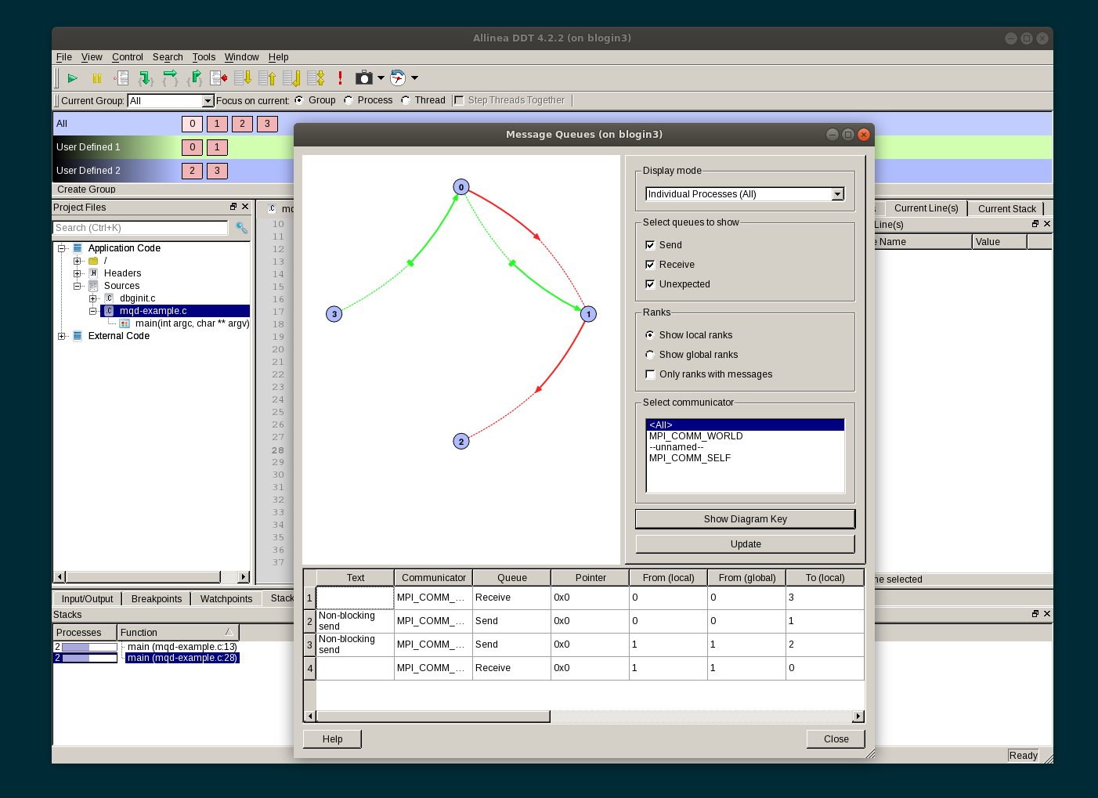
Parallel Debuggers
See in-flight operations

Slide 21
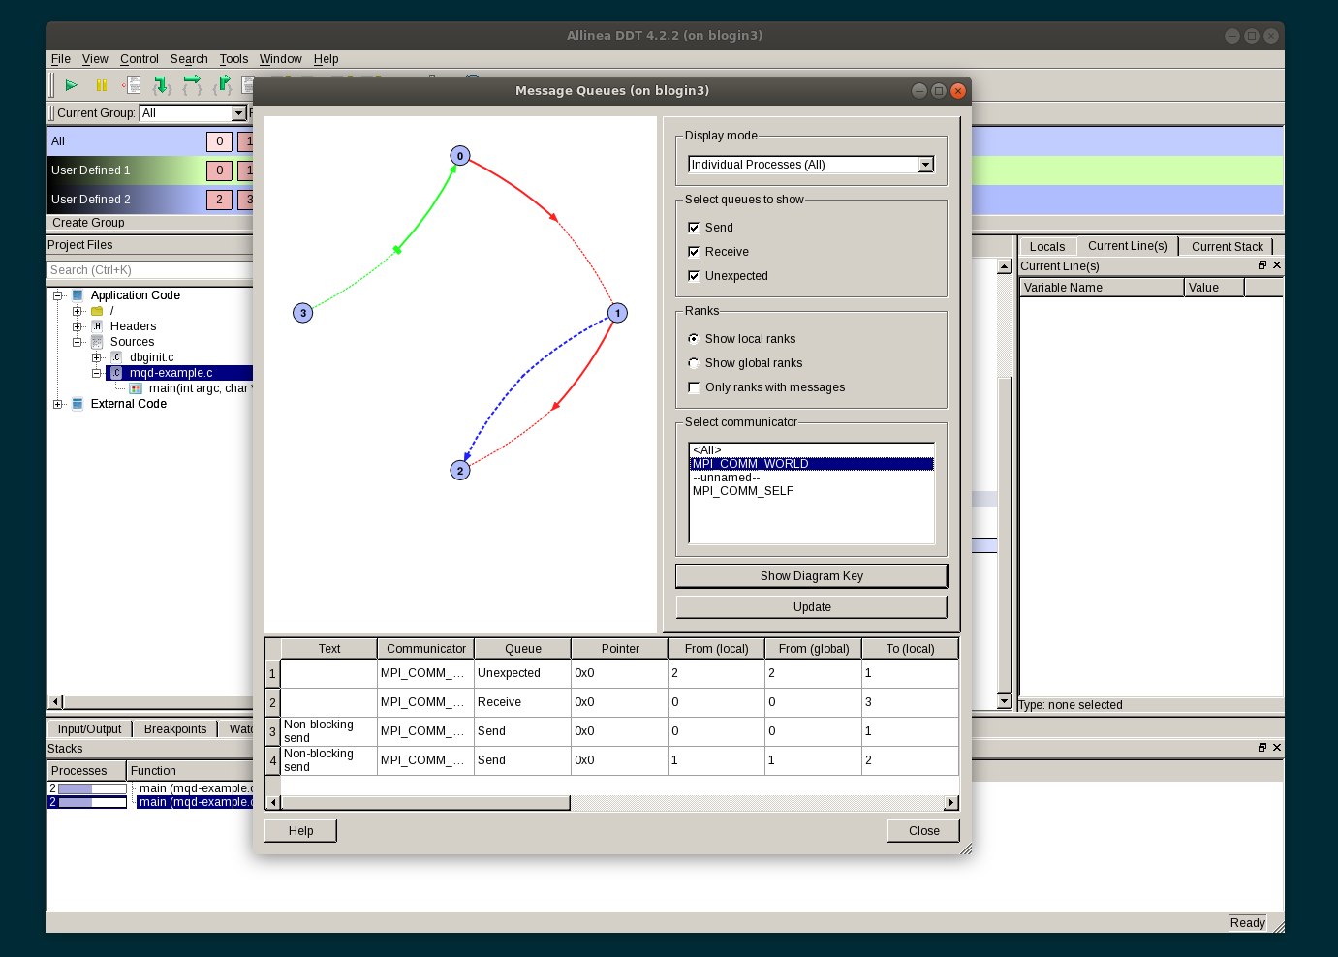
Parallel Debuggers
Beware unexpected messages (dotted blue line)

Slide 22
Example: Split Communication
debug/split.c
Processes are split into even and odd groups based on world rank
Each subgroup communicates, then root processes synchronize using MPI_COMM_WORLD
Use parallel debugger to control processes individually or by group
Visualize messages (globally and per communicator) with MQD

Slide 23
MPI Verification Tools
Some examples of tools that use the MPI Profiling interface (PMPI) to capture MPI usage and verify correctness
MPE Collective checking library
Checks for datatype, root, and various argument consistency in MPI collective calls
http://github.com/pmodels/mpe
ISP (In-Situ Partial Order)
Explores communication nondeterminism to uncover bugs such as deadlocks, resource dependencies, and leaks
http://formalverification.cs.utah.edu/ISP-release/

Slide 24
MPE Collective and Datatype Checking Library
Works by capturing MPI calls using the PMPI interface and performing additional error checking prior to the actual MPI operation
Verifies argument usage such as datatype(s), count(s), root, etc.
Uses additional communication that an optimized MPI library would not perform
MPI Application
Collchk Library
MPI Library
MPI_Bcast(…)
CollChk_same_root(…)
CollChk_dtype(…)
PMPI_Bcast(…)
PMPI_Bcast(…)

Slide 25
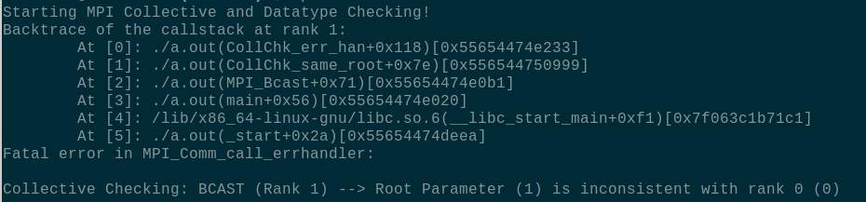
MPE Collective and Datatype Checking Library
If a check fails, prints a backtrace and aborts execution so you can locate and fix the bug

Slide 26
ISP
Works by capturing MPI calls using the PMPI interface and replaying steps in different order
Call issued
All calls are issued in program order
Call returns
The code after the call can now be executed
Call matches
An event that marks the call committing
Call completes
All resources associated with the call are freed

Slide 27
Flow of ISP
Executable
Proc₁
Proc₂
……
Proc_{n}
MPI Program
Run
Scheduler
Interposition Layer
MPI Runtime
Scheduler intercepts MPI calls
Reorders and/or rewrites the actual calls going into the MPI Runtime
Discovers maximal non-determinism ; plays through all choices

Slide 28
ISP Scheduler Actions (animation)
Scheduler
P0 P1 P2
Isend(1)
sendNext
Barrier
Isend(1, req)
Irecv(*, req)
Barrier
Barrier
Barrier
Isend(1, req)
Wait(req)
Recv(2)
Wait(req)
Wait(req)
MPI Runtime
Notes:
Focus on out-of-order execution!

Slide 29
ISP Scheduler Actions (animation)
Scheduler
P0 P1 P2
Isend(1)
Barrier
sendNext
Isend(1, req)
Irecv(*, req)
Barrier
Irecv(*)
Barrier
Barrier
Barrier
Isend(1, req)
Wait(req)
Recv(2)
Wait(req)
Wait(req)
MPI Runtime

Slide 30
ISP Scheduler Actions (animation)
Scheduler
P0 P1 P2
Isend(1)
Barrier
Barrier
Isend(1, req)
Irecv(*, req)
Barrier
Barrier
Barrier
Irecv(*)
Barrier
Barrier
Isend(1, req)
Barrier
Wait(req)
Recv(2)
Wait(req)
Wait(req)
Barrier
MPI Runtime

Slide 31
ISP Scheduler Actions (animation)
Scheduler
P0 P1 P2
Isend(1)
Irecv(2)
Barrier
Isend
Isend(1, req)
Irecv(*, req)
Barrier
Wait (req)
No
Match-Set
Irecv(*)
Barrier
Barrier
Isend(1, req)
Barrier
Recv(2)
SendNext
Wait(req)
Recv(2)
Wait(req)
Wait(req)
Deadlock!
Barrier
Wait
Isend(1)
MPI Runtime
Wait (req)

Slide 32
Summary
Approaches to debugging your MPI program
Print statements
Works everywhere
mpiexec can help differentiate output, sort into files
May be cumbersome at large scale
Serial debuggers (gdb)
Works *almost* everywhere
Launch one or more processes out of your job for debugging
Debug as you would a serial program
Parallel debuggers (Totalview, DDT)
Requires commercial license
Advanced GUIs
Insights into the MPI library
Available on large supercomputers with good scalability

