Slide 1

April 1Update

Slide 2
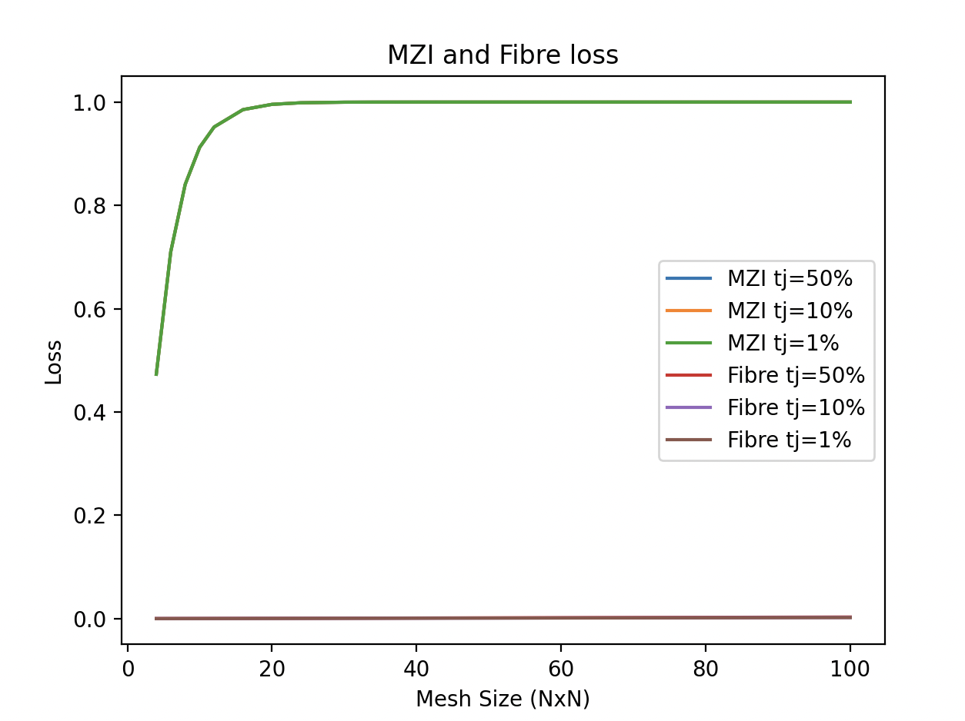
Graphs !
This makes sense to me
But uh the cnot…

Slide 3
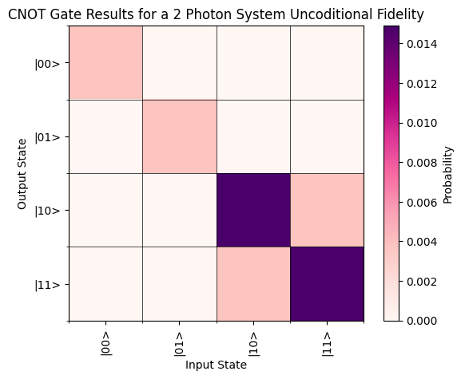
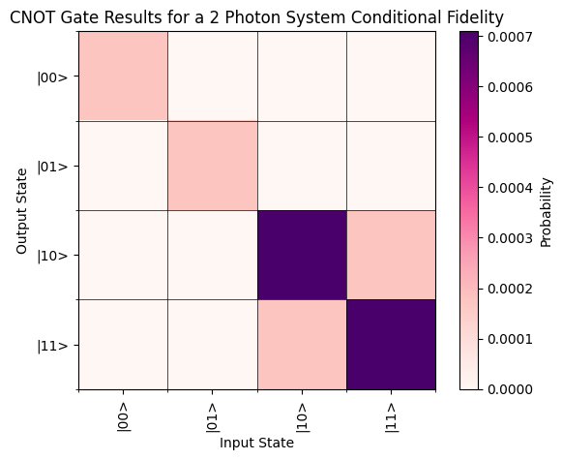
help

Slide 4
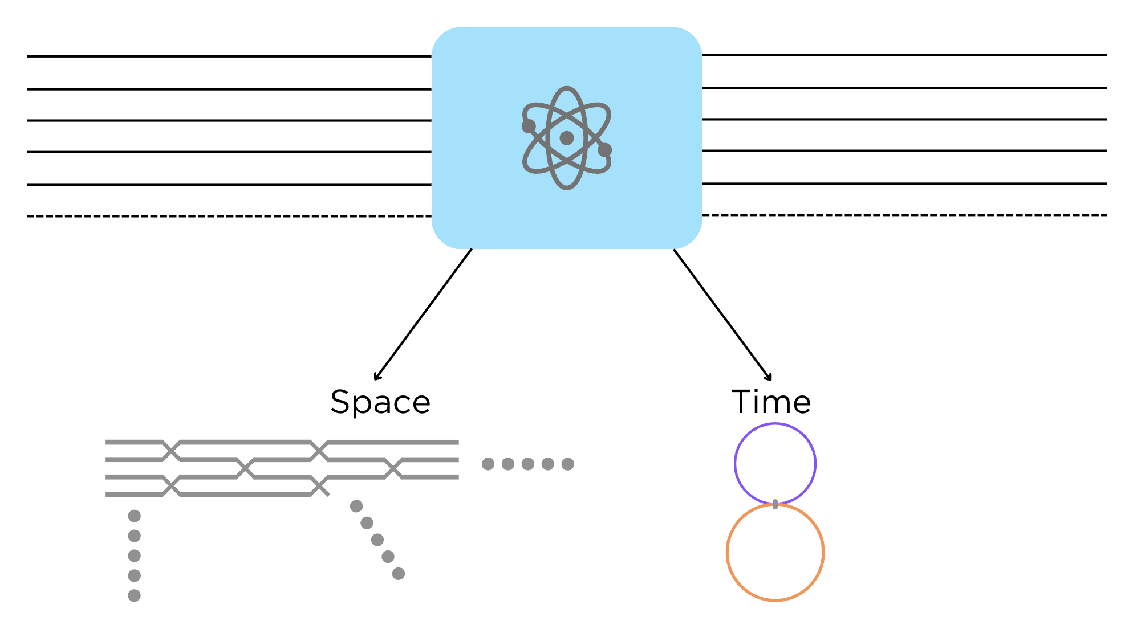
Other items
Can you send me the quantum dot paper? So I don’t cite the wrong thing
Is this ugly/does it make sense ?
Graphics / steps

