Slide 1
Quantum Logic Gates on Time-Bin Encoded Photonic Qubits
Ivanna Boras
Jan 24 2024

Slide 2
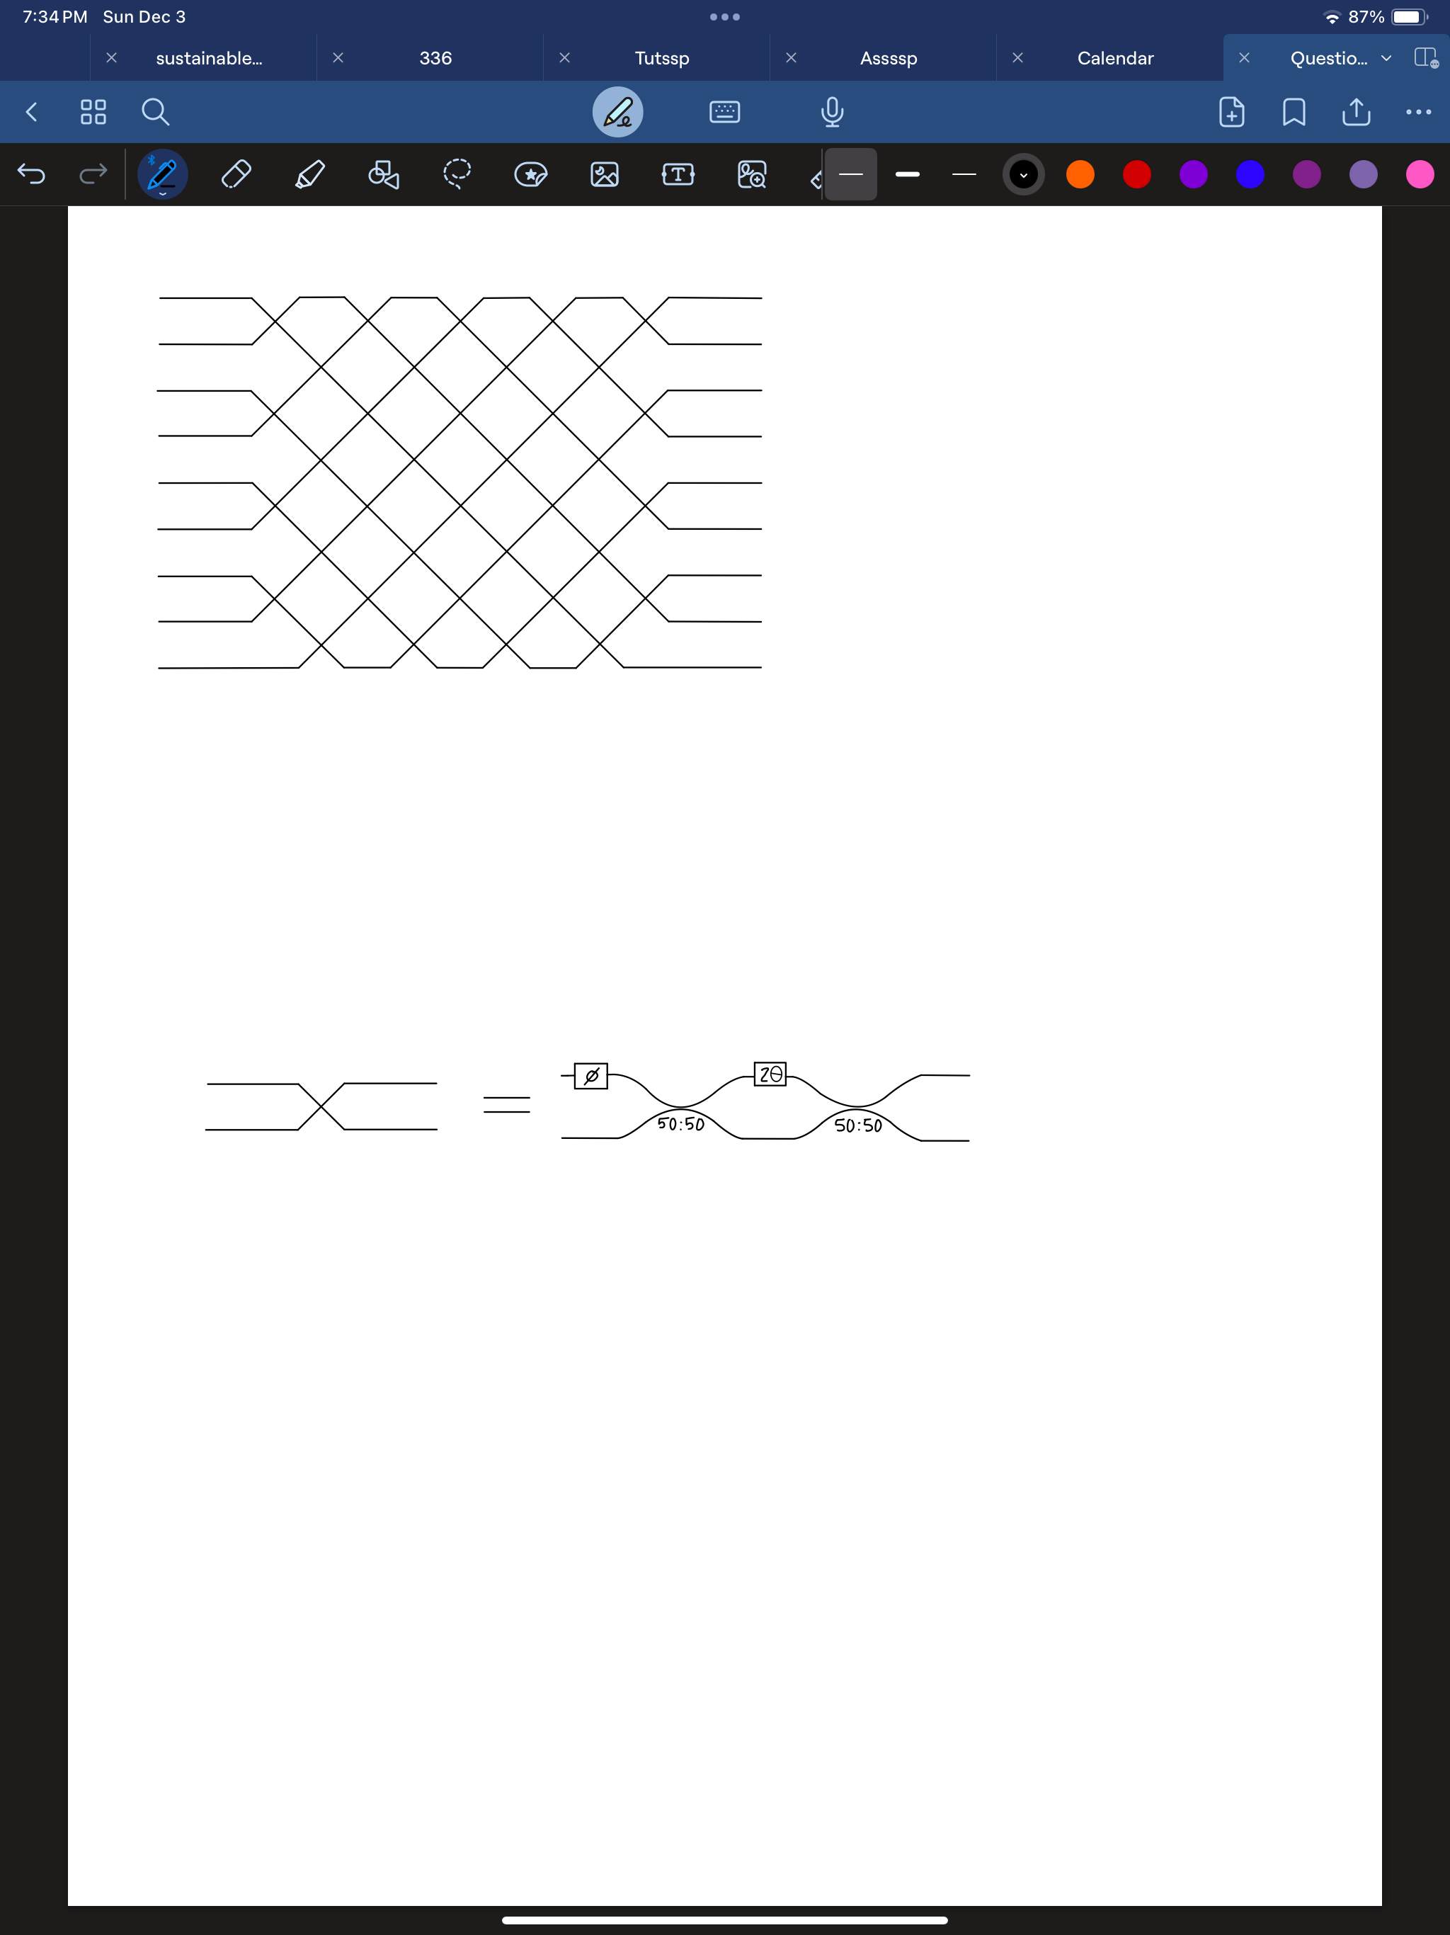
Motivation
Simplification of previous process
W. Clements et al., Optica, vol. 3, pp. 1460- 1465, 2016

Slide 3
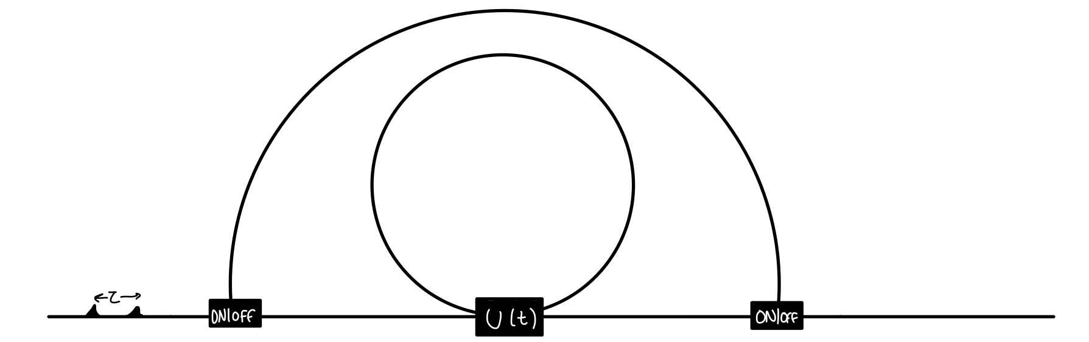
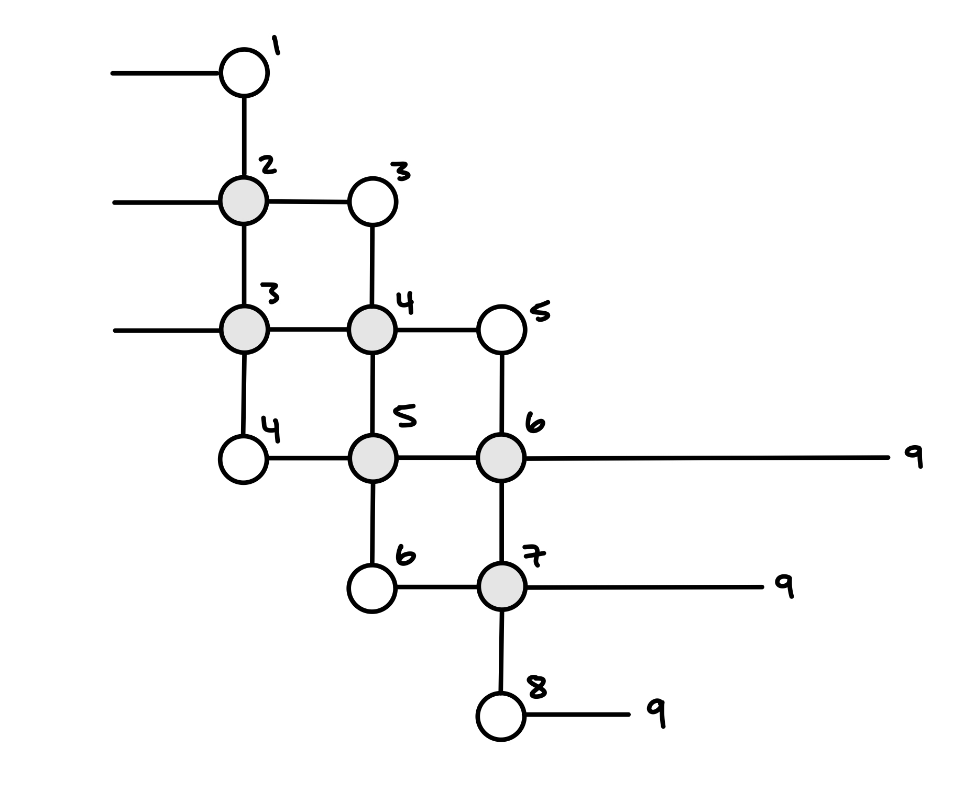
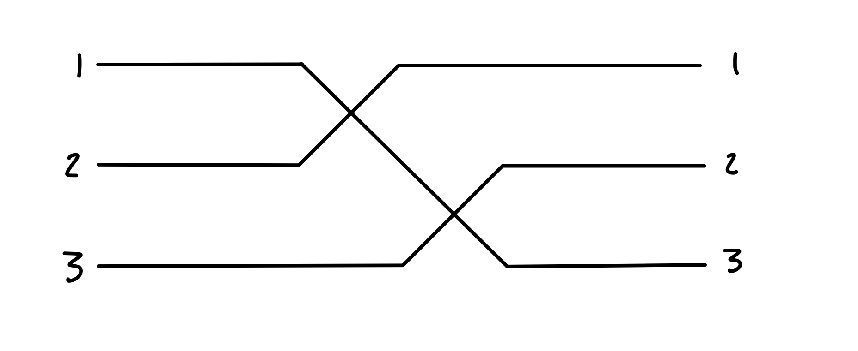
Motivation
ADD CITATION

Slide 4
Goals
Create a CNOT gate
Integrate losses

Slide 5
Progress
Unitary matrix to phase shifts conversion
Phase shift extraction

Slide 6
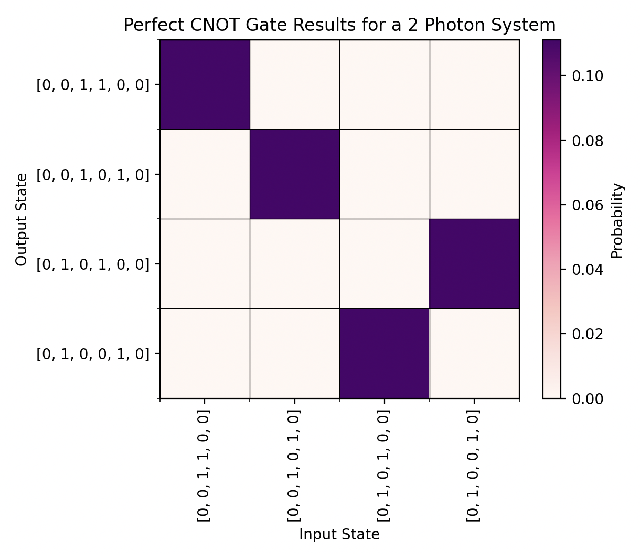
Progress
-

Slide 7
Plans
- talk about progress here I guess

Slide 8
Project Constraints
Computational Power
Time
Runtime and Data
Component Switching Time

Slide 9
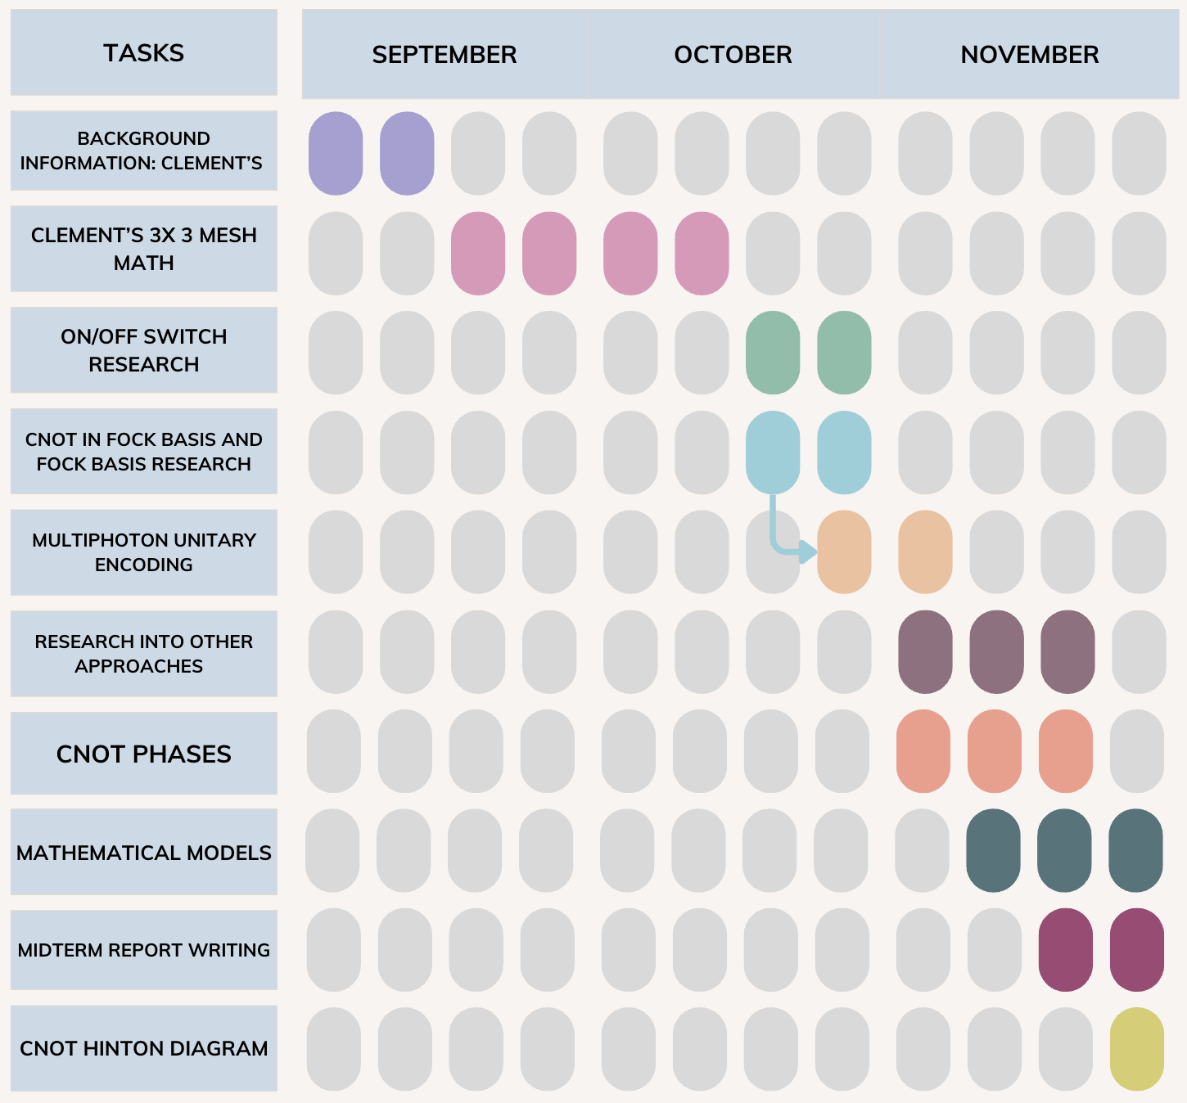
Project time-line

Slide 10
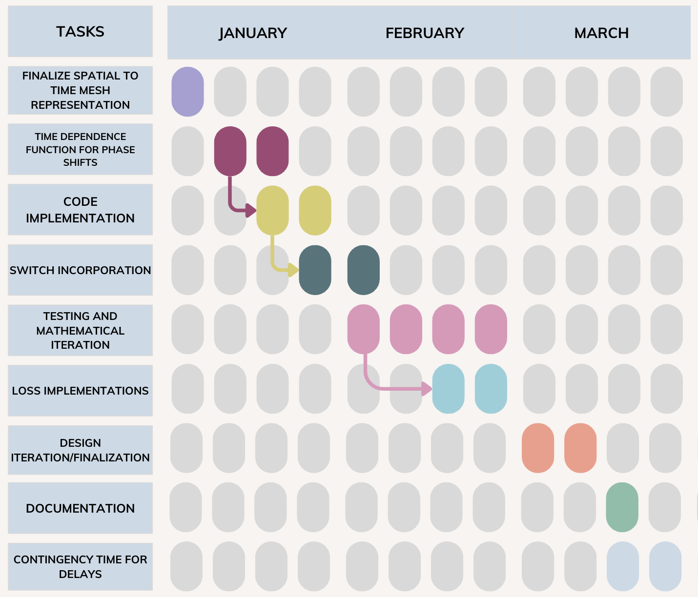
Project time-line

