Slide 1
November 1 Update

Slide 2
Articles!
I’ve been reading some of Christine’s papers
It seems like she does a lot of Time multiplexing stuff (although a lot of the stuff still includes like polarization stuff)
How familiar should I be with Special Unitary matrices / group theory ?
They have come up a few times and I’ve just been ignoring it ….

Slide 3
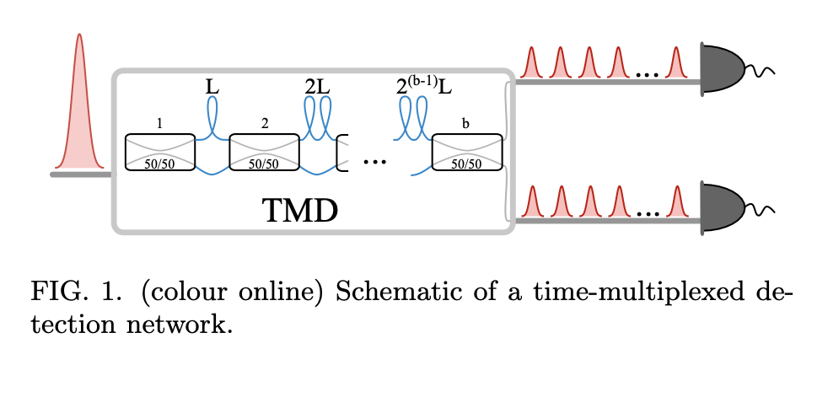
Information Extraction in photon-counting experiments
Interesting paper, talks a lot about how they calculated losses from interferometers and fiber optic cable
They had one part of the input pulse partially delayed in each beam splitter stage
pulses with 2^{b} different timings (time bins) were detected
They also found that the optimal bin count is 256 (at least for whatever set up they are using)
Apparently anything more than that makes like… no difference since there are many losses

Slide 4
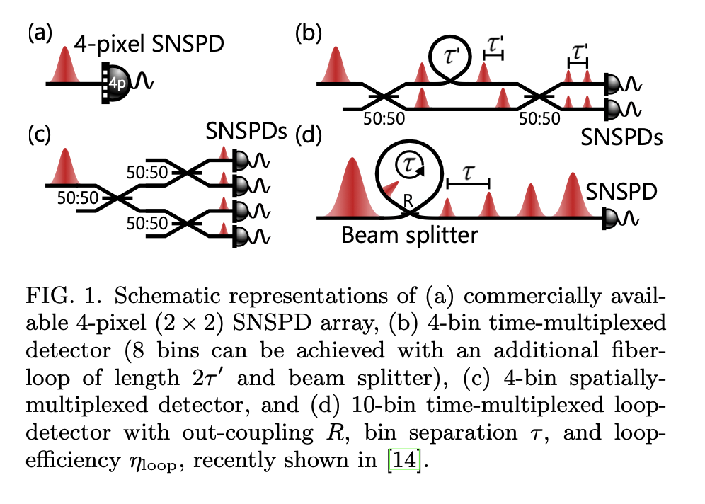
Limits of the time-multiplexed photon counting method
Found a paper that goes through different ways to do time-multiplexing (which seems… to be the same-ish thing)
This one was not very useful but it got me thinking

Slide 5
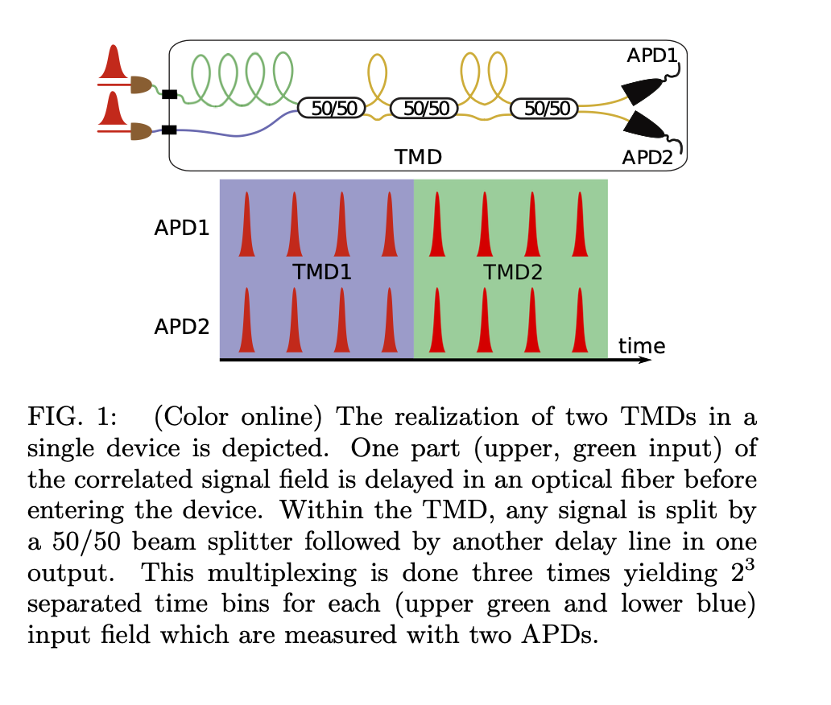
Uncovering Quantum Correlations with Time-Multiplexed Click Detection
They measured classicality with a quantum-ness probe
Not going to lie I'm not sure how it works or what that means
Google was not helpful ☹
More stuff about time bins though!

Slide 6
Code!
I’ve gotten the fock states
I’ve figured out how the indexing works
I’ve got the divide by 0 thing gone but the matrix still…… doesn’t exist
I also don’t know whether I am visualizing my stuff right?

