Slide 1





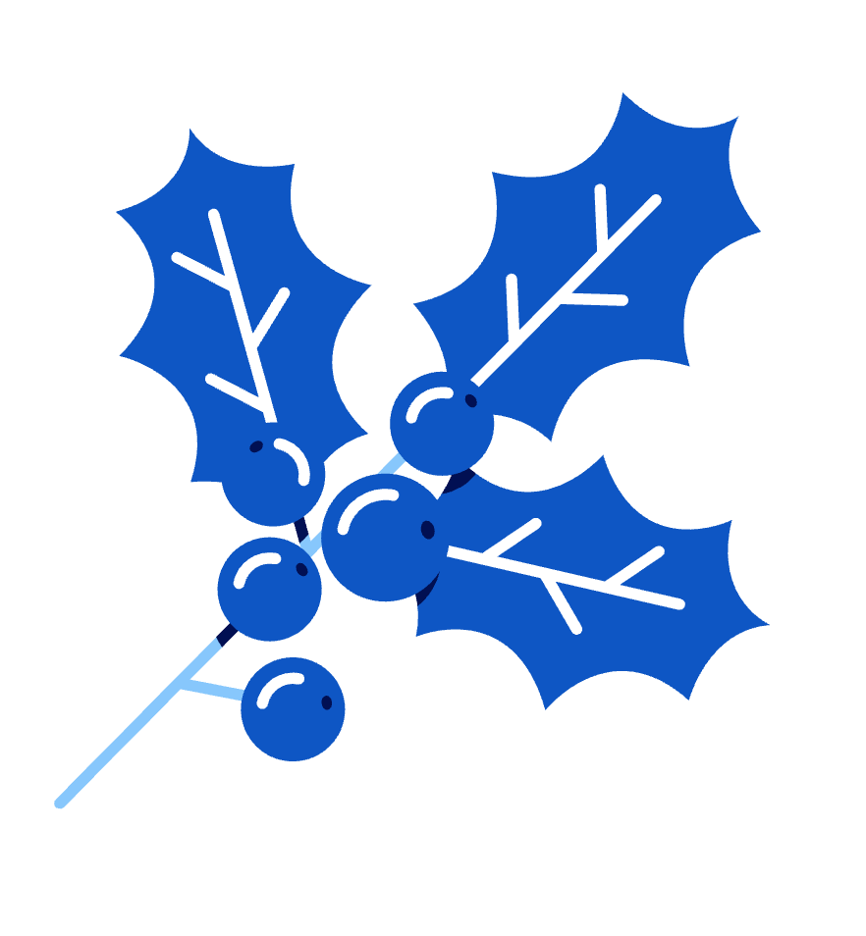



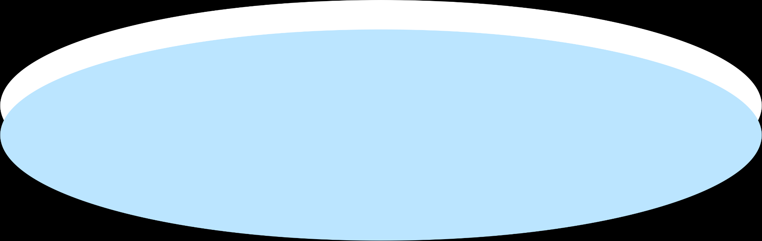
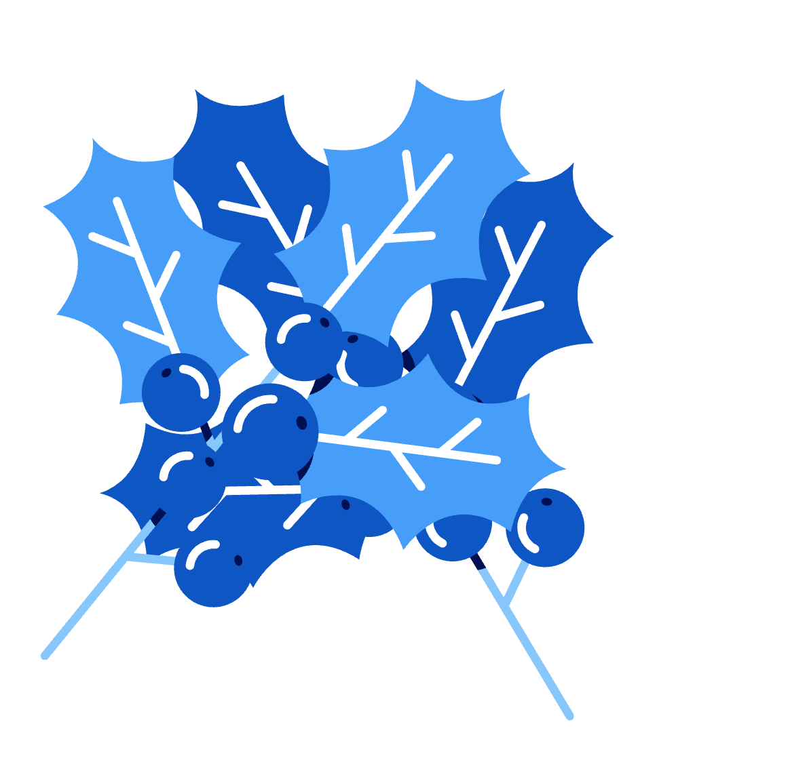
The final one… before winter Break!
Nov 29
Update

Slide 2


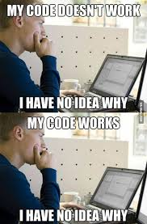
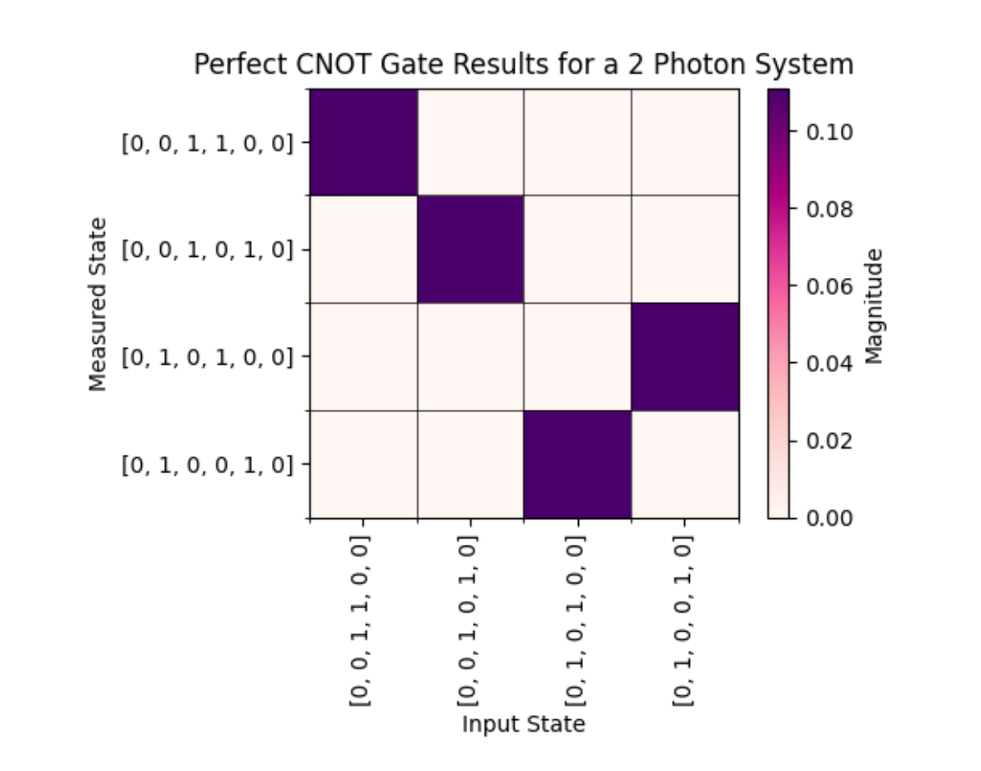
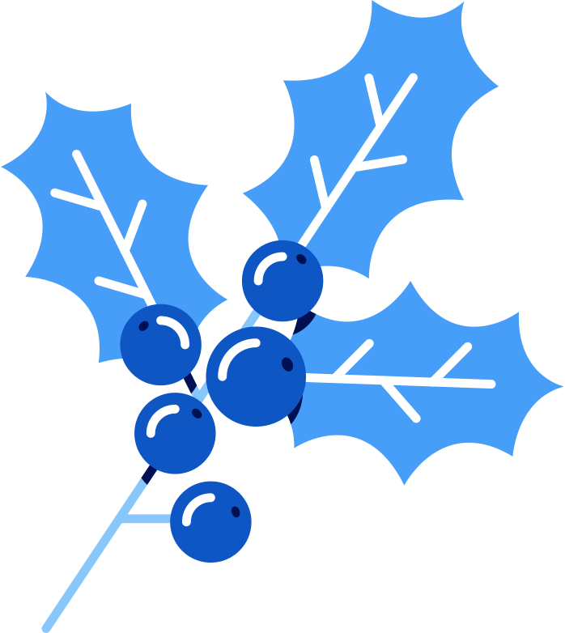
Review of midterm report
- Submitted the midterm report (yay)
- Honestly this took way longer than I thought
- Included the CNOT graph ( mentioned that probabilities will be added)
- I could not for the life of me get the boxes to align
- but then it magically worked
- found this meme while looking for memes for a different presentation and it seemed relevant so here you go

Slide 3
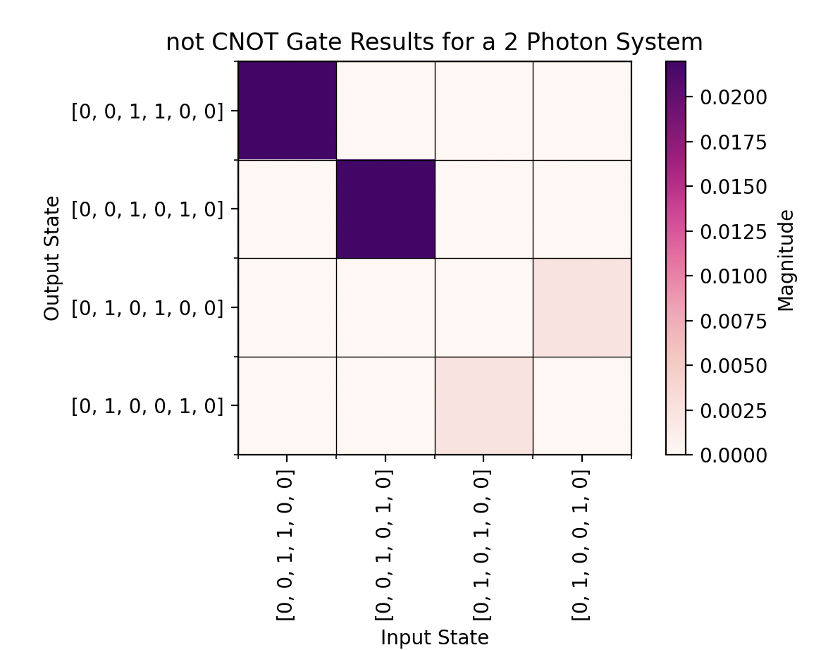
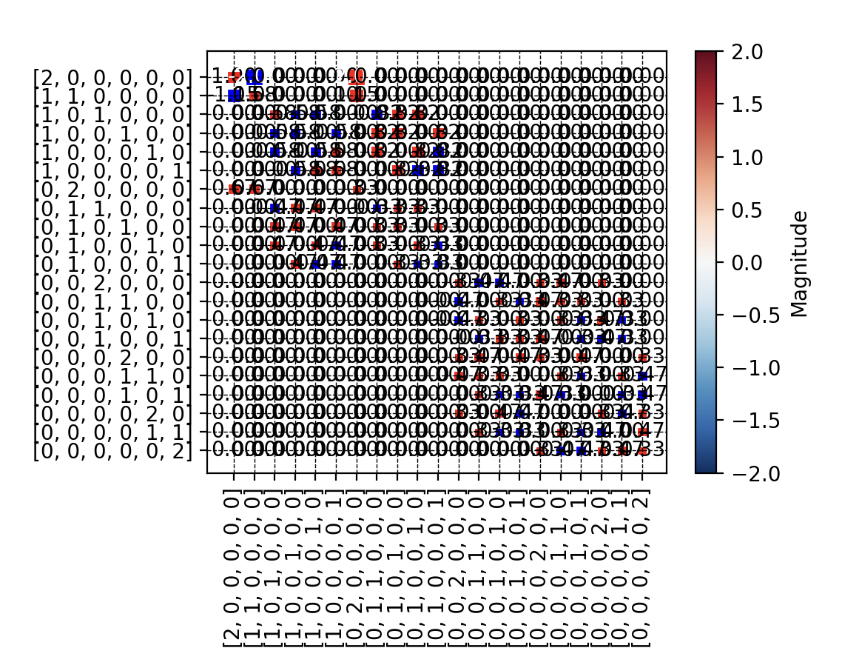

The rest of the CNOT gates
- I tried adding in the probabilities…. Got a range of graphs (this is the most recent) I’ll keep going! -> also what is x?
Notable mention: (I was plotting like 5 different things at once, python did not enjoy)

Slide 4
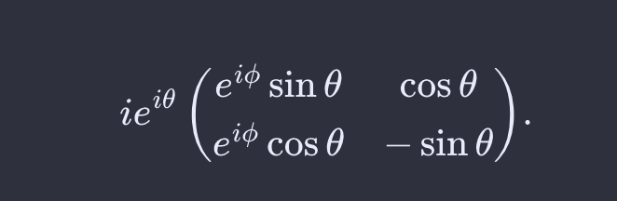
Other Updates
- Did what you said about ditching the tensor calc
- Since the MZI phase shifts are time-dependent…. Can I just stick a time term in there…. Is that, like, legal?
or would I want to multiply it by e^t? I’ve seen both of these done……. And I don’t really understand why you’d do one over the other , in one they were using polarization, the other was more general (?)
t
t
t
t
t
t
t
Notes:
Rect function = time
1550nm index ref
Spacial to time- make the mesh by hand – shouldn’t be hard to incorporate , make it infinite

