Slide 1
November 8 Update
yay

Slide 2
Code Stuff
I got the indexes for the basis going
I applied them to the multiphoton unitary (it worked)
The phases for the CNOT gate are also working now (yay)
But they’re all a list of 0 now so im DEF thinking about this wrong

Slide 3

Articles/Random
(Unfortunately) went down a math rabbit hole
About Markov’s fleas (?)
I also looked at other papers
I found many that do ONLY detection using time-multiplexing (again, same as last time)
Time-bin encoding is used a lot for quantum key distribution – I skimmed a few papers but most of them talk about the algorithm rather than the set up
Superconducting wire??? Crazyyy!!

Slide 4
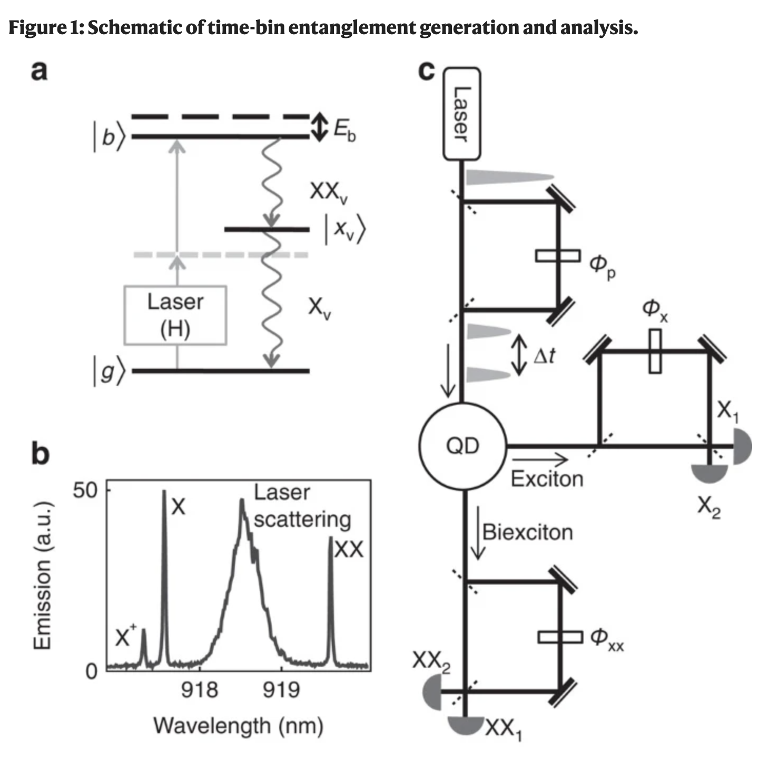
Time-bin entangled photons from a quantum dot
Found this cool paper
Its not relevant but was a cool read

Slide 5
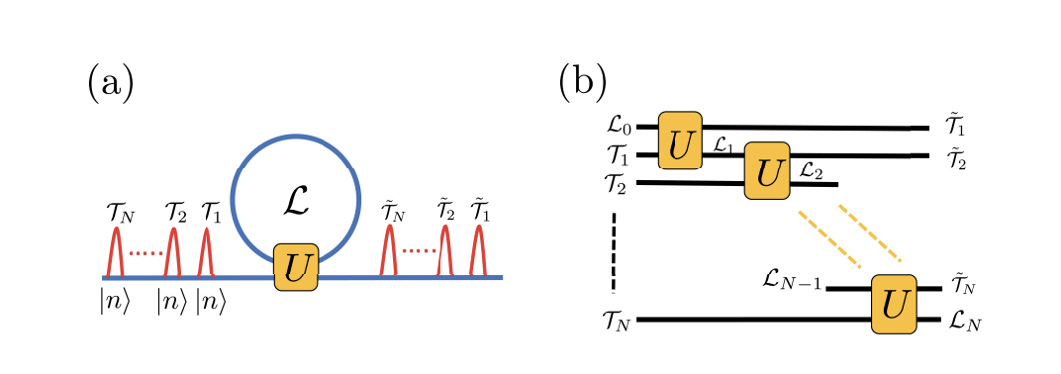
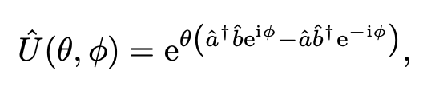
Tensor network states in time-bin quantum optics
They use only one loop from the looks of it
The length of the loop is equal to the distance light travels between two input time-bins
temporal overlap achieved between photons entering the loop at time step i and photons arriving at time step i+1.
Will read more about passive bosonic hopping coupling
That → is their Unitary
But I think this might describe *THE* math

Slide 6
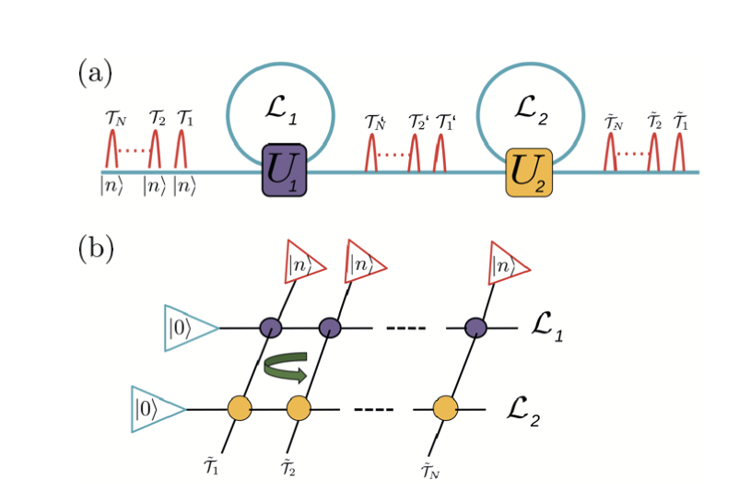
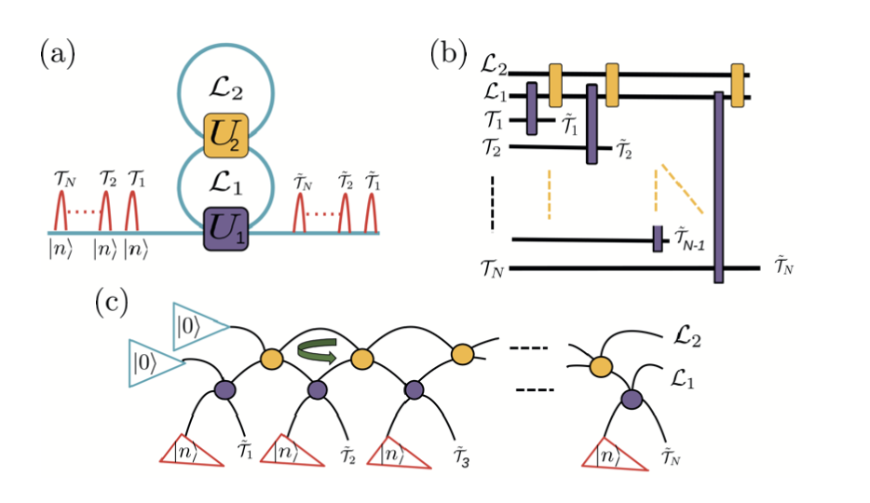
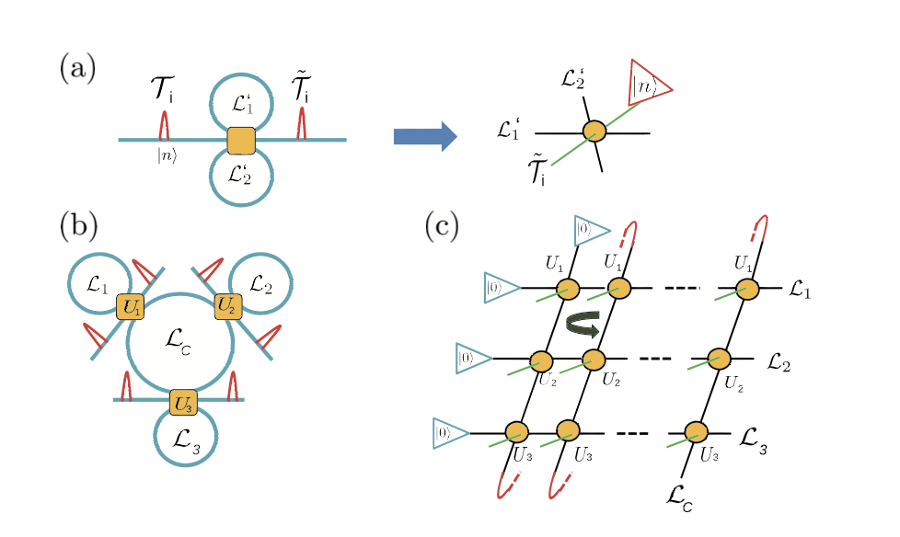
Tensor network states in time-bin quantum optics
It describes how to do the math for a single fiber loop (this is the math rabbit hole)
It also goes through how to approach different multi-loop set ups
Here both U’s are tensors
Unitary is purple, coupler is yellow
H(orrible)nourable mention

