Slide 1
October 18 Update

Slide 2
CNOT
- I’ve got something(?):
- see notebook
- Should I be using the H, V notation?
- see notebook/next slide
- What is L again? Some papers use L to be ‘left’(?)
Math⁻¹
- I got the math down, except for pi….. What is the argument of infinity?
(other) Math
- I’ve been reading ‘the computational complexity of linear optics’ and slowly getting through the lemmas

Slide 3
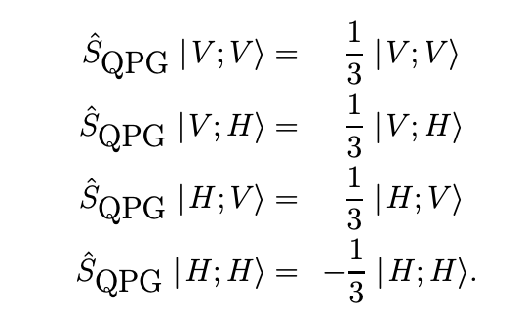
H and V (for example)
- I’ve seen this a lot, but usually in the context of polarization (otherwise it is not quite clear)
- Is this relevant notation ? It seems like its all *only* for polarized photons
Also seen in: Linear optical quantum computing: https://arxiv.org/pdf/quant-ph/0512071.pdf
Proposal for a simple quantum error correction test gate in linear optics: https://arxiv.org/pdf/quant-ph/0306190.pdf
Quantum-Logic Gate between Two Optical Photons with an Average Efficiency above 40%: https://arxiv.org/pdf/2111.09915.pdf
And others but I don’t want to make a slide that’s just a list

Slide 4
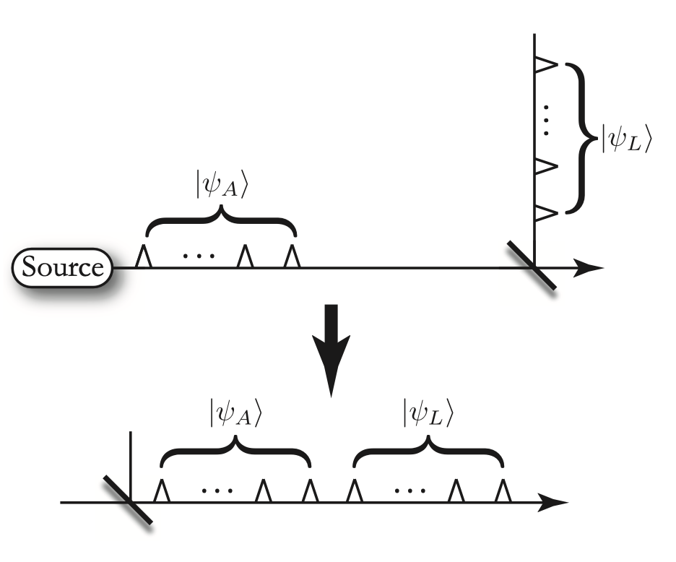
Background Research: A simple scheme for universal linear optics quantum computing with constant experimental complexity using fiber-loops
- Paper talks more about the time-bin encoding and how they implement the on/off switches (transmissivity)
- Seems like a lot of stuff from polarization rotation experiments can be adapted to time-bin encoding (at least that’s (literally) what the paper says)

Slide 5
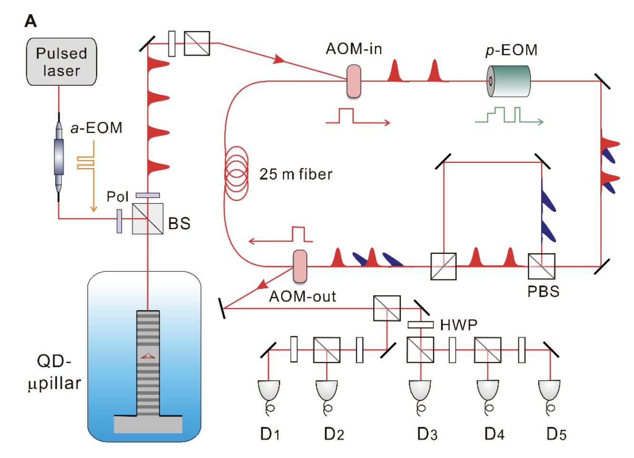
Background Research: Scalable boson sampling with a single-photon device
- Paper uses time-bin encoding and polarization rotation
- They have a lot of components in their circuit
- Some of their methods may be useful later…..

Slide 6
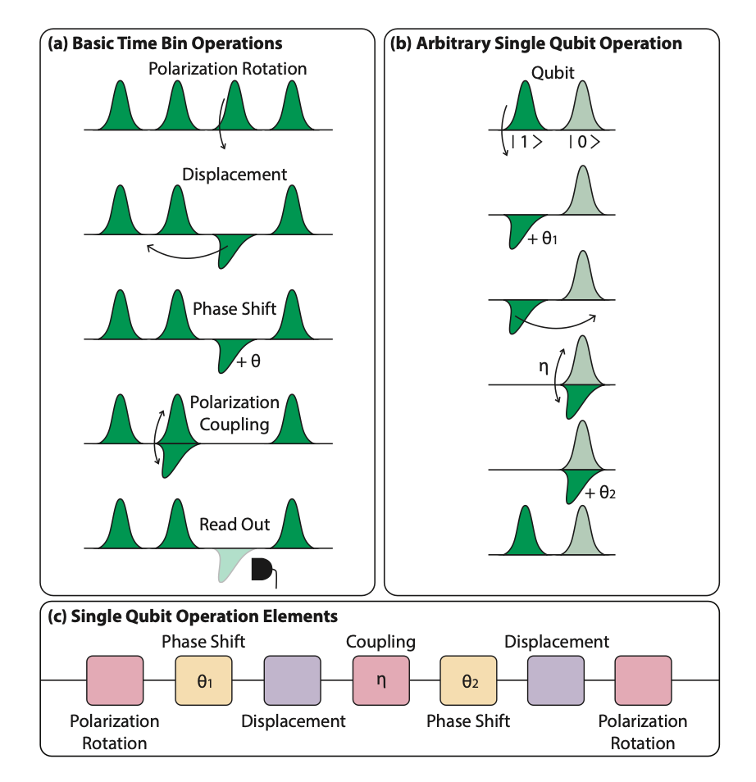
Background Research: Linear Optical Quantum Computing in a Single Spatial Mode
- Found a paper that explains how to apply time-bin encoding to logic gates
- they use polarization rotation (again) but I think its useful (maybe)

Slide 7
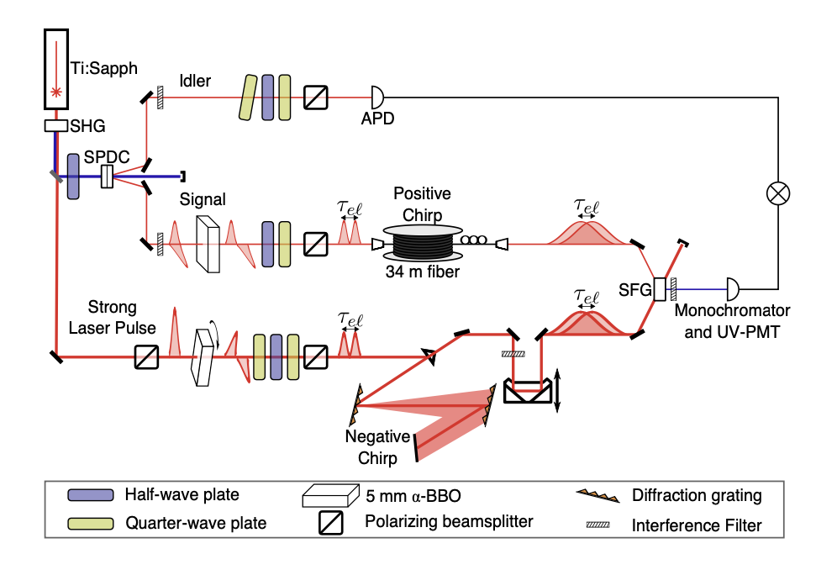
Background Research: Coherent ultrafast measurement of time-bin encoded photons
- This one uses photons and lasers and combines them in a crystal
- the H and V’s make a comeback
- Perhaps not very useful but might get some ideas from their setup (?)

