Slide 1
October 25 Update
Code!!!!!!!! And Articles

Slide 2
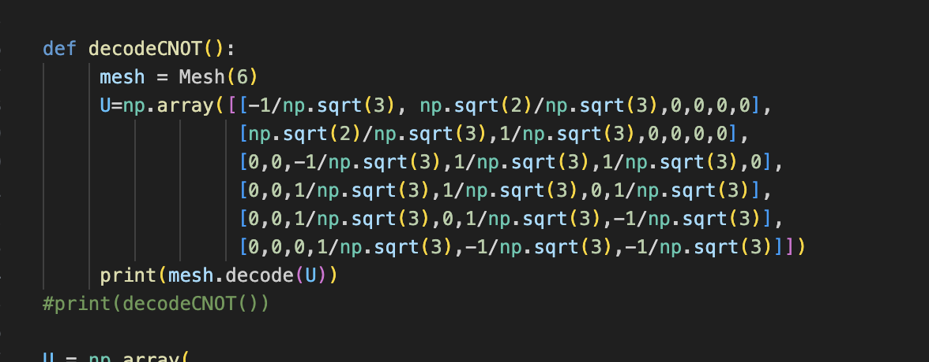
Code
I’ve been fighting the code demons
I am losing
I’ve tried getting the phases from the CNOT gate
It tells me: “AssertionError: Decomposition did not yield a diagonal matrix D.”

Slide 3
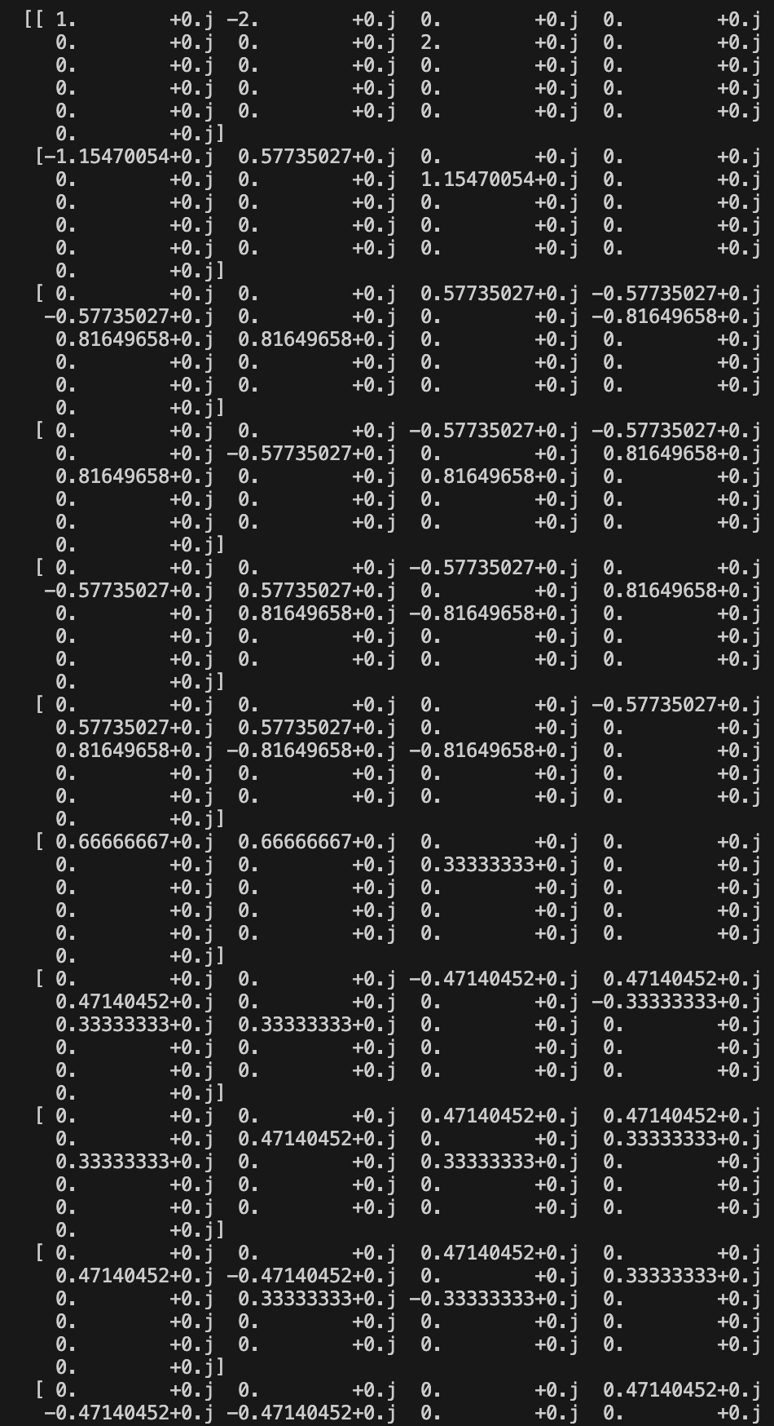
Code
I was able to get the aa library going though
I got a very large matrix ----------------------------→
I’ve been thinking/trying to implement the states into it
Like the |001100> states
Not gotten very far
We keep going

Slide 4
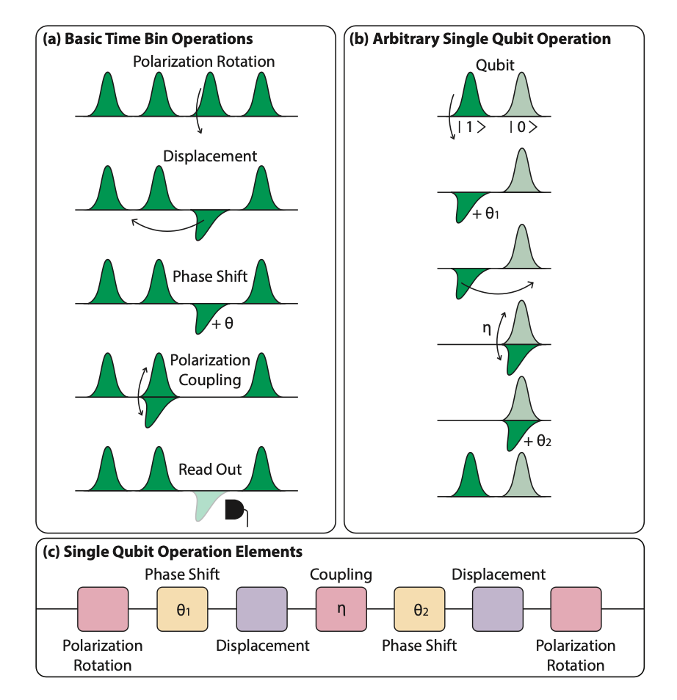
Article Search
I’ve been trying to find more articles like this one:
I’ve so far only found polarization stuff
I’ll keep looking !

