Slide 1
October 4 Update
Code, Math and Articles

Slide 2
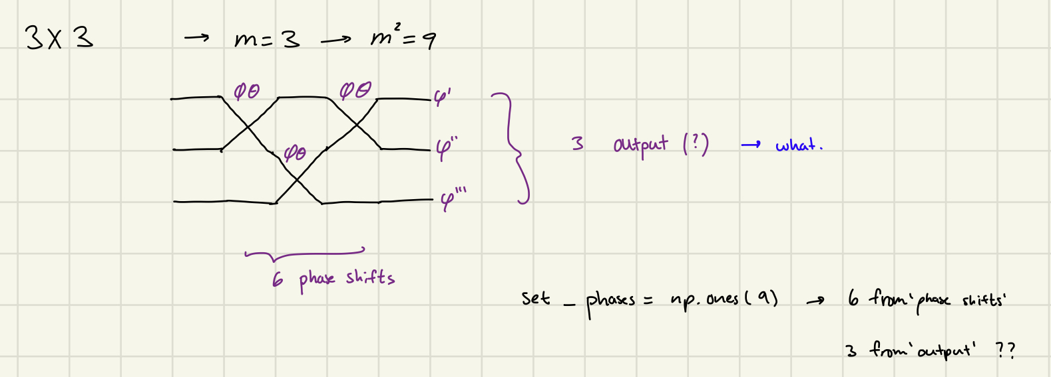
Code
I got the code to print (kind of) yay!
decode matrix won’t print
I think it’s because I am calling it wrong but also I don’t see it returning anything?
Set_phases takes m^2 arguments, which makes sense but how do you set up the final output matrix?
Unless I am understanding it wrong, here is a drawing:
the decode function doesn’t return anything (just checking?)

Slide 3
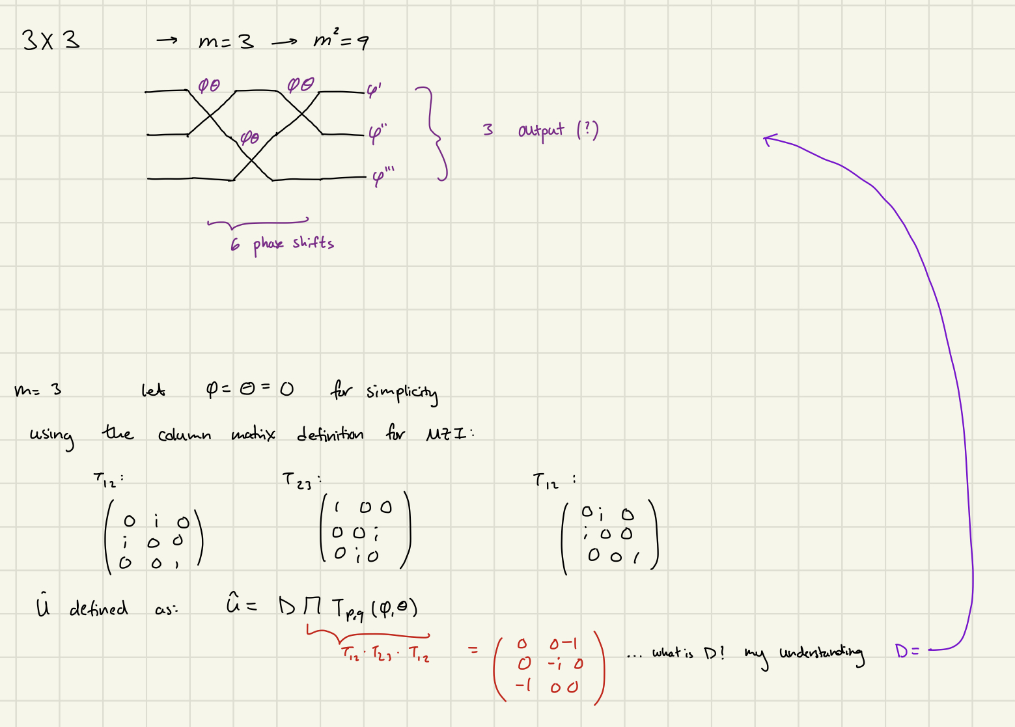
Math
What is D? It’s a diagonal matrix with phase shifts, but does this follow the same convention as T?
Here’s what I’m doing so far:
Perhaps D is not the output?
It says it is physically irrelevant
but then that means the math I
am doing is wrong (see next slide)

Slide 4
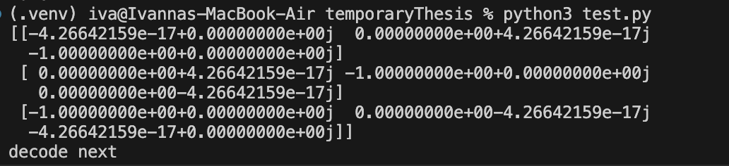
Math
The encoded matrix gives me:
Which does not match the U matrix I found
I figured this was the whole D thing, but perhaps I’m wrong

Slide 5
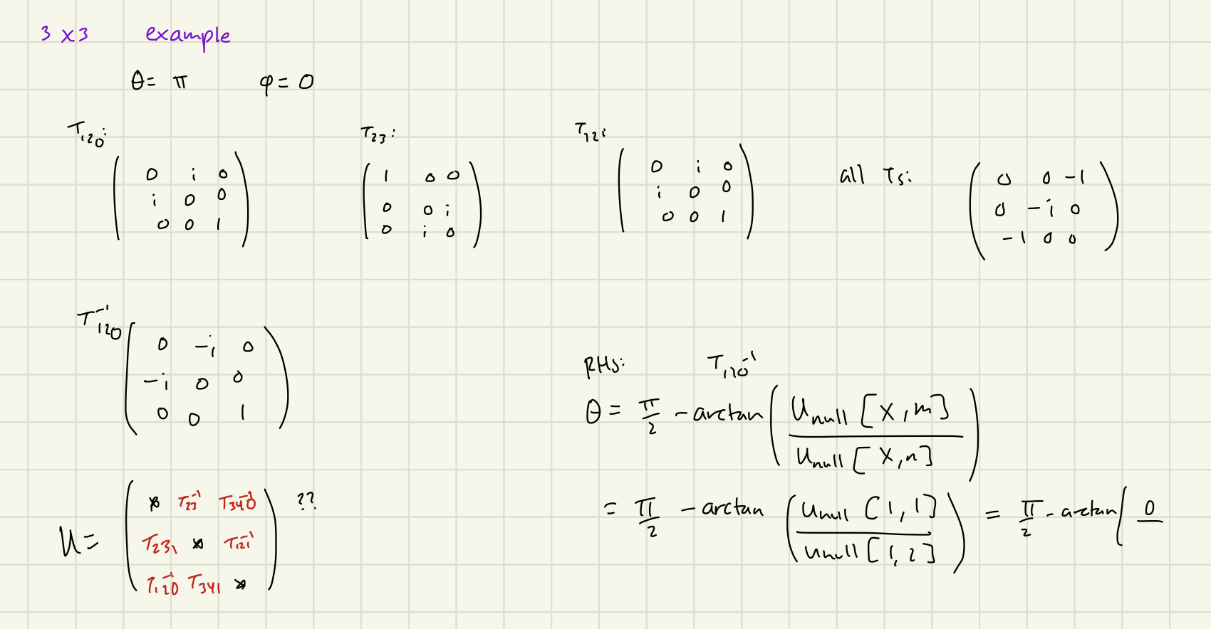
Math⁻¹
Here, what is the U expression? Its not very clear to me

Slide 6
Article Search
I’ve been looking at what has been done, found some cool articles
Found one about ‘microwave photons’ (not relevant but it was interesting)
Found another that used ion-cavities ( also not relevant but it was interesting)
Found an (actually relevant) one that is for boson sampling, https://journals.aps.org/prl/pdf/10.1103/PhysRevLett.118.190501
Found a cool ‘recent advances and applications’ article https://www.sciencedirect.com/science/article/pii/S2405428318300431#sec0017
Summarizes advances and applications in quantum optics, gives good overview of timebin encoding with loops
Links a few papers
https://onlinelibrary.wiley.com/doi/epdf/10.1002/lpor.201500321?src=getftr
https://journals.aps.org/prl/pdf/10.1103/PhysRevLett.111.150501
https://journals.aps.org/prl/pdf/10.1103/PhysRevLett.111.153602
https://journals.aps.org/pra/pdf/10.1103/PhysRevA.91.012306
Haven’t had time to go over them all properly
Finding relevant articles has been … interesting

