Slide 1
February 14 Update
No dreams this time ☹

Slide 2

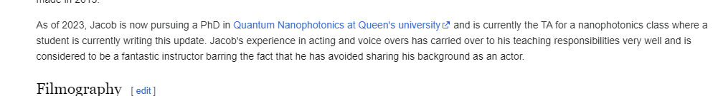
This past week !
The elmo meme I was talking about last week ->
My friend updated your wiki page live -> in front of me in nano (note that its NOT a nanophotnics course)

Slide 3
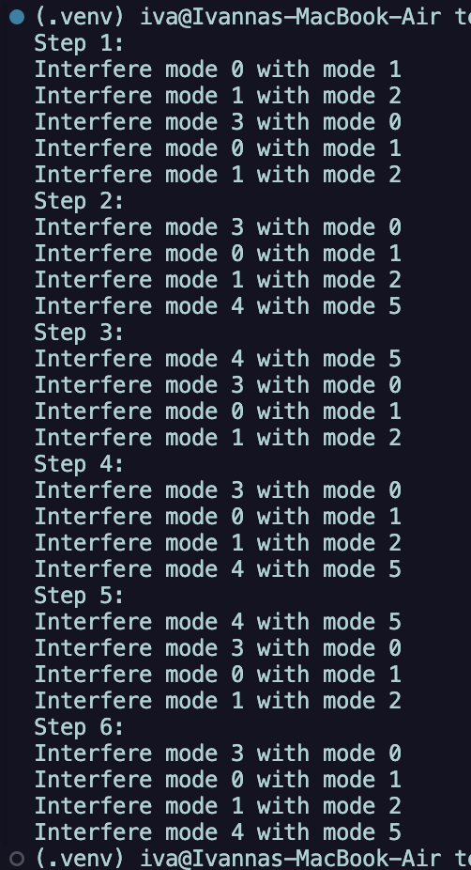
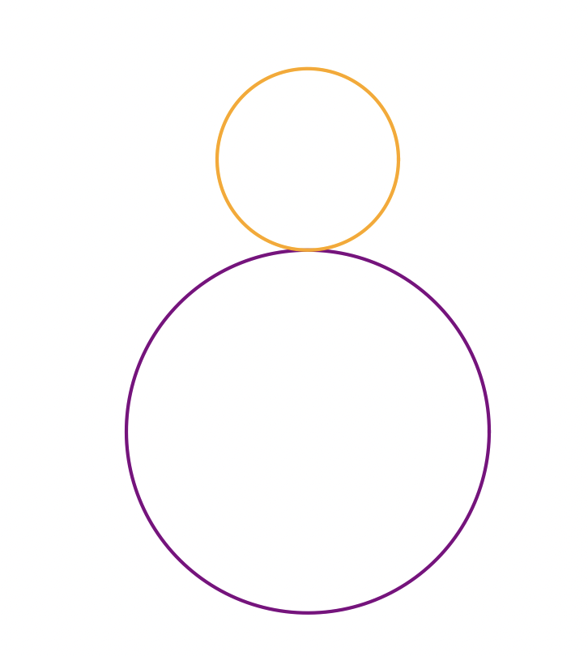
Ok actual stuff this time
- been busy but started incorporating stuff into code
- have decided that having a visual interface for the loops would be the best idea I think
- been thinking how to incorporate it into a clements configuration
- its well known / easy enough to follow … not sure how… don’t like coloured scheme too much rn
The output ive got going so far->
(as of 2:44 it does NOT look like that at all, its once again broken … trust the process)
Maybe I make mode 1=0 ? In the output or also I could just not ive got an idea do +1 yknow
Need to workshop this more since its not really doing what I want it to do , shouldn’t take me long
Also started thinking about the circles
Circles that have been thought
Also got any ogs tips?

