Slide 1
Feb 21 Update
Lost in the Loop

Slide 2
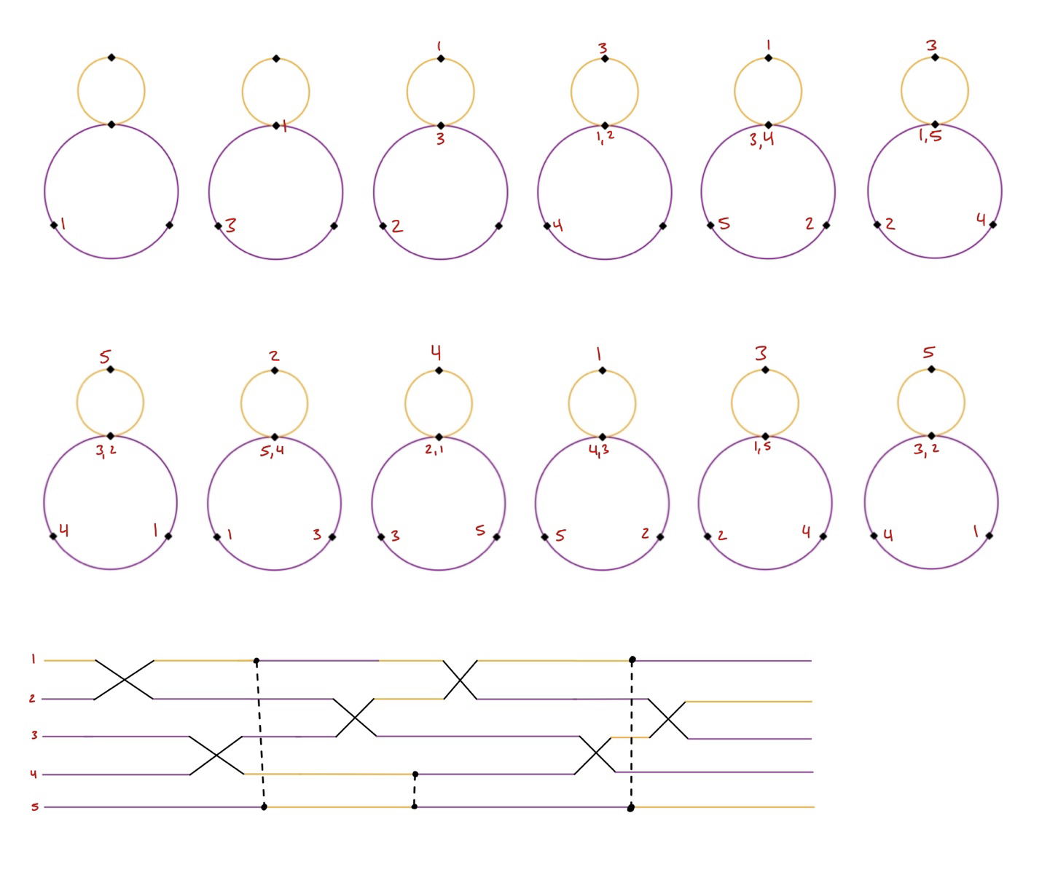
Loops
Slight change, but that’s ok a lot of the same stuff still applies
Working on finishing the algorithm in code
Notes:
Loss vs mesh size

