Slide 1


Feb 28 update
codes

Slide 2
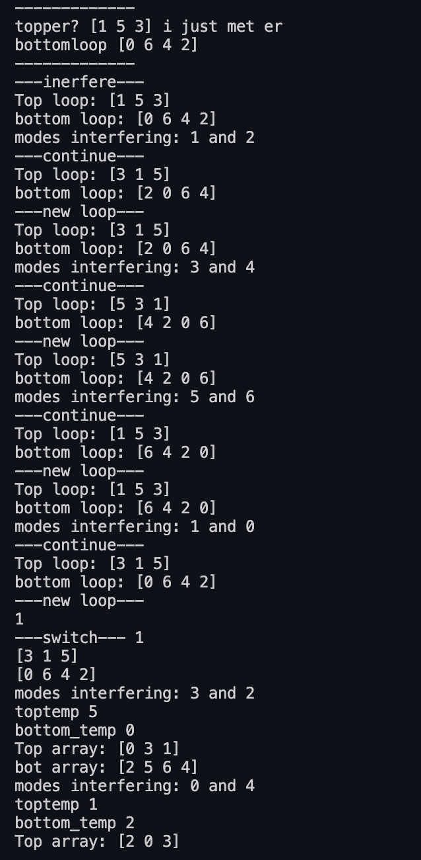


What’s up?
Got the algorithm working for N=4….. It gets weird when I add modes but I know the problem and should be an easy fix
Know how to add the time dependence, forgot to do that (commented it out at the start but is easy)
The phases ….. Math…. Help
I think I can start incorporating it now !
Phases should be the same each time as its still clements
I know when the pi shift occurs

