Slide 1
Jan 31 Update
Ivanna and the gift(?) of prophecy

Slide 2
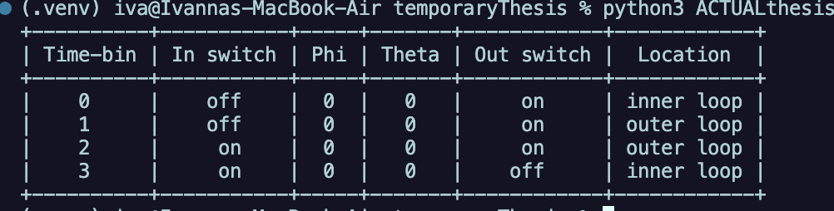
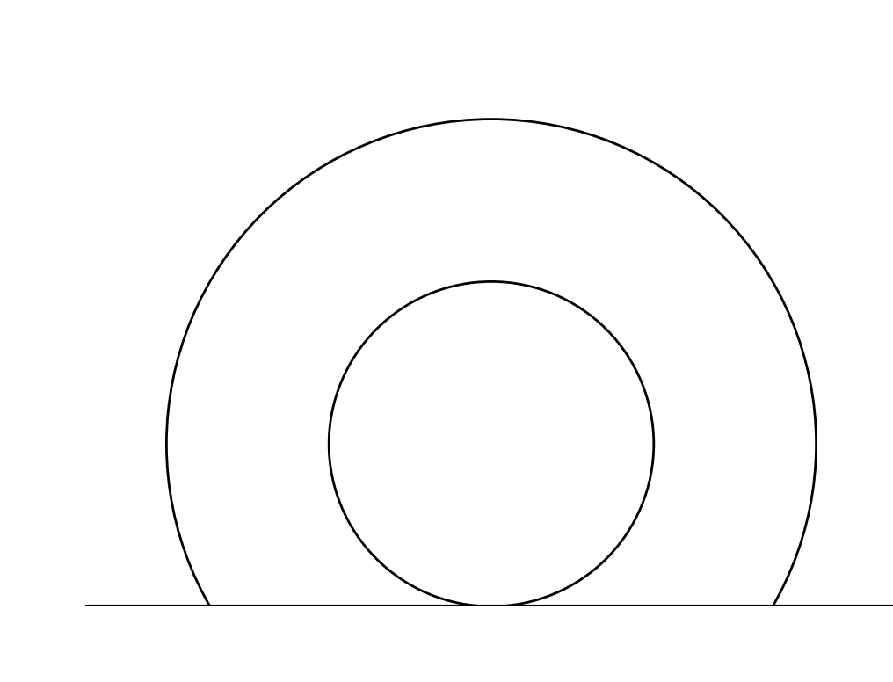
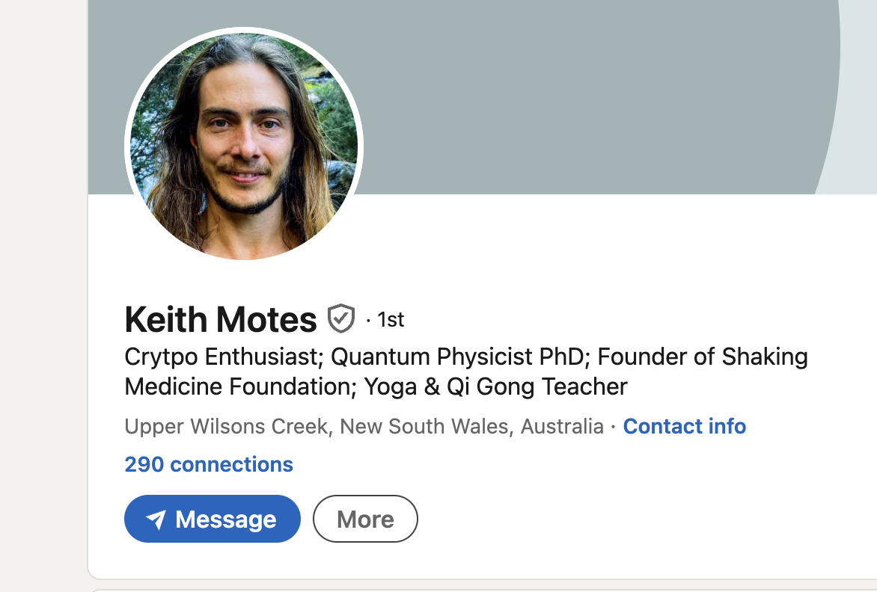
What’s going on ?
- I made a table
- was CONVINCED it was right literally until 5 am this morning when I had a dream
- also started plotting to see if it would help (making animations is harder
than I recall but I now have the loops
- Motes and I are best friends on linkedin now
- ill explain my horrifying(?) dream now but on paper so you see what I
mean

Slide 3
What in the loop

