Slide 1
March 13 Update

Slide 2
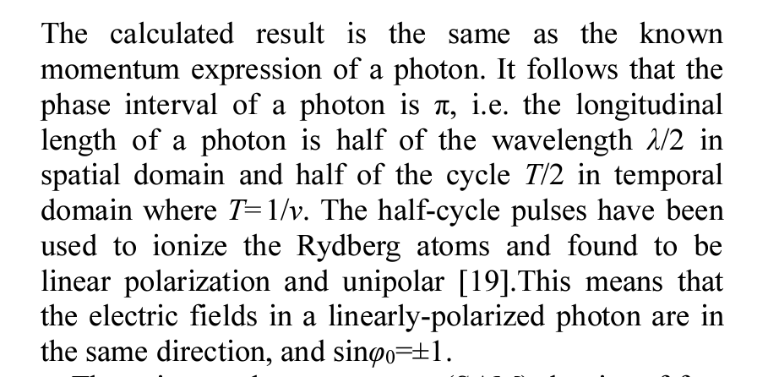
What I’ve been up to….
Trying to find stuff for loss
A lot of stuff for quantum keys? But its all for satellites…
Lots of stuff for SNSPDs
Motes paper is still the most relevant/shows up the most; perhaps I was too specific with my searching
I’ve done really basic math for the length- Tried to find the width of my photon and I am confused
am I meant to be looking at it spatially ? Time ?
Right now I have it as 1 second
I know this is not right; just a place holder
Working on the table – kind of works
Fixed the output issue I had last time
Got number of time bins needed for each uh N
I also take it back I don’t think the animation is
a good way of showing the movement
https://arxiv.org/pdf/1604.03869.pdf

