Slide 1

March 6 Update

Slide 2
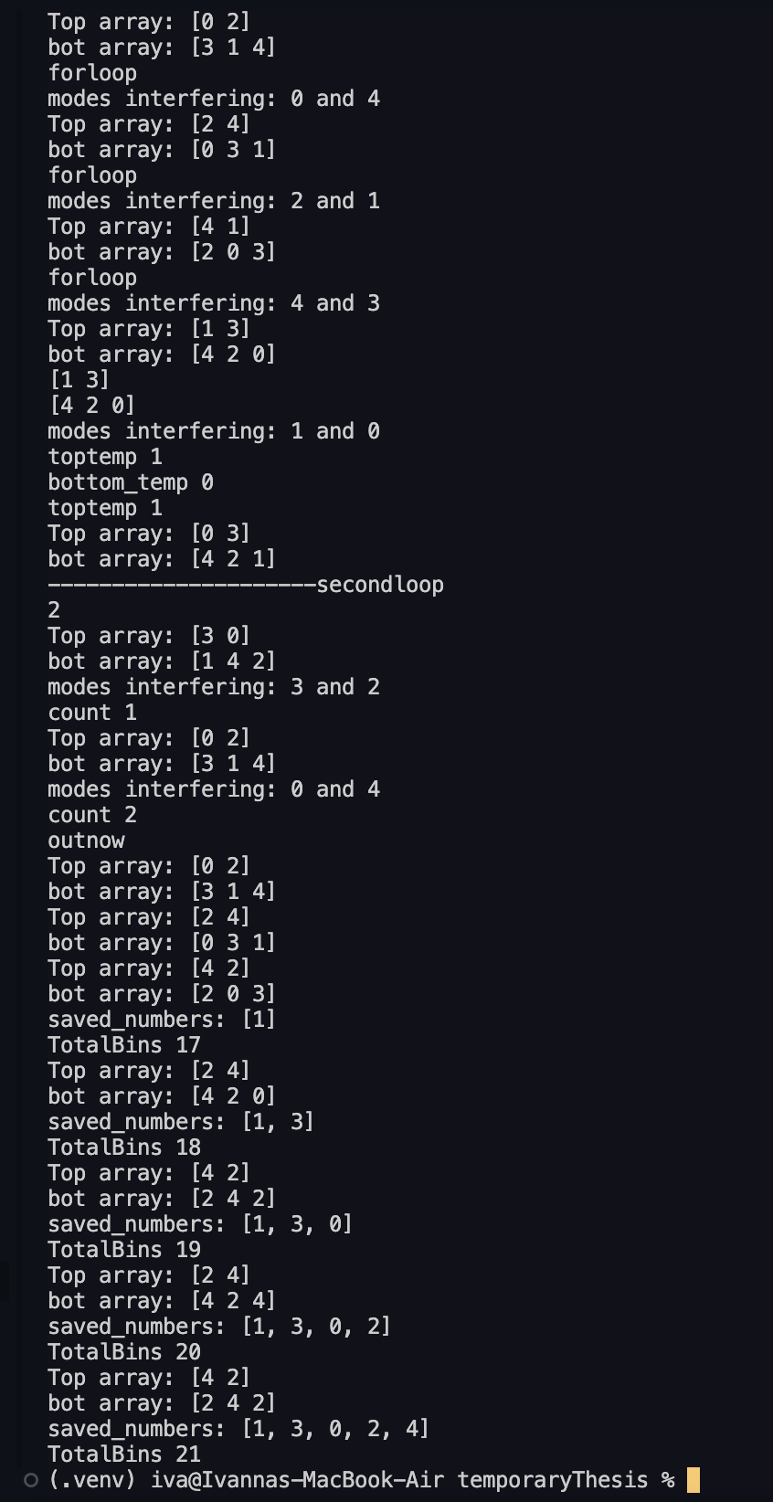
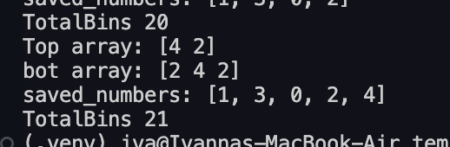
What I’ve been up to:
I got the general code working!!
Working on the time bin counting, place I have the counting going on rn is double counting but that’s just a code placement issue → will fix that later tonight
Know where the phase shifts go, just need to add them
Do I need my things to go to zero? → see code
My slay code Output (its not a table, should be easy to implement but I didn’t worry about that since that seems… not super duper important rn)→
Will add the switch times to figure out what length: you gave me a rough estimate of this before but I think we said we’d come back to it when we got to this step…. So now we’ve come back to it
What should I use?
I’ll make it general but I want to make sure it’s working well so I’ll do the math by hand first
Same with switch times
Notes:
1.468-index of ref for SMF-28e+ 1150 nm

