Slide 1
November 15 Update

Slide 2
Switches and Interferometer Questions
there are a lot of nanosecond switches, is there something specific I should avoid other than loss
Also been looking at lasers, probably looking at ps ones
also do I have to take … like… the interferometer into account?
based off what I found I am assuming no, but I’d rather ask now

Slide 3
Papers
I found another paper written by the person who did the boson sampling paper ! !
I’ve been looking at the tensor networks stuff
I think I really need to know how the tensor networks work, it seems…. Really relevant
All of the math seems to need tensors to work
Watched videos on tensor networks

Slide 4
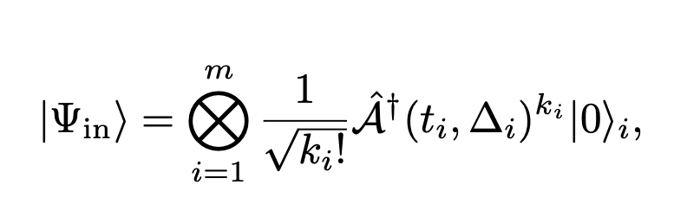
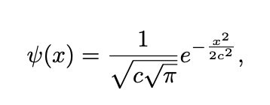
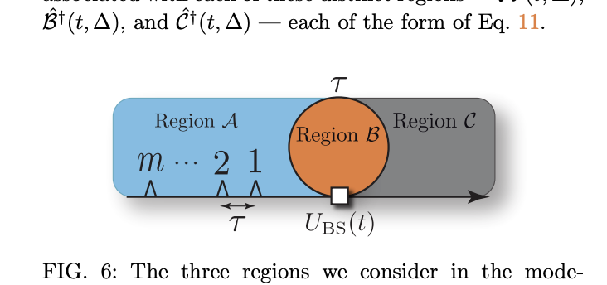
Implementing Scalable Boson Sampling with Time-Bin Encoding: Analysis of Loss, Mode Mismatch, and Time Jitter
The paper has a lot of different models to show how the system acts at different times
Also goes really in depth about losses
I want to look into “time-jitter” as it seems to be a concern

Slide 5
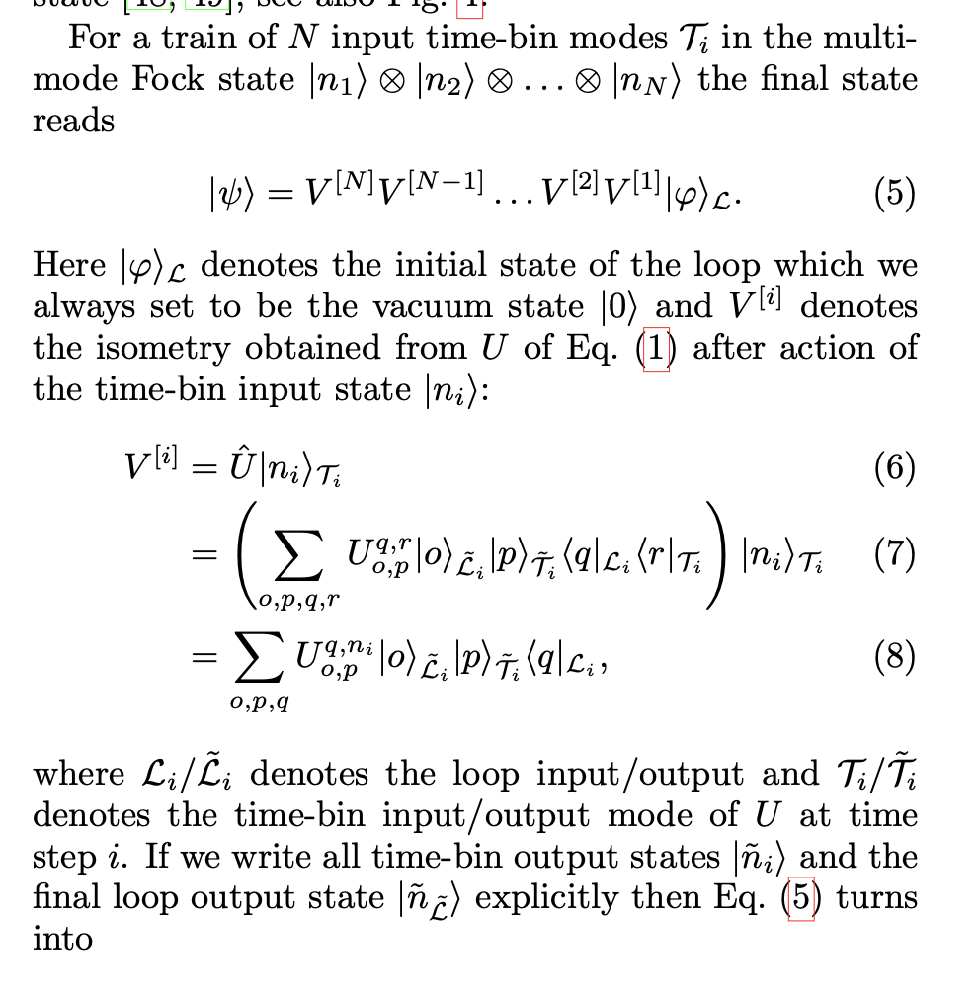
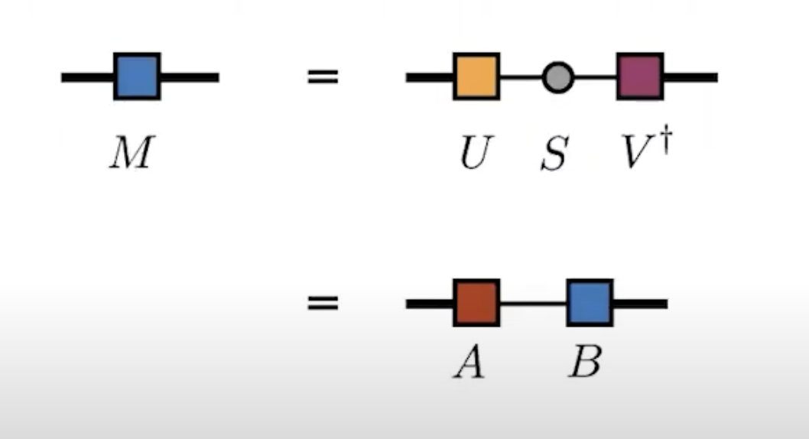
The 2 ways I’ve been trying to do it 1. Tensor Networks
I’m lost on notation , been watching so many videos
Everyone (?) hates the notation, they are literally using pictures to talk about this

Slide 6
Tensor Networks Continued
Ok but then if its hard then why do I want to use it:
if I can figure this out it seems like it would be better to use
I want to see if I can just simulate one loop and then add the other one (like break it into chunks I guess)
a lot of papers I’ve seen are using tensor networks as well now (at least for quantum computing applications) so it seems…. Relevant

Slide 7
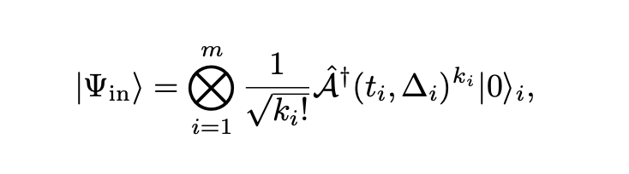
The 2 ways I’ve been trying to do it 2. Peter’s way
This is what I was originally thinking but hey its also all tensors
Not entirely sure how to add the switches in…
I was thinking of like splitting like this and then maybe adding a ‘region d’ for the secondary loop when the switches come in
Based on what I’ve seen that is going to be a tensor network fr

