Slide 1
March 27 Update

Slide 2
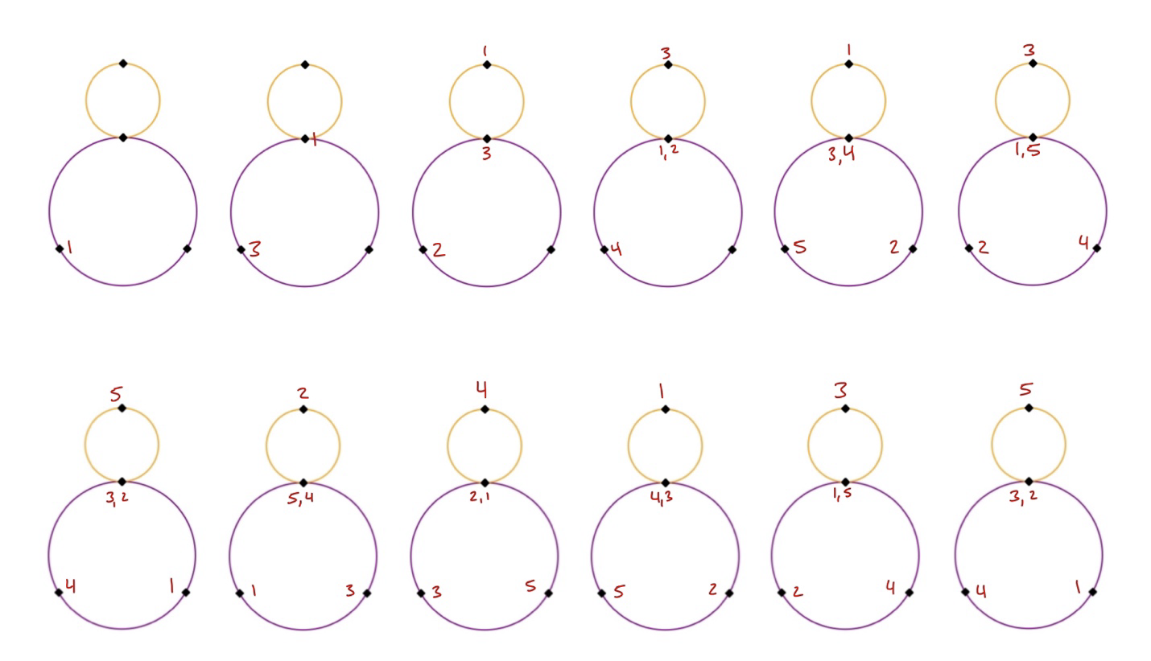
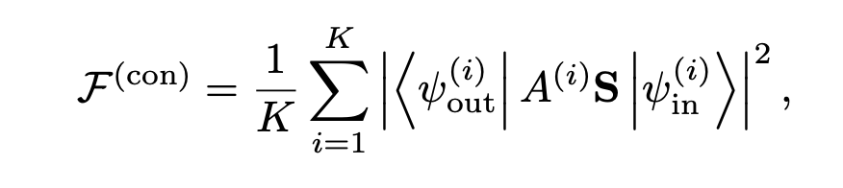
questions
How in depth should my diagram explanation be ?
Do my diagrams look ok
Go to canva bc the screenshots look whack
Hinton diagram -> Im meant to be doing
Right? -> not exactly working
- The phases
How in depth should I talk about

Slide 3
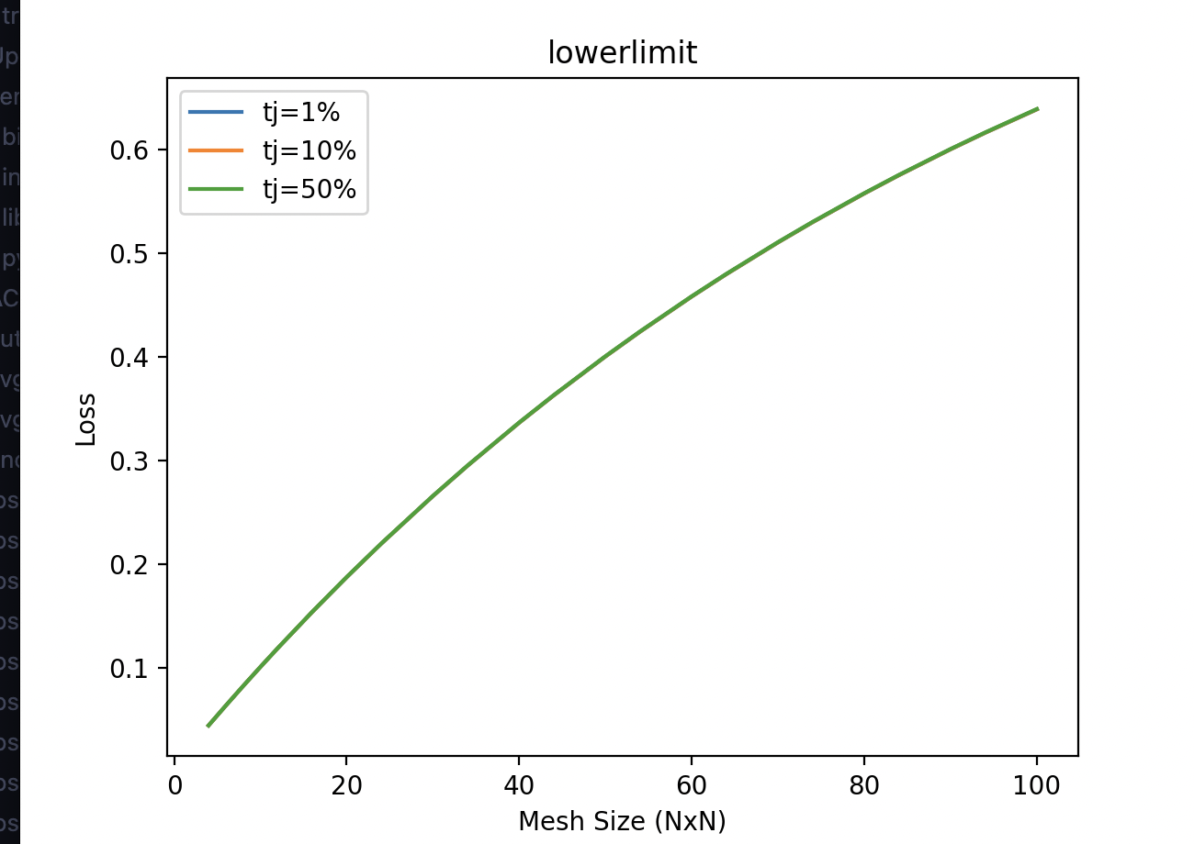
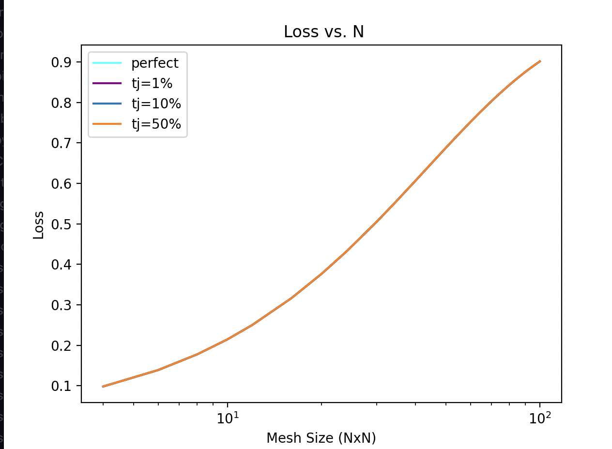
plots

Slide 4
