Slide 1
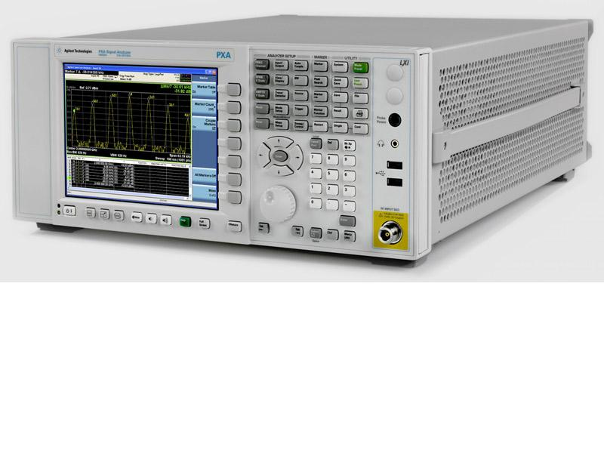
Low Pass Filter Design Example & Simulation

Slide 2
Election
Treasury Duty Relief & Appointment
Any other business

Slide 4
Example LPF Design
Clean up a second harmonic at least 17dB below Fc
Freg = 7 Mhz and use a Butterworth filter. Shunt Type.
Impedance= 50 Ohm in and 50 Ohm out.
Fc= 7 Mhz
Fs= 14 Mhz
Normalised Freg. = F/Fc = 2.0
Check Table for Frequency Response.
It shows N=4
Check table with normalized L & C values

Slide 7
Example
Check table with normalized L & C values
C1= 0.7654 L2=1.8478
C3=1.8478 L4=0.7654

Slide 8
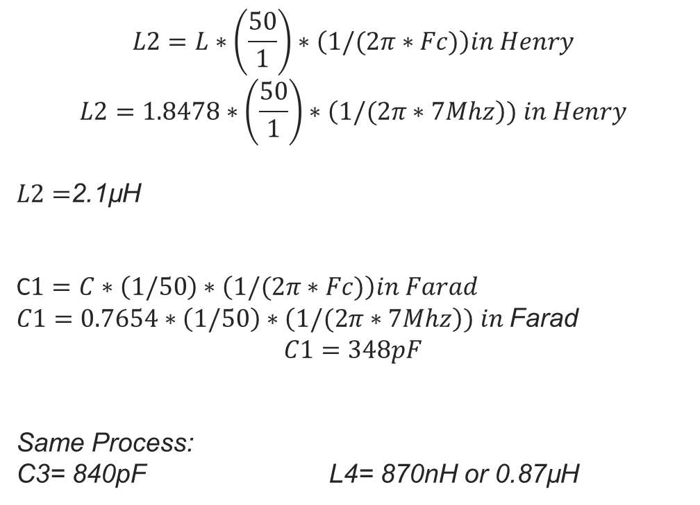
Example work out
$$L2=L∗\left(\frac{50}{1}\right)∗\left(1/(2π∗Fc)\right)in Henry$$
$$L2=1.8478∗\left(\frac{50}{1}\right)∗\left(1/(2π∗7Mhz\right)) in Henry$$
$L2=$2.1µH
C$1=C∗\left(1/50\right)∗\left(1/(2π∗Fc)\right)in Farad$
$C1=0.7654∗\left(1/50\right)∗\left(1/(2π∗7Mhz\right)) in$Farad
$$C1=348pF$$
Same Process:
C3= 840pF L4= 870nH or 0.87µH
50 Ohm
2.1uH
0.87uH
348p
840p
50 Ohm

Slide 9
Things to Consider
Insertion loss and Amplification
Standard Values versus Calc values
Coil Type.
Do you like a high or low Q
C suitability for the target Frequency
C max Voltage
L max Current or Power Rating
L and T dependence.
Keep in mind tolerances of C & L
Rp for C
Rs for L
Humidity impact
T impact on permanent change of C
G forces impact / Mechanical Structure
Ultimate Rejection
50 Ohm
2.1uH
0.87uH
348p
840p
50 Ohm

Slide 10
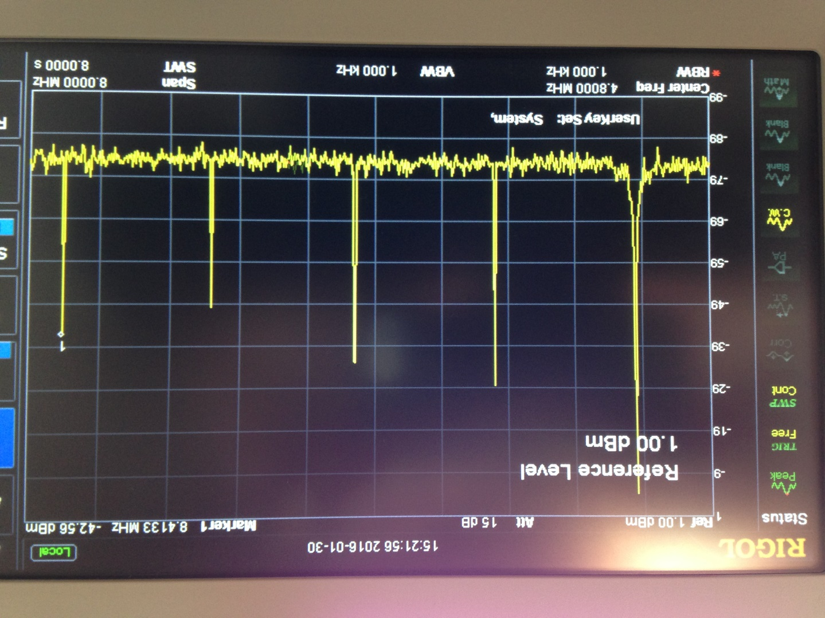
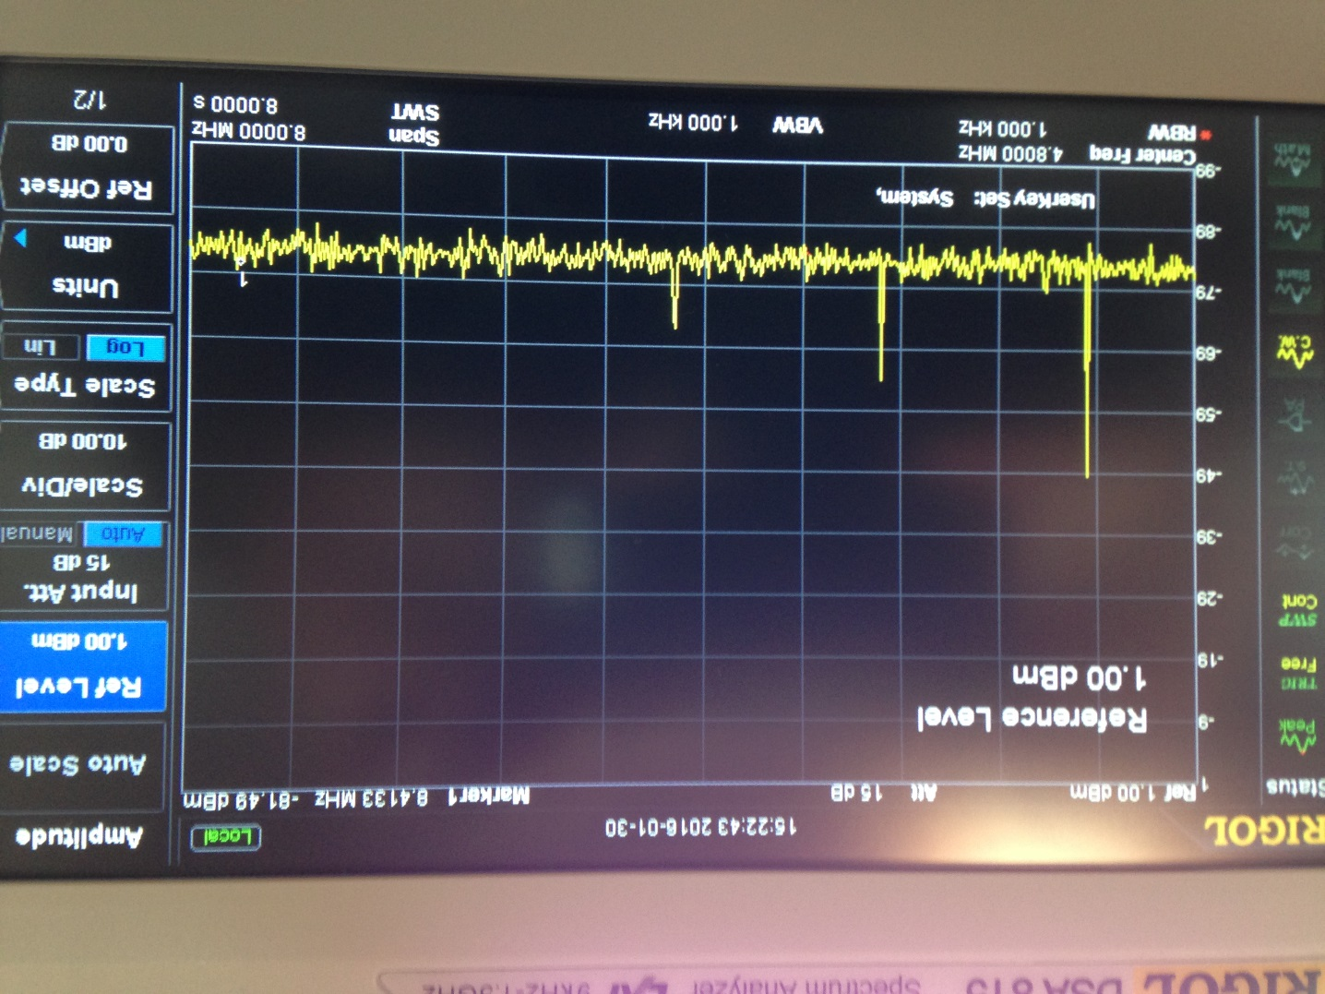
Too much attenuation 5th order LPF
Example of 1680kHz Low Power Transmitter ( 10mW).
Left no filter / Right after filter .

Slide 11
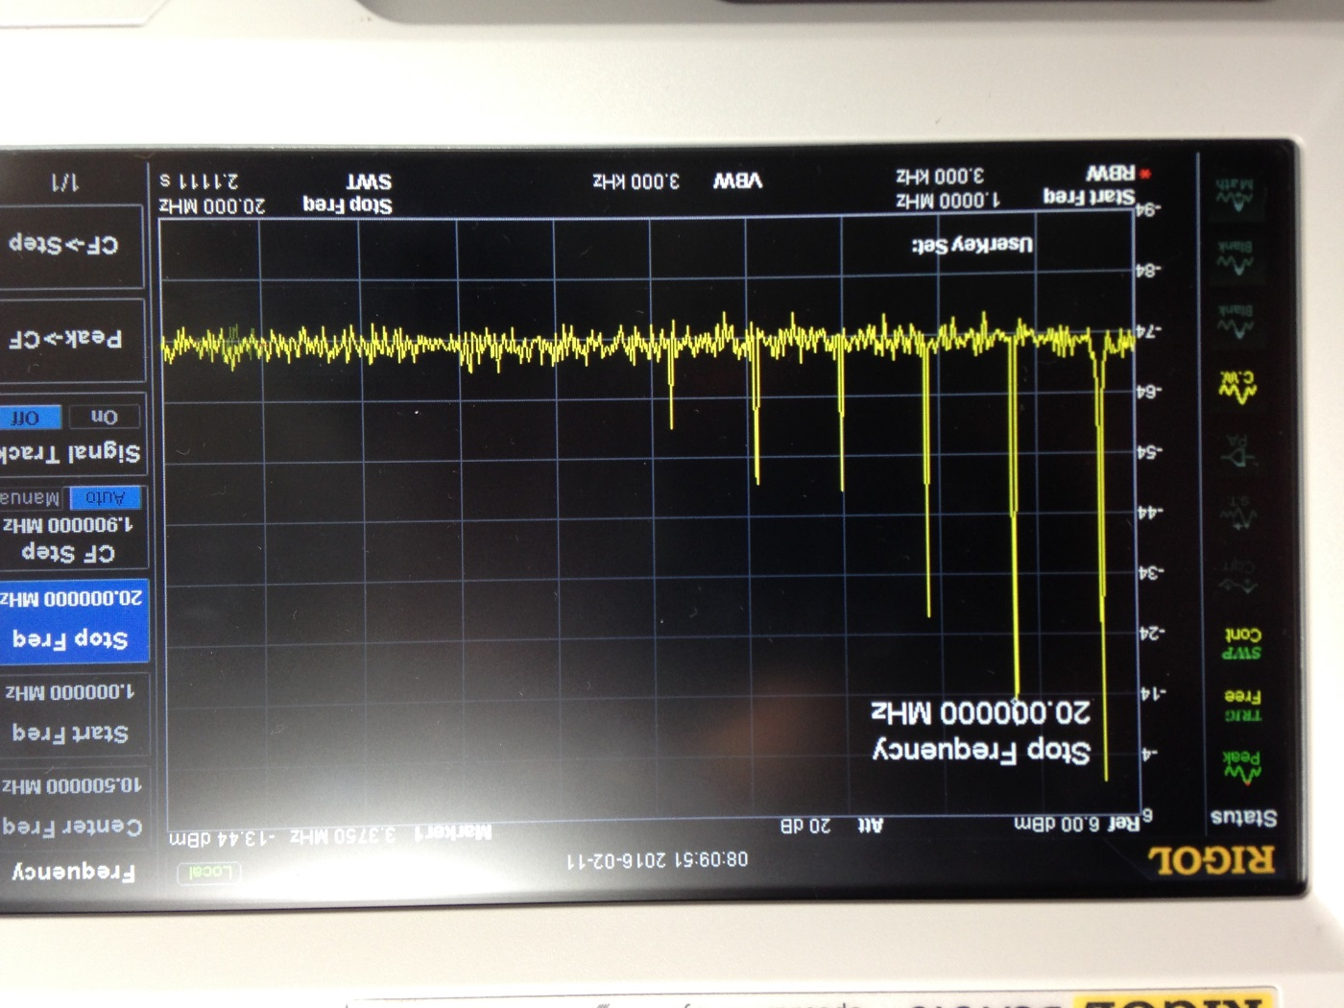
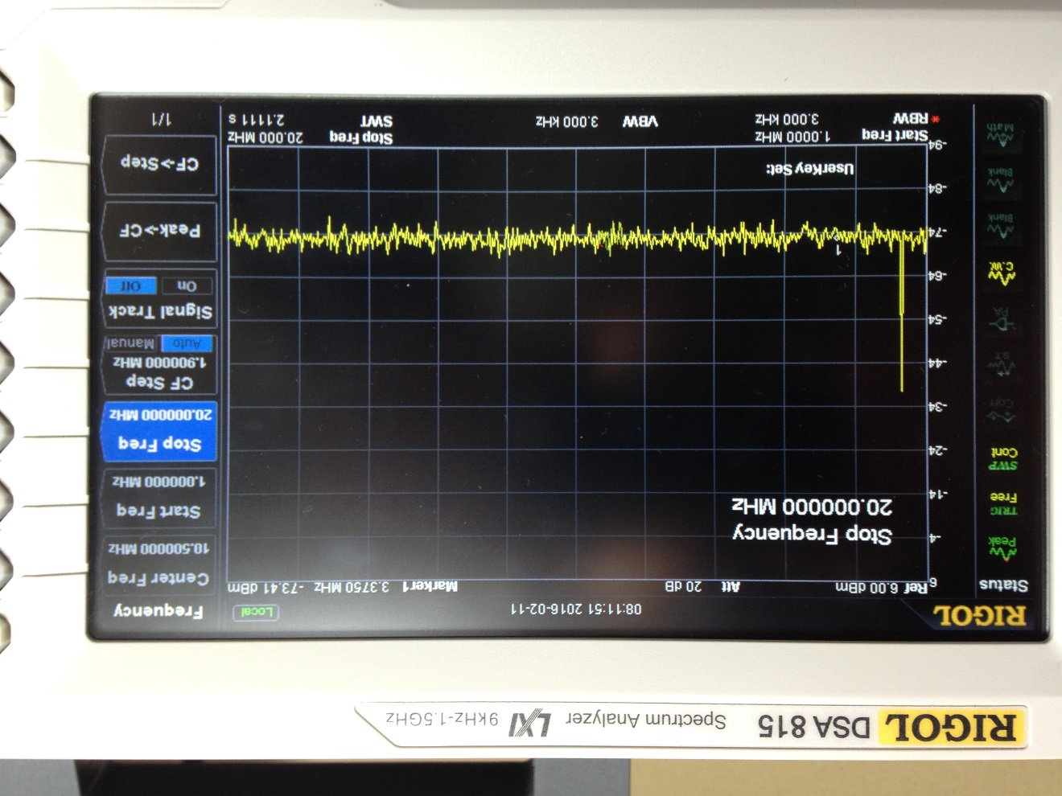
Before and After . Improved matching but still too much attenuation 5th order LPF
Output becomes micro watt QRP levels.

Slide 12
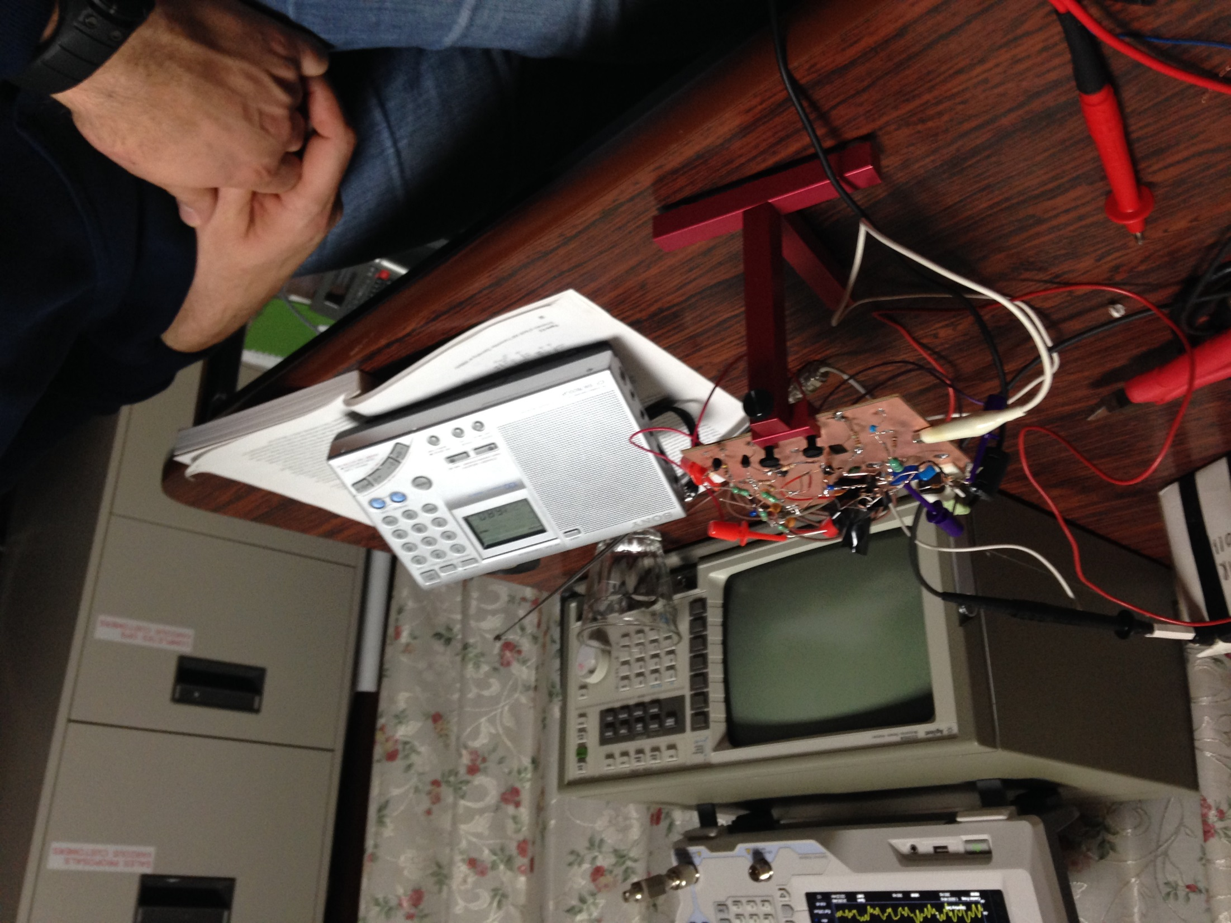
Before and After . Improved matching but still too much attenuation 5th order LPF

Slide 13
Sources and References:
ARRL 2006 Handbook

Slide 14
NOW SIMULATION
Tina Simulator
TI Student Version

