Slide 1


Watch world
Team: Sudeep & Ashmith

Slide 2
Thank YOU

Slide 3
INTRODUCTION
WATCH WORLD is an online web application system which provides online shopping centre for buying different watches by sitting at the comfort of their homes.
Customers can register and give feedback for the products. Various shopkeepers can register themselves on the application and add their products and services , which will be available for the customers to buy.

Slide 4
OBJECTIVE
The primary objective of the online shopping centre is to make the experience of buying watches easy.
One can go through the various available options of watches and select the one which they like and add it to the cart.
Customers can also provide feedback about the products.
Customers can also request for the available services provided by the shops.

Slide 5
Functional Requirements
a.) Admin Module:
The module can be accessed by the admin only. Shopkeeper or Customers cannot access this module. Sub modules are:
Login: Admin can login with username and password.
Shopkeepers Management: Admin can view the details of all shopkeepers registered through the website, verify them and has authority to remove the shopkeepers from the website.
Customer Management: Admin can view the details of all the Customers registered through the website.
Feedback module: Admin can view the feedback of customers.

Slide 6
Functional Requirements
Admin Module(continuation)
Manage Blogs: Admin can add blogs.
Manage Orders: Admin can view the monthly sales of the different shops.

Slide 7
Function requirements
b.) Shopkeeper Module:
The shopkeeper will have to register to the application in order access the application. Shopkeeper has following functions:
Registration: Shopkeeper needs to give primary information to the system for authorization and then he can use the web application.
Login: Shopkeeper can login with username and password.
Feedback: Shopkeeper can view feedback of the customers about a product.
Manage Profile: Shopkeeper can manage the shop details.
Manage Products: Shopkeeper can add and remove watches from their stores.

Slide 8
Function requirements
Shopkeeper Module (continuation)
Manage Orders: Shopkeeper can view the order details.
Manage Service: Shopkeeper can add and remove the services.
Manage Rental: Shopkeeper can see the requests of the customers for renting the products.
View Blogs: Shopkeeper can view the blogs.

Slide 9
Function requirements
c.) Customer Module:
Customer has to register to the application in order access the application.
Customer has following functions:
Registration: Customer needs to give primary information to the system for authorization and then he can use the web application.
Login: Customer can login with username and password.
Feedback: Customers can upload a feedback about a product.
Manage Profile: Customers can manage their profile details.
View products: Customers can view the different products.

Slide 10
Function requirements
Customer Module (continuation)
Add to cart: Customers can add products to their cart.
Request services: Customers can request for available services.
View feedback: Customers can view feedback of other customers

Slide 11
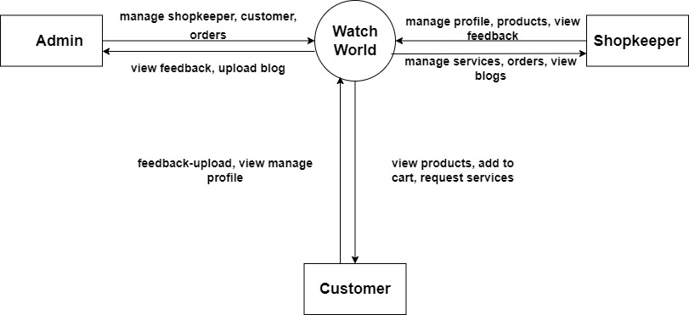
CONTEXT FLOW DIAGRAM

Slide 12
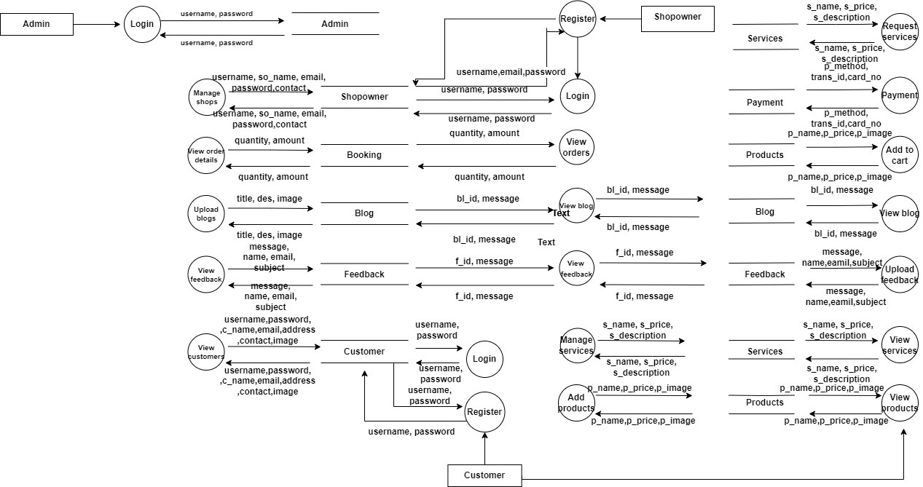
DFD LEVEL 1 FOR SYSTEM

Slide 13
TABLE STRUCTURE
The database watch_world is organized into following tables:
admin
blog
booking
cart
customer
feedback
products
requested_services

Slide 14
TABLE STRUCTURE
TABLE NAME: admin
This table is used to store the login details of admin
ADMIN TABLE
SL NO | FIELD NAME | DATA TYPE | SIZE | CONSTRAINTS | DESCRIPTION
1 | username | varchar | 50 | PRIMARY KEY | Admin’s user id
2 | password | varchar | 10 | NOT NULL | Admin’s password
3 | a_id | int | 10 | NOT NULL | Admin id

Slide 15
TABLE STRUCTURE
TABLE NAME: customer
This table is used to store customer details
CUSTOMER TABLE
SL NO | FIELD NAME | DATA TYPE | SIZE | CONSTRAINTS | DESCRIPTION
1 | c_id | int | 10 | PRIMARY KEY | Customer id
2 | username | text |  | NOT NULL | Username
3 | password | varchar | 20 | NOT NULL | Password
4 | c_name | text |  | NOT NULL | Customer name
5 | email | varchar | 50 | NOT NULL | Email
6 | address | varchar | 200 | NOT NULL | Address
7 | contact | int | 15 | NOT NULL | Contact
8 | image | varbinary | 500 | NOT NULL | Image
9 | status | varchar | 30 | NOT NULL | Status

Slide 16
TABLE STRUCTURE
TABLE NAME: shopowner
This table is used to store shopowner details
SHOPOWNER TABLE
SL NO | FIELD NAME | DATA TYPE | SIZE | CONSTRAINTS | DESCRIPTION
1 | s_id | int | 10 | PRIMARY KEY | Shopowner id
2 | username | text |  | NOT NULL | Username
3 | password | varchar | 20 | NOT NULL | Password
4 | so_name | varchar | 30 | NOT NULL | Full name
5 | email | varchar | 50 | NOT NULL | Email
6 | address | varchar | 100 | NOT NULL | Address
7 | contact | int | 10 | NOT NULL | Contact
8 | image | varbinary | 300 | NOT NULL | Image
9 | status | varchar | 30 | NOT NULL | status

Slide 17
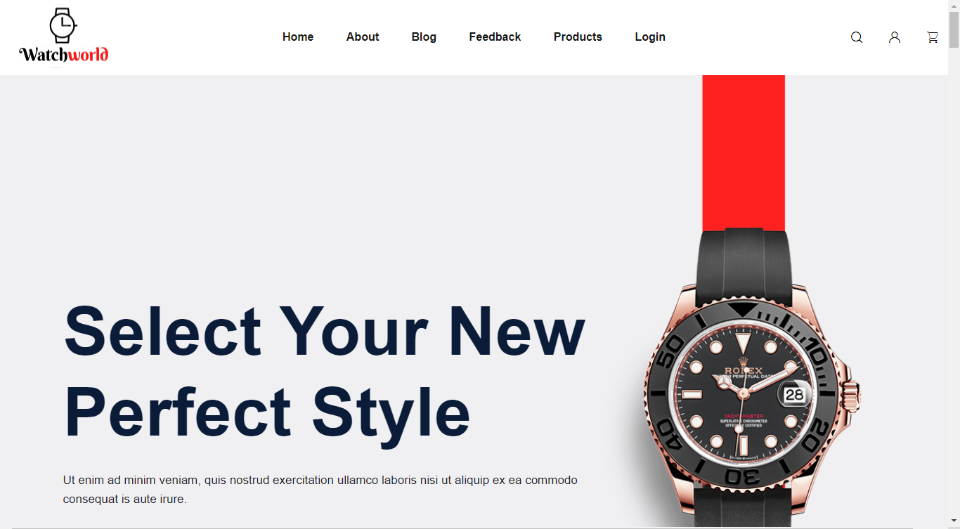
User interfaces
Home page

Slide 18
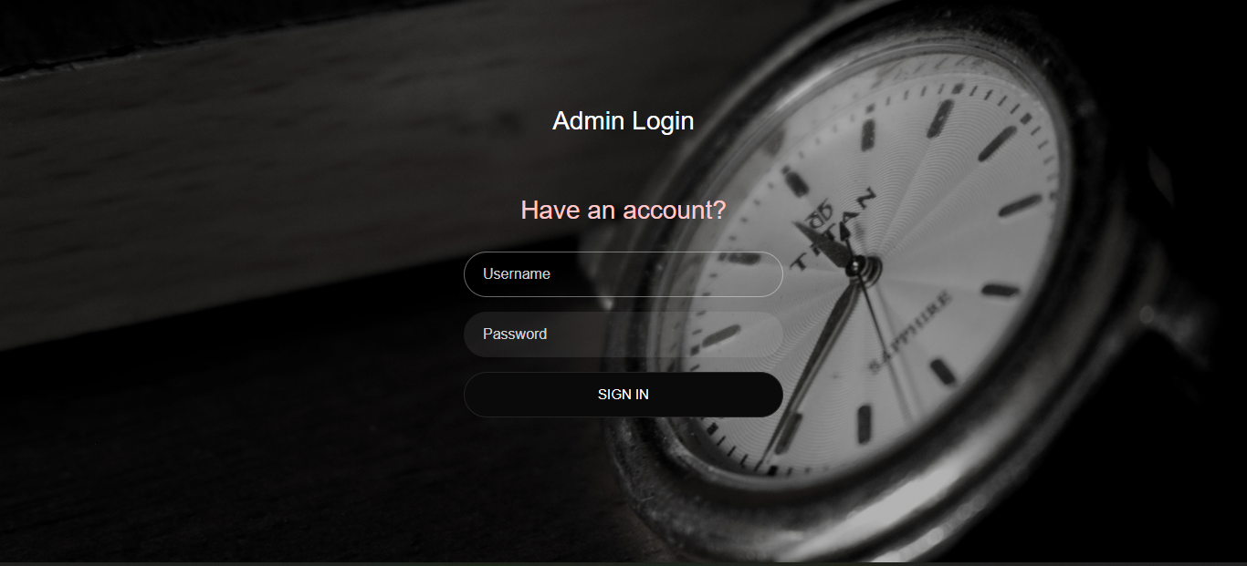
User interfaces
ADMIN LOGIN

Slide 19
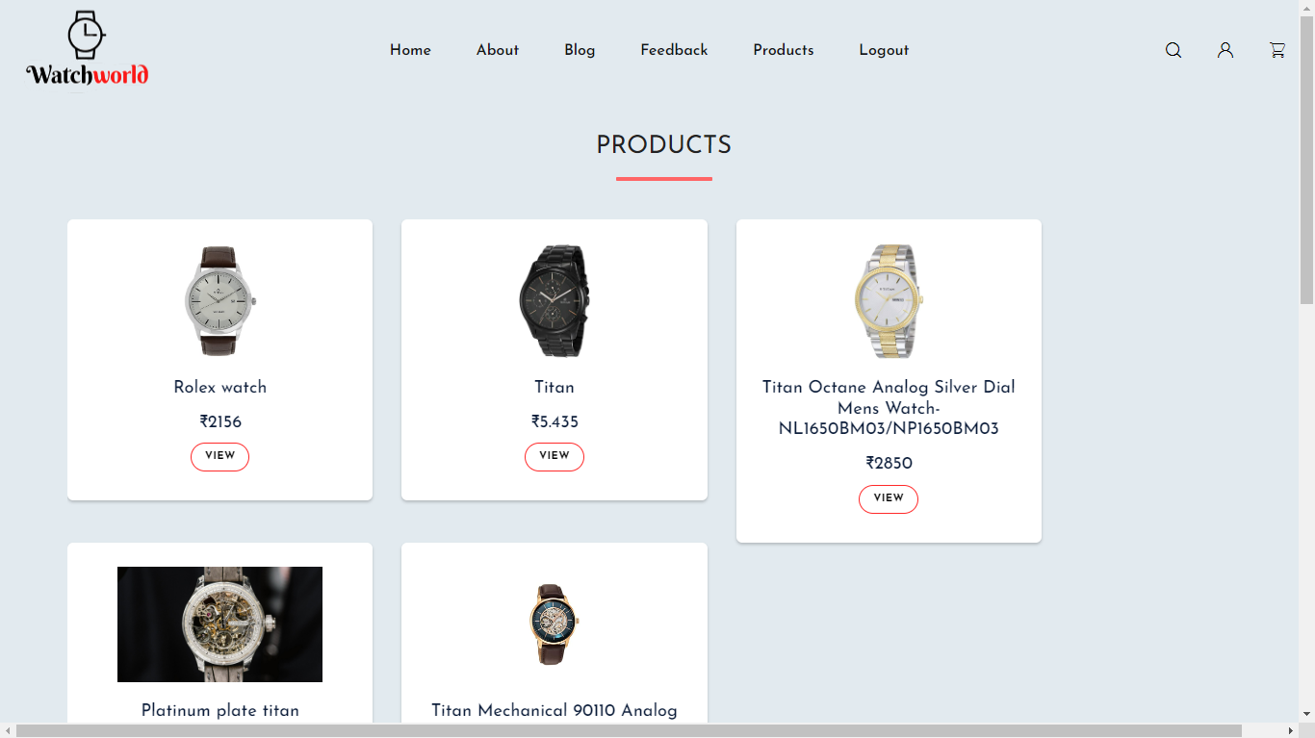
User interfaces
PRODUCTS PAGE

