Slide 1
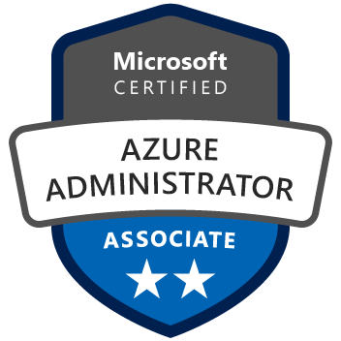

Exam AZ-103: Microsoft Azure Administrator Crash Course
Tim Warner
@TechTrainerTim

Slide 2
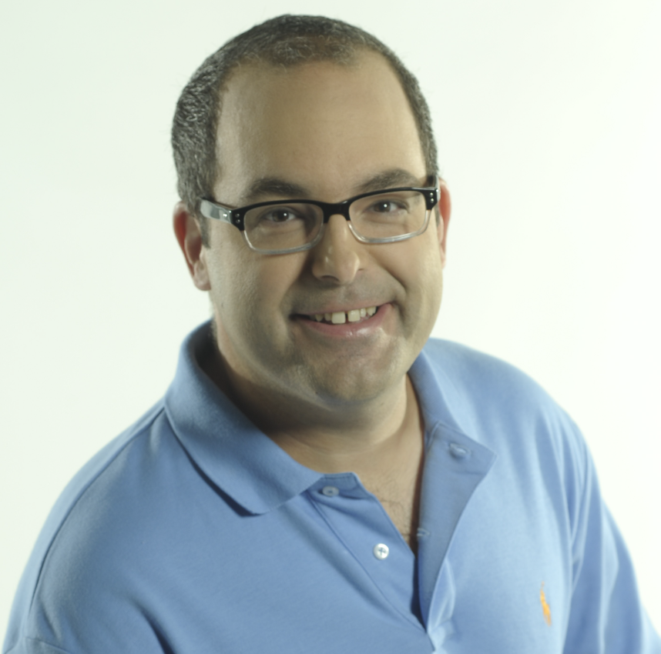
Tim Warner
MCT since 1997
MVP since 2017
Twitter: @TechTrainerTim
Az Admin badge: timw.info/azadmin

Slide 3
Day 1 of 2 Agenda
Introduction
Module 1: Manage Azure Subscriptions and Resources
Module 2 Implement and Manage Storage
Module 3: Deploy and Manage Virtual Machines
Synthesis and look ahead to Day 2

Slide 4
Day 2 of 2 Agenda
Quick content review
Module 4: Configure and Manage Virtual Networks
Module 5: Manage Identities
Module 6: Exam AZ-100 Exam Strategy

Slide 5
A Different Kind of Training
No slide show fatigue
Learn by doing – 100 percent demo
I’m here to answer your questions – take advantage of this!

Slide 6
Course Materials
timw.info/az103

Slide 7
Microsoft Role-Based Certifications

Slide 8
Tim's Cert Study Pyramid
Interdependence
Content knowledge
Practical application
Test-taking skills

Slide 9
Module 1: Manage Azure Subscriptions and Resources

Slide 10
Module 1 Learning Objectives
Manage Azure subscriptions
Analyze resource utilization and consumption
Manage resource groups
Manage Role Based Access Control (RBAC)

Slide 11
Module 1 Demo
Make user Contributor at the subscription scope
Log into Azure portal as the new Contributor
Create a deployment:
Resource group
Storage account
Grant another user read access to the resource group
Verify by attempting to delete the storage account

Slide 12
Module 2: Implement and Manage Storage

Slide 13
Module 2 Learning Objectives
Create and configure storage accounts
Import and export data to Azure
Configure Azure Files
Implement Azure backup

Slide 14
Module 2 Demo
Connect to storage account from Storage Explorer
Upload/download files
Create and used a shared access signature
Connect Azure Cloud Shell
Create cloud shell
View file share in shell and in Azure portal
Configure VM backup
Create Recovery Services vault

Slide 15
Module 3: Deploy and Manage Virtual Machines

Slide 16
Module 3 Learning Objectives
Create and configure a VM for Windows and Linux
Automate VM deployment
Manage Azure VM configuration
Manage Azure VM backups

Slide 17
Module 3 Demo
Create a Linux VM with SSH authentication via Azure portal
Place on one VNet
Create a Windows VM from an ARM template
Place on a second VNet
Practice restores from previously backed-up VM
Full restore
File Recovery

Slide 18
Module 4: Configure and Manage Virtual Networks

Slide 19
Module 4 Learning Objectives
Create connectivity between virtual networks
Implement and manage virtual networking
Configure name resolution
Create and configure a Network Security Group (NSG)

Slide 20
Module 4 Learning Objectives (Cont’d)
Implement Azure load balancer
Monitor and troubleshoot virtual networking
Integrate on-premises network with Azure virtual network

Slide 21
Module 4 Demo
Add a custom DNS server address
Create a VNet peering between the two Vnets
Use Network Watcher to test connectivity
Pay particular attention to NSGs
Walk through S2S VPN configuration at a high level

Slide 22
Module 5: Manage Identities

Slide 23
Module 5 Learning Objectives
Manage Azure Active Directory
Manage Azure AD objects (users, groups, devices)
Implement and manage hybrid identities
Implement multi-factor authentication (MFA)

Slide 24
Module 5 Demo
Create an MFA Users group
Create MFA conditional access policy
Based on Azure AD group membership
Create an Azure AD user
Grant RBAC at resource group level
Test access
MFA registration
Resource access

Slide 25
Module 6: Exam AZ-103 Study Strategy

Slide 26
Module 6 Learning Objectives
Master the concepts
Master the hands-on skills
Master test-taking skills
Know what to expect before, during, and after the exam

Slide 27
Module 6 Demo
Tour relevant websites:
Exam page(s) with registration workflow
Mindhub offers
MeasureUp.com
Work through practice items
Show MCP dashboard

Slide 28
Exam AZ-103 Item Types

Slide 29
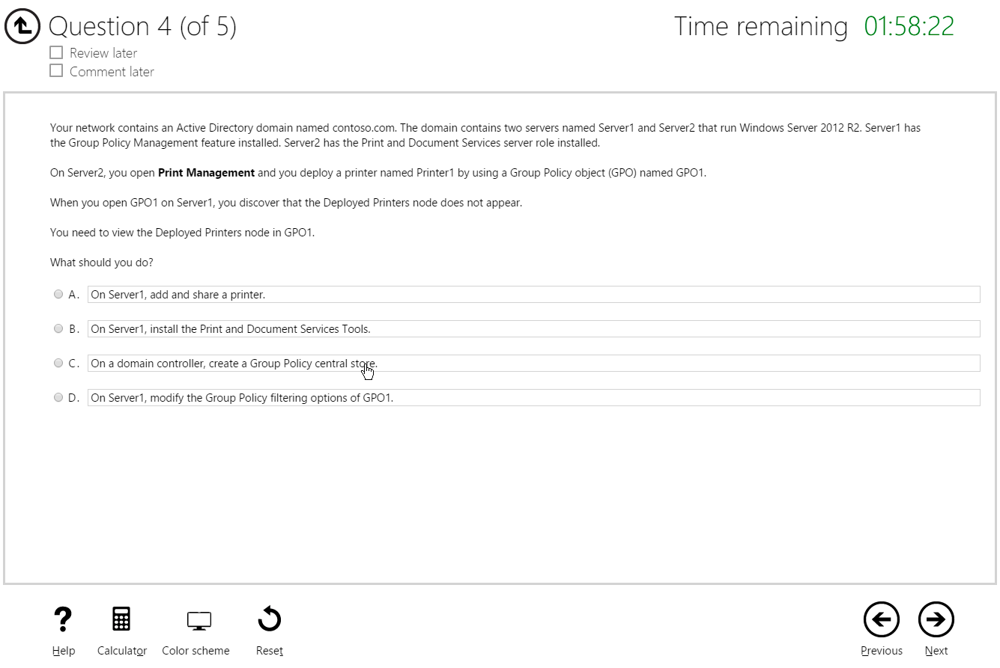
Single-Answer Multiple Choice

Slide 30
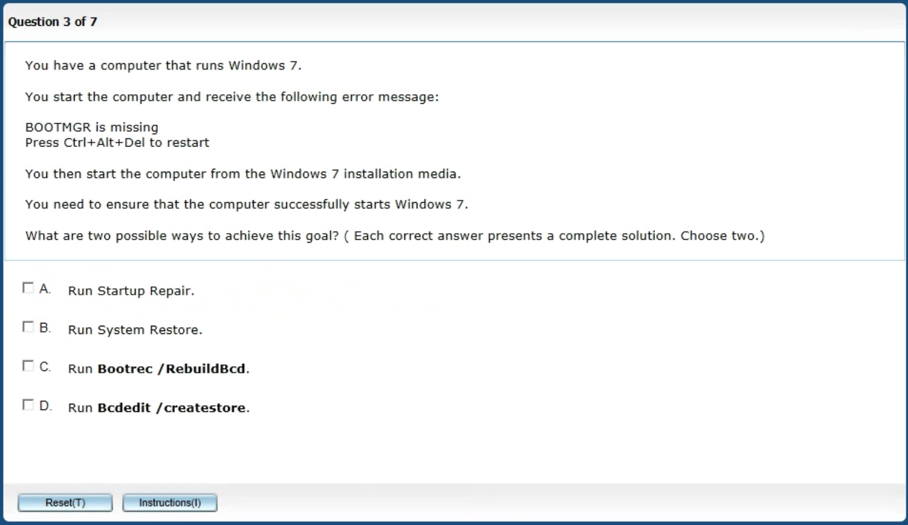
Multiple-Answer Multiple Choice

Slide 31
Repeated Scenario
You need to move an Azure VM to another hardware host.
Solution: You redeploy the VM.
Does this solution meet the goal?
Yes
No

Slide 32
Repeated Scenario
You need to move an Azure VM to another hardware host.
Solution: You restart the VM.
Does this solution meet the goal?
Yes
No

Slide 33
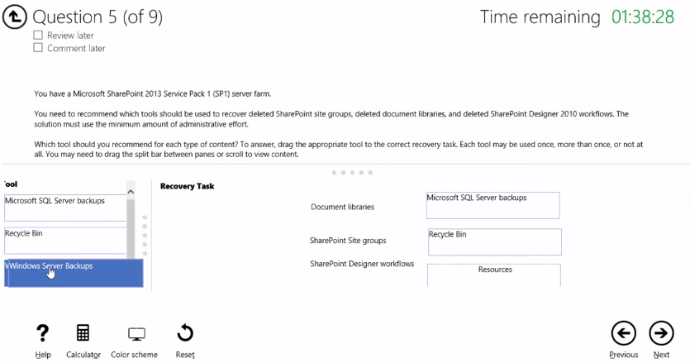
Select and Place

Slide 34
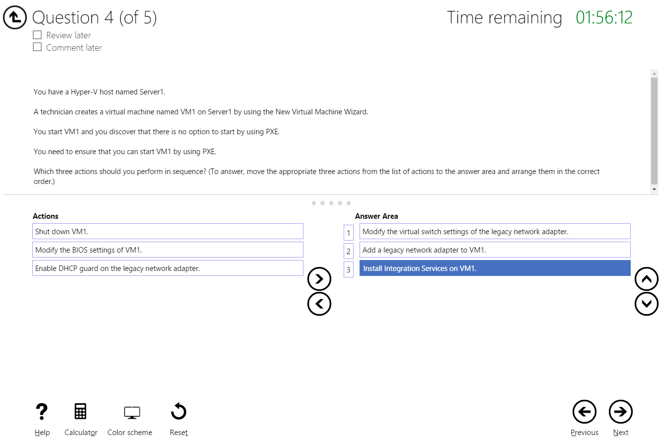
Build List and Reorder

Slide 35
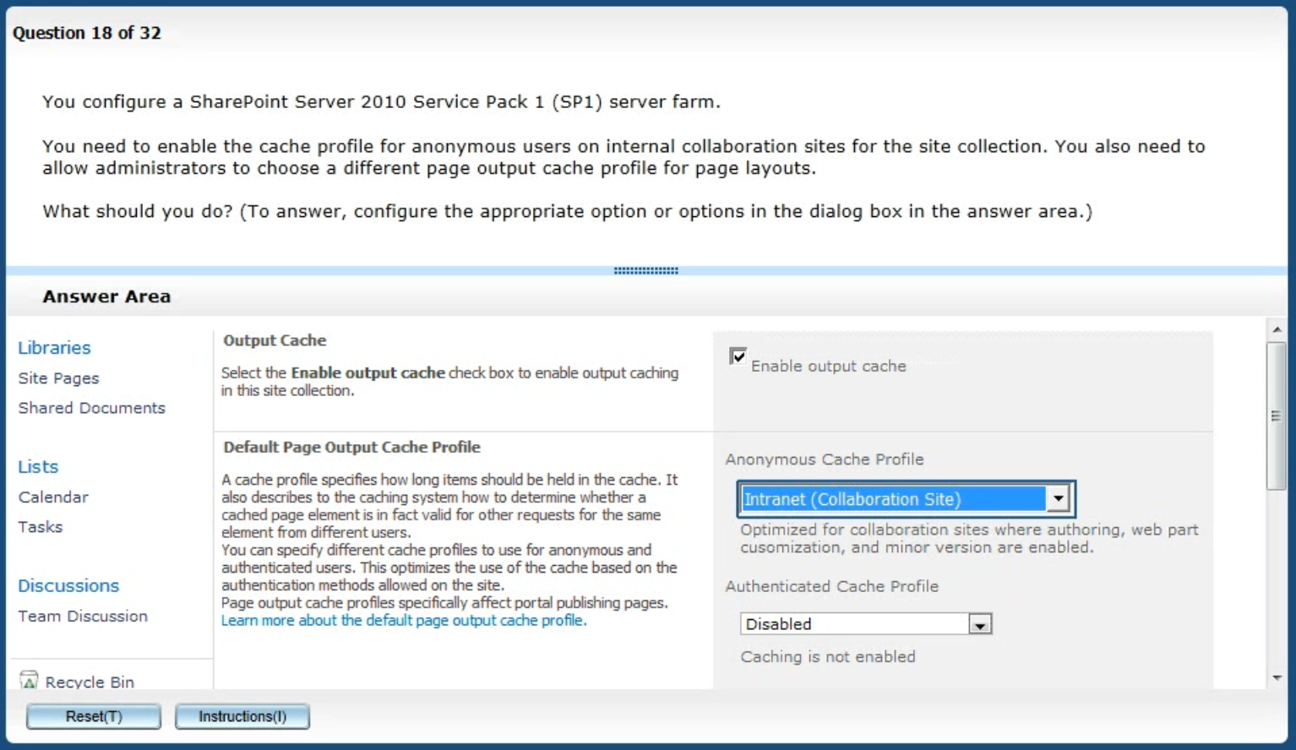
Active Screen

Slide 36
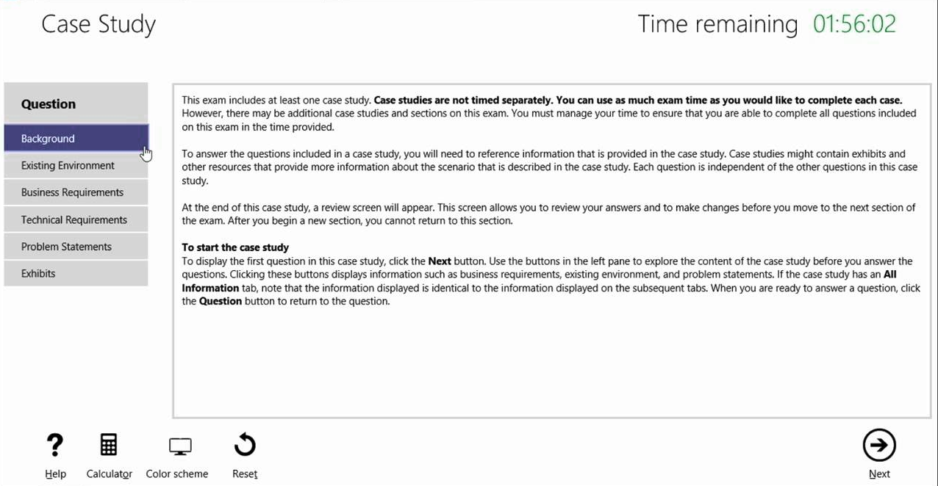
Case Study

Slide 37
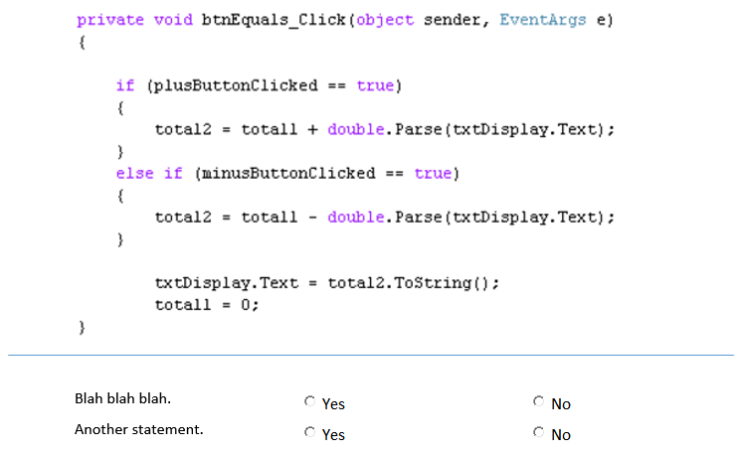
Statement / Code Analysis

Slide 38
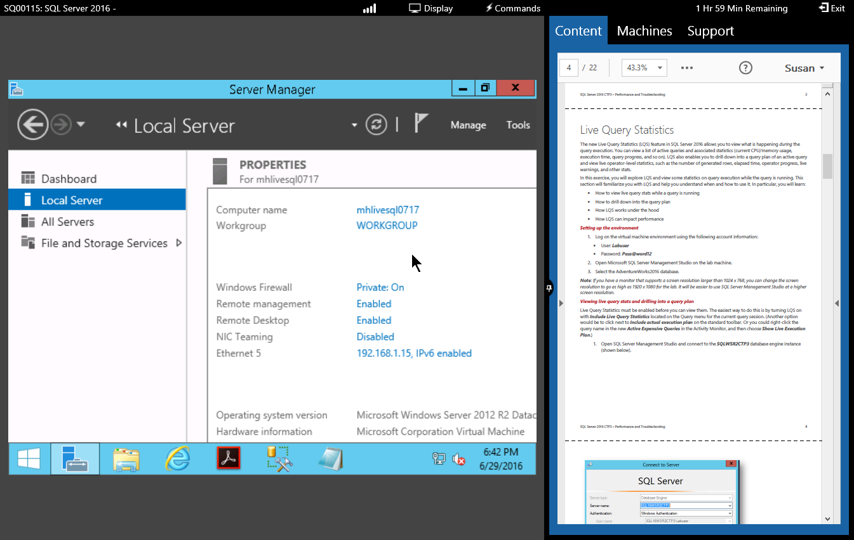
Performance-Based Lab

Slide 39
Thank You!
Course materials: timw.info/az103
Twitter: @TechTrainerTim
Website: TechTrainerTim.com

